Slide 1
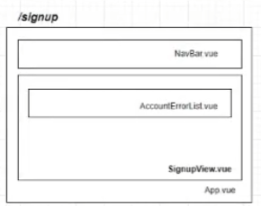
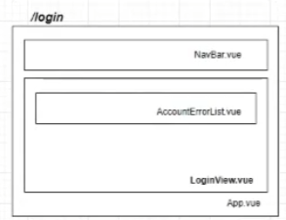
/
MainView.vue
App.vue

Slide 2
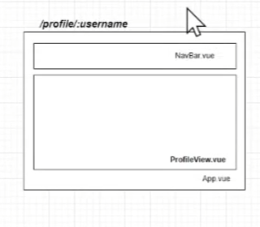
/logout
LogoutView.vue
App.vue

Slide 3
/movies
NavBar.vue
SearchBar.vue
RecommendMovieListItem.vue
RecommendMovieList.vue
PopularMovieListItem.vue
PopularMovieList.vue
MovieListView.vue
App.vue

Slide 4
/movies/:moviePk
NavBar.vue
YoutubeVideo.vue
ReviewListItem.vue
ReviewListItem.vue
ReviewListItem.vue
ReviewList.vue
MovieDetailView.vue
App.vue

Slide 5
/movies/:moviePk/video
NavBar.vue
YoutubeVideoDetailView.vue
App.vue

Slide 6
/movies/:moviePk/:reviewPk/
NavBar.vue
ReviewDetailView.vue
App.vue

Slide 7
/movies/:moviePk/reviews/new
NavBar.vue
ReviewForm.vue
ReviewNewView.vue
App.vue

Slide 8
/movies/:moviePk/:reviewPk/edit
NavBar.vue
ReviewForm.vue
ReviewEditView.vue
App.vue

Slide 9
/ott
NavBar.vue
SelectOtt.vue
OttListItem.vue
OttListItem.vue
OttListItem.vue
OttListView.vue
App.vue

Slide 10
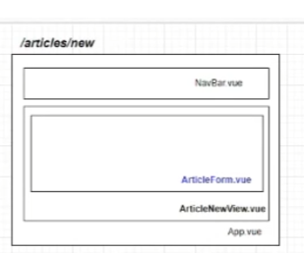
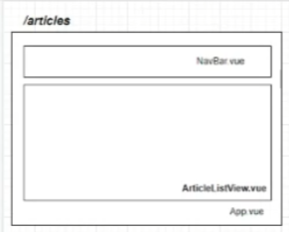

Slide 11
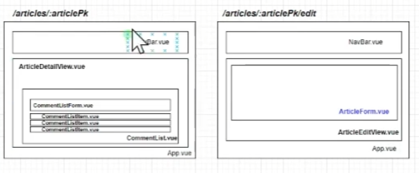

Slide 12
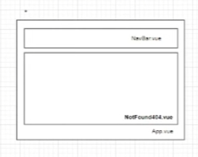

Slide 13
시간 되면 구현
/movies/universe
NavBar.vue
CommingSoonMovie.vue
OldMovie.vue
MovieListUniverseView.vue
App.vue

Slide 14
/movies/universe/:universePk
NavBar.vue
YoutubeVideo.vue
SummaryListItem.vue
SummaryListItem.vue
SummaryListItem.vue
SummaryList.vue
MovieDetailView.vue
App.vue

Slide 15
/movies/:moviePk/:universePk/
NavBar.vue
SummaryDetailView.vue
App.vue

