Slide 1
Deploying Machine Learning Models using Flask

Slide 2
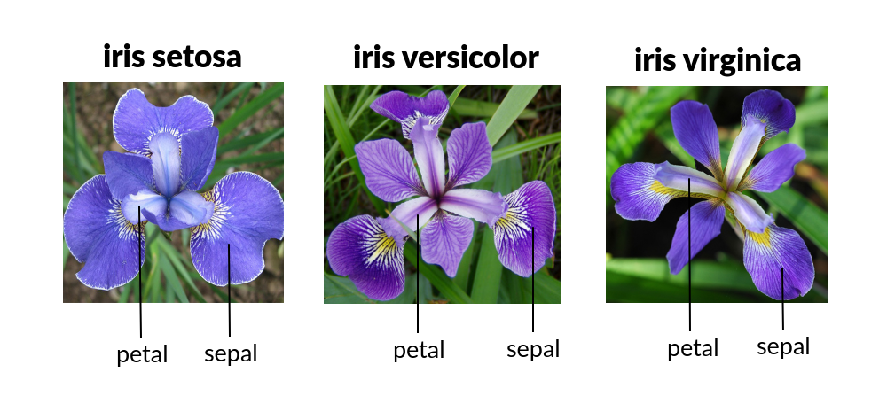
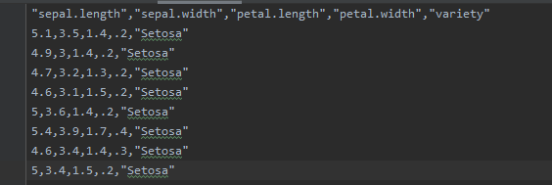
VERİ SETİ

Slide 3
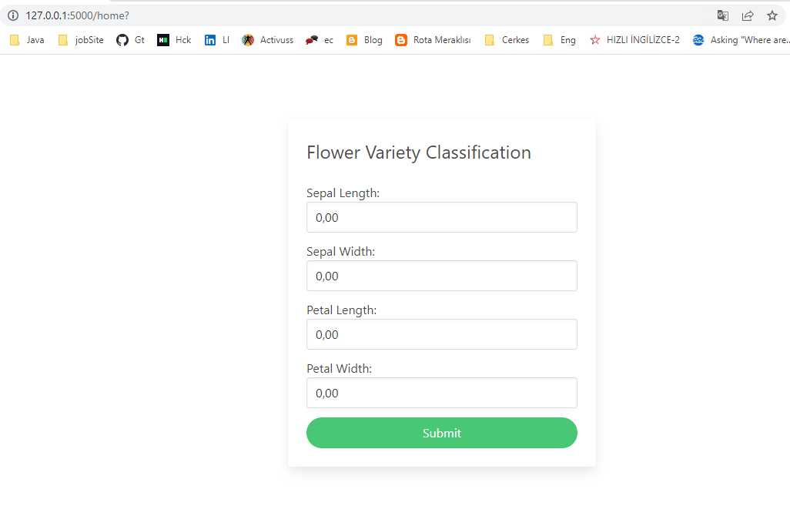
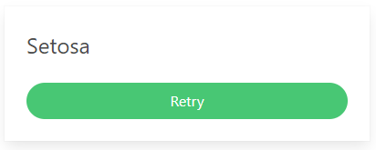
CLIENT
Notes:
http://127.0.0.1:5000/home? ----------→>>> http://127.0.0.1:5000/classify?slen=0&swid=0&plen=0&pwid=0

Slide 4
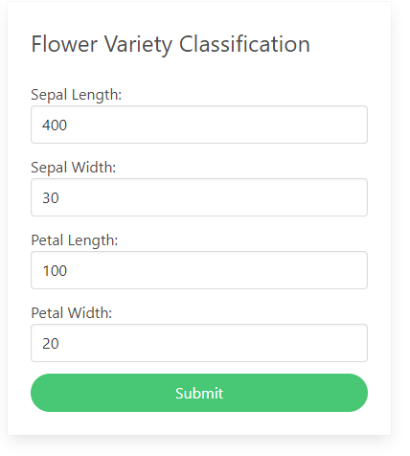
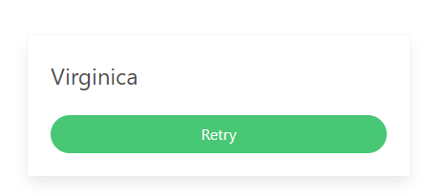
CLIENT

Slide 5
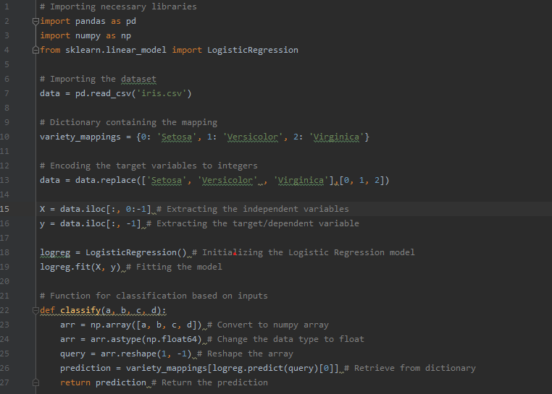
MODEL

Slide 6
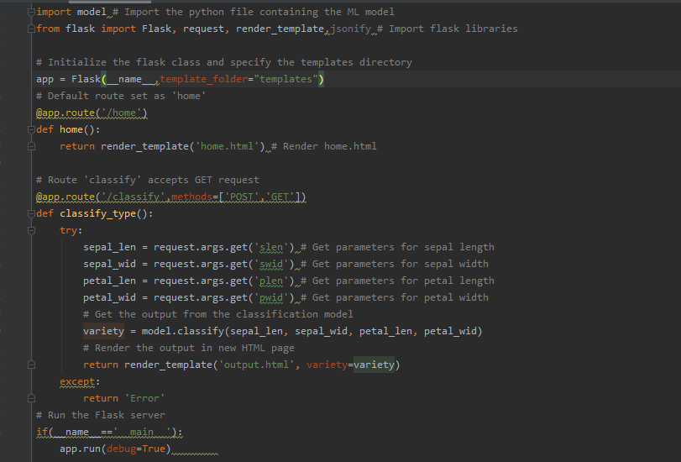
SERVER

Slide 7
