Slide 1

Interactive Mobile and Web Application Development
2024 December 28
FRESHFROMFARM
Organic and natural products straight from the farm
TEAM MEMBERS:
MAKHAMBETJANOV NURKHAN
MAKASHEV EMIR

Slide 2
Problem Statement
FreshFromFarm
Many consumers struggle to access fresh and high-quality products directly from local farmers. Products available in supermarkets often have long supply chains, reducing freshness and increasing prices. At the same time, farmers face challenges in reaching customers directly, leading to limited sales and growth opportunities.

Slide 3
Solution Overview
1
2
3
Fresh Access
Farmer Support
Sustainable Trade
Providing fresh, eco-friendly, and locally sourced products directly to consumers.
Supporting farmers with fair trade opportunities, helping them grow their businesses.
Promoting sustainability by reducing the environmental impact of long supply chains.

Slide 4
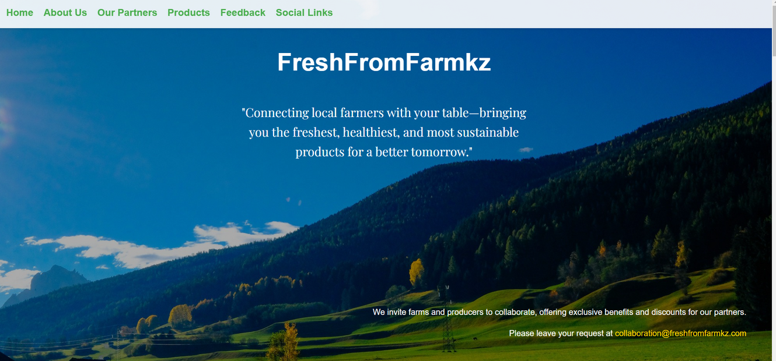
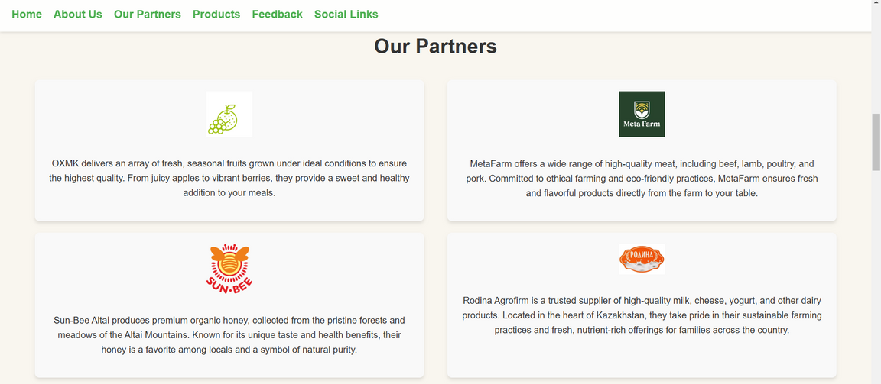
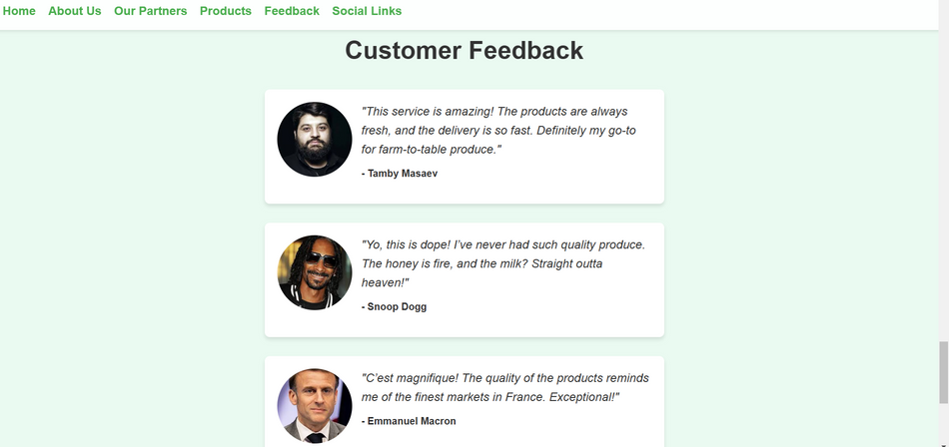
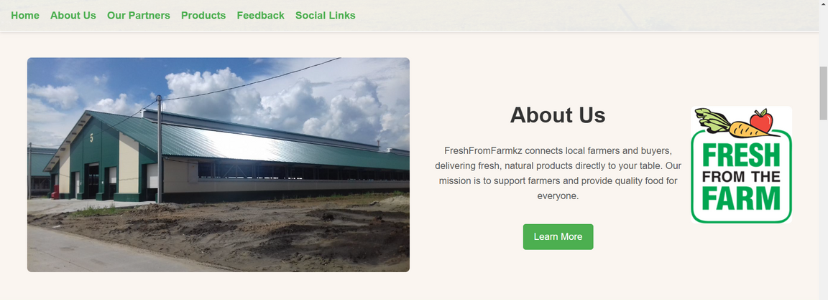
Demo
Home Page
Our Partners
Customer Feedback
About Us Section
The platform includes a welcoming home page, an informative "About Us" section with a link to learn more, a showcase of trusted partners, and a customer feedback section, all designed to build trust and offer a comfortable user experience.

Slide 5
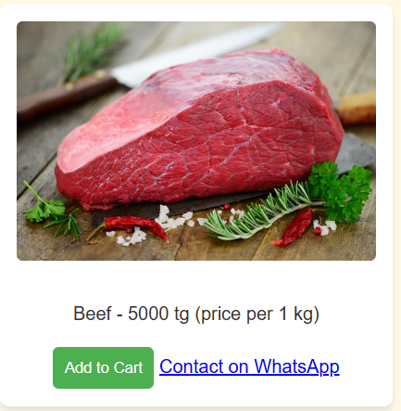
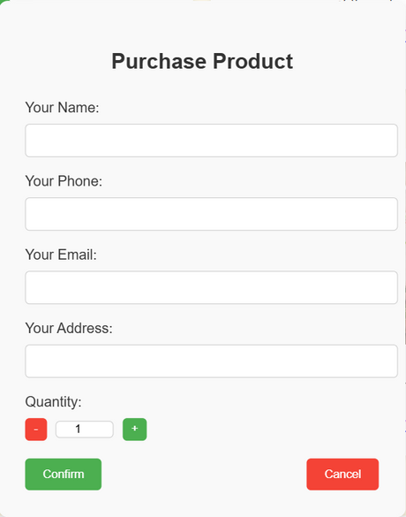
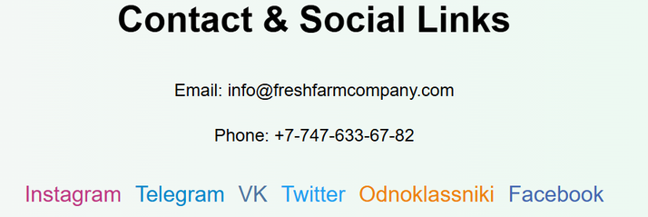
Demo
This page allows users to browse a variety of products categorized into dairy, meat, fruits, and honey. Clicking "Add to Cart" initiates the purchase process.
The purchase window enables users to enter their details, select product quantities, and confirm their order. The intuitive interface ensures a smooth and quick experience.
Product Page
Purchase Window
This section provides the company’s contact details, including email and phone, along with links to social media platforms like Instagram, Telegram, VK, and more, for easy communication with customers.
Social Media Links

Slide 6
Technical Approach
Technologies Used
Methodologies
HTML, CSS, JavaScript: For building the website structure, styling, and adding interactivity.
Responsive Design: Ensures compatibility with various devices and screen sizes.
Smooth Scroll and Animations: Improves user experience by providing seamless navigation and visually appealing effects.
Dynamic Modals: JavaScript-powered purchase windows for a user-friendly checkout experience.
Component-Based Development: Divided the site into reusable sections like navigation, product categories, and testimonials.
User-Centric Design: Focused on intuitive layouts and minimal clicks for completing actions.
Progressive Enhancement: Ensured basic functionality works without advanced features while adding enhancements for modern browsers.
4

Slide 7
Challenges
1
2
3
Designing the Product Section
Creating a Dynamic Purchase Window
Maintaining Smooth Performance
Problem: Structuring a section that accommodates multiple product categories (dairy, meat, fruits, honey) while maintaining a clean and organized layout.
Solution: Used a grid-based layout with hover effects for better usability and grouped products by category, ensuring each has a clear description and action buttons.
Problem: Making the purchase process intuitive while allowing users to input detailed information like quantity and delivery address.
Solution: Used JavaScript to create a customizable and visually enhanced modal window with clear input fields and interactive buttons.
Problem: Ensuring the website remains fast and responsive with added animations and dynamic content.
Solution: Minimized unnecessary code and optimized images to reduce page load times without sacrificing quality.

Slide 8
Impact
Impact
Future Scope
Support for Local Farmers: The platform empowers local farmers by providing them with direct access to a larger customer base, boosting their income and promoting sustainable agriculture.
Healthier Communities: By offering fresh, high-quality products, the platform encourages healthier eating habits and builds trust between consumers and producers.
Environmental Benefits: Reducing supply chain length lowers carbon emissions and minimizes waste, contributing to a more sustainable food system.
Expanded Product Range: Introduce new categories like organic products, handcrafted goods, or seasonal items.
Mobile Application: Develop a dedicated mobile app for easier access and enhanced user experience.
Data Insights for Farmers: Offer analytics and insights to help farmers understand customer preferences and optimize their offerings.
Loyalty Programs: Implement reward systems to encourage repeat purchases and foster customer loyalty.
Global Expansion: Scale the platform to support farmers and customers in other regions or countries.
4

