Slide 1
“Microtubules are a prime target of cancer chemotherapy: taxol derivatives and vinca alkaloids are microtubule poisons that account for one-third of all chemotherapeutic drugs used.” Carsten Janke [1]
“Microtubule-targeting drugs are of great value in the clinic, but it seems that we do not fully understand how and why they work. For cancer therapies, microtubule-targeting drugs affect the spindle and cell division. In my opinion as a cell biologist, translation is limited by our incomplete knowledge of the spindle, and basic research into how the spindle forms and functions will be instrumental in informing therapeutic approaches.” Rebecca Heald [1]
“Microtubules are involved in biological processes in virtually every cell, tissue and organ in the body, and microtubule disturbances underlie many diseases such as Alzheimer disease and Parkinson disease, as well as cancer. So, the potential of microtubule-based therapeutics is great. However, the microtubule system is very complex, and achieving full translational impact will require a deconstruction of that complexity — what today would be called a systems biology approach.” Gary Borisy [1]
References
1. “Microtubules: 50 years on from the discovery of tubulin,” Nature Reviews Molecular Cell Biology 17, 322 (2016)

Slide 2
Cellulyzer: An ImageJ Plugin for tracking cellular components
Program, documentation, feedback (issues, customization requests …)
https://github.com/nurlicht/CellulyzerDemo

Slide 3
Simplified picture
Images
Results
Tracking

Slide 4
Simplified picture
Images
Results
Tracking
Tracking parameters
Image distortions
Validating tracks
Visualizing tracks
Comparative study of many samples/groups
Adjusting microscope parameters
Practical issues

Slide 5
More Complete picture …
Images
Results
Particle Analysis
Tracking
Tracking parameters
Image distortions
Validating tracks
Visualizing tracks
Comparative study of many samples/groups
Adjusting microscope parameters
Practical issues

Slide 6
More Complete picture …
Images
Results
Pre-Processing
Particle Analysis
Tracking
Tracking parameters
Image distortions
Validating tracks
Visualizing tracks
Comparative study of many samples/groups
Adjusting microscope parameters
Practical issues

Slide 7
More Complete picture …
Images
Results
Pre-Processing
Particle Analysis
Tracking
Track Visualization
Images
Simulation
Tracking parameters
Image distortions
Validating tracks
Visualizing tracks
Comparative study of many samples/groups
Adjusting microscope parameters
Practical issues

Slide 8
More Complete picture …
Images
Results
Pre-Processing
Particle Analysis
Tracking
Track Visualization
Group Analysis
Images
Simulation
Tracking parameters
Image distortions
Validating tracks
Visualizing tracks
Comparative study of many samples/groups
Adjusting microscope parameters
Practical issues

Slide 9
More Complete picture …
Images
Results
Microscopy
Pre-Processing
Particle Analysis
Tracking
Track Visualization
Group Analysis
Imaging Parameters
Images
Simulation
Tracking parameters
Image distortions
Validating tracks
Visualizing tracks
Comparative study of many samples/groups
Adjusting microscope parameters
Practical issues

Slide 10
More Complete picture …
Images
Results
Microscopy
Pre-Processing
Particle Analysis
Tracking
Track Visualization
Group Analysis
Imaging Parameters
Images
Simulation
Reliable tracking requires “Particle Displacement < Inter-Particle Distance”
Highest possible image acquisition speed
Trade-off with image quality (exposure time, number of averages)
Manageable by robust Particle Analysis algorithms (up to a limit)
Tracking parameters
Image distortions
Validating tracks
Visualizing tracks
Comparative study of many samples/groups
Adjusting microscope parameters
Practical issues

Slide 11
Complete picture?
Images
Results
Microscopy
Pre-Processing
Particle Analysis
Tracking
Track Visualization
Group Analysis
Imaging Parameters
Images
Simulation
Tracking parameters
Image distortions
Validating tracks
Visualizing tracks
Comparative study of many samples/groups
Adjusting microscope parameters

Slide 12
Complete picture?
Images
?
Results
Microscopy
Pre-Processing
Particle Analysis
Tracking
Track Visualization
Group Analysis
Imaging Parameters
Images
Simulation

Slide 13
More Complete picture …
Images
Pairing
Results
Microscopy
Pre-Processing
Particle Analysis
Tracking
Track Visualization
Group Analysis
Imaging Parameters
Images
Simulation
Tracking parameters
Image distortions
Validating tracks
Visualizing tracks
Comparative study of many samples/groups
Adjusting microscope parameters
Identification of (centrosome-like) pairs before cell tracking

Slide 14
Complete picture
Images
Pairing
Results
Microscopy
Pre-Processing
Particle Analysis
Tracking
Track Visualization
Group Analysis
Imaging Parameters
Images
Simulation
Tracking parameters
Image distortions
Validating tracks
Visualizing tracks
Comparative study of many samples/groups
Adjusting microscope parameters
Identification of (centrosome-like) pairs before cell tracking

Slide 15
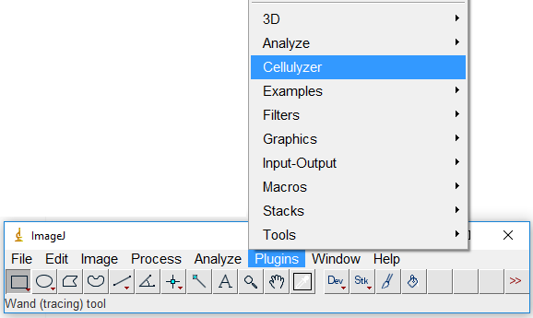
Images
Pairing
Results
Microscopy
Pre-Processing
Particle Analysis
Tracking
Track Visualization
Group Analysis
Imaging Parameters
Images
Simulation

Slide 16
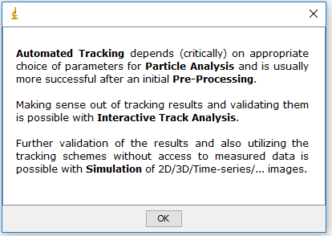
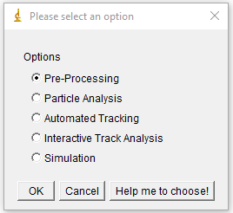
Images
Pairing
Results
Microscopy
Pre-Processing
Particle Analysis
Tracking
Track Visualization
Group Analysis
Imaging Parameters
Images
Simulation

Slide 17
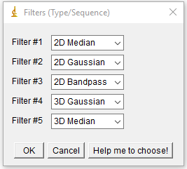
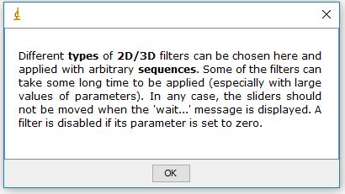
Images
Pairing
Results
Microscopy
Pre-Processing
Particle Analysis
Tracking
Track Visualization
Group Analysis
Imaging Parameters
Images
Simulation

Slide 18
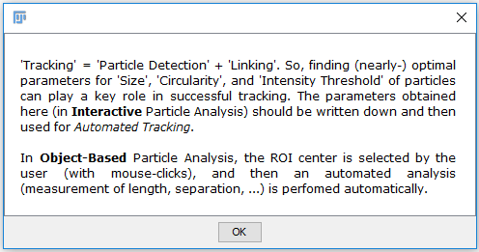
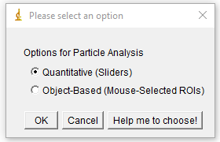
Images
Pairing
Results
Microscopy
Pre-Processing
Particle Analysis
Tracking
Track Visualization
Group Analysis
Imaging Parameters
Images
Simulation

Slide 19
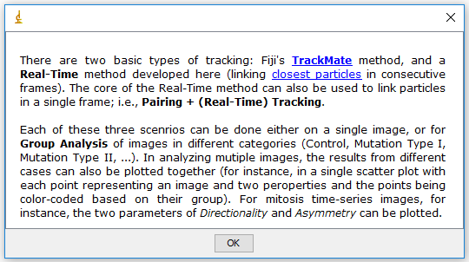
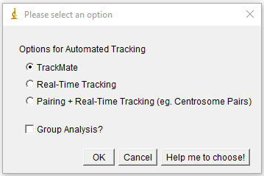
Images
Pairing
Results
Microscopy
Pre-Processing
Particle Analysis
Tracking
Track Visualization
Group Analysis
Imaging Parameters
Images
Simulation

Slide 20
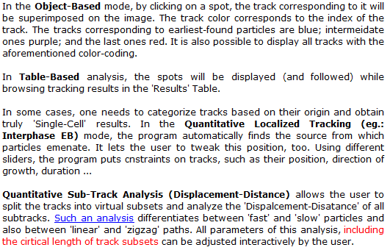
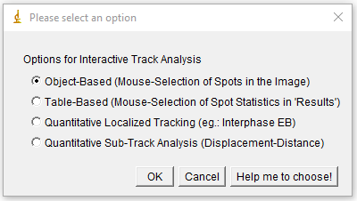
Images
Pairing
Results
Microscopy
Pre-Processing
Particle Analysis
Tracking
Track Visualization
Group Analysis
Imaging Parameters
Images
Simulation

Slide 21
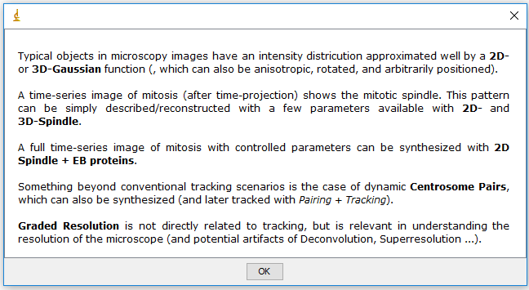
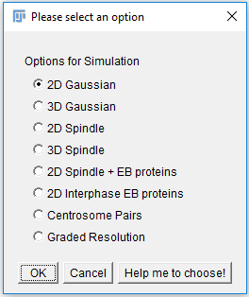
Images
Pairing
Results
Microscopy
Pre-Processing
Particle Analysis
Tracking
Track Visualization
Group Analysis
Imaging Parameters
Images
Simulation

Slide 22
Images
Pairing
Results
Microscopy
Pre-Processing
Particle Analysis
Tracking
Track Visualization
Group Analysis
Imaging Parameters
Images
Simulation

Slide 23
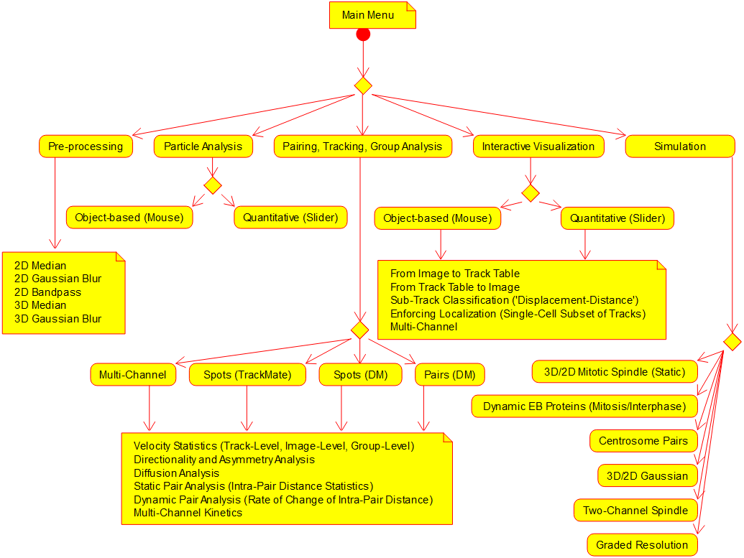

Slide 24
Images
Pairing
Results
Microscopy
Pre-Processing
Particle Analysis
Tracking
Track Visualization
Group Analysis
Imaging Parameters
Images
Simulation
Program, documentation, feedback (issues, customization requests …)
https://github.com/nurlicht/CellulyzerDemo

