Slide 1

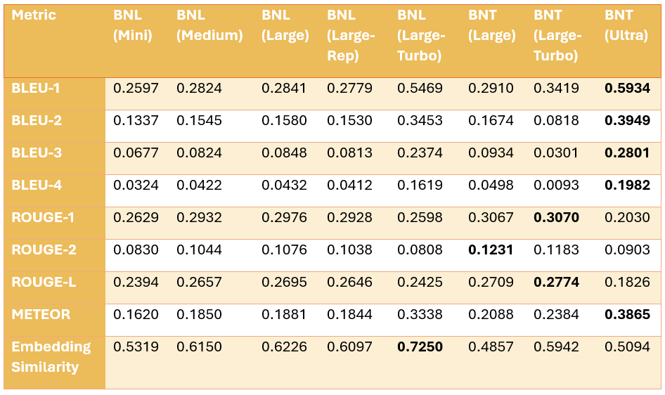
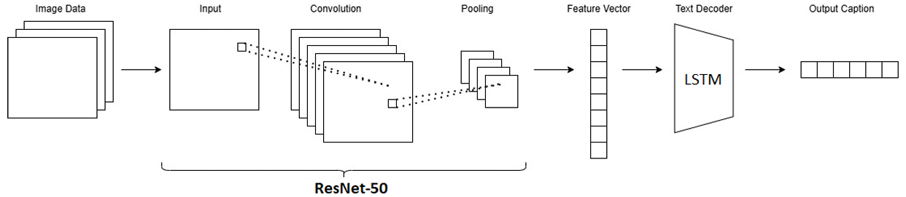
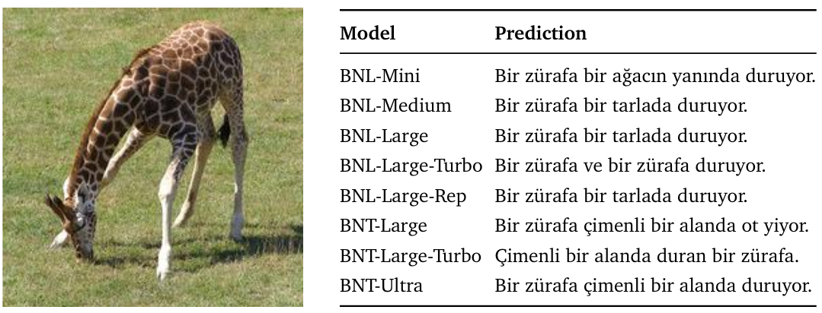
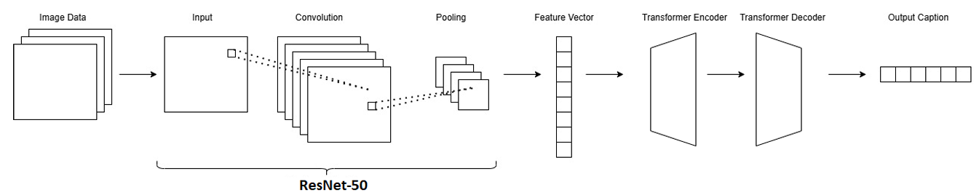
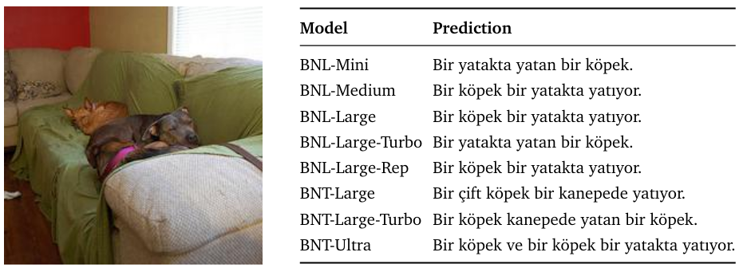
AUTOMATIC TITLE EXTRACTION FROM IMAGES BASED ON DEEP LEARNING
YILDIZ TECHNICAL UNIVERSITY
FACULTY OF ELECTRICAL AND ELECTRONICS
DEPARTMENT OF COMPUTER ENGINEERING
Berkay Gümüşay, Hira Nur Morca, Prof. Dr. Banu Diri
berkay.gumusay@std.yildiz.edu.tr, nur.morca@std.yildiz.edu.tr, diri@yildiz.edu.tr
Abstract
Image captioning involves generating short and meaningful textual descriptions for images.
With the rapid growth of visual data, captioning has become essential for tasks like categorization and accessibility.
This study aims to build a model capable of producing clear and relevant captions in Turkish.
III. Experimental/Application Results
Encoder CNN Comparison
InceptionV3 (BNL-Mini): Fastest model but lower feature quality.
VGG16 (BNL-Medium): Balanced in speed and feature richness.
ResNet50 (BNL-Large): Best feature quality but slowest.
Decoder Layer Comparison
LSTM (BNL-Large): Faster per epoch, performs well and adapts quickly.
Transformer (BNT-Large): Learns grammar better, requires fewer epochs despite longer training per epoch.
Tokenizer Comparison
Simple Tokenizer: Easier to use, faster, but lower accuracy.
BERT Tokenizer (Turbo models): Better handles Turkish morphology, resulting in higher caption quality.
Table 1 presents the performance comparison of all models across multiple evaluation metrics.
I. Introduction
Image captioning combines computer vision and natural language processing to generate descriptive texts for images.
Previous work like “TasvirEt” [1] used CNN-LSTM pipelines with custom datasets, while others [2] applied subword tokenization (e.g. BPE) to improve generalization.
Our approach uses a generative model trained on the MSCOCO dataset in different settings.
II. System Design
Our model uses an encoder–decoder framework to convert images into meaningful Turkish captions. The encoder extracts image features, while the decoder generates coherent sentences.
Encoder Layer
Employed CNNs in encoder layer are as follows:
InceptionV3
VGG16
ResNet50
Decoder Layer
Employed decoders are:
LSTM
Tokenizer
Tokenization
We apply two strategies:
Simple Word Tokenizer
BERT Tokenizer
Final Models
We trained two variants:
CNN + LSTM
CNN + Transformer
Both were trained on the Turkish MSCOCO-2014 dataset and demonstrated reliable caption generation across diverse visual contexts. The architecture of the ResNet50 + LSTM and ResNet50 + Transformer are visualized in Figure 1 and Figure 2, respectively.
Table 1. Performance Metrics Across Models
This study fills an important gap by evaluating image captioning models for the Turkish language, which is considered low-resource.
One limitation of this study is the use of a dataset that contains some linguistic inconsistencies and limited diversity in sentence structure.
Future research can focus on expanding and cleaning Turkish caption datasets to improve linguistic quality and diversity.
Generated captions for given images can be seen in Figure 3 and 4.
Figure 1. Architecture of ResNet50 + LSTM Model
Figure 2. Architecture of ResNet50 + Transformers Model
Figure 3. Predictions from models for a given picture
Figure 4. Predictions from models for a given picture
Conclusion
This study explored Turkish image captioning using different encoder-decoder models. Among the tested models, ResNet50 with Transformer (BNT-Ultra) gave the best results. Findings show that Transformer-based architectures and sub-word tokenization improve caption quality in morphologically rich languages like Turkish.
References
[1] Unal, M. E., Ozdemir, M. S., Genc, M. S., & Ozkan, M. (2016). Tasviret: A benchmark dataset for automatic Turkish description generation from images. In 2016 24th Signal Processing and Communication Application Conference (SIU) (pp. 1977–1980). IEEE.
[2] Kuyu, M., Erdem, A., & Erdem, E. (2018). Image captioning in Turkish with subword units. In 2018 26th Signal Processing and Communications Applications Conference (SIU) (pp. 1–4). IEEE.

