Slide 1
SAASTA.FI
Executive Review Meeting Q2/2007

Slide 2
Status Update Q2/2007
Key statistics for Q2
Number of users | 29
Number of posts | 494
Number of pageviews | 31 000
Number of visits | 7 500

Slide 3
Statistics – Most Viewed Pages
1 | Karpaasi näyttää | 531
2 | WTF?? (surprise slap in the face) | 408
3 | JSN rajoittaisi tyhmien ihmisten oikeutta verkkokeskusteluun… | 168
4 | Vote for best saasta of Q2/2007! | 134
5 | Turkish Rambo | 130

Slide 4
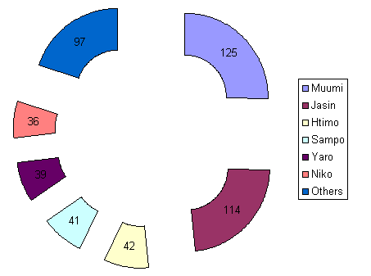
# of posts per user

Slide 5
Key Objectives for Q3/2007
Less videos, more pics & text
Quality over quantity
Double the amount of hits from africa

Slide 6
Strategy for Quality
Extend blog SW with features to enable easier voting
  ”Add to favorites”
  Dig it / Don’t dig it

Slide 7
Saasta awards
Number of votes: 24
  Big hand to all voters!!
Top 3 best posts
Top 3 best authors
Top 3 volume authors

Slide 8
Results

