Slide 1
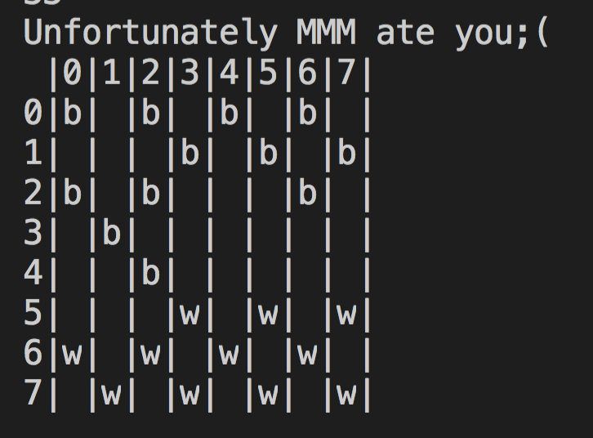
Can You Beat the MMM?
Nurpeiis Baimukan, Ghadeer Ghoshesh

Slide 2
Structure of the project

Slide 3
Cell
state – enum State {WHITE, BLACK, WHITEKING, BLACKKING, NONE};
Cell() Cell(State state) Const State& getState() void setState(State state)
Board
board – Unordered_map (type alias-unordered_map<position, Cell, pairhash> MoveType - checkMove(position start, position end, Player player)
void setBoard() MoveType move(position start, position end, Player player); const Unordered_map& getBoard();
IOstream
static string getSymbol(State state)
IOstream(); static movePosition getMove(); static void DrawBoard(Unordered_map &board)
MiniMax
unordered_map<long long, double> hashTable; unordered_map<long long, movePosition> moveTable; const int DEPTH = 9; Player checkEnd(Unordered_map board); string getBoardstate(Unordered_map board, Player player); long long hashFunction(string boardState); double assignPoints (string boardState); double theoreticalMax (string board); double theoreticalMin (string board); double evaluatePoints (string board); bool valid(int r, int c); void update(int depth, Unordered_map& nextBoard, long long key, Player player, double& current_point, movePosition & move); Unordered_map nextState (Unordered_map currentBoard, movePosition move, State change);
double explore(int depth, Unordered_map board, Player player); friend class Game;
Enum was used here- getters made sure that only
Game
Player currentPlayer Board board movePosition makeIO() Player getPlayer() void switchPlayer()
Game() void start()
Menu
Game g
void Options()
Notes:
Name – type

Slide 4
Cell & Board
Cell state – enum State {WHITE, BLACK, WHITEKING, BLACKKING, NONE};
The Board Class is where the checker- board gets set up. Furthermore, the Board class classifies the moves made by the players and moves the checker in the board if it is not prohibited move.

Slide 5
IOstream
A static member function can be called even if no objects of the class exist and the static functions are accessed using only the class name and the scope resolution operator ::

Slide 6
MiniMax
Black – Maximizes points
White – Minimizes points
How points evaluated: Go until the next 9 steps
Is having 5B and 4W checkers the same as having 4B and 3W Checkers?

Slide 7
MiniMax
MAX
MIN
MAX
2
-1
2
-1
4
2

Slide 8
MiniMax
Explore all possible moves
4²⁴/(10⁹*60*24) = 196 days to finish
Assuming Branching Factors
Apply Heuristics when assigning points and explore up to 14 future moves
Faster than previous method
Takes too long when few checkers left
Change Depth to 9
Takes up to 1 min 30 seconds. Average is around 10seconds
Success rate is high

Slide 9
Future Plans
Evaluating points is done through neural networks that uses data and not heuristics to evaluate points
Insert More More Rules

Slide 10
Trial

Slide 11
Graphical User Interface
Multiple Attempts to implement a Graphical user interface using C++ libraries and frameworks such as
OpenGL
GLUT
Windows
SFML

Slide 12
Challenges:
Windows and SFML do not work on mac environment
Open GL and GLUT frameworks also had problems so we had to to add extra files and libraries to make them compatible with IDEs on Mac and Linux
Still even after modifications faced problems in getting the visuals to work and respond to mouse clicks and drags

Slide 13
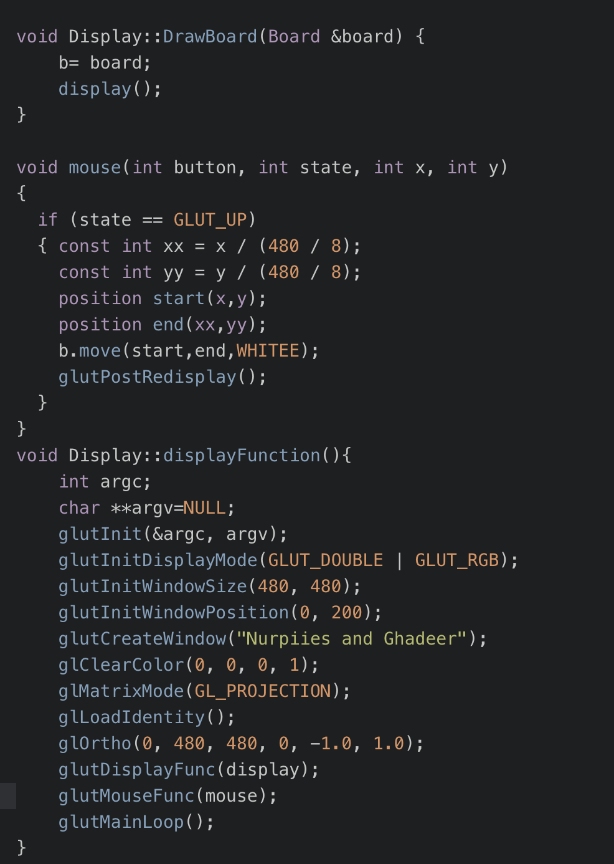
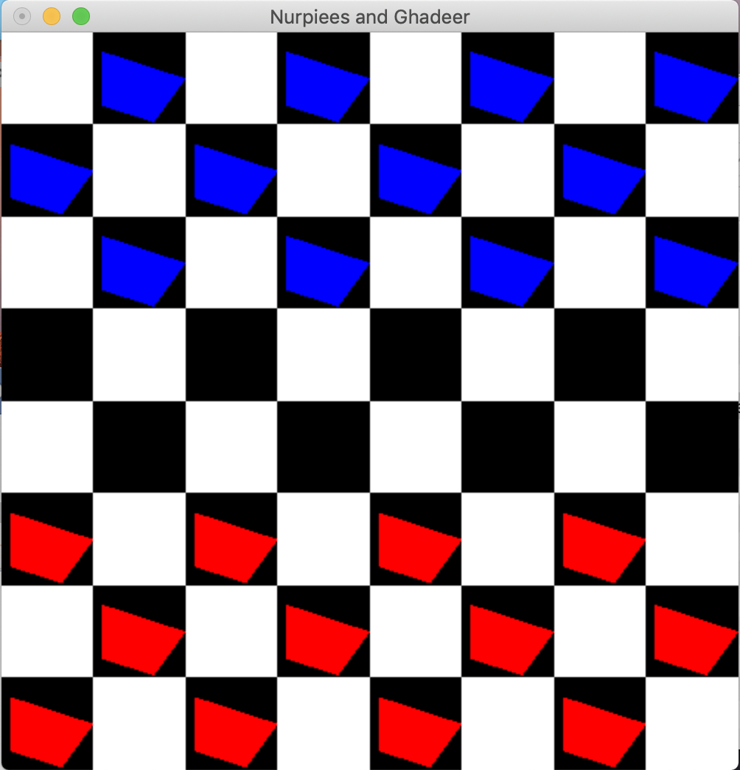
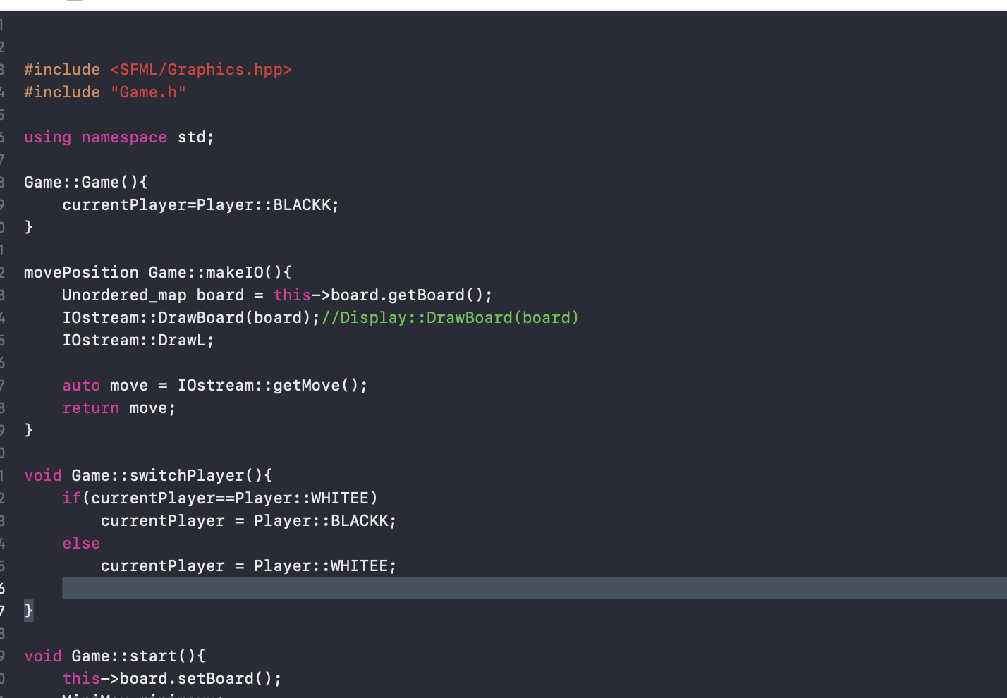
Different versions using different frameworks

Slide 14
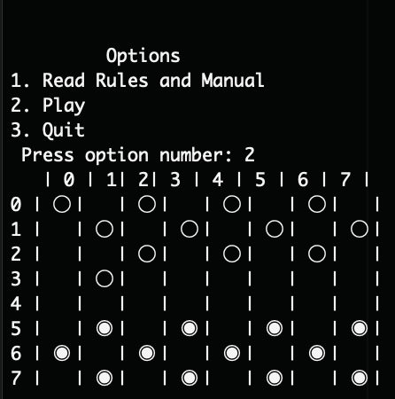
Final Interface from Terminal

