Slide 1
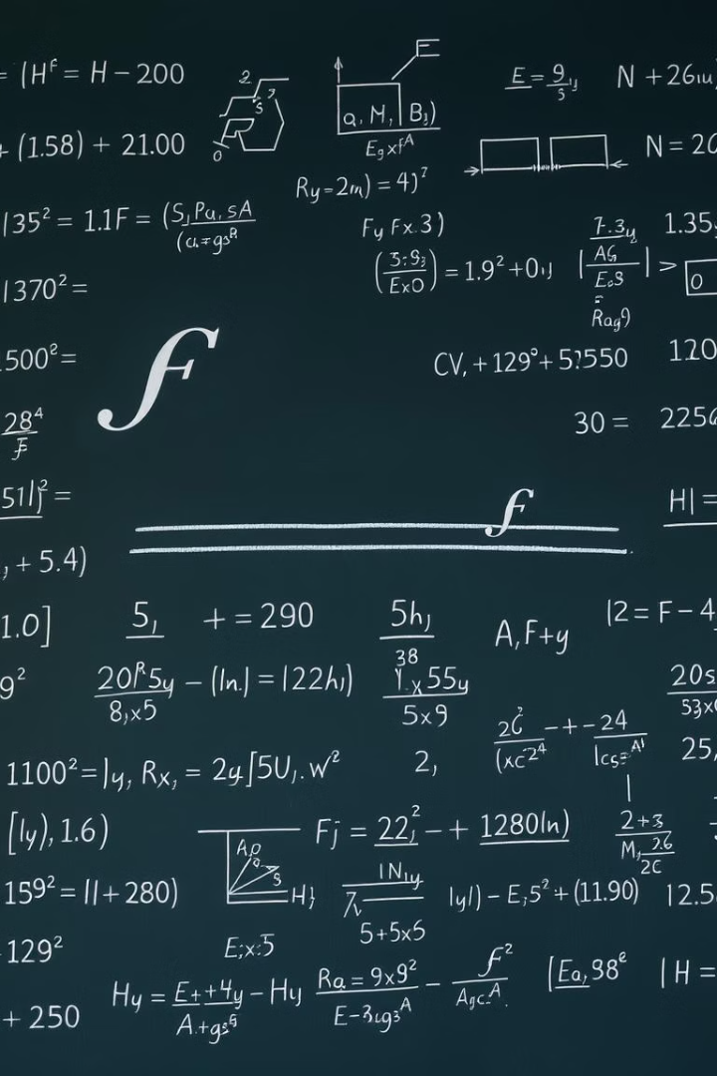
Function Approximation
Function approximation is the process of representing a complex function using a simpler, more manageable form. This powerful technique has numerous applications in fields like machine learning, data analysis, and numerical optimization.

Slide 2

Introduction to Function Approximation
1
Modeling Complex Functions
2
Improved Efficiency
By replacing a complex function with a simpler approximation, computation and analysis become more efficient.
Function approximation allows us to model complex, unknown functions using simpler, more tractable forms.
3
Applications Across Disciplines
Function approximation techniques are used in machine learning, control systems, signal processing, and more.

Slide 3
Types of Function Approximation
Linear Regression
Polynomial Regression
Spline Approximation
Fits a linear model to the data, finding the best-fit straight line.
Approximates the function using a polynomial of a specified degree.
Uses piecewise polynomial functions to create a smooth curve.

Slide 4
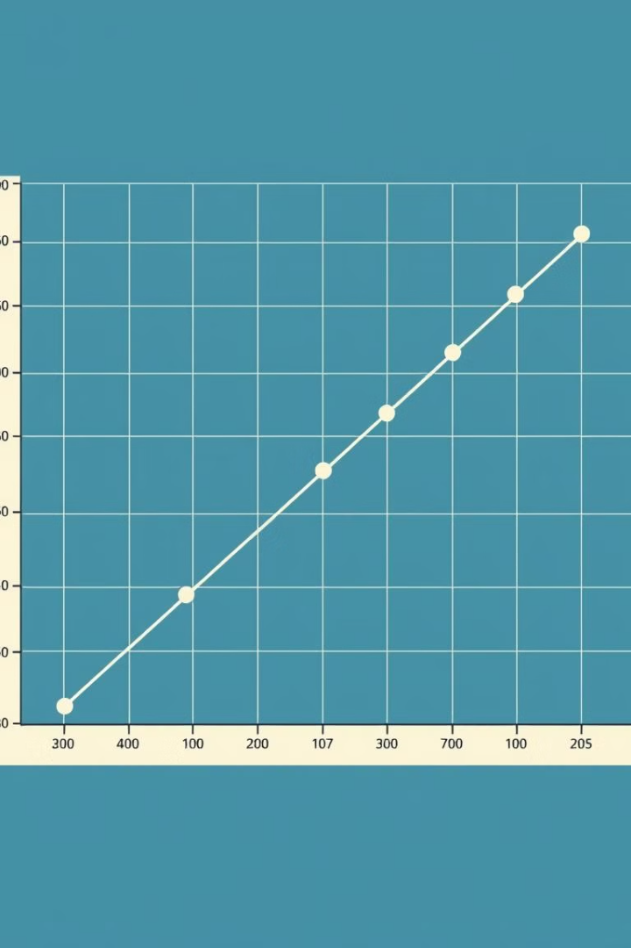
Linear Regression
Simple Form
Least Squares
Linear regression finds the best-fit straight line to represent the relationship between variables.
The model minimizes the sum of the squared differences between the predicted and actual values.
Interpretable Results
Limited Flexibility
Linear regression provides intuitive, easily interpreted coefficients describing the function's behavior.
Linear regression may not be suitable for complex, non-linear functions.

Slide 5
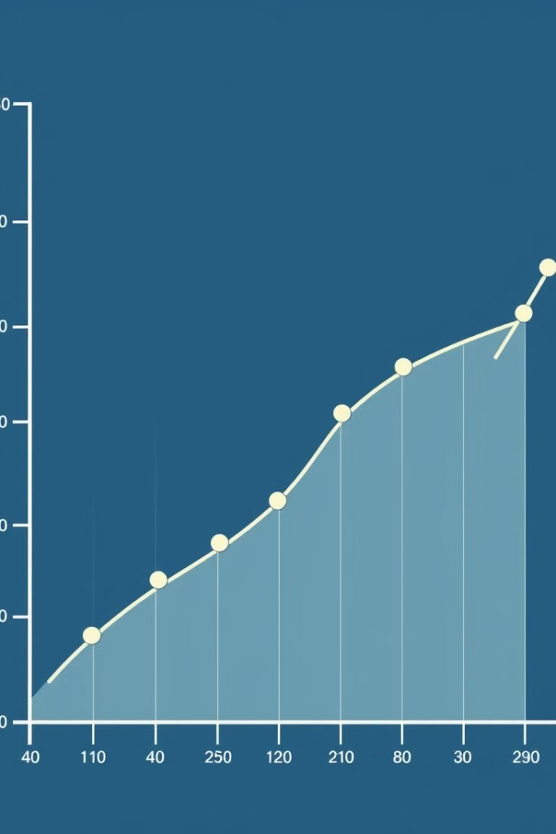
Polynomial Regression
1
Higher Flexibility
Polynomial regression can model more complex, non-linear relationships by using higher-degree polynomials.
2
Overfitting Risk
Using high-degree polynomials can lead to overfitting, where the model fits the noise in the data.
3
Careful Selection
The degree of the polynomial must be chosen carefully to balance flexibility and generalization.

Slide 6
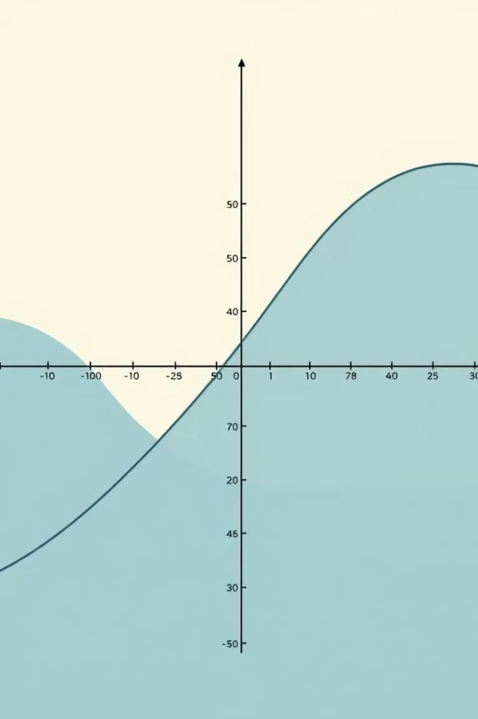



Spline Approximation
Piecewise Polynomials
Spline approximation uses a series of connected polynomial functions to create a smooth curve.
Continuity
Splines maintain continuity and smoothness by ensuring that derivatives match at the connection points.
Flexible Fit
Splines can effectively model a wide range of complex, non-linear functions.

Slide 7
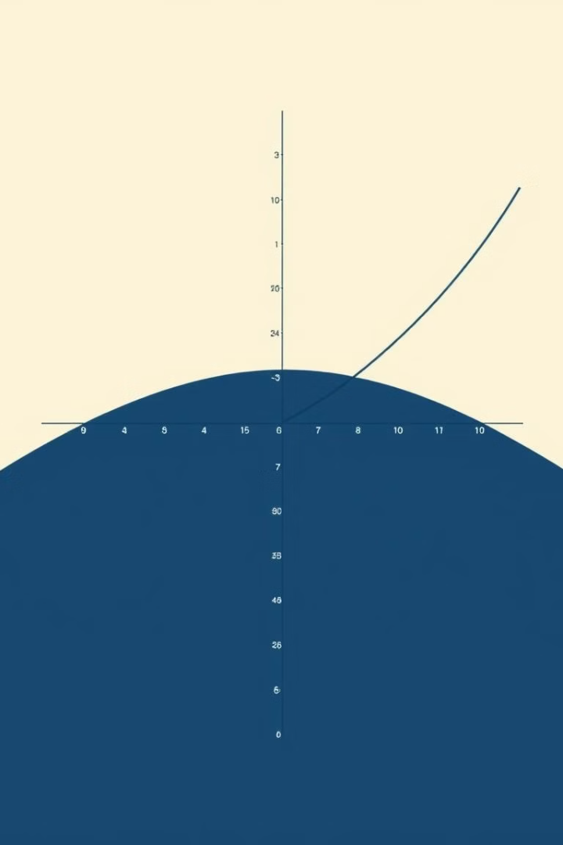



Radial Basis Functions
Kernel-based Approach
Radial basis functions use a kernel function to define the influence of each data point.
Flexible Modeling
RBFs can adapt to a wide range of complex, non-linear function shapes.
Interpolation
RBFs can be used to construct smooth, interpolating functions passing through data points.

Slide 8
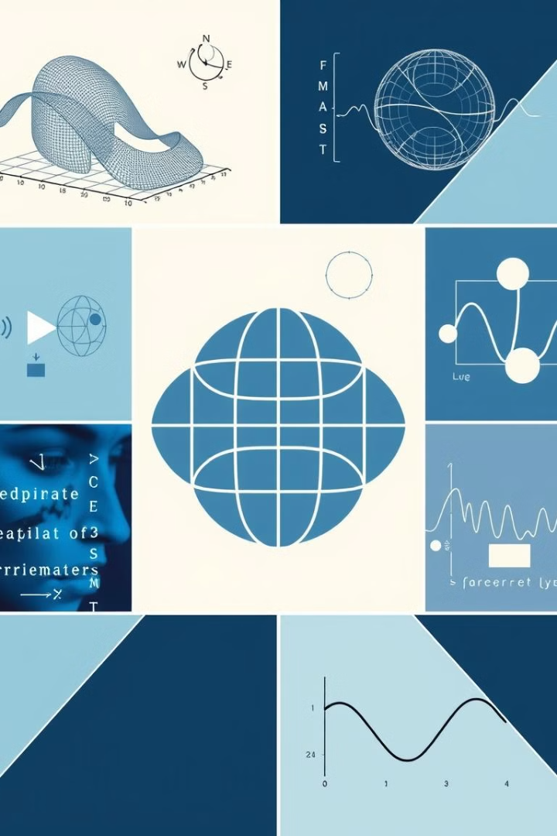
Applications of Function Approximation
Machine Learning
Approximating complex decision boundaries and modeling non-linear relationships.
Signal Processing
Filtering, denoising, and reconstructing signals from discrete data.
Control Systems
Modeling plant dynamics and designing optimal control strategies.
Data Analysis
Fitting curves and surfaces to experimental data for interpretation and prediction.

