Slide 1

Sorting, Searching, and Graph Algorithms: Mastering the Fundamentals
Algorithms are the building blocks of computer science, enabling us to process and analyze data efficiently. This presentation will explore the core concepts and powerful techniques behind sorting, searching, and graph algorithms - essential tools for tackling complex computational problems.

Slide 2
Sorting Algorithms: Navigating the Spectrum of Efficiency
Comparison-Based Sorting
Distribution-Based Sorting
Efficiency Trade-offs
Algorithms like Quicksort and Merge Sort rely on comparisons to rearrange elements into the desired order.
Techniques like Radix Sort and Bucket Sort sort data by distributing elements into different buckets based on their digits or values.
Each sorting algorithm has its own strengths and weaknesses, making them suitable for different scenarios and data characteristics.

Slide 3
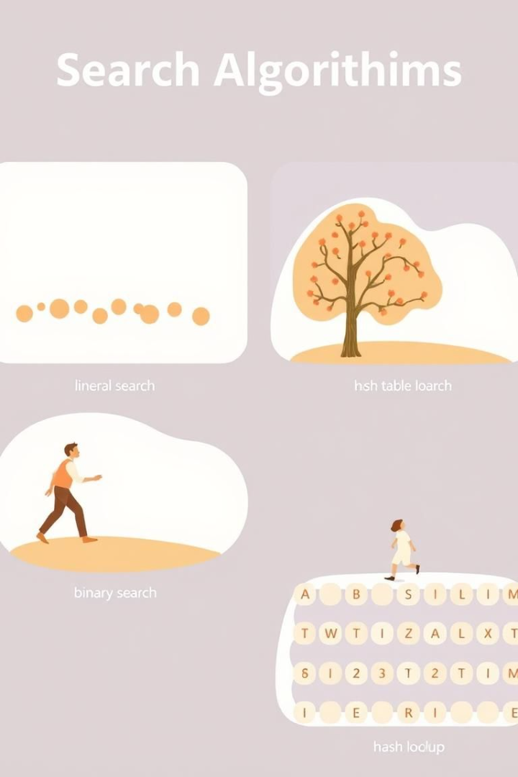
Searching Techniques: From Linear to Binary and Beyond
1
Linear Search
A simple, straightforward approach of checking each element in a list until the target is found.
2
Binary Search
A more efficient technique that repeatedly divides the search space in half, ideal for sorted data.
3
Advanced Searches
Hash tables, trie data structures, and other techniques offer even faster search times for specific use cases.

Slide 4
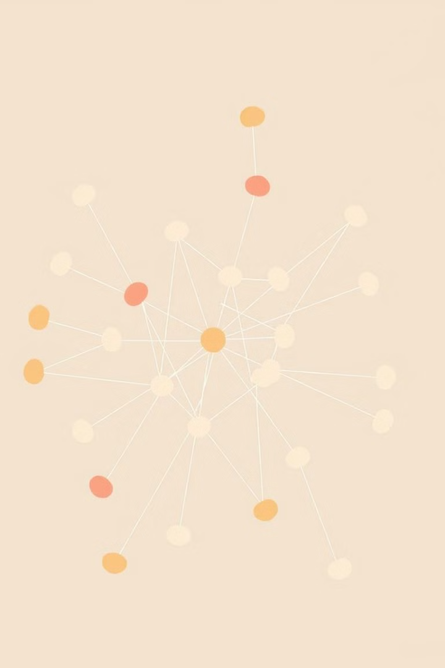



Graph Traversal: Breadth-First and Depth-First Approaches
Breadth-First Search
Explores all the neighboring nodes at the present depth before moving on to the nodes at the next depth level.
Depth-First Search
Explores as far as possible along each branch before backtracking and exploring the next branch at the current depth.
Traversal Applications
These fundamental graph traversal algorithms have a wide range of applications, from pathfinding to social network analysis.

Slide 5




Shortest Path Algorithms: Dijkstra and A* Strategies
Dijkstra's Algorithm
A* Search
Applications
A classic algorithm that finds the shortest path between two nodes by iteratively exploring the least-cost option.
A heuristic-based approach that combines Dijkstra's algorithm with an estimated cost to the destination, often more efficient.
These shortest path algorithms are widely used in navigation systems, logistics planning, and network routing.

Slide 6
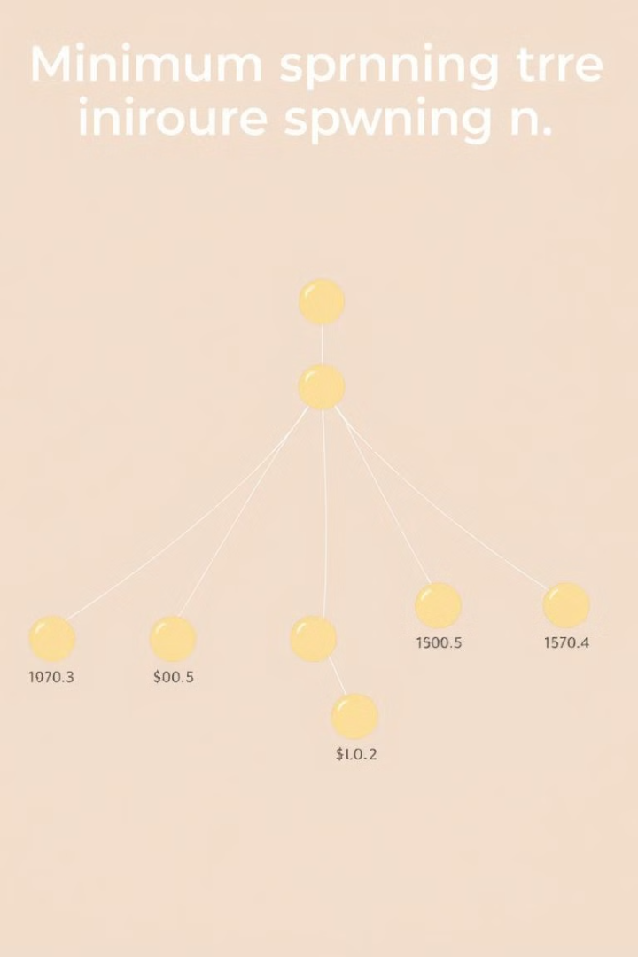
Minimum Spanning Trees: Kruskal and Prim's Algorithms
Kruskal's Algorithm
Prim's Algorithm
This greedy algorithm constructs the minimum spanning tree by repeatedly adding the lowest-weight edge that doesn't create a cycle.
An alternative approach that builds the minimum spanning tree by starting with a single node and iteratively adding the lowest-weight edge.
Use Cases
Minimum spanning trees are crucial in network design, transportation planning, and other optimization problems.

Slide 7

Advanced Graph Problems: Connectivity, Coloring, and Flow
Connected Components
Identifying distinct subgraphs where all nodes are reachable from one another.
Graph Coloring
Assigning colors to vertices such that no adjacent vertices share the same color.
Network Flow
Maximizing the amount of flow through a network from a source to a sink.

Slide 8

Conclusion: Applying Algorithmic Thinking to Real-World Problems
The fundamental algorithms and techniques covered in this presentation are the building blocks for solving a wide range of real-world problems, from optimizing transportation networks to analyzing social media data. By mastering these core concepts, you'll be equipped to tackle complex challenges and drive innovation in any field.

