Slide 1


Web Development
19th December 2017

Slide 2



Content
HTML
Bootstrap
Git

Slide 3
HTML
Hyper Text Mark-up Language

Slide 4
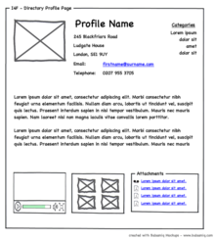
What is HTML?
A Mark-up Language that determine the layout, structure & content of any web page
Language read by browser to draw out the content

Slide 5
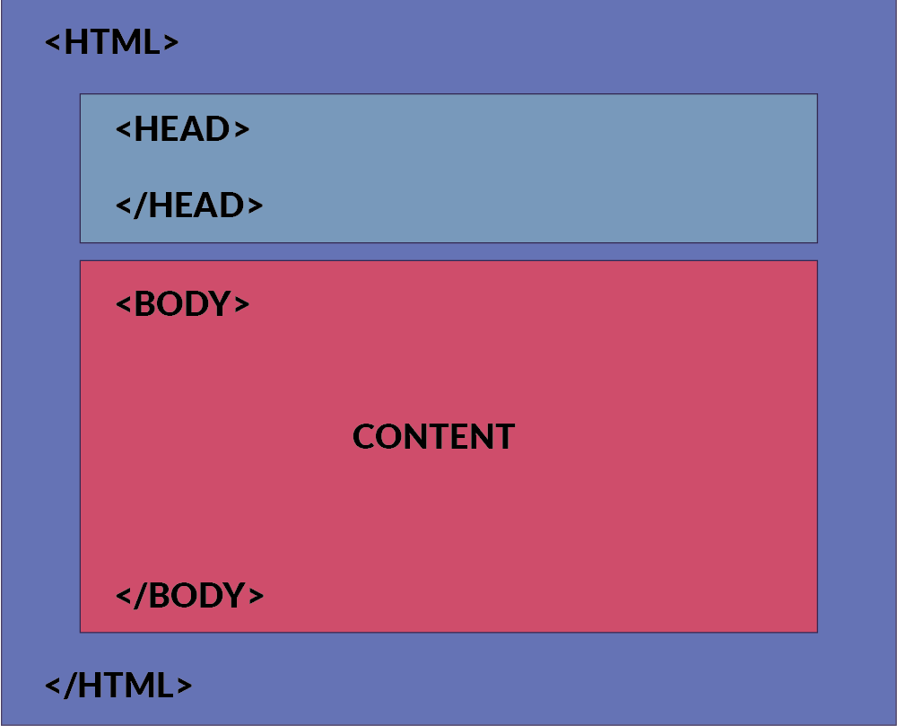
HTML Structure
Notes:
All those boxes shown in the structure are the html elements.
So, what are html elements?
They are what make up of html pages and determine the content. They are the building block so html pages. As you can see, they are represented by tag. And the ag usually consider of start & end tag.
The opening tag: This consists of the name of the element (in this case, p), wrapped in opening and closing angle brackets. This states where the element begins, or starts to take effect — in this case where the start of the paragraph is.
The closing tag: This is the same as the opening tag, except that it includes a forward slash before the element name. This states where the element ends — in this case where the end of the paragraph is. Failing to include a closing tag is a common beginner error, and can lead to strange results.
The content: This is the content of the element, which in this case is just text.
The element: The opening tag, plus the closing tag, plus the content, equals the element.

Slide 6
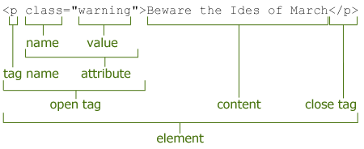
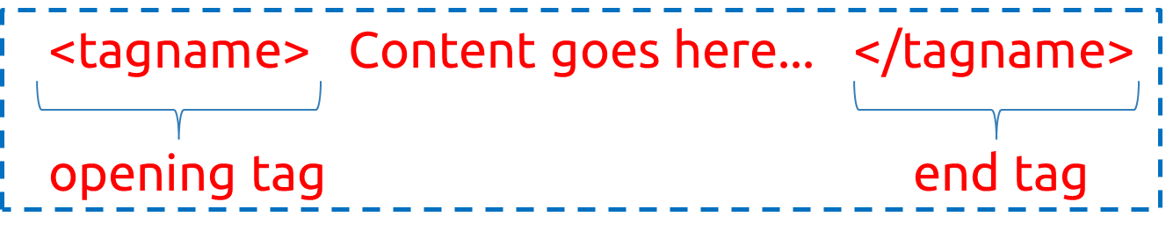
HTML Element
Building blocks of HTML pages
Represented by tags
Usually consider of opening & closing tag

Slide 7
Get Started on HTML
Create your first web pages
Create a new file and name it as index.html
Notices the changes of icon after renaming
Notes:
Index.html is the common used HTML file for the initial landing pages of any website.

Slide 8
Structure Tags
<html>
<head>
</head>
<body>
</body>
<html>

Slide 9
Basic HTML Element
<h1> This is Heading tag </h1>
<h3> This is another heading tag </h3>
<p> This is Paragraph tag </p>
<label> This is label tag </label>
<a> This is an anchor tag </a>

Slide 10
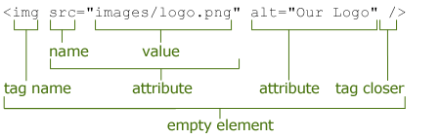
Empty HTML Element
Elements that have no content
Example :
<br /> (break line / new line)
<hr /> (horizontal ruler)
<img /> (image element)

Slide 11
Comments Element
Writing notes, comments on web pages
Do not want it to be displayed
Useful for documentation, for others to read and understand
Example:
<!-- …. -->
<!-- <p>……………</p> -->

Slide 12
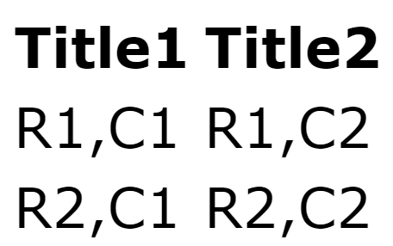
Table Element
<table>
<tr>
<th> Title1</th>
<th> Title2</th>
</tr>
<tr>
<td> R1, C1 </td>
<td> R1, C2 </td>
</tr>
<tr>
<td> R2, C1 </td>
<td> R2, C2 </td>
</tr>
</table>
Notes:
Element specific attributes: align, colspan, rowspan, bgcolor, border

Slide 13
Nesting Element
Elements inside elements
Example :
<p> element <u> inside </u> element</p>
Incorrect Example :
<p> element <u> inside element</p> </u>

Slide 14
Text Formatting Elements
<b> – bold text
<i> – Italic text
<u> – underline text
Notes:
Not gona focus on this, as this is commonly done using CSS now

Slide 15
Element’s Attributes
Provide additional information
Some elements does nothing on its own
Always specific at the start tag
2 type of attributes

Slide 16
Attributes Values
Single or double quotes?
<a href="http://example.com">link to example</a>
<a href='http://example.com'>link to example</a>
Incorrect :
<a href="http://example.com'>link to example</a>

Slide 17
Element Specific Attributes
Unique attributes of the element
Only work on specific elements
Example :
anchor tag, determine where should it redirect to
< a href = "https://google.com" > Google Website </a>
image tag, determine the the image source
<img src ="imageSrc.jpg" />

Slide 18
More Elements specific Attributes
<a href= "https://Google.com" target="_blank">anchor tag</a>
href – hyperlink reference
target – where should the link open in
<img src= "wizard.png" width="100" height="100" alt=" wizard picture " />
src – source of image
width – width of image
height – height of image
alt – what to display if the images failed to load

Slide 19
Global Attributes
Works on every elements
Example:
style – provide style details for the element
<p style= "color: red; text-align: center" > Red Color Text </p>

Slide 20
Other Common Global Attributes
Use with CSS & JS
id - Assign an ID name for the element
class - Assign an class name for the element
<img src= "wizard.png" id= "profile-pic" src= "img header profile" />

Slide 21
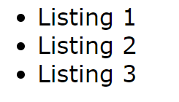
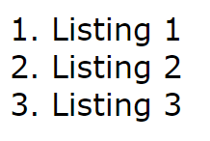
List Element
<ul>
<li> Listing 1 </li>
<li> Listing 2 </li>
<li> Listing 3 </li>
</ul>
<ol>
<li> Listing 1 </li>
<li> Listing 2 </li>
<li> Listing 3 </li>
</ol>
Notes:
<ul> = unorder list
<ul type="square">
<ul type="disc">
<ul type="circle">
<ol> = ordered list
<ol type = "1"> - Default-Case Numerals.
<ol type = "I"> - Upper-Case Numerals.
<ol type = "i"> - Lower-Case Numerals.
<ol type = "A"> - Upper-Case Letters.
<ol type = "a"> - Lower-Case Letters.
<ol type = "1" start = "4"> - Numerals starts with 4.
<ol type = "I" start = "4"> - Numerals starts with IV.
<ol type = "i" start = "4"> - Numerals starts with iv.
<ol type = "a" start = "4"> - Letters starts with d.
<ol type = "A" start = "4"> - Letters starts with D.

Slide 22

Button Element
<button> I’m a button </button>
Notes:
For this workshop, we won’t be covering Form Tag as it most probably won’t be used by the heartcode student.

Slide 23

Embedded Content
Example:
<iframe>.......</iframe>
<iframe width="560" height="315" src="https://www.youtube.com/embed/oWnvMeS2m08" frameborder="0" allowfullscreen></iframe>
Videos
Slides
Google forms

Slide 24

What’s in the head?
Links to CSS & JS (files or CDNs)
Page title
Metadata (for SEO)
E.g. author, keywords, description, etc
Page title example:
<title>YouTube</title>

Slide 25
Recap on HTML Syntax
Normal HTML Element
Consist of Open & Close Tag
Empty Element Tag
Consist of Open Tag ONLY

Slide 26
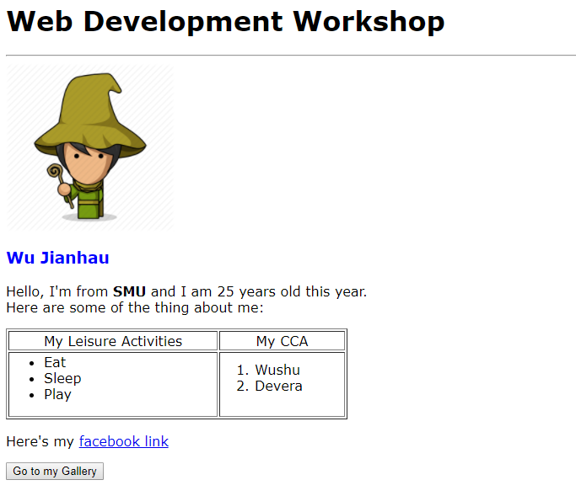
Exercise - HTML
Modify index.html
Add the following :
Image
Table
List
Header
Paragraph
Anchor Link & Button

Slide 27
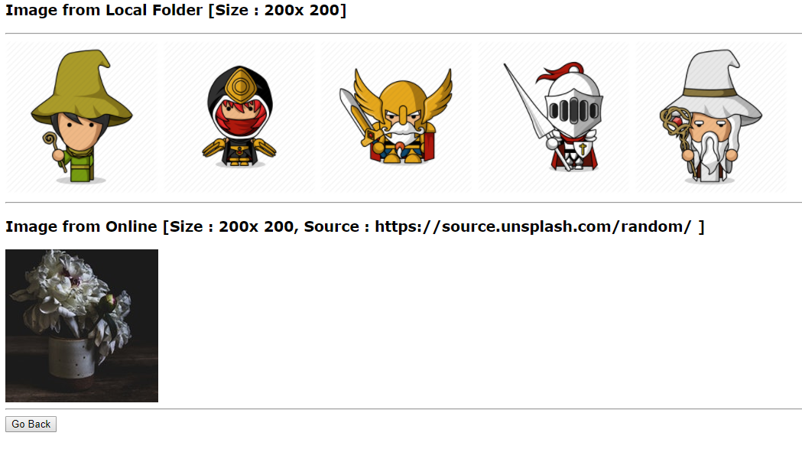
Exercise - HTML
Create gallery.html
Link between pages

Slide 28
Bootstrap
CSS Framework
Twitter Bootstrap @ https://getbootstrap.com/docs/3.3/

Slide 29
What is Bootstrap
CSS Framework
A library of CSS which have been created by groups of professional

Slide 30
Why use Bootstrap?
Easy to get started
Great grid system
Pre-define style for most HTML element
Extensive list of components
Bundled JavaScript plugins
Good documentation

Slide 31
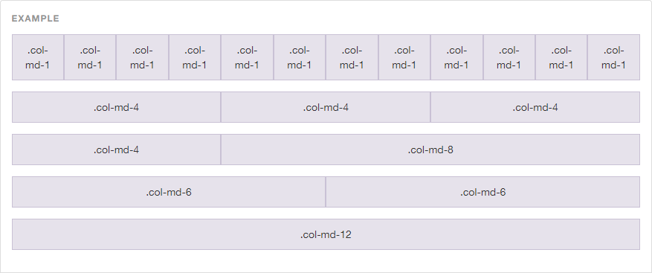
Bootstrap – Grid System
# of Column = 12

Slide 32
Adding Bootstrap
<link > tag to include external resources
Resources Link:
<link rel="stylesheet" href="https://cdnjs.cloudflare.com/ajax/libs/twitter-bootstrap/3.3.7/css/bootstrap.min.css" />
Add it to the head segment of the HTML

Slide 33
How to use Bootstrap
Using the class attribute of HTML tags
Lookup their documentation for class name to use
Apply it to your html attributes
Notes:
Documentation link for CSS : https://getbootstrap.com/docs/3.3/css/

Slide 34
Grid System Example
<div class="container">
<div class="row">
<div class="col-md-4">.col-md-4</div>
<div class="col-md-4 col-md-offset-4">.col-md-4 .col- md-offset-4</div>
</div>
</div>
Notes:
The container class include a small margin to either side. So that it will not take up the full screen width. This is for the ease of view, and to include a small margin to the side of the screen.
The row and col could seen it as a table. If the col exceed 12 col, it will moved to new row. But for good practise and ease of position, we use the class “row” for every new row of content we placing. It will helps with further enhancement and easier to modify.
For example if we can 3 row of content:
<div container> <div class=“row”>
<div class=“col-md-4”>
Content for 1st Row
Column 1
</div>
<div class=“col-md-4”>
Content for 1st Row
Column 2
</div>
<div class=“col-md-4”>
Content for 1st Row
Column 3
</div>
</div>
<div class=“row”>
<div class=“col-md-4 col-md-offset-4”> Content for 2nd Row
</div>
</div>
<div class=“row”>
<div class=“col-md-4”> Content for 3rd Row
</div>
<div class=“col-md-4 col-md-offset-4”> Content for 3rd Row
</div>
</div>
<div>

Slide 35
Example of Bootstrap CSS style
Image Tag Styling
<img src="https://source.unsplash.com/random" class="img-responsive img-rounded" />
Button Styling for <a> (hyperlink) Tag
<a href=“http:///www.google.com” class="btn btn-danger btn-block btn-lg“>Google</a>

Slide 36
Bootstrap Component
Addition to CSS styling, provide other reusable component
Predefine style and design
Save time and effort to design
Example: Thumbnails, Navigation Bar, Dropdown List
Notes:
Documentation link : https://getbootstrap.com/docs/3.3/components/

Slide 37
BOOTSTRAP COMPONENTS - Thumbnail
<div class="row">
<div class="col-sm-6 col-md-4">
<div class="thumbnail">
<img src="..." alt="..." />
<div class="caption">
<h3>Thumbnail label</h3>
<p>...</p>
</div>
</div>
</div>
</div>
Notes:
Example of a thumbnail

Slide 38
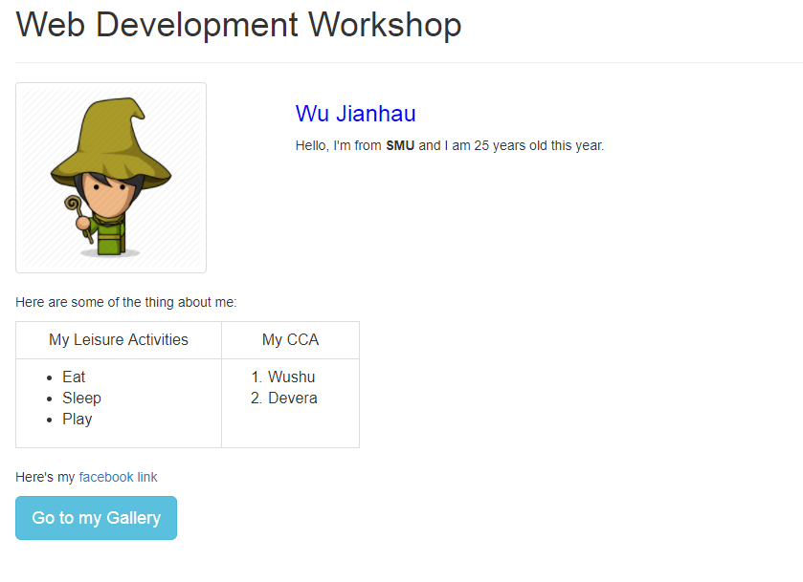
Exercise - Bootstrap
Modify index.html
Using Bootstrap CSS

Slide 39
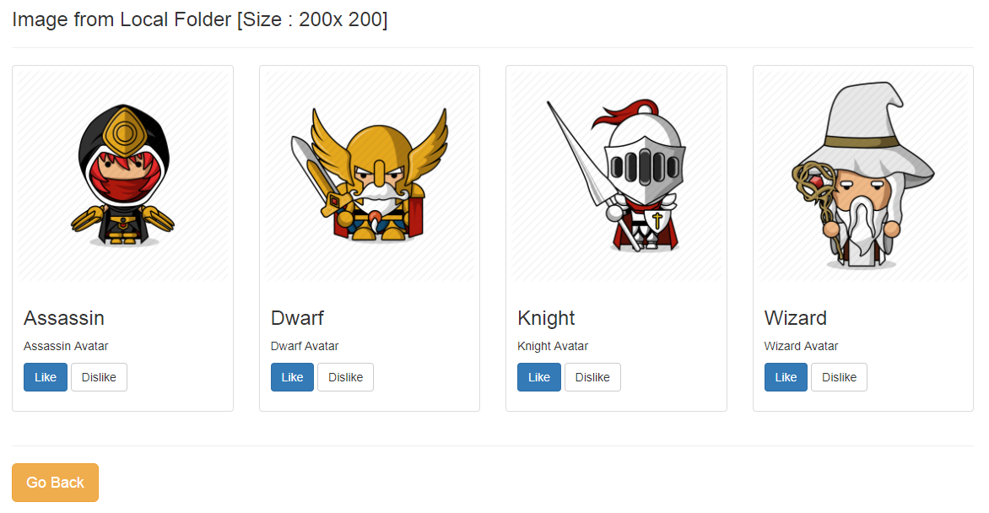
Exercise - Bootstrap
Modify gallery.html
Using Bootstrap Components [Thumbnail]

Slide 40
FONT-AWESOME ICON
Font-Awesome is not part of Bootstrap
Iconic font and CSS Framework
Include customize icons to your webpages

Slide 41
How to use Font-Awesome?
Same procedure as Bootstrap
Includes the link reference to the resources <link rel="stylesheet" href="https://cdnjs.cloudflare.com/ajax/libs/font-awesome/4.7.0/css/font-awesome.min.css" />
Find your desire icon on their website http://fontawesome.io/icons/
Add to your HTML pages through class attributes

Slide 42
Example of Font-Awesome Usage
Adding Instagram icon
<i class="fa fa-instagram" aria-hidden="true"></i>
Changing the size of the icon to 5x the size
<i class="fa fa-instagram fa-5x" aria-hidden="true"></i>

Slide 43
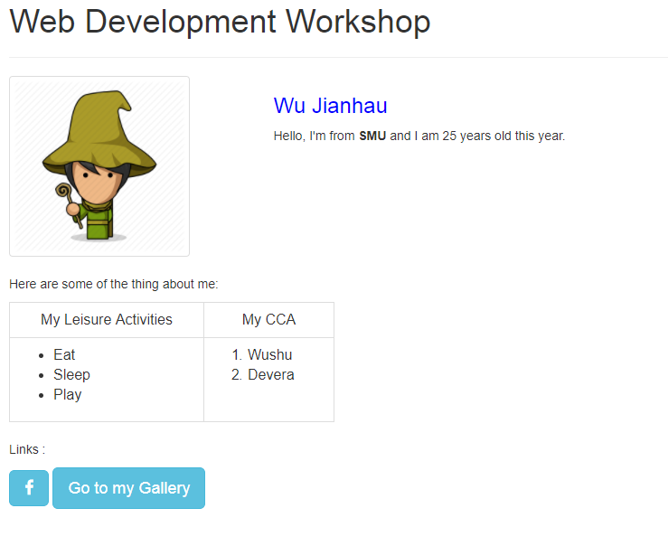
Exercise – Font-Awesome
Modify index.html
Include Facebook icon beside “Go to my Gallery”

Slide 44

GitHub
Online Code Repository

Slide 45
GitHub
Git repository hosting service
Store and share your code
https://github.com/

Slide 46
Using GitHub
Create an GitHub Account
Create a new Repository
Using Command Prompt to upload source code

Slide 47
Linking with GitHub
One-time Initialize to set-up repo folder [First time]
Commands
>> git init
>> git remote add origin https://github.com/wuhuu/firstRepo.git
>> git add .
>> git commit –m “first commit”
>> git push –u origin master

Slide 48
Upload to GitHub
Commands
>> git add .
>> git commit –m “short message of what its about”
>> git push –u origin master

Slide 49
Get update from GitHub
Commands
>> git pull origin master

Slide 50


Thank you!
Any Questions?

