Slide 1


Web Development

Slide 2
Content
CSS

Slide 3
CSS
Cascading Style Sheets

Slide 4
What is CSS?
Language for specifying how documents are presented
Bring colour and design to the web page you created

Slide 5
How does CSS affect HTML?
Web browsers apply CSS rules to the HTML
CSS rules formed from
1. Set of properties and values
update how the content is display
2. Selector
select the elements to apply

Slide 6
CSS Syntax
Selector
{
Property
:
Value
;
}

Slide 7
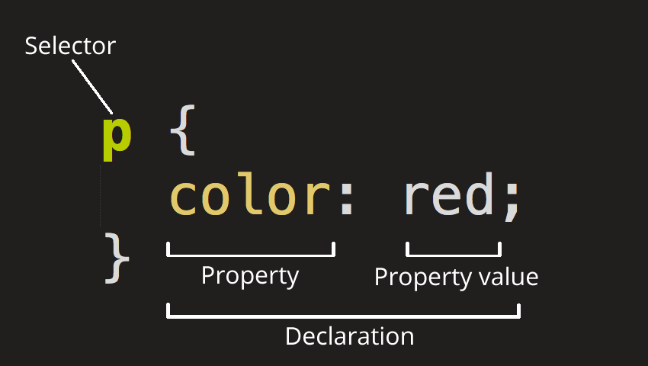
CSS Syntax

Slide 8
CSS Selector
ELEMENT Selector
CLASS Selector
ID Selector
Determine by HTML tag name
h1 , h2 , p , a , table , img
Determine by dot (.) symbol in CSS file
.blueText { color : blue } | class = “blueText”
Determine by hash (#) symbol in CSS file
#redText { color : red } | id= “redText”
Mix Style : h1 # redText

Slide 9
Different type of CSS Style & their Priority
Inline Element
In Head Section of HTML
External CSS File
<h1 style = “ color : red “> HELLO </h1>
<style>
h1 { color : red; }
</style>
<link rel=“stylesheet” href=“style.css” />

Slide 10
Ordering of CSS Style
Within style sheet, won’t affect
Order of including the style sheet matters
HTML will be read from top-down approach. **
Latest CSS include will overwrite previous style if conflicting
Notes:
HTML is been process in a top-down approach. When it read the link tag, it will read in a top down and apply the style as it process the style sheet. Hence if two different style sheet make changing the style of the same element. The last link tag, will rewrite the previous style sheet. You could see HTML process thing step by step, hence the latest step applied will be shown to the end-user.
Order of rules within the style sheet won’t affect, as the HTML is the determine factor of which rule will be applied first.

Slide 11
HTML Element used with styling
<div> … </div>
Division or Section
Group block elements together
<span> … </span>
inline container for phrasing content

Slide 12
Create External Styles Sheet
Similar to HTML
Create a new file and name it style.css
Extension end with .css

Slide 13
Applying Styles Sheet to HTML
link between html with external resource
<link rel="stylesheet" href= "assets/css/style.css">

Slide 14
Color
background-color: cyan;
color: #000; (font color only)
Color value specific by :
color name
HEX value
RGB / RGBA value
Notes:
RGBA – Red Green Blue Alpha.
Alpha refers to the gradient of the color
More details of the color can be read from : https://developer.mozilla.org/en-US/docs/Web/CSS/color_value

Slide 15
Opacity
specifies the opacity/transparency of an element
property can take a value from 0.0 - 1.0
The lower value, the more transparent
Example :
opacity : 0.5;
Notes:
RGBA – Red Green Blue Alpha.
Alpha refers to the gradient of the color
More details of the color can be read from : https://developer.mozilla.org/en-US/docs/Web/CSS/color_value

Slide 16
Layouts
Margin
Padding
Position
Text-align

Slide 17
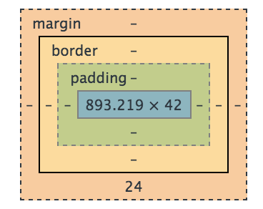
CSS Box Model
Content – The content of the box, where text and images appears
Padding – Clears an area around the content. The padding is affected by the background and color of the box
Border – A border that goes around the padding and content. The border is affected by the background color of the box.
Margin – The empty area around the border. The margin is completely transparent, no background color

Slide 18
Layout: Margin & Padding
Margin : space outside
Padding : space inside
Values declared using in px, % , or auto
Value are declared for all 4 sides
Notes:
Other ways to declare the value :
margin : 10px;
margin : 10px; 5px; (top&bottom, right&left)
margin : 10px; 20px; 5px; (top,righ&left,bottom)
margin : 10px 5px; 15px; 20px; (clockwise from the top)

Slide 19
Layout: Position
Absolute
Starts from the left hand corner of the page
Relative
Starts from where the element currently is
Top & left properties are used to move the position

Slide 20
Layout: text-align
text-align : center | left | right | justify
Same as the alignment in MS Word

Slide 21
Sizing and Border
Content size
height | width : % | px | auto
Content border
border : size style color
Example: border : 2px dashed yellow;
border-radius
Example: border-radius : 20px;
Notes:
Border is applied to all 4 sides.
If want to customise each side, could use the following :
border-top
border-left
border-right
border-bottom
Border-radius is for the rounded corners of the boxes.
Ways to declare border radius :
/* 1st value is top left and bottom right corners,
2nd value is top right and bottom left */
border-radius: 20px 10px;
/* 1st value is top left corner, 2nd value is top right
and bottom left, 3rd value is bottom right */
border-radius: 20px 10px 50px;
/* top left, top right, bottom right, bottom left */
border-radius: 20px 10px 50px 0;

Slide 22
Font
Font-family : specific the font family to use in order from left to right
Font-size : side of the font
Font-style : normal | italic | oblique
Font-weight : thickness of the font. (bold)
Notes:
Example of value :
Font-family : "Trebuchet MS", Helvetica, sans-serif;
Font-size : % | px |medium|xx-small|x-small|small|large|x-large|xx-large|smaller|larger
Font-style : normal|italic|oblique
Font-weight : 100-900 or bold
Example of single line declaration :
Font: italic bold 20px Georgia, serif;
Font-family order is important, with the right being the most general font. When the 1st font on the left is not supported by the client browser, it will applied the next font on the right

Slide 23
Display
Block
Inline
none

Slide 24

Property for Anchor element
How to change the style?
Use text-decoration: none;

Slide 25
Exercise – CSS
Include the style sheet to the html pages
Modify style.css
Complete the style sheet

Slide 26
Text-Transform
text-transform : lowercase | uppercase | capitalizes;
/* lowercase
this will be transformed to lowercase. */
p {text-transform: lowercase; }
/* uppercase
THIS WILL BE TRANSFORMED TO UPPERCASE */
p {text-transform: uppercase; }
/* capitalizes
This Will Be Transformed To Capitalize All Words */
p {text-transform: capitalizes ; }

Slide 27
CSS Animate Effects
:hover
transition property
/* mouse over link */ /* selected link */
a:hover { color: green; } a:active { color: yellow; }
div {
transition: <property> <duration> <timing-function> <delay>;
}
div { transition: width 0.5s ease 1s; }
Notes:
Transition property normally goes along with ‘:hover ‘ or ‘:before and :after’
The transition provide the effect of how one style (rules) applied to another style (rules), in which it created the animation effect of it. This transition will be similar to powerpoint slides transition effects.

Slide 28
Transition Property
Property
Duration
Delay
Timing-function
specify the names of CSS properties to which a transition effect should be applied. [ all (default) , none, <specific CSS property name> ]
specifies the number of seconds or milliseconds a transition animation should take to complete [ 0ms , 0s (default) ]
specifies the amount of time to wait before the start of transition effect
Establish an acceleration curve, so the speed of the transition can vary over its duration. [ ease (default) , ease-in , ease-out , linear , ]

Slide 29
Other External Library
Font awesome http://fontawesome.io/
animate.css https://daneden.github.io/animate.css/
wow.js http://mynameismatthieu.com/WOW/
Commonly used
Make use of the style and design created by others.
Includes in the class attributes of the HTML elements
Based on the documentation/ example given on their sites

Slide 30


Thank you!
Any Questions?

