Slide 1


Web Development
19th December 2017

Slide 2
Content
Recap
JavaScript & Jquery Plugins
Git

Slide 3
RECAP
HTML, CSS, BOOTSTRAP, FONT AWESOME

Slide 4
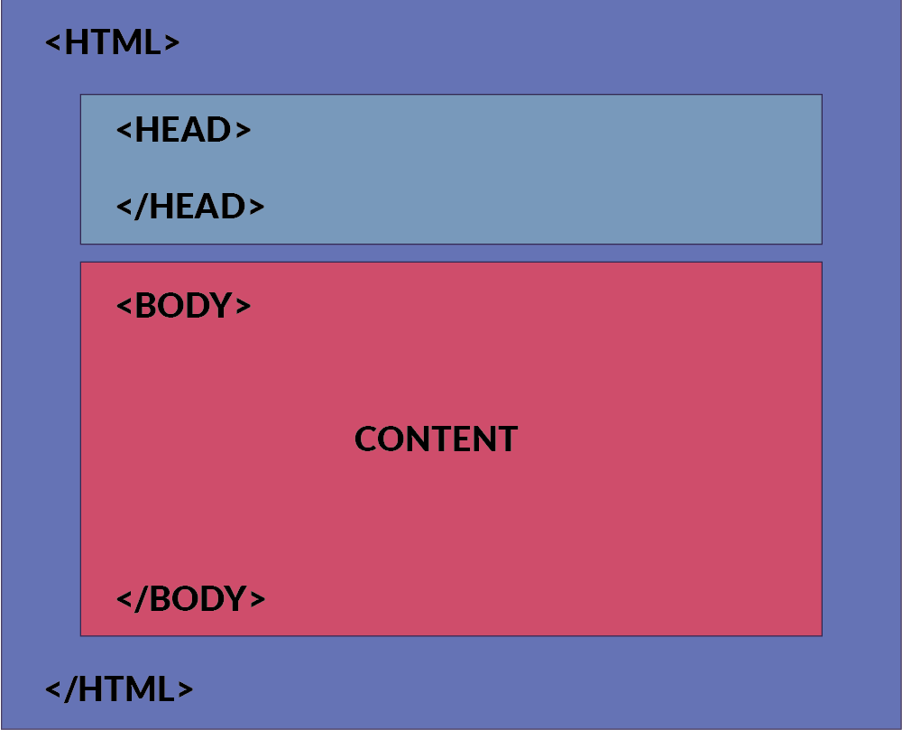
Structure Tags
<html>
<head>
</head>
<body>
</body>
<html>

Slide 5
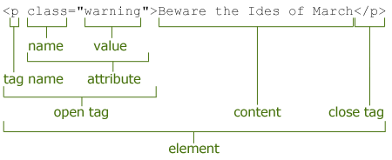
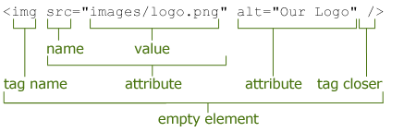
Recap on HTML Syntax
Normal HTML Element
Consist of Open & Close Tag
Empty Element Tag
Consist of Open Tag ONLY

Slide 6
How does CSS affect HTML?
Web browsers apply CSS rules to the HTML
CSS rules formed from
1. Set of properties and values
update how the content is display
2. Selector
select the elements to apply

Slide 7
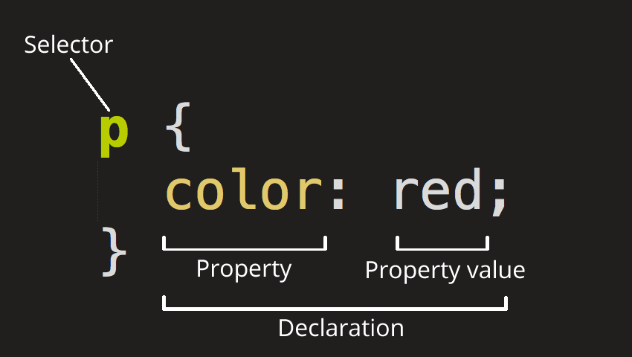
CSS Syntax

Slide 8
CSS Selector
ELEMENT Selector
CLASS Selector
ID Selector
Determine by HTML tag name
h1 , h2 , p , a , table , img
Determine by dot (.) symbol in CSS file
.blueText { color : blue } | class = “blueText”
Determine by hash (#) symbol in CSS file
#redText { color : red } | id= “redText”
Mix Style : h1 # redText

Slide 9
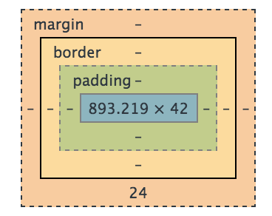
CSS Box Model
Content – The content of the box, where text and images appears
Padding – Clears an area around the content. The padding is affected by the background and color of the box
Border – A border that goes around the padding and content. The border is affected by the background color of the box.
Margin – The empty area around the border. The margin is completely transparent, no background color

Slide 10
Create External Styles Sheet
Similar to HTML
Create a new file and name it style.css
Extension end with .css

Slide 11
Applying Styles Sheet to HTML
link between html with external resource
<link rel="stylesheet" href= "assets/css/style.css">

Slide 12
Adding Bootstrap
<link > tag to include external resources
Resources Link:
<link rel="stylesheet" href="https://cdnjs.cloudflare.com/ajax/libs/twitter-bootstrap/3.3.7/css/bootstrap.min.css" />
Add it to the head segment of the HTML

Slide 13
How to use Bootstrap
Using the class attribute of HTML tags
Lookup their documentation for class name to use
Apply it to your html attributes
Notes:
Documentation link for CSS : https://getbootstrap.com/docs/3.3/css/

Slide 14
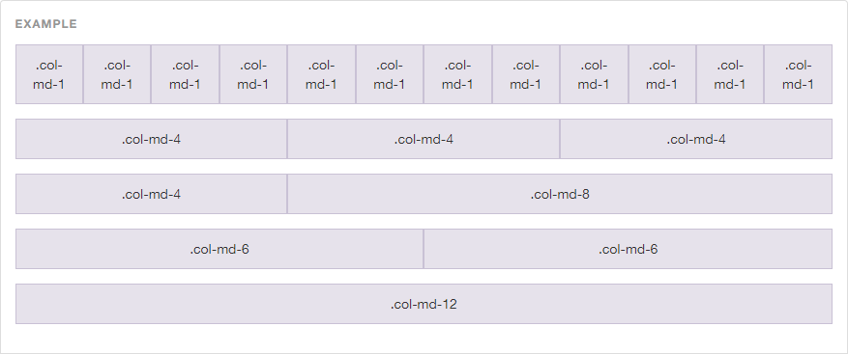
Bootstrap – Grid System
# of Column = 12

Slide 15
FONT-AWESOME ICON
Font-Awesome is not part of Bootstrap
Iconic font and CSS Framework
Include customize icons to your webpages

Slide 16
How to use Font-Awesome?
Same procedure as Bootstrap
Includes the link reference to the resources <link rel="stylesheet" href="https://cdnjs.cloudflare.com/ajax/libs/font-awesome/4.7.0/css/font-awesome.min.css" />
Find your desire icon on their website http://fontawesome.io/icons/
Add to your HTML pages through class attributes

Slide 17
JS
JavaScript

Slide 18
What is JavaScript?
To program the behaviour of web pages
Add interactivity and effects to websites

Slide 19
How to Includes JS?
Similar to CSS
Internal JavaScript
External JavaScript
JavaScript are normally placed in the body segment
Normally Placed at the bottom of the pages
Order of JavaScript library matters as well
Notes:
Why does JS are placed in the body instead of the head segment?
1. To Speed up the loading time of the pages, when HTML DOM are loaded. It will load the head segment first before loading the body. The white blank pages we see when we visit any browser, that the loading time for the head resources.
Why does JS Script tend to be place at the bottom of the pages?
1. HTML is execute in a top-down order approach. That includes the js scripts.
2. If the script is place above the element (id=A) and calles the element(id=A) within the script then it will not work. Cause when it execte the script, it could not find the element (id=A).

Slide 20
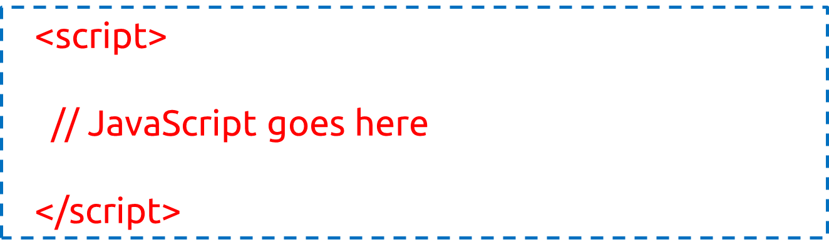
Internal JavaScript
Written within the HTML
Using <script> elements
Notes:
Do you wonder why we do not have type="text/javascript" inside the <script> tag? This is not required in HTML5. JavaScript is the default scripting language in HTML5 and in all modern browsers!

Slide 21

External JavaScript
Has “ .js “ filename extension. E.g. script.js
Using <script> tag to include the js file

Slide 22
JQuery
JavaScript Library

Slide 23
What’s JQuery?
JavaScript Library
Simplifies JavaScript programming
"write less, do more“
A lot of plugins / library extended from JQuery

Slide 24
Adding JQuery
Include the following tag into the HTML
<script src="https://cdnjs.cloudflare.com/ajax/libs/jquery/3.2.1/jquery.min.js"></script>

Slide 25
PLUGINS

Slide 26
CDNJS
https://cdnjs.com/
Online library repository
Reference to online rather than local copy
Does not have to download the libraries

Slide 27
Animation Effects
Animated.css
CSS only Library
https://daneden.github.io/animate.css/
WOW.js
Add on of JavaScript to animated.css
http://mynameismatthieu.com/WOW/
Notes:
WOW.js is used in addition to animated.css to includes more effects. It provides effects when scrolling down.
Animated.css load and run the animation effect once the html pages is loaded. However, WOW.js run the animation effect when the screen is scroll to the item area.
WOW.js provide more setting to the animation as well, such as the duration and delay. With its advance setting

Slide 28
Animated.css
Include the following stylesheet (Animated.css) <link rel="stylesheet“ href="https://cdnjs.cloudflare.com/ajax/libs/animate.css/3.5.2/animate.min.css">
Add the class “animated” to the element
Add the class “infinite” for infinite loop
Add the class name of the effect to the same element
Full List of animation effect is found on their website
Example : <h1 class="animated infinite bounce">Example</h1>

Slide 29
WOW.js
Include Animated.css & WOW.js https://cdnjs.cloudflare.com/ajax/libs/wow/1.1.2/wow.min.js
Add the following script to activate WOW.js <script> new WOW().init(); </script>
Add the class “wow” to the element followed by animation effect name
Animation effect name is from Animated.css
Example <h1 class="wow bounceInUp"> Example </h1>
Notes:
Animated.css link is on previous slides

Slide 30
WOW.js Advanced Options
data-wow-duration: Change the animation duration
data-wow-delay: Delay before the animation starts
data-wow-offset: Distance to start the animation (related to the browser bottom)
data-wow-iteration: Number of times the animation is repeated
Add the following attributes to the HTML element.
Example:
<h1 class="wow slideInLeft" data-wow-duration="2s" data-wow-delay="5s"> Example </h1>

Slide 31
Smooth Scroll
Used on navigation to another link within the same page
Animation of scrolling the page to the new link
Default effect is jump there directly

Slide 32
Smooth Scroll
Save the JS from https://kryogenix.org/code/browser/smoothscroll/smoothscroll.js
Include smoothscroll.js to the HTML page
Using id and ‘#’ to navigate within same page
Example:
<a href=“#aboutUs”> Link to About Us </a>
<h1 id=“aboutUs”> Content of About Us </h1>
Notes:
Documentation and more usage of smooth scroll can be found at https://github.com/galambalazs/smoothscroll-for-websites/wiki

Slide 33
Owl Carousel Slider
https://owlcarousel2.github.io/OwlCarousel2/
Image Sliders Plugins
Notes:
https://owlcarousel2.github.io/OwlCarousel2/index.html

Slide 34
How to use Carousel Slider?
Search the following at cdnjs.com and add those link to HTML
JQuery
OwlCarousel2
Notes:
Jquery : <script src="https://cdnjs.cloudflare.com/ajax/libs/jquery/3.1.1/jquery.min.js"></script>
Carousel JS : <script src="https://cdnjs.cloudflare.com/ajax/libs/OwlCarousel2/2.2.1/owl.carousel.js"></script>
Carousel CSS : <link rel="stylesheet" href="https://cdnjs.cloudflare.com/ajax/libs/OwlCarousel2/2.2.1/assets/owl.carousel.min.css" />
<link rel="stylesheet" href="https://cdnjs.cloudflare.com/ajax/libs/OwlCarousel2/2.2.1/assets/owl.theme.default.min.css" />

Slide 35
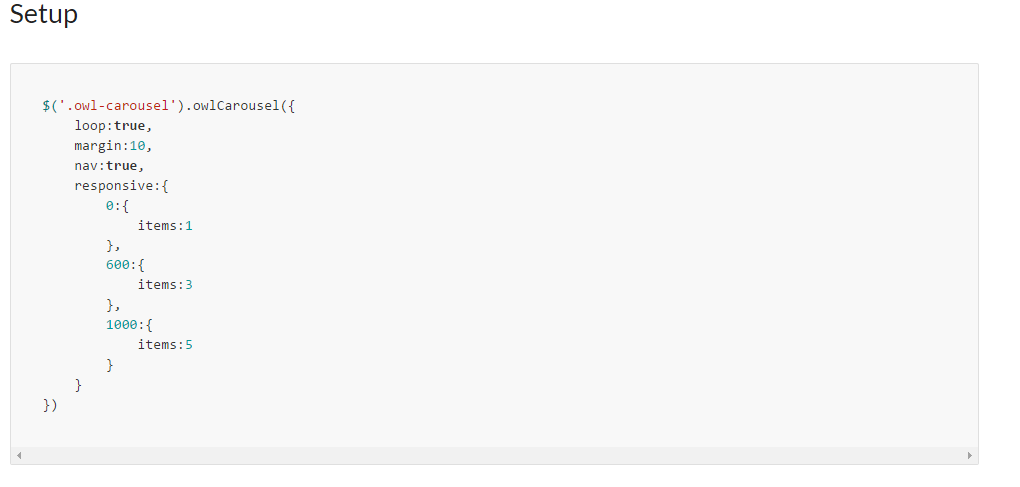
How to use Carousel Slider?
From owlcarousel2 website, Select Demos -> Basic
Copy the ‘Setup’ over to your own script tag at HTML
Notes:
The setup is to initialise the behaviour of the carousel, it is use to set the options for it. More options are added to this script. Hence, this script is needed for the carousel to function.
The data type for the object is object / dict, hence for every new property/option, it is separated by a comma
Example of including option for auto-play of the slider: <script>
$('.owl-carousel').owlCarousel({
loop:true, // this option specific whether the slides goes in a loop or stop at last item
margin:10,
nav:true, // this option set whether to display the next and previous button
responsive:{ // this will change the number of item to display
0:{ // if the width of the screen is more then 0px, it will display the number of item stated
items:1
},
600:{ // if the width of the screen is more then 600px, it will display the number of item stated
items:3
},
1000: { // if the width of the screen is more then 1000px, I twill display the number of item stated
Item:5
} // if you view it at full screen on laptop, it should display 5. if you resize your screen to half, it should display 3. and on mobile, it should display 1
},
autoplay:true, // this include new option for autoplay.
autoplayTimeout:3000, // additional setting to autoplay. Take note that each other is separated by a comma. The option name and value are separate by a :
autoplayHoverPause:false // this option set whether to pause the autoplay when you hover over the slider. More option can be found on their documentation, and is mentioned on next slides
})
</script>

Slide 36
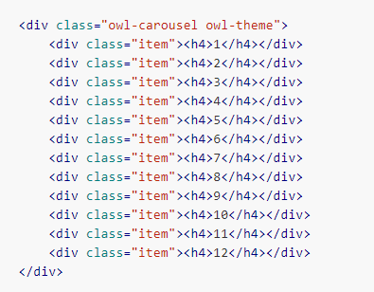
How to use Carousel Slider?
Copy the HTML Segment into your HTML document
Edit the content within the <div>
For more options, go to Docs -> Options to include more setting to it
Notes:
Follow the template on the HTML segment. Change the content within the <div class=“item”> [Change this content ]</div> .
The content item within the div, is the display item. So if you want to do a simple slide, you could change the h4 tag to an image tag. And if you want to includes caption in the slider, add in other tag into the item. Such as h3 or p tag.
Example of Slider for Bootstrap thumbnail images:
<div class="owl-carousel owl-theme">
<div class="item">
<!-- content for slider are placed within the div -->
<!-- start of thumbnail.-->
<div class="thumbnail">
<img src="https://source.unsplash.com/random" class="img-responsive"/>
<div class="caption">
<h3>Photo 1</h3>
<p>Description of Photo 1</p>
</div>
</div>
<!-- end thumbnail -->
</div>
<div class="item">
<!-- start of thumbnail -->
<div class="thumbnail">
<img src="https://source.unsplash.com/random" class="img-responsive"/>
<div class="caption">
<h3>Photo 2</h3>
<p>Description of Photo 2</p>
</div>
</div>
<!-- end thumbnail -->
</div>
<div class="item">
<!-- start of thumbnail -->
<div class="thumbnail">
<img src="https://source.unsplash.com/random" class="img-responsive"/>
<div class="caption">
<h3>Photo 3</h3>
<p>Description of Photo 3</p>
</div>
</div>
<!-- end thumbnail -->
</div>
<div class="item">
<!-- start of thumbnail -->
<div class="thumbnail">
<img src="https://source.unsplash.com/random" class="img-responsive"/>
<div class="caption">
<h3>Photo 4</h3>
<p>Description of Photo 4</p>
</div>
</div>
<!-- end thumbnail -->
</div>
<div class="item">
<!-- start of thumbnail -->
<div class="thumbnail">
<img src="https://source.unsplash.com/random" class="img-responsive"/>
<div class="caption">
<h3>Photo 5</h3>
<p>Description of Photo 5</p>
</div>
</div>
<!-- end thumbnail -->
</div>
<div class="item">
<!-- start of thumbnail -->
<div class="thumbnail">
<img src="https://source.unsplash.com/random" class="img-responsive"/>
<div class="caption">
<h3>Photo 6</h3>
<p>Description of Photo 6</p>
</div>
</div>
<!-- end thumbnail -->
</div>
</div> <!-- end of row for content -->

Slide 37
Light-Box
http://lokeshdhakar.com/projects/lightbox2/
Image Preview Plugins
Notes:
https://owlcarousel2.github.io/OwlCarousel2/index.html

Slide 38
How to use Light Box?
Search for the JS & CSS library on CDNJS
Include the resource into your HTML
Add custom attributes to the anchor tag (Image Link)
Custom Attributes
data-lightbox – Group name
data-title – Image Caption
Notes:
Follow the template on the HTML segment. Change the content within the <div class=“item”> [Change this content ]</div> .
The content item within the div, is the display item. So if you want to do a simple slide, you could change the h4 tag to an image tag. And if you want to includes caption in the slider, add in other tag into the item. Such as h3 or p tag.
Example of Slider for Bootstrap thumbnail images:
<div class="owl-carousel owl-theme">
<div class="item">
<!-- content for slider are placed within the div -->
<!-- start of thumbnail.-->
<div class="thumbnail">
<img src="https://source.unsplash.com/random" class="img-responsive"/>
<div class="caption">
<h3>Photo 1</h3>
<p>Description of Photo 1</p>
</div>
</div>
<!-- end thumbnail -->
</div>
<div class="item">
<!-- start of thumbnail -->
<div class="thumbnail">
<img src="https://source.unsplash.com/random" class="img-responsive"/>
<div class="caption">
<h3>Photo 2</h3>
<p>Description of Photo 2</p>
</div>
</div>
<!-- end thumbnail -->
</div>
<div class="item">
<!-- start of thumbnail -->
<div class="thumbnail">
<img src="https://source.unsplash.com/random" class="img-responsive"/>
<div class="caption">
<h3>Photo 3</h3>
<p>Description of Photo 3</p>
</div>
</div>
<!-- end thumbnail -->
</div>
<div class="item">
<!-- start of thumbnail -->
<div class="thumbnail">
<img src="https://source.unsplash.com/random" class="img-responsive"/>
<div class="caption">
<h3>Photo 4</h3>
<p>Description of Photo 4</p>
</div>
</div>
<!-- end thumbnail -->
</div>
<div class="item">
<!-- start of thumbnail -->
<div class="thumbnail">
<img src="https://source.unsplash.com/random" class="img-responsive"/>
<div class="caption">
<h3>Photo 5</h3>
<p>Description of Photo 5</p>
</div>
</div>
<!-- end thumbnail -->
</div>
<div class="item">
<!-- start of thumbnail -->
<div class="thumbnail">
<img src="https://source.unsplash.com/random" class="img-responsive"/>
<div class="caption">
<h3>Photo 6</h3>
<p>Description of Photo 6</p>
</div>
</div>
<!-- end thumbnail -->
</div>
</div> <!-- end of row for content -->

Slide 39
Exercise
Modify the index.html to include animation effects & others

