Slide 1
OPENSTACK

Slide 2
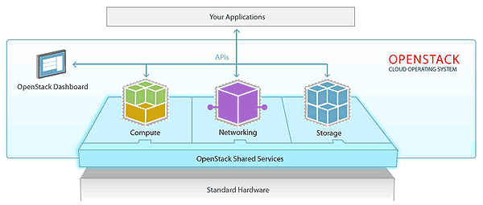
OpenStack is a cloud operating system that controls large pools of compute, storage, and networking resources throughout a datacenter, all managed and provisioned through APIs with common authentication mechanisms.

Slide 3
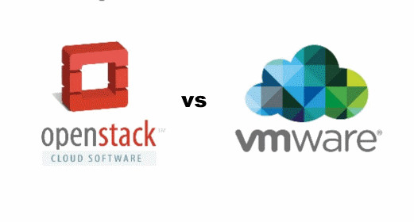

Slide 4
Deploymen Method
Production:
RHOSP
Triple-O
Canonical
FUEL Mirantis (obsolete)
Etc.
Test Environment
Packstack
Devstack
Etc.

Slide 5
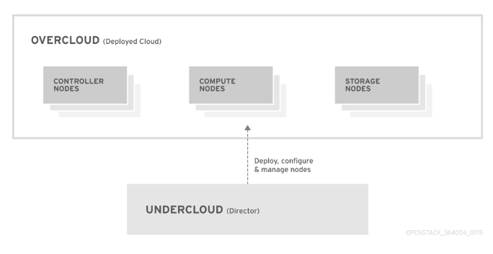
Triple O / RHOSP

Slide 6
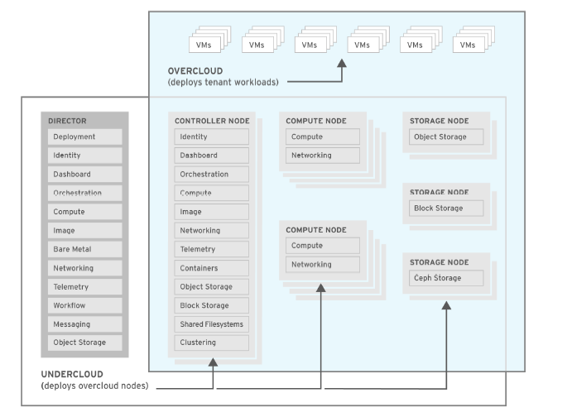
Triple O / RHOSP

Slide 7
Controller
Nodes that provide administration, networking, and high availability for the OpenStack environment. An ideal OpenStack environment recommends three of these nodes together in a high availability cluster.

Slide 8
A default Controller node contains the following components:
OpenStack Dashboard (horizon)
OpenStack Identity (keystone)
OpenStack Compute (nova) API
OpenStack Networking (neutron)
OpenStack Image Service (glance)
OpenStack Block Storage (cinder)
OpenStack Object Storage (swift)
OpenStack Orchestration (heat)
OpenStack Telemetry (ceilometer)
OpenStack Telemetry Metrics (gnocchi)
OpenStack Telemetry Alarming (aodh)
OpenStack Telemetry Event Storage (panko)
OpenStack Clustering (sahara)
OpenStack Shared File Systems (manila)
OpenStack Bare Metal (ironic)
MariaDB
Open vSwitch
Pacemaker and Galera for ha

Slide 9
Compute
provide computing resources for the OpenStack environment. You can add more Compute nodes to scale out your environment over time. A default Compute node contains the following components:
OpenStack Compute (nova)
KVM/QEMU
OpenStack Telemetry (ceilometer) agent
Open vSwitch

Slide 10
Storage
Nodes that provide storage for the OpenStack environment. This includes nodes for:
Ceph Storage nodes
Block storage (cinder)
Object storage (swift)

Slide 11
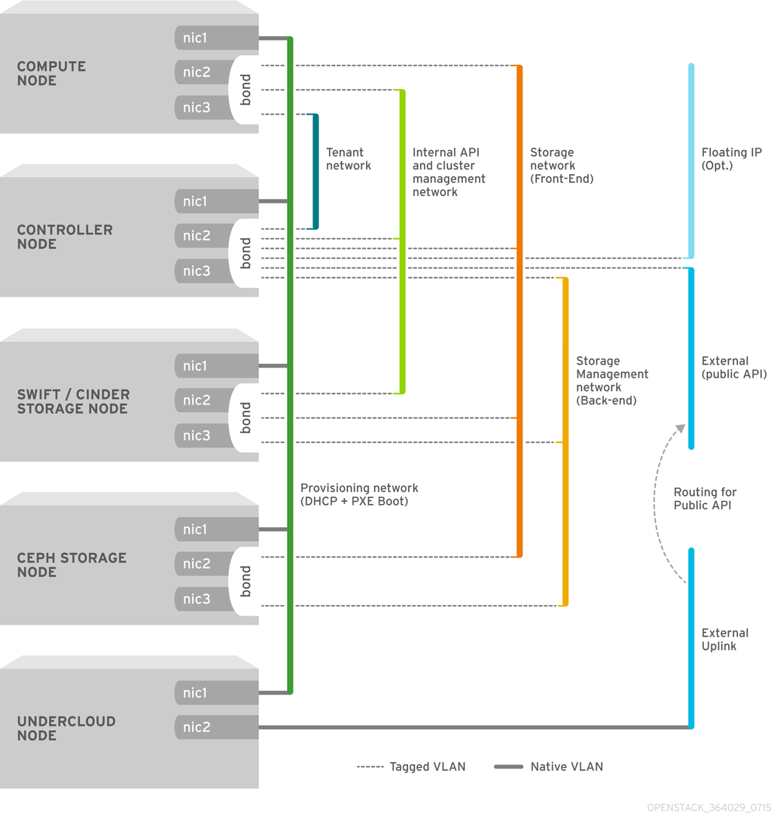
Network Requitment

Slide 12
Optimization
System Optimization - NUMA - CPU Pinning - Huge Paging
I/O Optimization - SRIOV - DPDK - OVS-DPDK

Slide 13
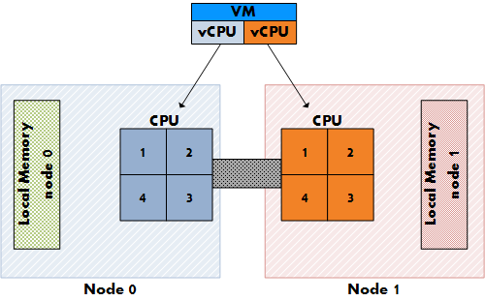
Numa

Slide 14
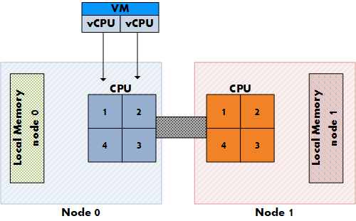
Numa

Slide 15
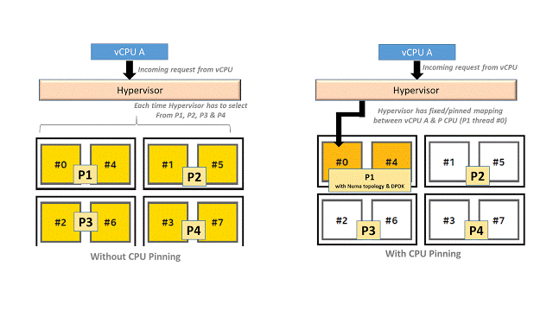
CPU Pinning

Slide 16
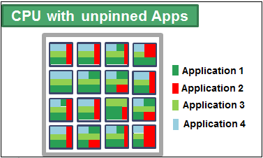
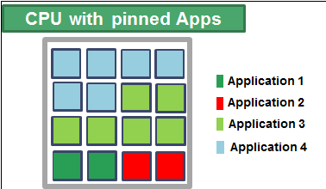
CPU Pinning

Slide 17
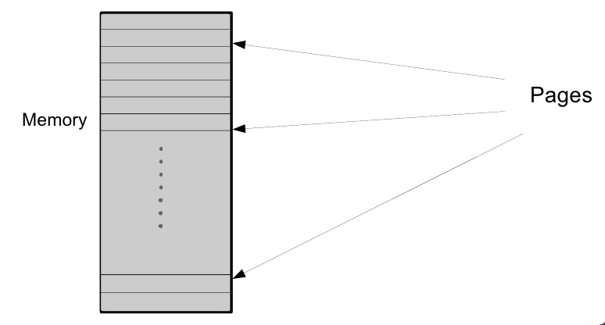
Huge Page

Slide 18
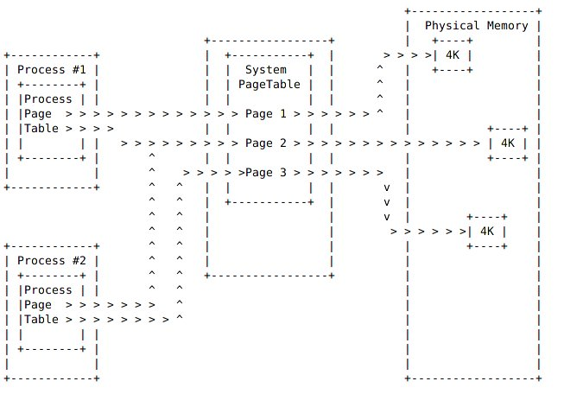
Huge Page

Slide 19
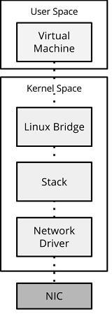
I/O Optimization
Standart data path :
NIC to Linux Bridge
Linux Bridge to Virtual Instance

Slide 20
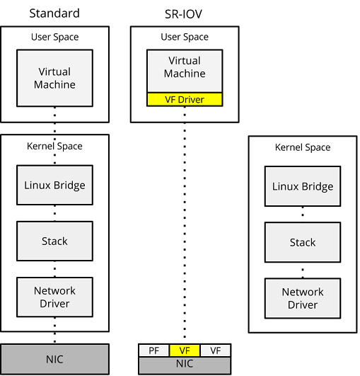
SR-IOV

Slide 21
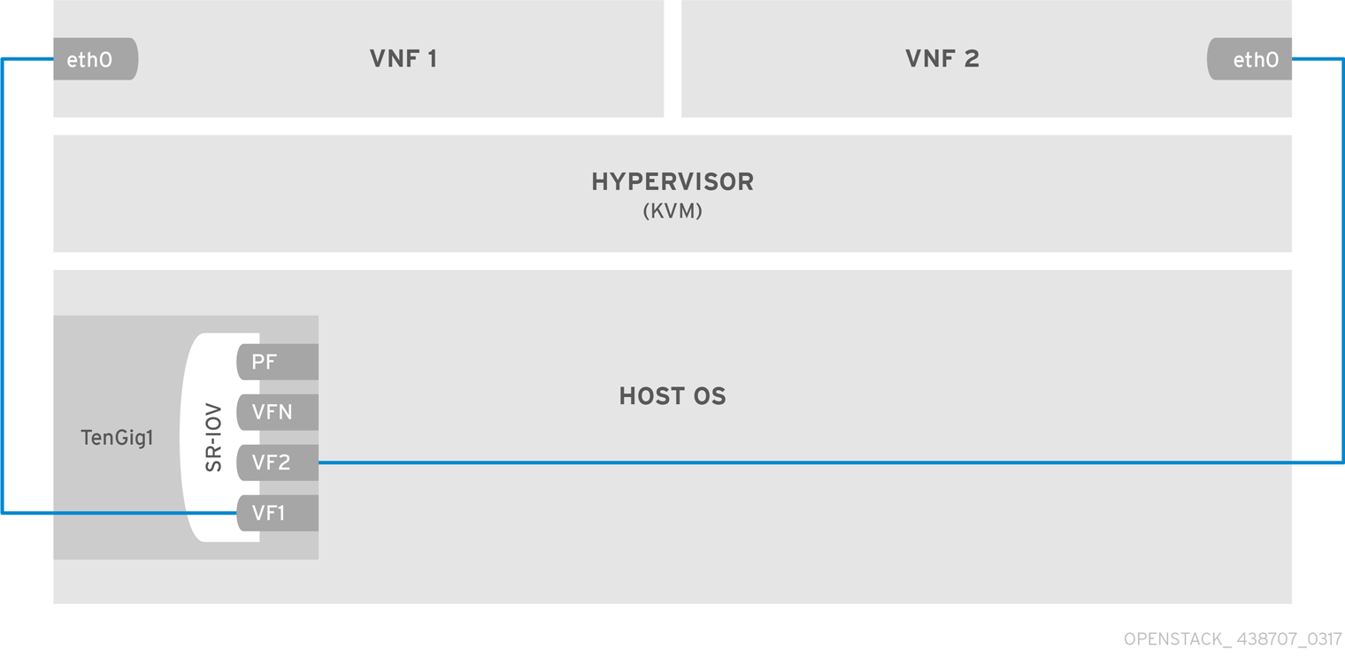
SR-IOV

Slide 22
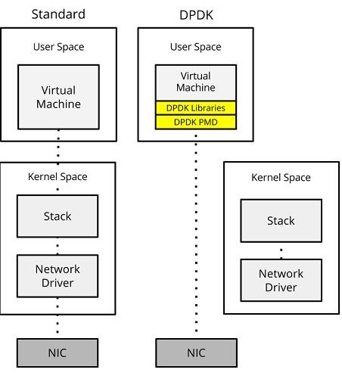
DPDK

Slide 23
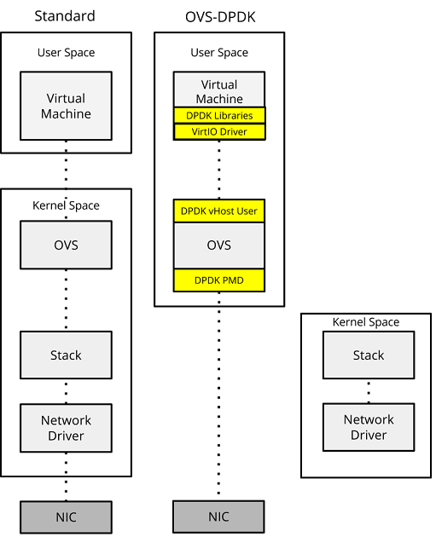
DPDK

