Slide 1
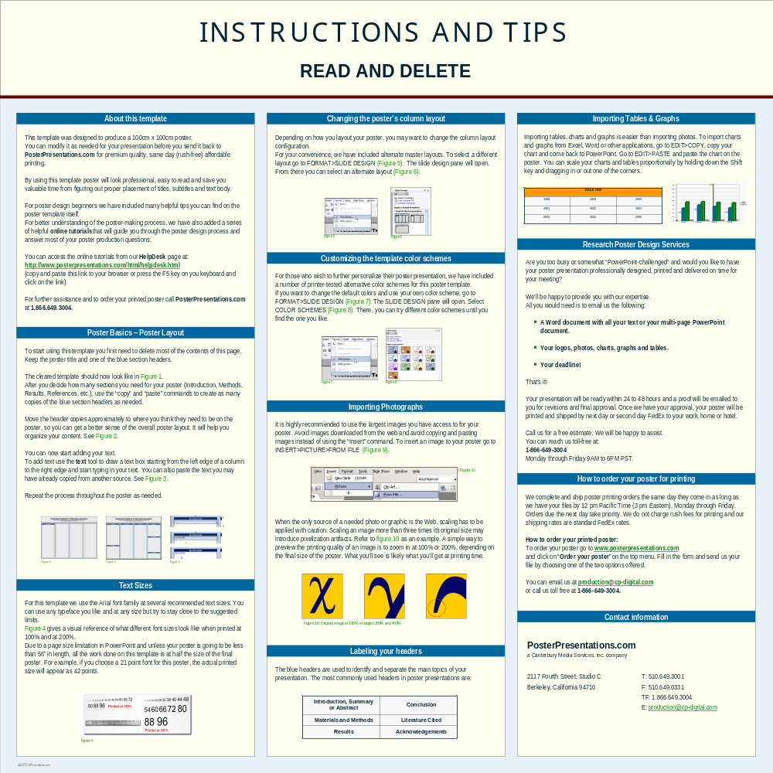
Professional Template for a 70cm x 100cm poster presentation
Your name and the names of the people who have contributed to this presentation go here.
The names and addresses of the associated institutions go here.
About this template
This template was designed to produce a 70cm x 100xm poster.
You can modify it as needed for your presentation before you send it back to PosterPresentations.com for premium quality, same day (rush-free) affordable printing.
By using this template poster will look professional, easy to read and save you valuable time from figuring out proper placement of titles, subtitles and text body.
For poster design beginners we have included many helpful tips you can find on the poster template itself.
For better understanding of the poster-making process, we have also added a series of helpful online tutorials that will guide you through the poster design process and answer most of your poster production questions.
You can access the online tutorials from our HelpDesk page at:
http://www.posterpresentations.com/html/helpdesk.html
(copy and paste this link to your browser or press the F5 key on you keyboard and click on the link)
For further assistance and to order your printed poster call PosterPresentations.com at 1.866.649.3004.

