Slide 1
C Boot Camp
8 April 2019
Minsu Kang

Slide 2
About this recitation..
Because each of you has different level about C language,
we do not specifically cover all concepts of C-language.
If you are curious about details of them, I will teach you after recitation.
Rather, we focus on the differences between C++ and C (dynamic memory allocation and some features), and some built-in library functions for your assignments.

Slide 3
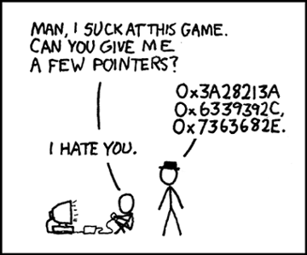
Agenda
C Basics
C Libraries
Debugging Tools
Version Control
Compilation
Demo

Slide 4
C Basics

Slide 5
C Basics
The minimum you must know to do well in this class
You have seen these concepts before
Make sure you remember them.
Summary:
Pointers/Arrays/Structs/Casting
Memory Management
Function pointers/Generic Types
Strings
GrabBag (Macros, typedefs, header guards/files, etc)

Slide 6
Pointers
Stores address of a value in memory
eg int*, char*, int**, etc
Access the value by dereferencing (*a); can be used to read value or write value to given address
dereferencing NULL causes a runtime error
Pointer to type a references a block of sizeof(a) bytes
Get the address of a value in memory with the ‘&’ operator
Can alias pointers to same address

Slide 7
Call by Value vs Call by Reference
Call-by-value: Changes made to arguments passed to a function aren’t reflected in the calling function
Call-by-reference: Changes made to arguments passed to a function are reflected in the calling function
C is a call-by-value language
To cause changes to values outside the function, use pointers
Do not assign the pointer to a different value (that won’t be reflected!)
Instead, dereference the pointer and assign a value to that address
void swap(int* a, int* b) {
int temp = *a;
*a = *b;
*b = temp;
}
int x = 42;
int y = 54;
swap(&x, &y);
printf(“%d\n”, x); // 54
printf(“%d\n”, y); // 42

Slide 8
Call by Value vs Call by Reference
void func(int* var) {
...
}
int variable = 0;
func(&variable);
...
func
main
var (0x090)
variable (0x020)
0x020
0
call func (0x020)
Address 0x020 passed to pointer variable var in ‘func’

Slide 9
Call by Value vs Call by Reference
void func(int* var) {
...
}
int variable = 0;
func(&variable);
...
func
main
var (0x090)
variable (0x020)
0x020
0
call func (0x020)
Using ‘var’ pointer in function func, we can access ‘variable’ in the main, so that we can freely modify value of the ‘variable’.

Slide 10
Pointer Arithmetic
Can add/subtract from an address to get a new address
Only perform when absolutely necessary (i.e., malloc)
Result depends on the pointer type
A+i, where A is a pointer = 0x100, i is an int (x86-64)
int* A: A+i = 0x100 + sizeof(int) * i = 0x100 + 4 * i
char* A: A+i = 0x100 + sizeof(char) * i = 0x100 + i
int** A: A + i = 0x100 + sizeof(int*) * i = 0x100 + 8 * i
base_address(A) + data_size(sizeof..) * index(i)
Rule of thumb: cast pointer explicitly to avoid confusion
Prefer (char*)(A) + i vs A + i, even if char* A
Absolutely do this in macros (i.e., malloc)

Slide 11
Structs
Collection of values placed under one name in a single block of memory
Can put structs, arrays in other structs
Given a struct instance, access the fields using the ‘.’ operator
Given a struct pointer, access the fields using the ‘->’ operator
struct foo_s {
int a;
char b;
};
struct bar_s {
char ar[10];
foo_s baz;
};
bar_s biz; // bar_s instance
biz.ar[0] = ‘a’;
biz.baz.a = 42;
bar_s* boz = &biz; // bar_s ptr
boz->baz.b = ‘b’;

Slide 12
Arrays/Strings
Arrays: fixed-size collection of elements of the same type
Can allocate on the stack or on the heap
int A[10]; // A is array of 10 int’s on the stack
int* A = calloc(10, sizeof(int)); // A is array of 10 int’s on the heap
Strings: Null-character (‘\0’) terminated character arrays
Null-character tells us where the string ends
All standard C library functions on strings assume null-termination.

Slide 13
Casting
Can cast a variable to a different type
Integer Type Casting:
signed <-> unsigned: change interpretation of most significant bit
smaller signed -> larger signed: sign-extend (duplicate the sign bit)
smaller unsigned -> larger unsigned: zero-extend (duplicate 0)
Cautions:
cast explicitly, out of practice. C will cast operations involving different types implicitly, often leading to errors
never cast to a smaller type; will truncate (lose) data
never cast a pointer to a larger type and dereference it, this accesses memory with undefined contents

Slide 14
Malloc, Free, Calloc
Handle dynamic memory
void* malloc (size_t size):
allocate block of memory of size bytes
does not initialize memory
void* calloc (size_t num, size_t size):
allocate block of memory for array of num elements, each size bytes long
initializes memory to zero values
void free(void* ptr):
frees memory block, previously allocated by malloc, calloc, realloc, pointed by ptr
use exactly once for each pointer you allocate
size argument:
should be computed using the sizeof operator
sizeof: takes a type and gives you its size
e.g., sizeof(int), sizeof(int*)

Slide 15
Malloc Function
void* malloc (size_t size):
allocate block of memory of size bytes
does not initialize memory
<datatype>* <var name> = (<datatype>*)malloc(sizeof(<datatype>)*N);
Examples
int* ptr = (int*)malloc(sizeof(int) * 3);
ptr
4 bytes
4 bytes
4 bytes
0
1
2

Slide 16
Calloc Function
void* calloc (size_t num, size_t size):
allocate block of memory for array of num elements, each size bytes long
initializes memory to zero values
<datatype>* <var name> = (<datatype>*)calloc(N, sizeof(<datatype>));
Examples
int* ptr = (int*)calloc(3, sizeof(int));
ptr
4 bytes
4 bytes
4 bytes
0
1
2

Slide 17
Free Function
void free(void* ptr):
frees memory block, previously allocated by malloc, calloc, realloc, pointed by ptr
use exactly once for each pointer you allocate
free(<pointer_name>);
Examples
free(ptr);
ptr
4 bytes
4 bytes
4 bytes
ptr
free
0
1
2

Slide 18
Memory Management Rules
If you dynamically allocate memory blocks,
they will be placed on the ‘heap’ area of the memory
Do not forget to deallocate malloced memory!!!!
(property of heap area)
Malloced block will not be deallocated until program terminates!
: Main reason of memory leak
Use free function to deallocate malloced block
Free a malloced block exactly once
Should not dereference a freed memory block

Slide 19
Stack Vs Heap Allocation
Local variables and function arguments are placed on the stack
deallocated after the variable leaves scope
do not return a pointer to a stack-allocated variable!
do not reference the address of a variable outside its scope!
Memory blocks allocated by calls to malloc/calloc are placed on the heap
Globals, constants are placed elsewhere
Example:
// a is a pointer on the stack to a memory block on the heap
int* a = malloc(sizeof(int));

Slide 20
Typedefs
Creates an alias type name for a different type
Useful to simplify names of complex data types
struct list_node {
int x;
int y;
};
typedef struct list_node* node;
node foo; // struct list_node* type
Definition of structure

Slide 21
Typedefs
Creates an alias type name for a different type
Useful to simplify names of complex data types
struct list_node {
int x;
int y;
};
typedef struct list_node* node;
node foo; // struct list_node* type
struct list_node* <=> node

Slide 22
Macros
Fragment of code given a name; replace occurrence of name with contents of macro
No function call overhead, type neutral
Uses:
defining constants (INT_MAX, ARRAY_SIZE)
defining simple operations (MAX(a, b))
122-style contracts (REQUIRES, ENSURES)
Warnings:
Use parentheses around arguments/expressions, to avoid problems after substitution
Do not pass expressions with side effects as arguments to macros
#define INT_MAX 0x7FFFFFFFF
#define MAX(A, B) ((A) > (B) ? (A) : (B))
#define REQUIRES(COND) assert(COND)
#define WORD_SIZE 4
#define NEXT_WORD(a) ((char*)(a) + WORD_SIZE)

Slide 23
Generic Types
void* type is C’s provision for generic types
Raw pointer to some memory location (unknown type)
Can point a variable with any data type but can’t dereference a void*
Must cast void* to another type in order to dereference it
Can cast back and forth between void* and other pointer types
// stack usage:
int x = 42; int y = 54;
stack S = stack_new():
push(S, &x);
push(S, &y);
int a = *(int*)pop(S);
int b = *(int*)pop(S);
// stack implementation:
typedef void* elem;
stack stack_new();
void push(stack S, elem e);
elem pop(stack S);

Slide 24
Generic TYPES – Malloc function with void *
void* malloc (size_t size):
Examples
void* ptr = (void*)malloc(sizeof(int) * 3);
ptr
12 bytes
?
malloc(sizeof(int) * 3);

Slide 25
Generic TYPES - Malloc function with typecasting
void* malloc (size_t size):
allocate block of memory of size bytes
does not initialize memory
<datatype>* <var name> = (<datatype>*)malloc(sizeof(<datatype>)*N);
Examples
int* ptr = (int*)malloc(sizeof(int) * 3);
typecasting
ptr
4 bytes
4 bytes
4 bytes
12 bytes
0
1
2
malloc(sizeof(int) * 3);
After being pointed with int* ptr

Slide 26
Header Files
Includes C declarations and macro definitions to be shared across multiple files
Only include function prototypes/macros; no implementation code!
Usage: #include <header.h>
#include <lib> for standard libraries (eg #include <string.h>)
#include “file” for your source files (eg #include “header.h”)
Never include .c files (bad practice)
// list.h
struct list_node {
int data;
struct list_node* next;
}; typedef struct list_node* node;
node new_list();
void add_node(int e, node l);
// list.c
#include “list.h”
node new_list() {
// implementation
}
void add_node(int e, node l) {
// implementation
}
// stacks.h
#include “list.h”
struct stack_head {
node top;
node bottom;
};
typedef struct stack_head* stack
stack new_stack();
void push(int e, stack S);

Slide 27
Header Guards
Double-inclusion problem: include same header file twice
//grandfather.h
//father.h
#include “grandfather.h”
//child.h
#include “father.h”
#include “grandfather.h”
Error: child.h includes grandfather.h twice
Solution: header guard ensures single inclusion
//grandfather.h
#ifndef GRANDFATHER_H
#define GRANDFATHER_H
#endif
//father.h
#ifndef FATHER_H
#define FATHER_H
#endif
//child.h
#include “father.h”
#include “grandfather.h”
Okay: child.h only includes grandfather.h once

Slide 28
Odds and Ends
Prefix vs Postfix increment/decrement
a++: use a in the expression, then increment a
++a: increment a, then use a in the expression
Switch Statements:
remember break statements after every case, unless you want fall through (may be desirable in some cases)
should probably use a default case
Variable/function modifiers:
global variables: defined outside functions, seen by all files
static variables/functions: seen only in file it’s declared in
Refer to K&R for other modifiers and their meanings

Slide 29
C Libraries

Slide 30
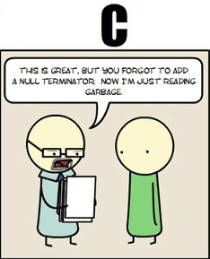
string.h: Common String/Array Methods
One the most useful libraries available to you
Used heavily in shell/proxy labs
Important usage details regarding arguments:
prefixes: str -> strings, mem -> arbitrary memory blocks.
ensure that all strings are ‘/0’ terminated!
ensure that dest is large enough to store src!
ensure that src actually contains n bytes!
ensure that src/dest don’t overlap!

Slide 31
string.h: Common String/Array Methods
Copying:
void* memcpy (void* dest, void* src, size_t n): copy n bytes of src into dest, return dest
char* strcpy(char* dest, char* src): copy src string into dest, return dest
Concatenation:
char * strcat (char * dest, char* src): append copy of src to end of dest, return dest
Comparison:
int strcmp (char * str1, char * str2): compare str1, str2 by character (based on ASCII value of each character, then string length), return comparison result str1 < str2: -1, str1 == str2: 0, str1 > str2: 1

Slide 32
string.h: Common String/Array Methods (Continued)
Searching:
char* strstr (char * str1, char * str2): return pointer to first occurrence of str2 in str1, else NULL
char* strtok (char * str, char * delimiters): tokenize str according to delimiter characters provided in delimiters, return the next token per successive stroke call, using str = NULL
Other:
size_t strlen ( const char * str ): returns length of the string (up to, but not including the ‘\0’ character)
void * memset (void* ptr, int val, size_t n ): set first n bytes of memory block addressed by ptr to val (use this for setting bytes only; don’t use to set int arrays or anything else!)

Slide 33
stdlib.h: General Purpose Functions
Dynamic memory allocation:
malloc, calloc, free
String conversion:
int atoi(char* str): parse string into integral value (return 0 if not parsed)
System Calls:
void exit(int status): terminate calling process, return status to parent process
void abort(): aborts process abnormally
Searching/Sorting:
provide array, array size, element size, comparator (function pointer)
bsearch: returns pointer to matching element in the array
qsort: sorts the array destructively
Integer arithmetic:
int abs(int n): returns absolute value of n
Types:
size_t: unsigned integral type (store size of any object)

Slide 34
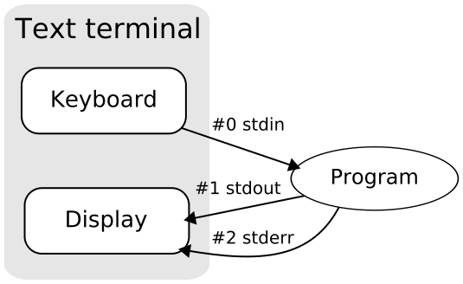
stdio.h
Another really useful library.
Used heavily in cache/shell/proxy labs
Used for:
argument parsing
file handling
input/output

Slide 35
stdio.h: Common I/O Methods
FILE* fopen (char* filename, char* mode): open the file with specified filename in specified mode (read, write, append, etc), associate it with stream identified by returned file pointer
int fscanf (FILE* stream, char* format, ...): read data from the stream, store it according to the parameter format at the memory locations pointed at by additional arguments.
int fclose (FILE* stream): close the file associated with the stream
int fprintf (FILE* stream, char* format, ... ): write the C string pointed at by format to the stream, using any additional arguments to fill in format specifiers.

Slide 36
Getopt
Command)
./<binaryfilename> -x 10
Need to include getopt.h and unistd.h to use
Used to parse command-line arguments.
Typically called in a loop to retrieve arguments
Switch statement used to handle options
colon indicates required argument
optarg is set to value of option argument
Returns -1 when no more arguments present
Very useful for Cache lab!
Code)
int main(int argc, char** argv){
int opt, x;
/* looping over arguments */
while(-1 != (opt = getopt(argc, argv, “x:"))){
switch(opt) {
case 'x':
x = atoi(optarg);
break;
default:
printf(“wrong argument\n");
break;
}
}
}
char *

Slide 37
Note about Library Functions
These functions can return error codes
malloc could fail -> exception handling needed!
a file couldn’t be opened -> exception handling needed!
a string may be incorrectly parsed
Remember to check for the error cases and handle the errors accordingly
may have to terminate the program (eg malloc fails)
may be able to recover (user entered bad input)

Slide 38
Debugging
GDB, Valgrind

Slide 39
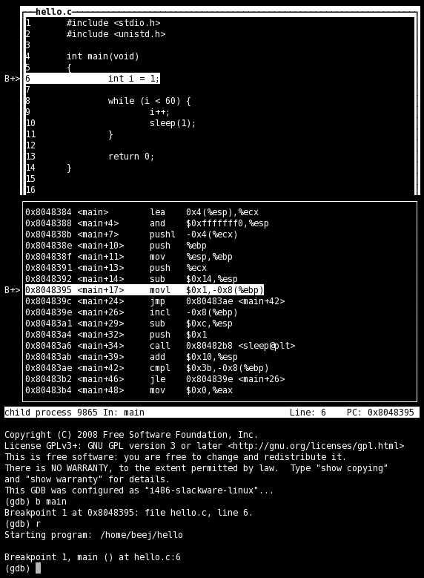
GDB
No longer stepping through assembly!
Use the step/next commands
break on line numbers, functions
Use list to display code at line-numbers and functions
Use print with variables
Use gdbtui
Nice display for viewing source/executing commands

Slide 40
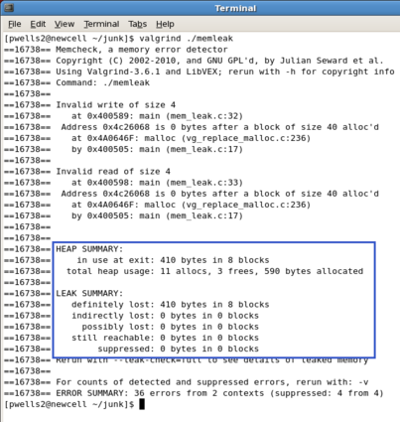
Valgrind
Find memory errors, detect memory leaks
Common errors:
Illegal read/write errors
Use of uninitialized values
Illegal frees
Overlapping source/destination addresses
Typical solutions
Did you allocate enough memory?
Did you accidentally free stack variables/something twice?
Did you initialize all your variables?
Did use something that you just free’d?
--leak-check=full
Memcheck gives details for each definitely/possibly lost memory block (where it was allocated

Slide 41
Compilation
GCC, Make Files

Slide 42
GCC
Used to compile C/C++ projects
List the files that will be compiled to form an executable
Specify options via flags
Important Flags:
-g: produce debug information (important; used by GDB/valgrind)
-Werror: treat all warnings as errors (this is our default)
-Wall/-Wextra: enable all construction warnings
-pedantic: indicate all mandatory diagnostics listed in C-standard
-O0/-O1/-O2: optimization levels
-o <filename>: name output binary file ‘filename’
Example:
gcc -g -Werror -Wall -Wextra -pedantic foo.c bar.c -o baz

Slide 43
Make Files
Command-line compilation becomes inefficient when compiling many files together
Solution: use make-files
Single operation to compile files together
Only recompiles updated files
# Makefile for the malloc lab driver
#
CC = gcc
CFLAGS = -Wall -Wextra -Werror -O2 -g -DDRIVER -std=gnu99
OBJS = mdriver.o mm.o memlib.o fsecs.o fcyc.o clock.o ftimer.o
all: mdriver
mdriver: $(OBJS)
$(CC) $(CFLAGS) -o mdriver $(OBJS)
mdriver.o: mdriver.c fsecs.h fcyc.h clock.h memlib.h config.h mm.h
memlib.o: memlib.c memlib.h
mm.o: mm.c mm.h memlib.h
fsecs.o: fsecs.c fsecs.h config.h
fcyc.o: fcyc.c fcyc.h
ftimer.o: ftimer.c ftimer.h config.h
clock.o: clock.c clock.h
clean:
rm -f *~ *.o mdriver

Slide 44
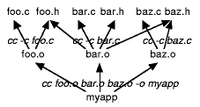
Make File Rules
Comments start with a ‘#’, Commands start with a TAB.
Common Make File Format:
target: source(s) TAB: command TAB: command
Macros: similar to C-macros, find and replace:
CC = gcc CCOPT = -g -DDEBUG -DPRINT foo.o: foo.c foo.h $(CC) $(CCOPT) -c foo.c
See http://www.andrew.cmu.edu/course/15-123-kesden/index/lecture_index.html for more details

Slide 45
Questions?

