Slide 1
Recitation2: Bomb Lab
CSE251, Spring 2019
Sehoon Kim
sshhee@unist.ac.kr

Slide 2
Lab info
Due
Mar 27 (Wed), 11:59PM
TA’s
Sehoon Kim (sshhee@unist.ac.kr, Tue 14:30~15:30 @106-605)
Anvar Alisheri (alisher@unist.ac.kr, Thu 19:30~20:30 @106-709)
We’ll cover:
Introduction for bomb lab
objdump / GDB tutorial

Slide 3
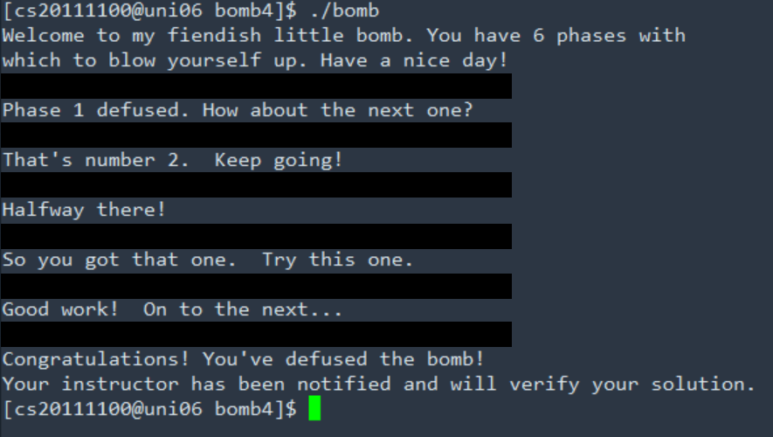
Bomb Lab
What to do?
Defuse a bomb by typing passwords for each phase.
This is not a coding assignment, instead you have to decode a binary file.

Slide 4
Bomb Lab
How to do?
Get an assembly code from binary code.
Use a debugger to identify data.
One of those options is objdump/GDB.

Slide 5
objdump/GDB
How to use?
There are lots of documents on internet.
One of them is
http://csapp.cs.cmu.edu/2e/docs/gdbnotes-x86-64.pdf
,which is able to be found in lab2 description.

Slide 6
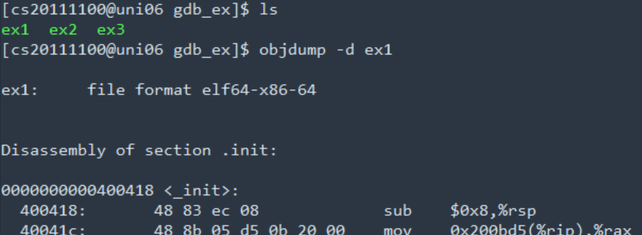
objdump/GDB – example1
Purpose: To predict outputs of sample programs by analyzing assembly codes.
There are 3 unknown binary files.
“$ objdump –d ex1” command generates an assembly code for ex1.
You can store it as a file by redirection.
ex) $ objdump –d ex1 > ex1_assembly

Slide 7
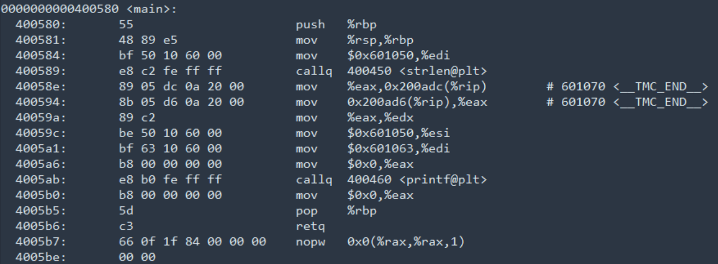
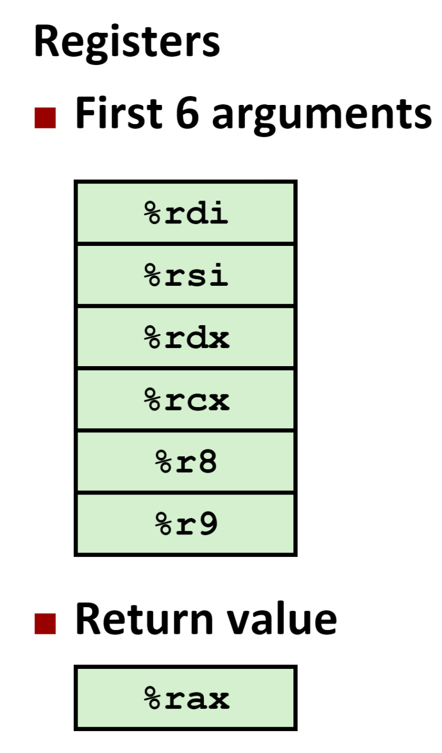
objdump/GDB – example1
Then it must be an input
Which accepts an C-string and returns an integer
What is the input string??
-> Identify by GDB!!
We are interested in main().

Slide 8
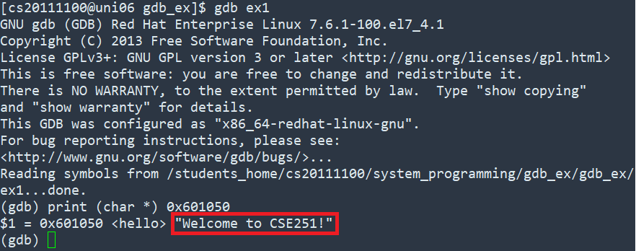
objdump/GDB – example1
How can I identify C-string by gdb?
Can be found in the link of slide 4.

Slide 9


objdump/GDB – example1
Return value is stored in 0x601070
and is used as 3rd argument of printf().
So it is
printf (“%s %d\n”, “Welcome to CSE251!”, 18)
Then predict the output of printf() by identifying remaining arguments.

Slide 10
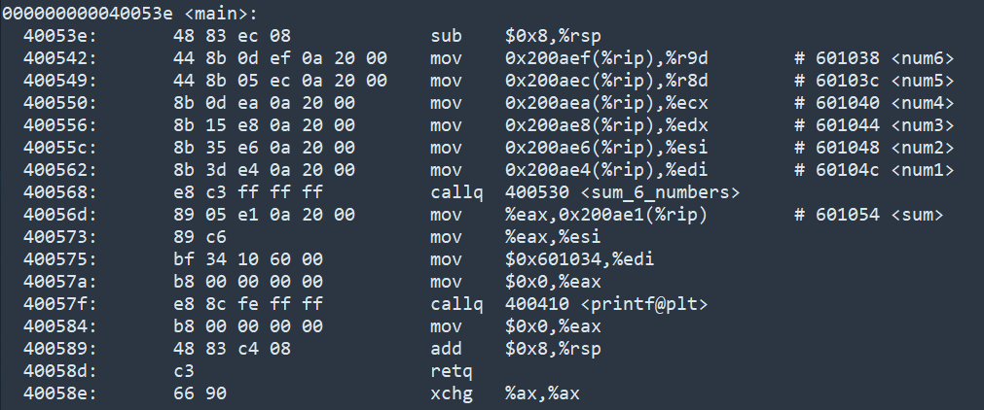
objdump/GDB – example2
It seems that some function named “sum_6_numbers()” is called,
with 6 arguments.
Then, let’s find what this function does.

Slide 11
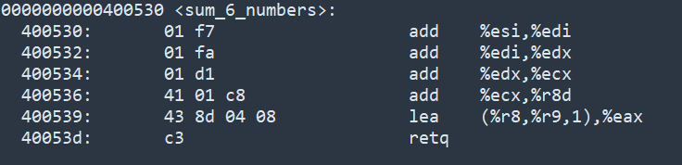
objdump/GDB – example2
sum_6_numbers (a, b, c, d, e, f)
%edi <= a + b
a
b
c
d
e
f
%edx <= c + (a + b)
%ecx <= d + (a + b + c)
%r8d <= e + (a + b + c + d)
%eax <= (a + b + c + d + e) + 1*f
return (a + b + c + d + e + f)
As the name implies, it returns sum of 6 input numbers.
(Unfortunately, function names in our bombs are not kind enough to allow conjecture.)

Slide 12
objdump/GDB – example2
Each argument for sum_6_numbers() and printf() can be got in the same way.
Compare the ouput of ex2 and your conjecture.

Slide 13
objdump/GDB – example3
Try by yourself!

Slide 14
Hints
Main process can be found in bomb.c
But each function is hidden, so you must go deep in to assembly code to identify.
Do not input any word without identifying as you might lose your points.
Do not use brute force neither.
If you have trouble with Python variables when using gdb, please refer to
https://class.unicss.org/cse251-2019-spring/cse251-2019-spring/issues/28#note_392

