Slide 1
Attack Lab
CSE251, Spring 2019
Recitation 1: Wed, March 13th, 2019
Changmin Yi
ulistar93@unist.ac.kr
Reference : CMU 15-213: Intro to Computer Systems Fall 2015 Recitation 3 - Dhruven Shah, Ben Spinelli

Slide 2
Agenda
Stack review
Attack lab overview
Phases 1-3: Buffer overflow attacks
Phases 4-5: ROP attacks

Slide 3
Notices
Typo in pdf, Due date is Apr 8. Monday.

Slide 4
x86-64 Linux Memory Layout
not drawn to scale
00007FFFFFFFFFFF
Shared
Libraries
Stack
Runtime stack (8MB limit)
E. g., local variables
Heap
Dynamically allocated as needed
When call malloc(), calloc(), new()
Data
Statically allocated data
E.g., global vars, static vars, string constants
Text / Shared Libraries
Executable machine instructions
Read-only
00007FFFF0000000
Stack
8MB
Heap
Data
Text
Hex Address
400000
000000

Slide 5
x86-64: Register Conventions
Arguments passed in registers:
%rdi, %rsi, %rdx, %rcx, %r8, %r9
Return value: %rax
Callee-saved: %rbx, %r12, %r13, %r14, %rbp, %rsp
Caller-saved: %rdi, %rsi, %rdx, %rcx, %r8, %r9, %rax, %r10, %r11
Stack pointer: %rsp
Instruction pointer: %rip

Slide 6
x86-64: The Stack
Grows downward towards lower memory addresses
%rsp points to top of stack
push %reg: subtract 8 from %rsp, put
val in %reg at (%rsp)
pop %reg: put val at (%rsp) in %reg,
add 8 to %rsp
Bottom
0x7fffffffffff
%rsp
Top

Slide 7
Buffer Overflow Stack Example #1
After call to gets
void echo() { char buf[4];
gets(buf); . . . }
echo:
subq $24, %rsp
movq %rsp, %rdi
call gets
. . .
Stack Frame
for call_echo
00
00
00
00
Return Address
(8 bytes)
00
40
06
f6
00
32
31
30
call_echo:
20 bytes unused
39
38
37
36
. . .
4006f1: callq 4006cf <echo>
4006f6: add $0x8,%rsp
. . .
35
34
33
32
31
30
39
38
37
36
35
34
33
32
31
30
buf
%rsp
unix>./bufdemo-nsp
Type a string:01234567890123456789012
01234567890123456789012
“01234567890123456789012\0”
Overflowed buffer, but did not corrupt state

Slide 8
Buffer Overflow Stack Example #2
After call to gets
void echo() { char buf[4];
gets(buf); . . . }
echo:
subq $24, %rsp
movq %rsp, %rdi
call gets
. . .
Stack Frame
for call_echo
Return Address
(8 bytes)
00
00
00
00
00
40
00
34
33
32
31
30
call_echo:
20 bytes unused
39
38
37
36
. . .
4006f1: callq 4006cf <echo>
4006f6: add $0x8,%rsp
. . .
35
34
33
32
31
30
39
38
37
36
35
34
33
32
31
30
buf
%rsp
unix>./bufdemo-nsp
Type a string:0123456789012345678901234
Segmentation fault

Slide 9
Buffer Overflow Stack Example #2
After call to gets
void echo() { char buf[4];
gets(buf); . . . }
echo:
subq $24, %rsp
movq %rsp, %rdi
call gets
. . .
Stack Frame
for call_echo
Return Address
(8 bytes)
00
00
00
00
00
40
06
00
33
32
31
30
call_echo:
20 bytes unused
39
38
37
36
. . .
4006f1: callq 4006cf <echo>
4006f6: add $0x8,%rsp
. . .
35
34
33
32
31
30
39
38
37
36
35
34
33
32
31
30
buf
%rsp
unix>./bufdemo-nsp
Type a string:012345678901234567890123
012345678901234567890123

Slide 11
Attack Lab Overview: Phases 1-3
Overview
Exploit x86-64 by overwriting the stack
Overflow a buffer, overwrite return address
Execute injected code
Key Advice
Brush up on your x86-64 conventions!
Use objdump –d to determine relevant offsets
Use GDB to determine stack addresses

Slide 12
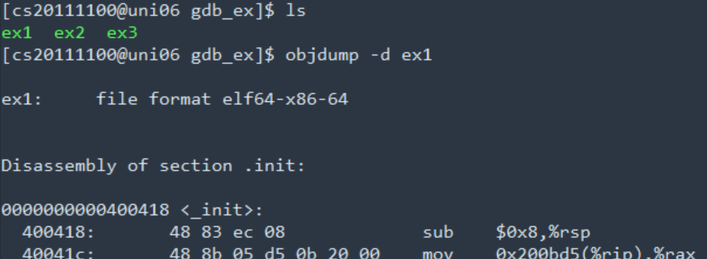
objdump/GDB – example1 / reci 2
Purpose: To predict outputs of sample programs by analyzing assembly codes.
There are 3 unknown binary files.
“$ objdump –d ex1” command generates an assembly code for ex1.
You can store it as a file by redirection.
ex) $ objdump –d ex1 > ex1_assembly

Slide 13
Buffer Overflows
Exploit strcpy vulnerability to overwrite important info on stack
When this function returns, where will it begin executing?
Recall
ret:pop %rip
What if we want to inject new code to execute?
0xAABBCCDD
0xFFFFFFFF 0xFFFFFFFF 0xFFFFFFFF 0xFFFFFFFF 0xFFFFFFFF 0xFFFFFFFF 0xFFFFFFFF 0xFFFFFFFF 0xFFFFFFFF 0xFFFFFFFF 0xFFFFFFFF
Old Return address
buf

Slide 14
Attack Lab Overview: Phases 4-5
Overview
Utilize return-oriented programming to execute arbitrary code
Useful when stack is non-executable or randomized
Find gadgets, string together to form injected code
Key Advice
Use mixture of pop & mov instructions + constants to perform specific task

Slide 15
ROP Example: Solution
Next address in ROP chain….
Address 1
0xBBBBBBBB
Address 2
0xFFFFFFFF 0xFFFFFFFF 0xFFFFFFFF 0xFFFFFFFF 0xFFFFFFFF 0xFFFFFFFF 0xFFFFFFFF 0xFFFFFFFF 0xFFFFFFFF 0xFFFFFFFF (filler…..)
Gadgets:
Address 1: mov %rbx, %rax; ret
Address 2: pop %rbx; ret
Old Return address
void foo(char *input){
char buf[32];
...
strcpy (buf, input);
return;
}
buf

Slide 16
Gadget example
In rtarget
400f18

Slide 17
Tools
objdump –d
View byte code and assembly instructions, determine stack offsets
./hex2raw
Pass raw ASCII strings to targets
gdb
Step through execution, determine stack addresses
gcc –c
Generate object file from assembly language file

Slide 18
More Tips
Draw stack diagrams
Memo what data is assigned register
Be careful of byte ordering (little endian)

Slide 19
Questions?

