Slide 1

Piece12
CS 319 Term Project
Fantastic4
Berk Mehmet Gürlek
İsmail Yavuzselim Taşçı
Nursena Kurubaş
Ali Kemal Özkan

Slide 2
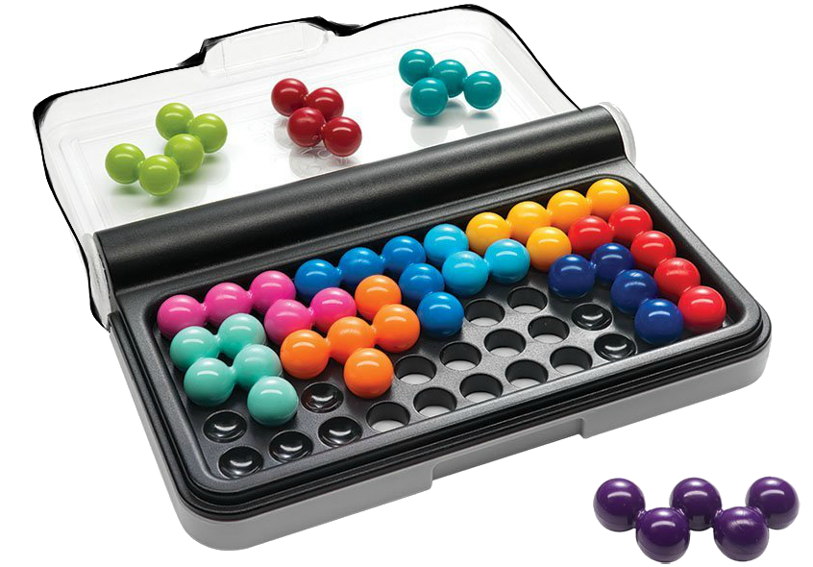
IQ Puzzler Pro
Mind and puzzle game
Singleplayer
Different levels of difficulty

Slide 3


Additional Features for Piece12
Desktop + Android Version
Music & Sound Effects
Time and Memory Mode with 30 different levels
Level Progression
Coin earning system & Shop
Daily Missions
Leaderboard
Augmented Reality Background
Multiplayer option

Slide 4
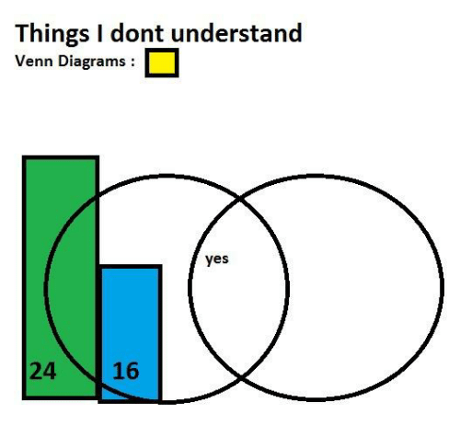
Dynamic Model
Sequence Diagram
State Diagrams

Slide 5

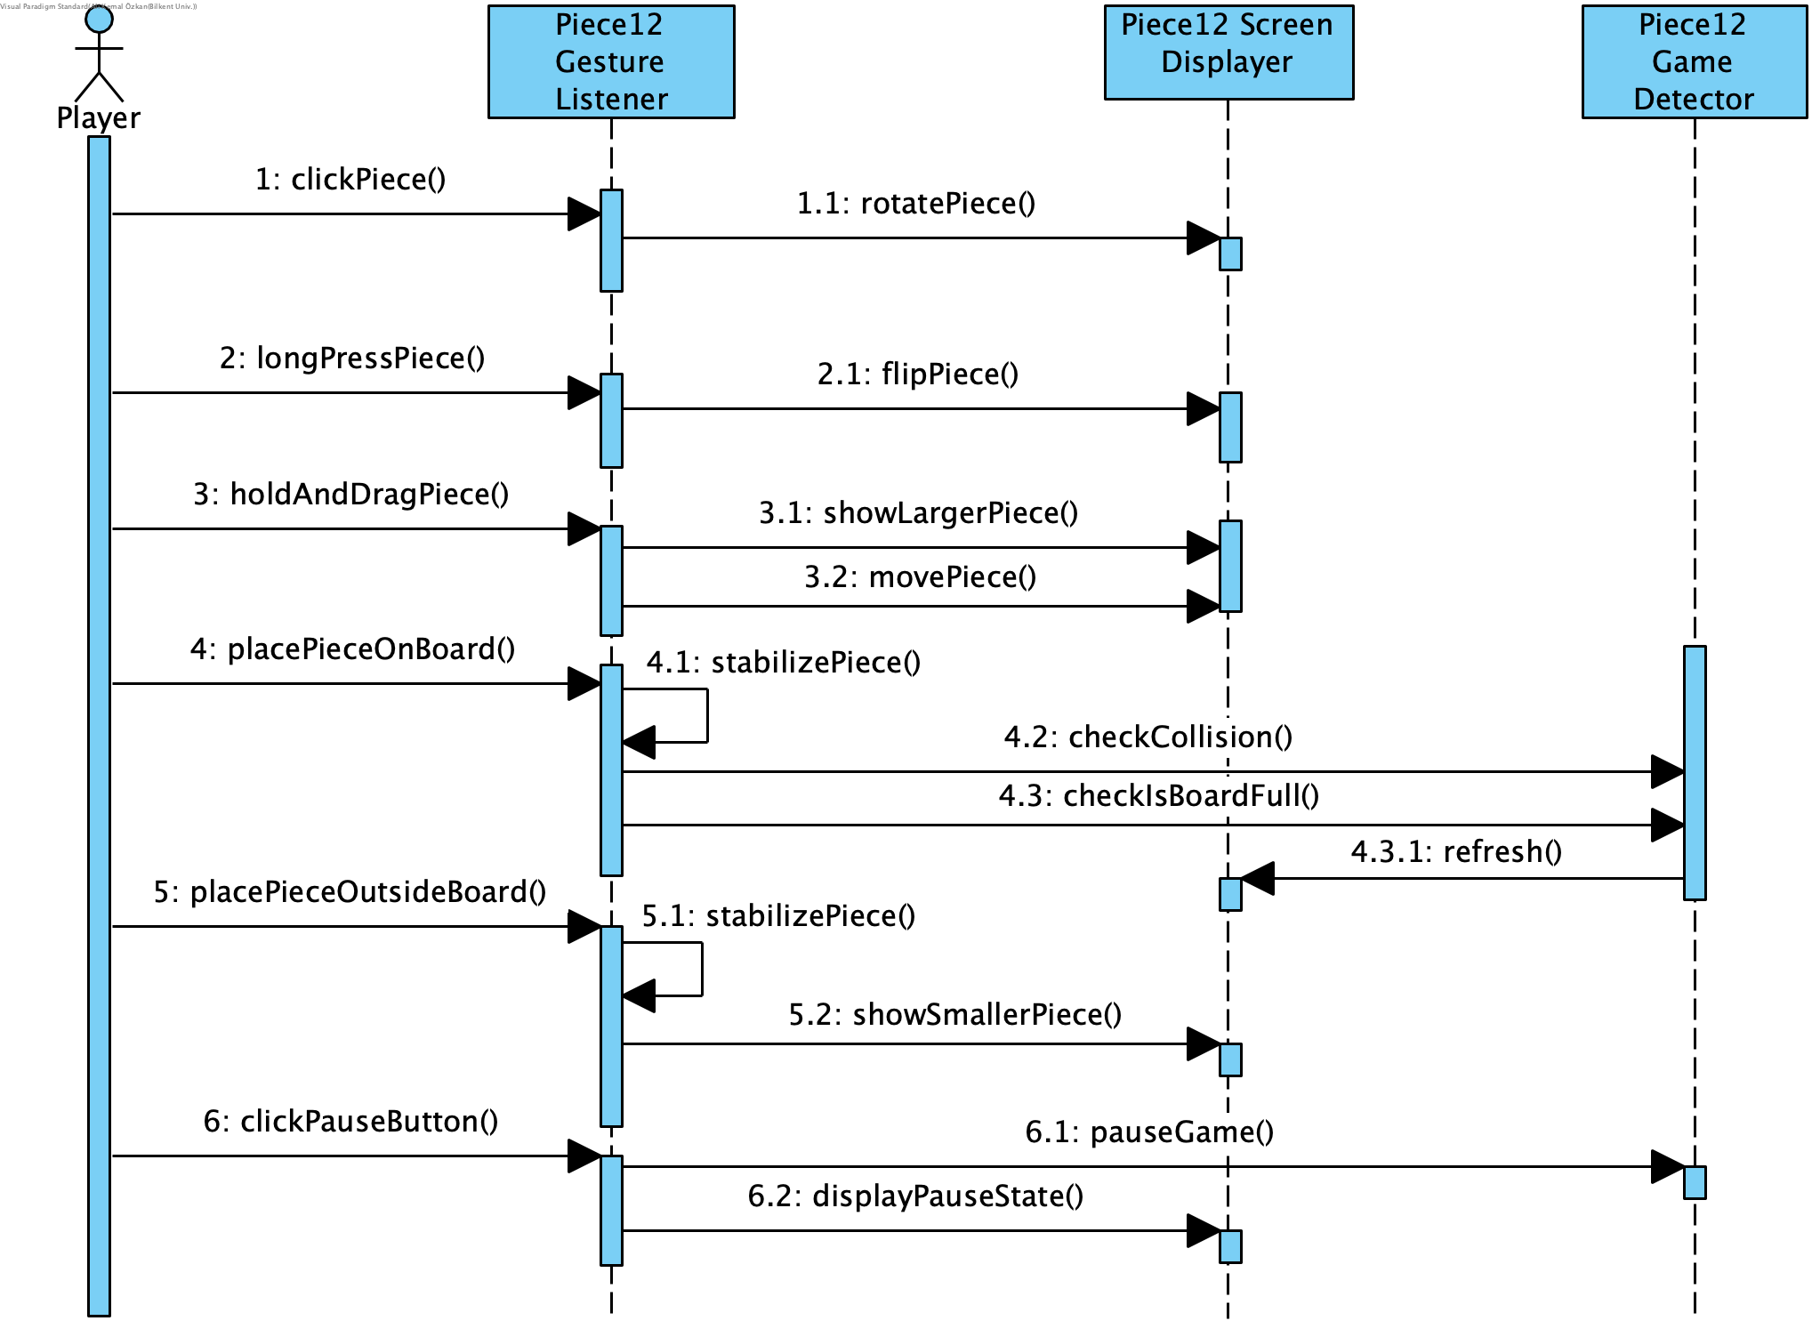
Sequence Diagram
for
Game Play

Slide 6
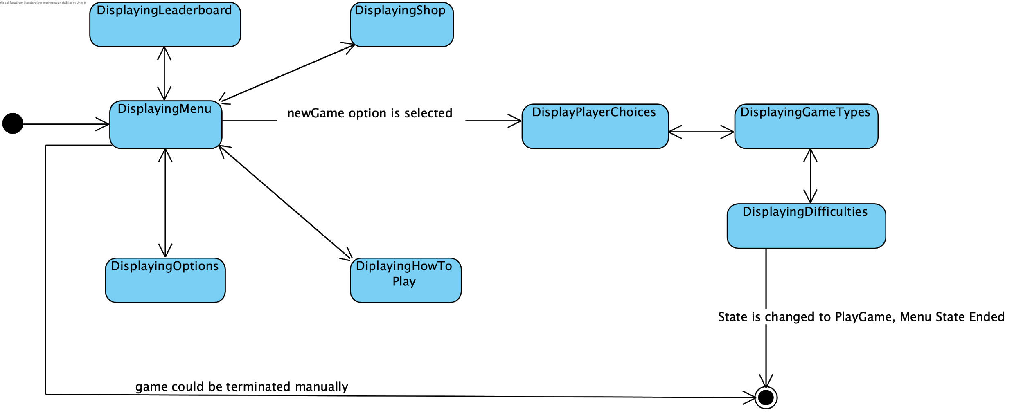
State Diagram - Menu

Slide 7
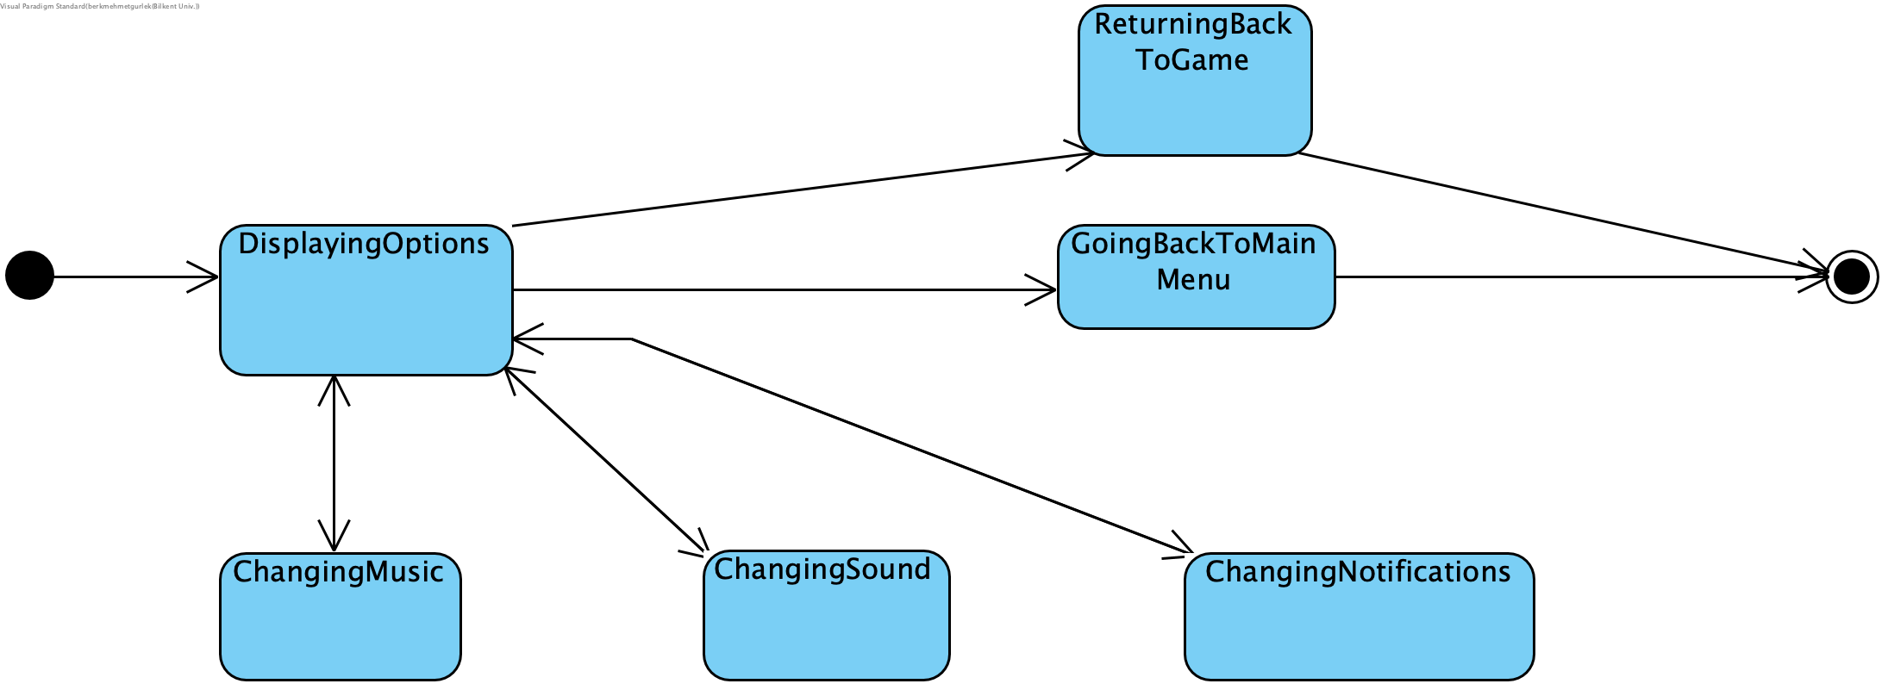
State Diagram - Options

Slide 8
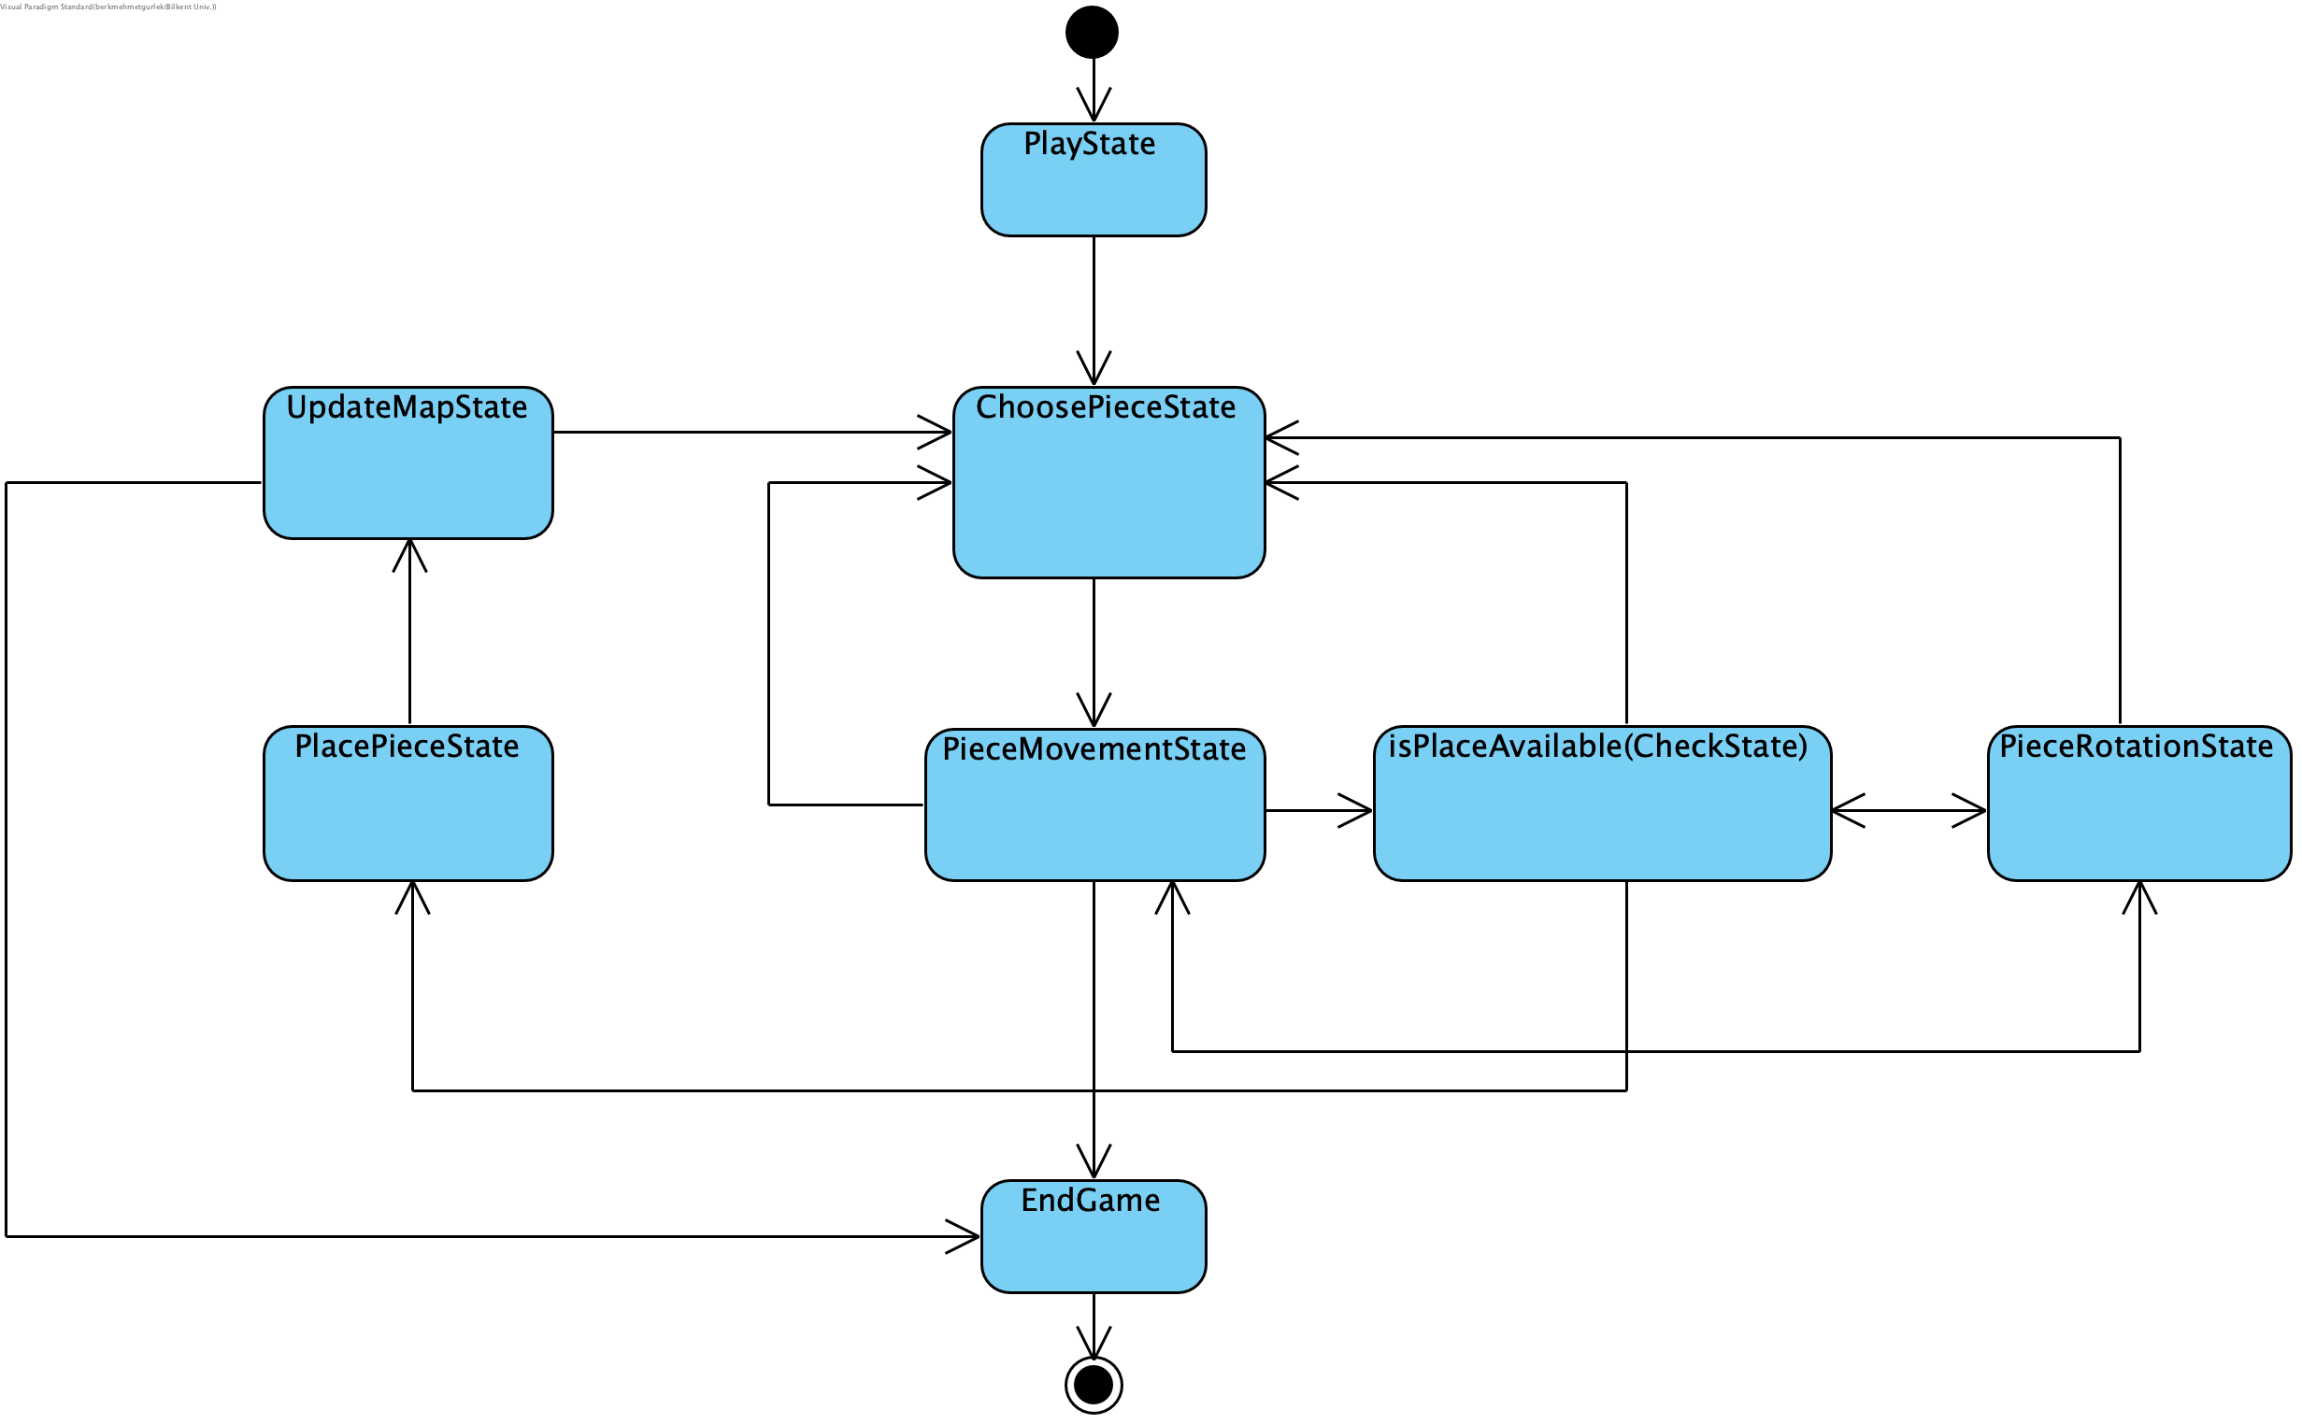
State Diagram - Game

Slide 9

Subsystem Decomposition
Game Manager Subsystem
Game States Subsystem

Slide 10
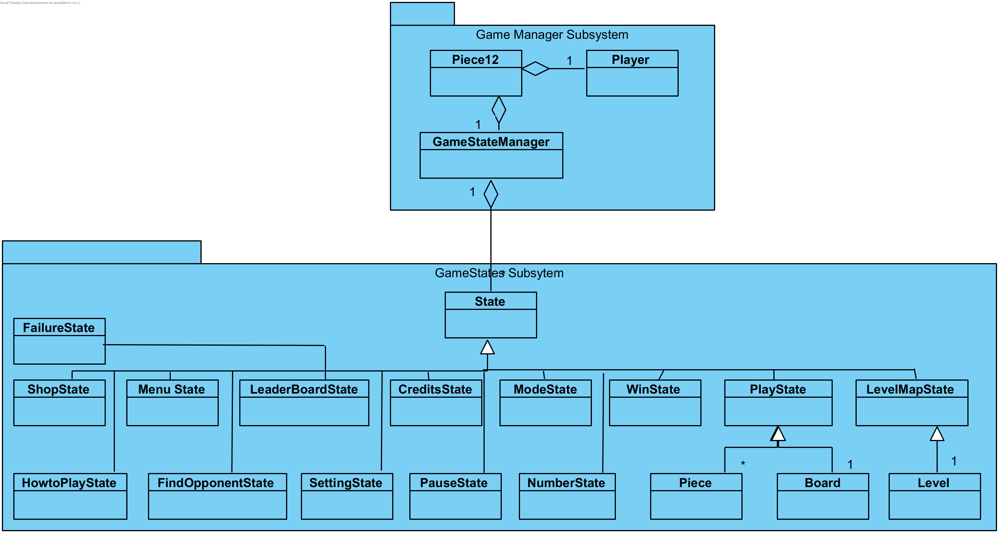

Slide 11
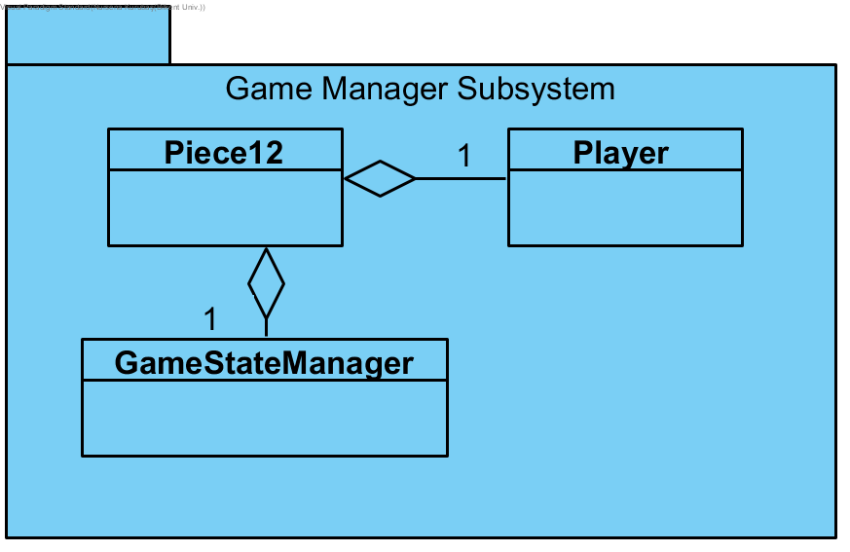
Game Manager Subsystem

Slide 12
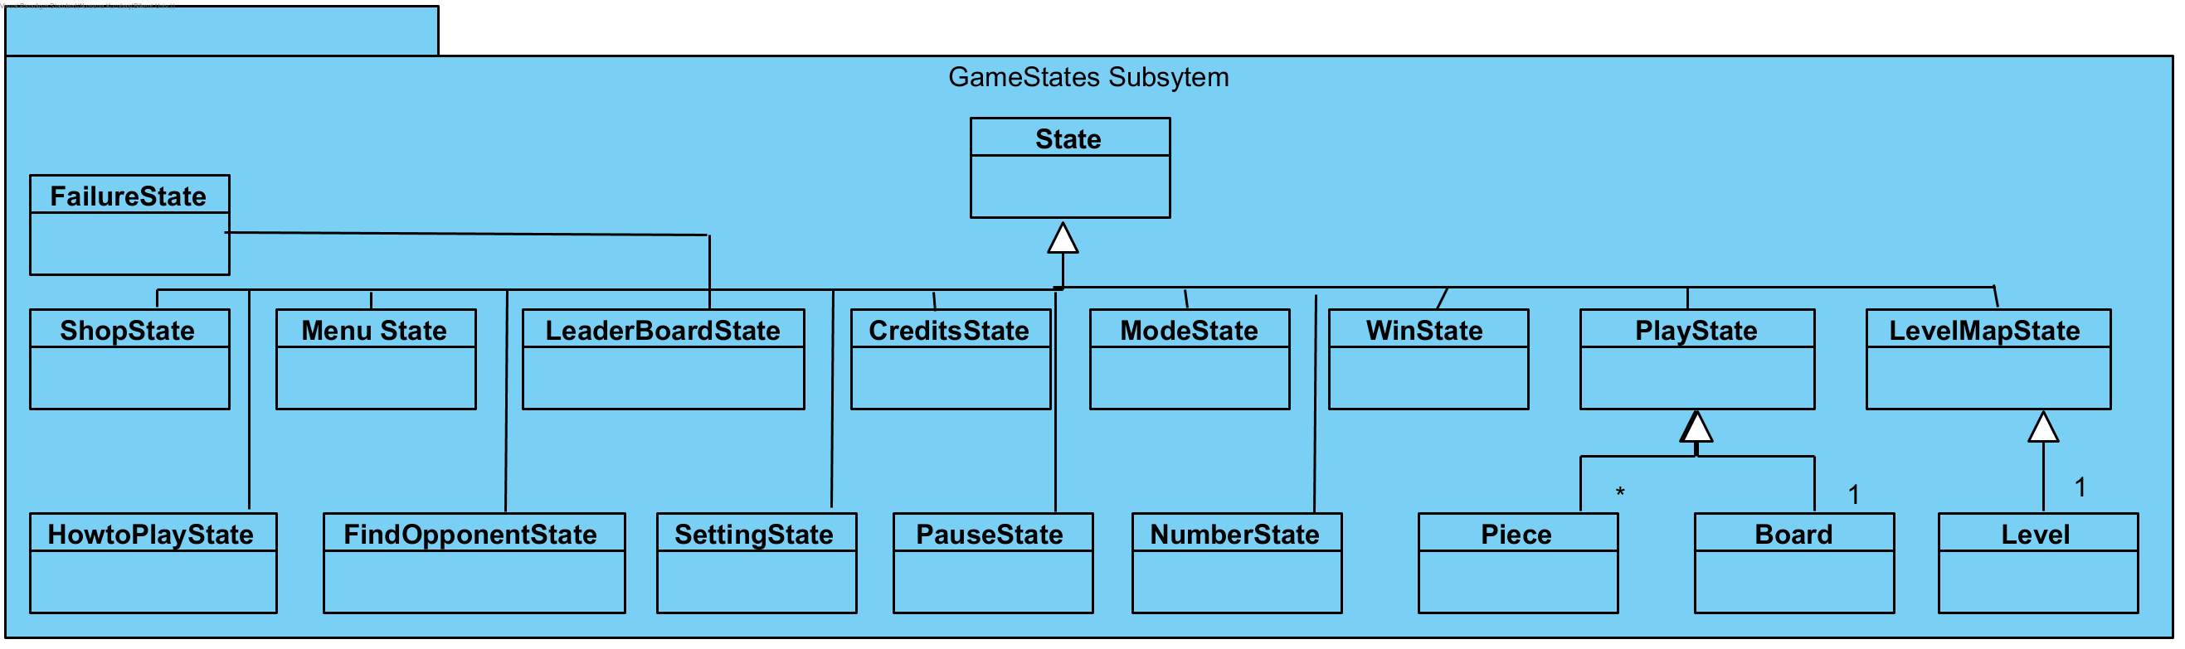
Game States Subsystem

Slide 13

Design Trade-Offs and Decisions
Efficient testing (code for desktop) vs. Efficient coding (code for android)
Implementing more features vs. Quality of code

Slide 14


Implementing an Android Game
Why Android?
Struggles while using LibGDX
Java for Object-Oriented Programming
Experiencing different platforms for GUI
Testing struggles - Using desktop version
Fitting game to different sized screens
Reverting to Android version

Slide 15


