Slide 1

Firearm Injury in the United States: A Resource Book
FICAP Forum, March 21, 2002
Mollie Greves, Fred Watters, Maura Dunfey
Notes:
Thanks for coming
why us?
what is the sourcebook?

Slide 2
The FICAP Resource Book
Easy to read, accessible description of firearm injury in the U.S. (magnitude, repercussions and implications) as best we understand
Equips people with the necessary information to address this complex public health problem
Select excerpts today…more to follow
Feedback from group

Slide 3
Reasons for Studying Firearm Injury
High rates of deaths and non-fatal injuries
Impact on society including psychosocial and economic costs
Disproportionate impact on youth
Preventable
Data
Policy
Safer communities
Notes:
1) The sheer numbers of firearm injuries and deaths in the United States demonstrate its impact on American society. Firearms, especially handguns, are effective lethal weapons with the capability to escalate an often-impulsive act of interpersonal violence or suicidal thoughts into immediate death.
2) The repercussions of firearm violence have a far-reaching impact on society.
3) Firearm violence has a disproportionately high impact on young people which translates into many potential years of life lost, a high degree of lifetime suffering for victims and survivors, and loss of productivity.
4) Finally, firearm violence and its subsequent repercussions are largely preventable. Research on firearm violence provides mounting evidence that specific changes can be made that will reduce the deaths, disability, and costs to society.

Slide 4

Look to the Facts Annual Firearm Mortality--U.S., 1969-1999
# of deaths (in thousands)
Source: National Center for Health Statistics, CDC
Notes:
2nd leading cause of death from injury behind motor vehicle.
Firearm Violence widespread as we know: accounting for an average of 32,833 deaths every year from 69-99.
We can see a major thirty-year trend with deaths at levels not seen since the early seventies; 1999 first year under 30,000 deaths since 1971
Data only touches the surface to describe the magnitude of the impacts on society

Slide 5
Estimated Average Annual Number of Firearm Injuries in the U.S., 1993-98
Source: Morbidity and Mortality Weekly Reports: April 13, 2001, Vol. 50, No. SS-2, CDC
Notes:
See the large difference and greater number of nonfatal injuries except for suicides.
In this six year time period there were more than 100,000 firearm injuries!!
Firearms are good at maiming as well as killing.
These data are not complete: self-treated, privately treated go unreported.

Slide 6
Average Annual Firearm Injuries U.S., 1993-98
FATAL
NON-FATAL
35,208 Total
79,385 Total
Source: Morbidity and Mortality Weekly Reports: April 13, 2001, Vol. 50, No. SS-2, CDC
Notes:
Better visual of last slide
Look at unintentional (this it primarily male youths)
Suicide: high success rate
Non-fatal: Unintentional firearm events are 17%, compared to 3% of fatal.
Non-fatal events lead to disability, wide range of repercussions
which Maura will now discuss

Slide 7
Average Annual Firearm Injury Death Rates in
High-Income Developed Countries
ICE* countries’ injuries by intent for selected recent years
*International Collaborative Effort on Injury Statistics
Notes:
Before we go further in the particulars of American Firearm Deaths, important to step back and see how we compare.
Introduce where data from
Overall rates of fatal injury from firearms is more than twice that of the next highest rate (eg. France).
Although some countries’ firearm suicide rates approach the U.S. levels (eg. France), firearm homicide is far greater in the U.S. than other industrialized nations.
For firearm homicides, the rate in the U.S. (8 per 100,000) is eight times the next highest rate.
Compared to high-income Asian countries (Taiwan, Singapore, Hong Kong, and Japan), the firearm mortality rate in the U.S. is over 70 times higher than in most of Asia

Slide 8
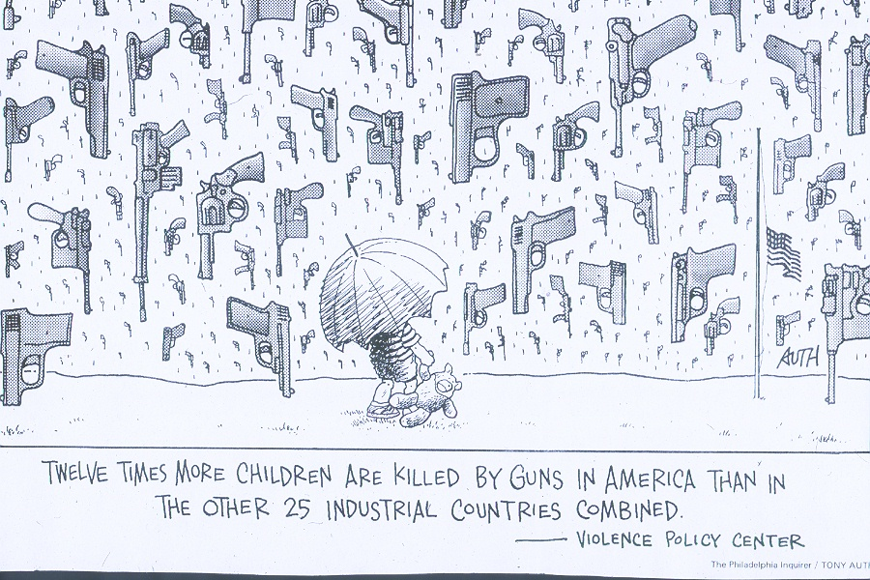
Firearm Violence & American Youth
Notes:
In some ways then we have a uniquely American problem….
There is a correlation between firearm availability and rates of homicide consistent across high-income industrialized nations: where there are more firearms, there are higher rates of homicides.
The U.S. has the highest rates of both firearm homicides and private firearm ownership
One thing that all this data allow s is the ability to look closely at different populations

Slide 9
Top 10 Leading Causes of Death, 15-24 Year-Olds, U.S., 1999
Number of deaths
Source: National Center for Injury Prevention and Control and National Vital Statistics Report, CDC
Notes:
In order to design effective intervention one must know the particular situation of the population at risk
As I said, Firearm violence has a disproportionately high impact on young people.
Among the leading causes of death for those ages 15-24, homicide ranks second and suicide ranks third, and the majority of both are firearm-related.
Total firearm related = 7323 in 1999
Diseases that attract more public attention and research funding to treat and prevent cause fewer deaths than firearms.

Slide 10
Firearm & Non-Firearm Homicide U.S., 1980-1999
Rate* per 100,000 Population
Source: NCIPC for 1980-1998 and National Vital Statistics Report for 1999. * Age-adjusted rates per 100,000 U.S. standard population year 2000 standard
Notes:
So we know that firearms account for more than half of all homicides
the picture over time is fairly clear
It is almost uncanny how total follows firearms over time

Slide 11
Firearm-Related Homicide, by Age
U.S., 1969-1999
Rate* per 100,000 Population
Source: NCIPC for 1969-1998 data and National Vital Statistics Report for 1999 *Age-adjusted rates per 100,000 U.S. standard population based on year 2000 standard for 1969-80 and year 2000 for 1980-99
Notes:
To break this same picture down in age groups and look at the trends over a longer period of time
Introduce graph first
Between 1985 and 1998, the firearm homicide death rate (deaths per 100,000) increased 168% for 15 to 19 year olds;
remained about the same for 25 to 29 year olds,
and decreased for those over age 35.
The increases in rates of homicide in the early nineties from last slide was driven by the increases in firearm homicide rates and those rates were driven by youth homicide rates.
The majority (54%) of homicide victims in 1999 was younger than 40 years old. Thirty-five percent of victims were between ages 15 and 29.
This type of data begs the question of what is driving these trends. What started happening different in 1986?

Slide 12
Firearm Homicides by Age, Race, and Sex--U.S., 1999
Rate* per 100,000 Population
Age
Source: National Vital Statistics Data, CDC
*Age-adjusted rate per 100,000 U.S. standard population based on year 2000 standard.
Notes:
Again the data can be used to look at different pieces of the puzzle.
Black males by far the highest rates at any age
Black females actually higher than white males in 15-19 yr olds and 25-29 yr olds.
AND
Black males aged 20-24 years had the highest rate at 100.8 per 100,000 population.
Explain reporting difficulties due to NVS report.
More groups available from WISQARS but only since 1999 for Hispanics
1999 date on WISQARS was released about a month ago

Slide 13
U.S. Murder Weapons by Type, 2000
78.7%
4.7%
5.5%
11.1%
Source: FBI Uniform Crime Report, 2000
Notes:
When studying interpersonal firearm violence it is very important to look at the particulars of the agent pathway.
I’d mentioned before that firearms involved in 70% of homicides
in 2000…..
READ %’s from the slide
As Dr. Schwab talked about at the Forum on Ballistics,
since the 1980s, trend toward increased use of semi-automatic pistols, especially 9-mm pistols, instead of revolvers.
As a result, increased rate of multiple bullet wounds with a subsequent higher rate of mortality and more complicated wounding patterns for the victims.
McGonigal MD, Cole J, Schwab CW, Kauder DR, Rotondo MF, & Angood PB. Urban firearm deaths: A five-year perspective. J Trauma, 35, 532-537, 1993.
Wintemute GJ. The relationship between firearm design and firearm violence. Handguns in the 1990s. JAMA, 1996, 275 (22): 1749-1753.
Nance ML, Stafford PW, & Schwab CW. Firearm injury among urban youth during the last decade: An escalation in violence. J Ped Surg, 32:949, 1997.

Slide 14
Firearms for Self-Protection… depends on who you ask
Controversy over the frequency of criminal and self-defense gun use (DGU).
DGU occurs 2.5 million times/year
Kleck, G., Armed: New Perspectives on Gun Control, ch 7, 2001
NCVS survey estimates 60,000-120,000 times/year
Difference in numbers is due to who asks, what they ask, and the way they ask.
Hemenway, D., Azrael, D., Miller, M., Injury Prevention, 2000
Vizzard, W.J., Shots in the Dark: The Policy, Politics, and Symbolism of Gun Control, 2000
Notes:
In many communities through out the country
the trends which I have spoken of along with many other factors
drive people to feel they need to arm themselves at home
or for some all the time
Read Kleck bullet
This and other studies like it are matched against studies like Kellermans
Read bullets 2 and 3
In 1998 an estimated 39% of U.S. households had a firearm, 24% had a handgun
Study followed handgun purchasers compared to general pop and found that the rate of firearm suicide in the first week after purchase was 57 times higher.
Wintemute et al “Mortality Among Recent Purchasers ofHandguns, “NEJM 341:21, 1583-9, Nov 18,1999

Slide 15
Handguns in the Home
In homes with handguns:
Homicide is 3x higher
Suicide is 5x higher
For a household member 15 - 24, suicide risk is 10x higher (Kellerman et al. NEJM 1986, 1992)
For gun purchasers, suicide rate is 57x higher during first week; for women, suicide rate remains 15x higher for up to six years
Risk of homicide increases 2x for women, decreases .2 for men with purchase of handgun (Wintemute et al. NEJM,1999)

Slide 16

Just the tip of the iceberg...
Notes:
But that is literally...
We have looked only at deaths, there is more to the story.
For every firearm death, there are approx. 2 nonfatal violent firearm injuries
Not to mention all of the other repercussions on families and society
.

Slide 17
Repercussions to Society
Healthcare
Disability
Economic
Psychosocial
Notes:
Repercussions are widespread. They include, but are not limited to…
Extend to feeling unsafe in our communities and have impact on something as far-reaching as childhood development.

Slide 18
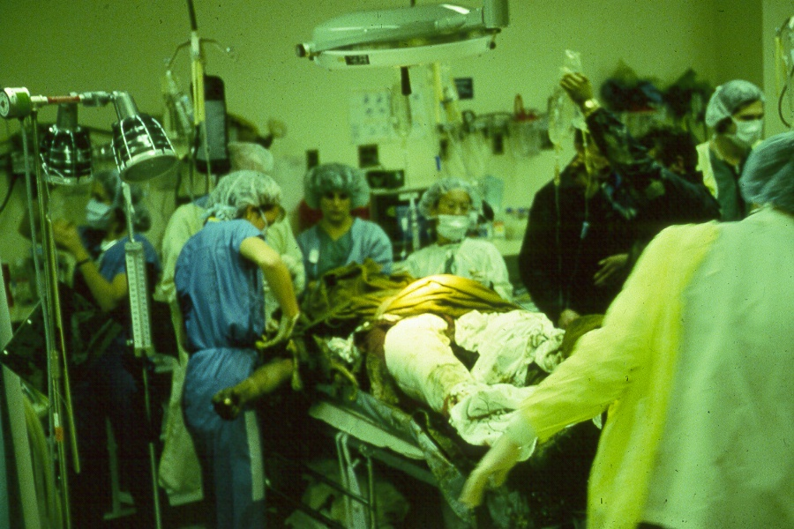
The Role Of Trauma Centers
Notes:
Intentional self-directed firearm injuries = death 76.6% of cases
Intentional interpersonal “ “ = death 21.6% of cases
Unintentional “ “ = death 7.3% of cases
Survivors lead to disability
There is of course also variation in location of the injuries. Example: The case fatality for head injuries was 3.3 times higher than for gunshot wounds to other parts of the body.

Slide 19
Firearm Injury
Hospitalization Outcomes All Injuries vs. Firearm Injuries
All Injuries
Estimated for 1997: 29,000,000
Estimated 1993-1998 Annual Average: 110,000
Source: National Electronic Injury Surveillance System and National Vital Statistics Reports, CDC
Notes:
CWS – Lethality of Firearms

Slide 20
Physical Repercussions
Brain and Spinal cord injuries
Amputation
Loss of productivity
Long-term disability
Ongoing medical costs
Cook & Ludwig, 2000

Slide 21
Years of Potential Life Lost (YPLL) U.S., All Races, Both Sexes, <65, 1999
All Firearm Deaths
Top 5 Causes of Injury-related Deaths
Top 5 Causes of Deaths
YPLL
Source: National Center for Health Statistics Vital Statistics System, CDC
Notes:
Another way to highlight how firearms affects youth is the years of potential life lost.
Here compare firearms to other types of injuries and to all top 5 causes of death among those age 65 and younger.
Firearm YPLL is #2 behind MVAs and is comparable to YPLL among the top 5 overall causes of death

Slide 22
Economic Repercussions
Economic cost estimate of firearm injuries for direct and indirect costs = $100 billion each year
Most costs are due to long-term consequences, not acute medical care care
Firearm-related injuries are the most expensive cause of fatal injuries
Cook & Ludwig, Gun Violence: The Real Costs, 2000
Notes:
Firearm use and injury have a broader impact. Economic impact is complex: Miller - Emergency services and transport,Medical care,Mental Health, Productivity, Administrative costs, Individual and family quality of life.
Cook & Ludwig: Direct medical and productivity costs: $100 billion annually; Contingent Valuation:$80 billion to eliminate firearm homicide &20 billion to eliminate unintentional & self-inflicted shootings
The impact doesn’t stop there… ripple effect seen in our whole society with gated communities, metal detectors, see-through backpacks, people afraid to leave the office after dark...

Slide 23
Psychological Repercussions:
Survivors of traumatic injury experience higher levels of
Post-traumatic Psychological Distress (Richmond & Kauder; J Traumatic Stress, 2000)
Depression (Richmond, Thompson, Deatrick, & Kauder; J Adv Nurs, 2000)
Excerpts from Firearm Injury Survivors
“It dramatically changed my life to a point that I got depressed. Wanted to kill myself-I got help.”
“Bouts with depression. I wouldn’t get out of bed. I would only do things I had to do”
Richmond, Thompson, Deatrick, & Kauder, 2000
Notes:
It is not all about the numbers.
Anecdotal evidence suggesting the impact of being a firearm injury victim.

Slide 24
Psychosocial Repercussions
Children exposed to violence have higher incidences of substance abuse, school failure, anxiety, and behavioral problems (Urban Seminar Series on Children’s Health and Safety, Harvard University, 2000)
“The development of an ecology of danger reflects the confluence and interaction of several sources of contagion. First is the contagion of fear.” (Wilkinson, D.L., “Violent Events and Social Identity: Specifying the Relationship Between Respect and Masculinity in Inner-city Youth Violence,” Sociological Studies of Children and Youth. Vol 8, pp 231-265)
Notes:
The magnitude of psychosocial repercussions is beginning to be recognized. We need more literature specific to firearm injuries.
We know from research with survivors and families of other types of traumatic injury that there are higher levels of PTSD, depression
Children in particular are affected also with higher rates of…

Slide 25
DESIRE TO CARRY
FEAR
DEMAND
Firearm Injury and Death
PRODUCTION
Availability
Notes:
All of these events, this data, these deaths, don’t exist in a vacuum.
There is a constant flow

Slide 26
Juvenile Arrestees Are More Likely to Carry Semi-automatic Handguns
1 in 5 juvenile arrestees in 1999 carried a gun all or most of the time
4 in 5 firearms recovered were handguns
Semi-automatics were the most frequently possessed (52%)
Semi-automatics were more common among those under 24 yrs old (58-60%)
PERCENT %
AGE
Source: U.S. Dept of Justice, Office of Juvenile Justice and Delinquency Prevention, “Kids and Guns.” 1999 National Report Series, Juvenile Justice Bulletin, March 2000.
Notes:
DESIRE TO CARRY, especially by youth, could be for many reasons, the results are quite clear though…..
Back in 1976, 56% of homicides committed by juveniles (under 18) involved a firearm;
By 1999 that percentage had risen to 68.5%..
Fox, JA, and Zawitz, MW. Homicide Trends in the US. BJS, DOJ, March 2001.
Read slide in general
Semi-auto pistols are the most frequently traced firearm across all ages (52%)

Slide 27
Domestic Production of Civilian Firearms 1946-1998
# of Firearms manufactured (in thousands)
Source: Bureau of Alcohol, Tobacco, and Firearms, 2000
Notes:
A key place where DATA is available is at the point of production….
1st purchasers aren’t the illegal ones according the ATF but as far as our pathway is concerned this is the start of the Agent line
explain graph
Unfortunately firearm homicide data unreliable this far back
In 1980, pistols accounted for 32% of the 2.3 million handguns produced.
In 1994, they accounted for 77% of the 2.6 million handguns produced.
Does production proceed or follow peaks in crime?
US Department of the Treasury. Bureau of Alcohol, Tobacco and Firearms. Commerce in Firearms in the United States, February 2000. Available at: http://www.atf.treas.gov.)
US. Dept. of Justice, Office of Juvenile Justice and Delinquency Prevention Kids and Guns. 1999 National Report Series, Juvenile Justice Bulletin., March 2000. Available at: http://www.ojjdp.ncjrs.org.

Slide 28
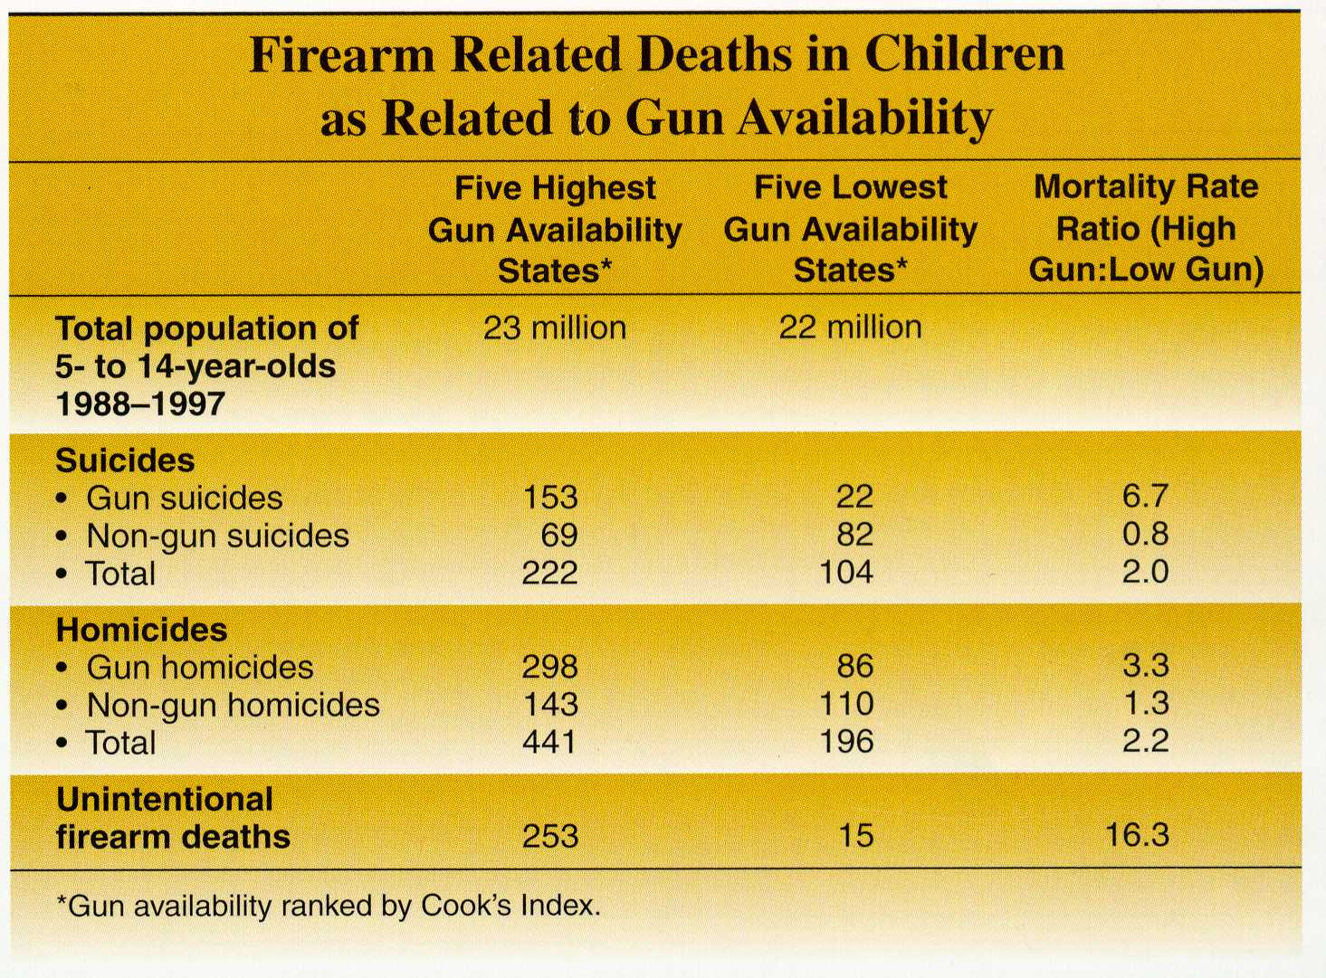
Source: Miller M, Azrael D, Hemenway D. Firearm availability and unintentional firearm deaths, suicide, and homicide among 5-14 year olds. Journal of Trauma. 2002; 52(2): 267-73.
Notes:
One point on that cycle is AVAILABILITY
Miller, , Azreal, and Hemenway published last month in the Journal of Trauma showed the flow in part of that cycle
10 yr study
6817 5-14 yr olds killed in US
even controlling for poverty, urbanization, education, there is a very strong correlation between access and firearm death across all intents

Slide 29
DESIRE TO CARRY
FEAR
DEMAND
Firearm Injury and Death
PRODUCTION
Availability
Notes:
All of these events, this data, these deaths, don’t exist in a vacuum.
There is a constant flow

Slide 30
What can we do?
Notes:
We have described the problem and its impact in various forms. What, then, can we do?

Slide 31
Address Multi-factorial Causes With Prevention
Many root causes of firearm violence
Efforts to reduce firearm violence must
Address different causes
Be implemented on many levels, from local community programs to federal legislation
Be consistent with individuals’ beliefs and attitudes
Prevention is the most cost effective and efficient way to reduce firearm injuries
Notes:
We know from the both of literature many root causes of violence have been identified and they are complex—poverty, drugs, lack of education, racial inequality, domestic violence, fear, stress, substance abuse, mental illness
No single solution—challenges are real
In order to reduce firearm injury, we must address underlying contributing factors
Significant change will require implementing many different types of interventions
At all levels—local community programs all the way to federal legislation
ABOVE ALL, focus on PREVENTION

Slide 32
Pathways to and from event
Physical, Social Environments
Agent: Firearm
Repercussions
Host: Carrier
Host: At-risk

Slide 33
Many Proposed Interventions Meet Political Resistance
Responsible gun owners and powerful lobby largely oppose firearm interventions, especially legislation
Symbolism of firearms
Controversial interpretation of the 2nd Amendment
“Slippery slope” argument invoked to resist any new regulation of firearms
Gun control advocates unrealistic in their goals
Prohibition
No acknowledgement of legitimate use of firearms
Notes:
Why when the data clearly shows the degree of injury caused by firearms is it so difficult to make progress?
Firearm interventions, particularly in form of regulation or legislation, often resisted by a powerful lobby, primarily organized by the NRA
Several entrenched ideologies held by people and organizations important to acknowledge:
Symbolism of firearm: self-protection from both criminals and government
Interpretation of the 2nd amendment protecting an individuals’ right to own firearms
Opposed to any new regulation of firearms because it would slide down
We live in a society that believes protects an individual’s freedom to own firearms
Interventions must be consistent with individual’s attitudes!!!!

Slide 34
Unite on Common Ground
Reasonable Middle Ground
Left
Right
Recognize firearm injury as a public health problem
Focus on reducing lethality & increasing safety
Data/Research
Agent: Firearm Safety, Availability
Individuals
Environment: Local to National
Notes:
In order to enact change, we must seek middle ground in this politically charged issue
Focus on the public’s health
Focus on reducing lethality and increasing safety, not necessarily banning weapons
Move from DATA

Slide 35
Injury Reduction as a Goal Motor Vehicle Injuries as a Model
Injury control experts recognized that changing the vehicle and highway environment was more effective than changing human behavior
Automobiles and roads were improved to decrease collisions and reduce serious injuries if there was a collision
Since the 1950s, the number of motor vehicle fatalities per mile has been reduced by over 75%.
Hemenway D. NEJM, 1998
Notes:
NEXT STEP: Identify the potential interventions
Motor Vehicle injuries reduced through multiple interventions addressing multiple causes: driver competence (individual), automobile safety (agent), road safety (environment)

Slide 36
Firearm and Motor-vehicle related Mortality U.S., 1968-1999
Rate* per 100,000 population
Source: MMWR Vol 43, No 3 and National Center for Injury Prevention and Control
*Age-adjusted rates per 100,000 U.S. standard population based on year 1940 standard for 1968-1980
and to 2000 standard for 1981-1999
Notes:
Motor vehicle-related mortality has steadily declined since the 1960s thanks to the comprehensive changes in design, operation, and use of automobiles, roads and drivers
In mid 1990s many thought that firearm injury deaths would overtake automobile deaths
Our goal to reduce firearm deaths/injuries in the same manner!

Slide 37

The Maze of Data
13 National Data Systems are available
Managed by separate Federal Agencies
Primarily broad-based information surveillance
Community & Individual circumstances not consistently collected (ie: types of weapon, victim-offender relation, injury locale, etc.)
--Annest & Mercy, Amer Jnl of Prev Med, 1998
National Vital Statistics System-Final Mortality Data (NVSSF)
National Vital Statistics System-Current Mortality Sample (NVSSS)
Uniform Crime Reporting System- Supplemental Homicide Reports (UCRSHR)
Census of Fatal Occupational Injuries (CFOI)
National Traumatic Occupational Fatality Surveillance System (NTOF)
Law Enforcement Officers Killed and Assaulted (LEOKA)
National Ambulatory Medical Care Survey (NAMCS)
National Hospital Ambulatory Medical Care Survey (NHAMCS)
Survey of Occupational Injuries and Illnesses (SOII)
Youth Risk Behavior Surveillance System (YRBSS)
National Crime Victimization Survey(NCVS)
National Health Interview Survey (NHIS)
Notes:
Daunting task of beginning to get a clear picture of the problem.
Many different sources that don’t always agree with each other
7 of 13 didn’t exist 10-15 years ago
Some advances1) ability to track non-fatals in ER 2) System to monitor risk behaviors in youth 3) better dissemination of national information
Despite this there are significant gaps FOREMOST is:
the inability for these national data systems to capture or describe the shear COMPLEXITY of incidents in which firearms occur.

Slide 38
Establishing a National Violent Death Reporting System (NVDRS)
Within the total provided, $1,500,000 above the budget request is for the National Violent Death Reporting System to gather information on the circumstances of violent deaths and develop effective methods of prevention and intervention
FY02 Appropriations Bill
Notes:
NVDRS is step in right direction.
Limited funding for pilot program approved in by Congress in 2002

Slide 39
Intervention Approaches
Individual, Environment, and Agent
Intent: Homicide, Suicide, Unintentional
Stage of event: Pre, Peri, Post
No single proven intervention
All variables intersect
Approaches have varying levels
Basic building blocks

Slide 40
Point of Intervention: Individuals
Knowledge:
Provide accurate information about the dangers of carrying handguns for self-protection
Educate people about proper use and storage of firearms
Attitudes:
Modify societal permissiveness toward violence
Modify youth beliefs about carrying firearms
Behavior:
Prevent criminals & youth from purchasing, carrying weapons
Require training and licensing for firearm purchase
Provide comprehensive mental health and substance abuse treatment
Notes:
Specifically for reducing firearm injuries, possible interventions that would be directed toward the individuals at risk, both as perpetrators and victims

Slide 41
Point of Intervention: Firearm • Environment
Purchase
Handgun advertising
Waiting periods
Background checks
Private/3rd party sales (straw purchases and gun shows)
Frequency, quantity of purchase (one gun a month)
“Shall issue” versus “may issue”
Storage
Registration
Safe storage
Concealed carry
Use
Ammunition availability
Targeted policing (hotspots) or enforcement
Notes:
Here, possible interventions for changing factors in the physical and social environment around firearm purchase, storage and use

Slide 42
Point of Intervention: Individual • Environment
Supports for high risk youth
Neighborhood supports: housing developments, zoning, etc.
Appropriate mental health services and substance abuse treatments

Slide 43

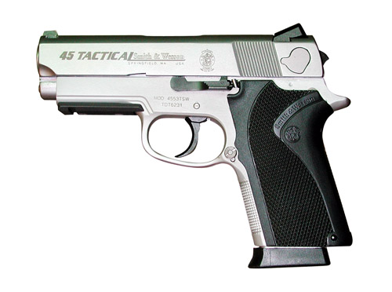
Point of Intervention: Firearm Design
NHTSA: The Agency's values underpin the assurance of safe, secure, efficient automotive travel.
Virtually every consumer product is regulated by the CPSC
Notes:
Automobile safety regulated by National Highway Traffic Safety Administration
Consumer Product Safety Commission (CPSC) beginning in 1973 regulates everything from teddy bears to McDonald’s toys with the notable exception of the firearm
Points out the absurdity that a product so dangerous is not monitored for basic safety factors

Slide 44
Point of Intervention: Firearm Design
Safety design
Childproof trigger mechanism
Personalized weapons: electronic, radio frequency or fingerprint
Magazine safeties
Loaded chamber indicators
Internal and external trigger locks
Automatic, semi-automatic and caliber
Tamper-proof serial number encoded with weapon-specific information
Notes:
Specific possible interventions that would modify the firearm design to make a very dangerous product less likely to be used unintentionally by children or youth, or illegally by criminals

Slide 45
Community-level Interventions Are Gaining Momentum
Many programs being implemented and evaluated
Tools to help communities are available
DOJ: Office of Juvenile Justice and Delinquency Prevention “Promising Strategies to Reduce Gun Violence,” 1999
CDC: Division of Violence Prevention “Best Practices of Youth Violence Prevention: A Sourcebook for Community Action,” 2000
Institute of Justice/Univ. of Maryland: “Preventing Crime: What Works, What Doesn’t, What’s Promising,” 1998
Notes:
As we are learning from the data, different communities are affected differently, urban v. rural, etc.
Community-level interventions are necessary to address the violence
Good news in many communities across the nation already implementing programs
Workbook tools are available, including work done at FICAP for the Medical Professionals as Advocates program (MPAP)

Slide 46
Not All Interventions (or Evaluations) Are Created Equal
Some interventions have proven unsuccessful in evaluation studies
Scare tactic approaches
Gun buyback programs
Ongoing research is needed to continue evaluations of community programs and legal interventions
Multiple, creative measures must be used to evaluate programs
Notes:
Need to continue to evaluate programs
Already know from some research that scare tactic approaches and gun buyback programs are not useful in preventing future violence
Need appropriate measures

Slide 47
Link Data to Communities to Facilitate Local Interventions
Enable communities with data and tools at the local level to identify
Magnitude of firearm injuries
Community attitudes
Persons at-risk
Resources available
Workable action plan
Notes:
Goal is to link communities with the data to facilitate local interventions
Enable communities and health care professionals with tools to…

Slide 48
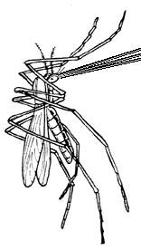
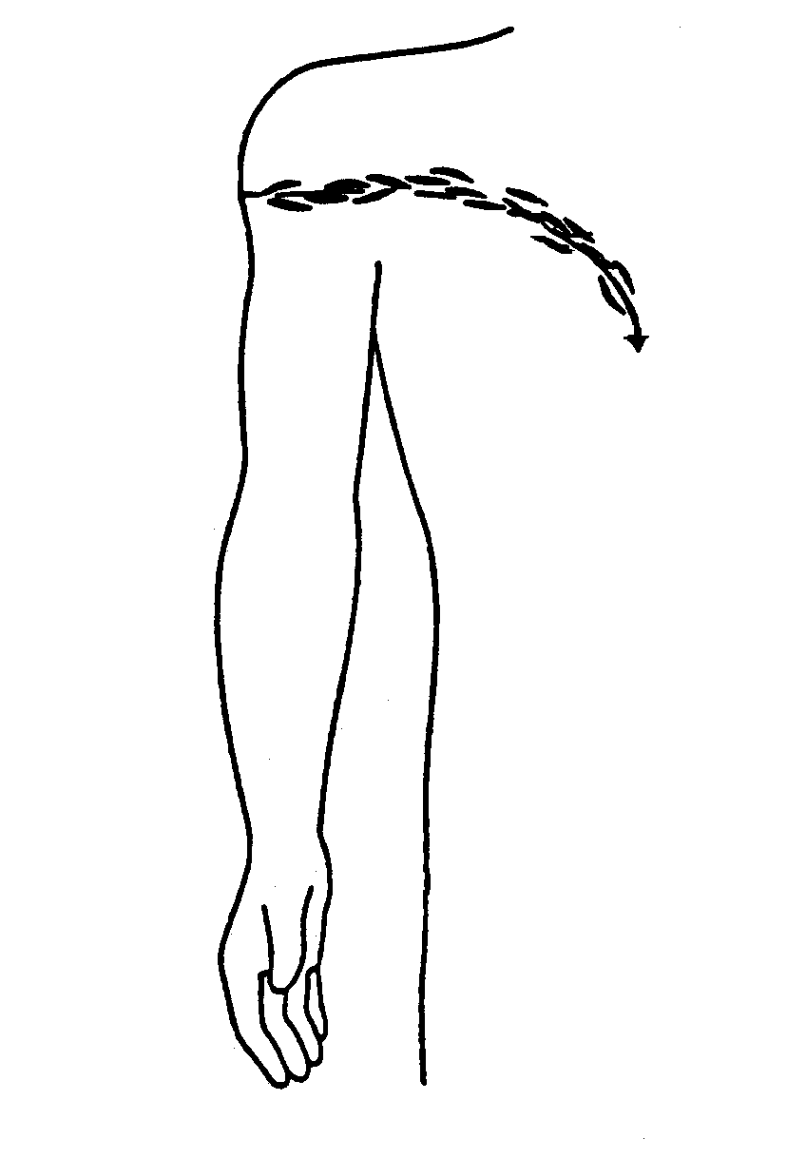
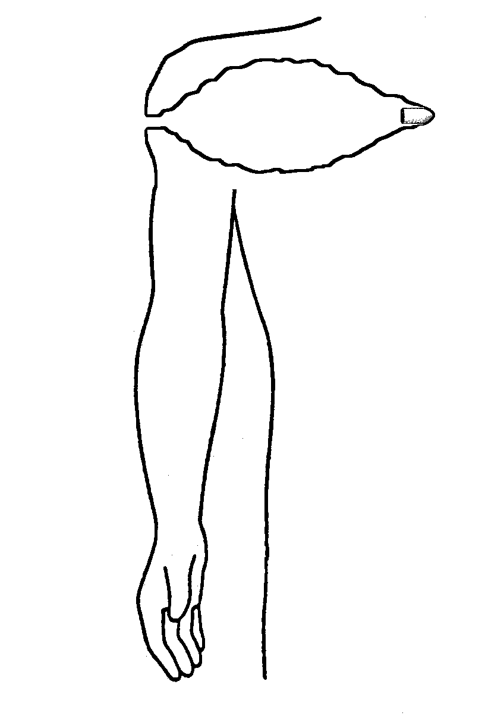
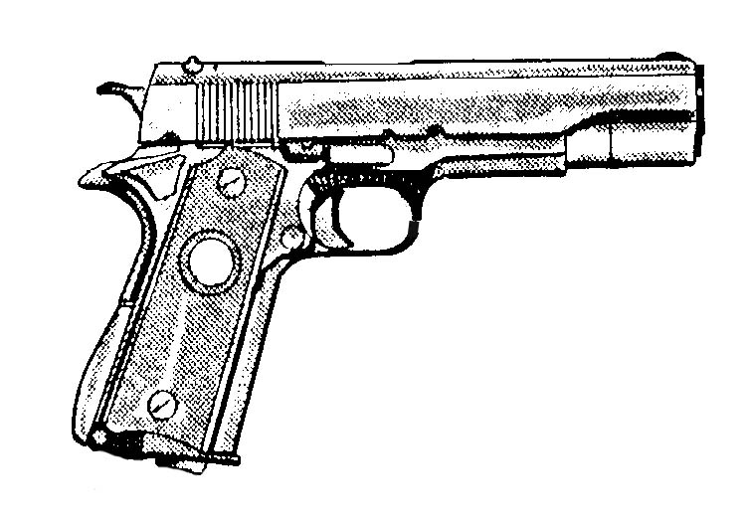
Seeking Solutions Only the beginning...
1900
2000
Notes:
We’re in the middle of this…nobody knew what caused yellow fever.
This slide is here to remind us of the power of prevention and how it has been used to reduce or eradicate other diseases, injuries
Initially public health model applied to reducing infectious diseases, then extended to injury prevention with motor vehicles, now want to extend the application to firearm injuries.
Mosquito is an agent of disease: malaria. Agent/vector: Target the anophales. Environment: Get rid of unnecessary pools of water. Host: Get prophylaxis, Put on your insect repellant.
So, too, is the firearm an agent of disease. – How should we intervene with agent, environment and hosts.

Slide 49
Questions Comments Feedback

Slide 51
Objectives
Describe firearm injury in the U.S. (magnitude, repercussions and implications)
Understand data, sources, and limitations of available data
Develop an interdisciplinary tool or resource book on firearm injury
Feedback from group
Notes:
Firearm injury is a huge topic
Primary focus on describing magnitude of the problem
Less emphasis on interventions
Feedback on our manuscript

Slide 52
Our Primary Data Sources
National Vital Statistics System
WISQARS (Web-based Injury Statistics Query & Reporting System)
FBI Uniform Crime Reporting System
National Crime Victimization Survey
National Electronic Injury Surveillance System (NEISS)
Peer-reviewed journals
Notes:
National Vital Statistics System: Published by the CDC National Center for Health Statistics. Currently takes about 18 months to collect, compile, verify, and release statistics to the public.
)WISQARS is an interactive database system that provides customized reports of injury-related data.
FBI Uniform Crime Reporting System: Compiles crime statistics annually from 17,000 city, county, and state law enforcement agencies that submit data voluntarily. Most reliable homicide data.
National Crime Victimization Survey: Conducted by the Bureau of Justice Statistics in the DOJ. Collects date on reported and unreported fatal and non-fatal violent crimes against ages 12 or older.
National Electronic Injury Surveillance System (NEISS): Collected by the Consumer Product Safety Commission from 91 hospitals in the US then extrapolated to entire country. Used to estimate non-fatal injuries.
Peer-reviewed journals: Provide analysis of the available data as well as controlled studies by are often published long after the data was collected.

Slide 53

The Role of Firearms
Firearms are used in:
70% of homicides
57% of suicides
40% of robberies
20% of aggravated assaults
Handguns represent one-third of all firearms in U.S.
Handguns account for two-thirds of firearm crime
Over 70% of all firearm homicides
Approximately 50-70% of all firearm suicides
Cook PJ, Ludwig J. Guns in America: Police Foundation. Washington DC. 1996.
National Summary of Injury Mortality Data, 1987-1994. NCIPC, 1996.
Notes:
So what is the role of firearms in different events?
Read stats
Handguns comprise about one-third of all firearms owned in the U.S. (65 million of 192 million total)³,
but they account for two-thirds of firearm crime,
over 70% of all firearm homicides, and
approximately 50-70% of all firearm suicides⁴
For some subgroups of the population, such as women and youth, the proportion of handgun death is higher.
In 1998, 77% of female firearm homicide victims were killed by handguns.
Impact on Youth I’ll return to in a moment

Slide 54
New approaches to diagnosis and management of wounds
Damage control
Vascular shunts
Open abdomen
Delayed repair of intestines
Multi-cavitary exsanguinations
References:
Rotondo MF, Schwab CW, McGonigal MD et al. J Trauma, 1993 Reilly PM, Rotondo MF, Schwab CW et al. J Trauma, 1995 Johnson JW, Gracias VH, Schwab CW et al. J Trauma, 2001 Hoey BA, Schwab CW. Ann Chir Gyn (in press) Shapiro MB, Jenkins DH, Schwab CW et al. J Trauma, 2000
Notes:
CWS – our mission is to improve outcomes – Examples of some of our advances in clinical care

Slide 55
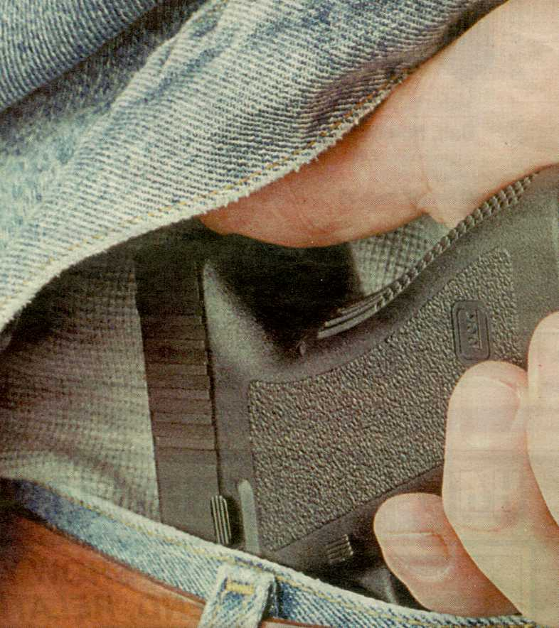
The AGENT:
Types of Firearms
Handguns
Long guns
Pistols
Revolvers
Rifles
Shotguns
Lightweight, powerful
Easy to Conceal
Easy to Fire
Designed Specifically To Injure or Kill Human Beings
Fired from the shoulder
Serve a sporting purpose
Notes:
The model pathway of firearm injury suggested several points of intervention
I’ve mentioned the heavy impact of handguns several times…..
I’ll just take a moment to delineate the difference
long guns are designed to serve a broader sporting purpose,
(Read hand gun part of slide)
Handguns are especially effective use in self-inflicted injuries.
Often involved in unintentional shootings
effective for interpersonal violence use in crimes
DESIGNED SPECIFICALLY TO KILL OR INJURE HUMAN BEINGS

Slide 56

Intentional Self-directed Violence Firearm Suicide: A Hidden Problem
More Americans kill themselves than are killed by others
Suicide is the 11th leading cause of death
Firearms account for 50-70% of suicide deaths
More likely to die at the scene (Case Fatality Index >70%)
Stigmatized
Notes:
Brings us to a difficult point for many Americans to grasp and admit…..
Read bullets
Over the past two decades the suicide rate has remained virtually unchanged, with fluctuations in rates tending to follow firearm suicide more than non-firearm suicide
Very difficult to intervene due to
lethality of firearm, f.a. suicide has high case fatality.
CFI is 90% for head
Stigmata from social acceptability to speak of it
and some believe it is not violence at all but a personal choice

Slide 57
Firearm Suicide by Gender and Age— U.S., 1999
Rate* per 100,000 population
Age
Source: National Center for Injury Prevention and Control, CDC
*Age-adjusted rates per 100,000 population based on year 2000 standard
Notes:
In 1999 (29,199 suicides), 57% were with firearms. 70% of those involved handguns
Disparity between male/female
although estimated female 3 X more likely to attempt
male more likely to succeed, largely because of lethality of methods.
60% of male suicides involved firearms
vs 38% female, this may be changing. According to suicide researchers
Age distribution: higher elderly
Significant portion of male youth/ adolescents

Slide 58
U.S. Male Firearm Suicide by Race/Ethnicity for Youth and Elderly, 1990-1998
Rate* per 100,000 population
Source: National Center for Injury Prevention and Control, CDC
*Age-adjusted rate per 100,000 U.S. standard population based on year 2000 standard.
Notes:
Although each of these groups would probably require very different interventions, it is telling to look at them together
In 1999 about 72% (21,107) firearm suicide victims were white males, that’s a rate of 19.1 per 100,000.
American Indian/AK native male 15-24 is higher than for any other ethnic group. 26.21 per 100,000 surpassed only by white males over 75
Suicide among black youths once uncommon has grown sharply
1980 15-19 yrs was 1.99 / 100,000
1998 15-18 yrs quadrupled to 7.99 / 100,000

Slide 59
Firearm Deaths, by Type U.S. 1999
Undetermined 1%
Legal Intervention 1%
Unintentional 3%
Homicide 38%
Suicide 57%
Source: National Center for Vital Statistics Data, CDC, 2001
Notes:
Here’s that same data I showed in the profile of 1999 earlier.
I’ve talked about homicide, talked about suicide.
Unintentional may be only 3%, but that raw percentage doesn’t tell the story
Who is being affected?

Slide 60
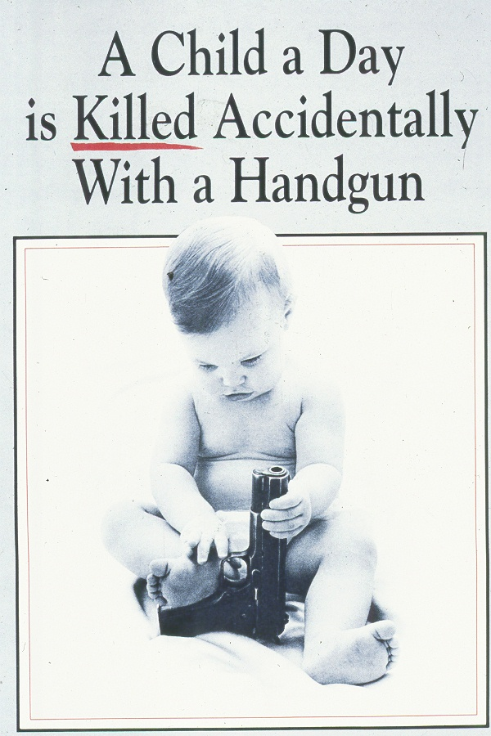
Unintentional Firearm Deaths
Almost 1000 Americans die annually from unintentional firearm injury
Unintentional youth firearm deaths, 1999
87 between 1 - 14 years
126 between 15-19 years
125 between 20-24 years
“Accident” vs. Unintentional
IT’S PREVENTABLE
Notes:
824 unintentionals in 1999
Rate has been declining since the 30’s which correlates with
decrease in percent of population engaging in hunting,
living in rural areas,
and handling guns regularly
Baker, O’Neill, and Ginsberg’s 1992 The Injury Fact Book.
This is not true for youth in the US who saw an increase from the late 80’s into the early nineties
Although this disturbing picture uses the word
Accident isn’t correct
It implies no control.
Unintentional firearm deaths are the most preventable

Slide 61
Unintentional Firearm Mortality U.S., 1990-1998
Rate* per 100,000 population
Source: National Center for Health Statistics data, CDC
*Age-adjusted rate per 100,000 U.S. standard population based on year 2000 standard.
Notes:
Maybe the raw numbers from the last slide didn’t seem significant….when we look at the differences in rates….The group affected jumps out… …
15-24 year old males are disproportionately affected
We know who’s affected. How do we intervene?

Slide 62
Data Limitations Affect Development of Interventions
Existing data are limited
Lack of uniformity
Lack appropriate denominators
Incomplete, without specifics (e-codes, circumstances, location, weapon type)
Unlinked datasets
Media and ideological impressions dominate discussions
Notes:
FIRST STEP: ESTABLISH MORE CONSISTENT, comprehensive, data system for defining the problem and providing reliable surveillance
need population based, national in scope, community specific, to properly target, drive and evaluate interventions
Determine the causes of the problem

Slide 63
Most Americans Are Ready for Change
68% favor government safety regulations
70% agree that government should do “everything” possible to keep handguns away from criminals
82% agree with mandatory registration of handguns
90% want handgun manufacturers to make serial numbers tamper-resistant
Teret et al, NEJM, 1998
Notes:
Bottom line is that most people do support change
Study of Americans including firearm owners: (52% of firearm owners agreed that govt should do everything it can to keep handguns away from criminals)

Slide 64
© 1/2002
RESEARCH AGENDA:
Causal Pathways Illustrate Points of Intervention
Agents:
Firearm & Ammunition
Environments: Social, Physical, and Others
Discharged
Firearm/Ammo
Host(s):
Carrier
Shooter
Host(s):
At-Risk
Injured
Community & Individual Responses
Pre-Firearm Injury Incident
Peri-Incident
Post-Incident

