Slide 1
Rules
Jan 28, 2017

Slide 2
An if-then rule
If (x) and (y) and (z), then A
x, y, z : Antecedent
A : Consequent
Length of a rule: Number of antecedents

Slide 3
Goodness OF A RULE

Slide 4
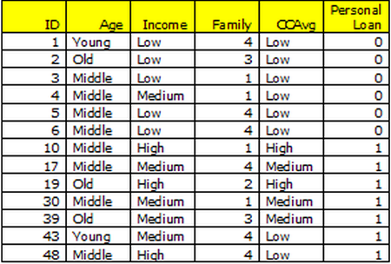
“if CCAvg is medium then loan = accept”
3 in 13.
23% of the data is covered by this rule.
This is called SUPPORT or COVERAGE.
* Adapted from Universal Bank data on predicting loan purchase likelihood of existing bank customers

Slide 5
“if CCAvg is medium then loan = accept”
Of the three
occasions LHS is present, RHS
too is present.
This rule has
100% CONFIDENCE or ACCURACY.

Slide 6
“if loan = accept then CCAvg is medium”
What are SUPPORT and CONFIDENCE now?
Support remains same at 3/13 (23%), but Confidence dips to 3/7 (43%).

Slide 7
Findings
Support remains same if rule is switched
Confidence changes
Recall from Probability, P(Y and X) = P(X and Y) but P(Y|X) $≠$ P(X|Y)

Slide 8
Let us look at another case
A transaction table contains 100 records. We want to find rules with Support greater than 20% and Confidence higher than 80%.

Slide 9
Let us say X is present in 25 transactions out of 100 transactions/records. If Y is an obvious class , it is present in, say, all the records. What are Support and Confidence?
Support = 25/100 = 25% (both items are present in a total of 25% of transactions)
Confidence = 25/25 =100% (if X is present then Y is always present).

Slide 10
Confidence is not adequate
This seems to have a very high confidence.
But, in reality, Y is present whether or not X is present. So, there is no REAL relationship between the two.
Clearly, we need another metric. That metric is called LIFT.

Slide 11
LIFT as a goodness metric
We divide the confidence of Y with the probability of Y.
The lift of a rule X =>Y is defined as:
LIFT = P(Y|X) / P(Y).
In our case, as Y is there in all transactions, P(Y)=1. So, LIFT =1.

Slide 12
Interpreting Lift
If lift > 1, then X and Y are positively correlated
If lift < 1, then X are Y are negatively correlated
If lift = 1, then X and Y are independent (above case)

Slide 13
Examples Cont.
Total transactions 100. Y occurs in 20 where X also occurred (recall X occurred 25 times) and does not occur elsewhere. What are Support, Confidence and Lift now?
Support of X->Y: 20/100 = 20% (where X and Y occur).
Confidence of X->Y: 20/25 = 80%.
Lift = 0.8/0.2 (confidence/probability of Y) = 4

Slide 14
Y occurs in 20 records where X occurs and 70 transactions where X does not occur. What are Support, Confidence and Lift now?
Support of X->Y: 20/100 = 20% (where X and Y occur).
Confidence of X->Y: 20/25 = 80%
Lift = 0.8/0.9 (confidence/probability of Y) = 0.89

Slide 15
Two-step process
Find all item sets that have minimum support. These are called frequent item sets.
Use frequent item sets to generate rules.

Slide 16
The Apriori Algorithm — Example
Database D
Minsup = 0.5
L₁
C₁
Scan D
C₂
C₂
L₂
Scan D
C₃
Scan D
L₃

Slide 17
E.g. item set
{Milk, Diaper, Beer}
Rules
{Milk, Diaper} → {Beer} (s=0.4, c=0.67)
{Milk, Beer} → {Diaper} (s=0.4, c=1.0)
{Diaper, Beer} → {Milk} (s=0.4, c=0.67)
{Beer} → {Milk, Diaper} (s=0.4, c=0.67)
{Diaper} → {Milk, Beer} (s=0.4, c=0.5)
{Milk} → {Diaper, Beer} (s=0.4, c=0.5)
Observation:
Rules originating from the same itemset have identical support but can have different confidence

Slide 18
Definition
An expression of the form X → Y is a rule, where X and Y are itemset
X is the rule’s antecedent and Y is the rule’s consequent
E.g:
Rule Evaluation Metrics
Support (s)
Fraction of transactions that contain both X and Y
Confidence (c)
Measures how often items in Y appear in transactions that contain X

