Slide 1

Telecom Churn Prediction Statistical Model
Think Data

Slide 2
Company background
Company business objective
Problem Statement
Company Background
‘Firm X’ is a leading telecommunications provider who earns most of its revenue by providing internet services to the customers
Company Business Objectives
To retain the customers
To have a business plan in place which can help them to lure new customers
Problem Statement
Because of heavy marketing and promotion schemes of other companies, this company existing customer started churning
We need to design a model which can give an understanding to this company – Why their customers are churning and what can be done to avoid the same.
To design a model – We need to leverage the data collected by company which has all details of customer along with its status – Whether they churned or not?

Slide 3
Problem Solving Methodology
Business Understanding and Data Understanding
Data Cleansing and Preparation
Model Development
Model Evaluation and Testing
Model Acceptance or Rejection
Exploratory Data Analysis
Data Transformation ( Conversion of Categorical into dummy variables, Numerical in standardized format)

Slide 4
Data Cleansing and Preparation(Slide 1)
This has been performed in multiple stages -
Stage 1 - Missing Value identification and treatment
Found missing value in Total Charge column
Total 11 rows were getting affected out of 7043 rows which is almost 1 percent
Moreover all these rows belong to those customer who are not getting churned
Because no of rows are minimal and of those customers who are not getting churned
So removed all the these 11 records from our data
Stage 2 - Duplicate removal – Not required
No duplicates were observed in entire data set
Stage 3 – Changing the data types of variables
After analyzing the data set – All character variables got converted to factor as those variables contain discreet values for which factor is appropriate data type
One numeric variables also get converted to factor i.e. Senior Citizen as it also contains discreet values which is 0 and 1.
Continued…

Slide 5
Data Cleansing and Preparation(Last Slide)
Stage 4 – Outlier treatments - Not required
Checked all the numerical column i.e. Tenure, Monthly charges and Total charges but did not see the outliers, below graph will explain the same –
Tenure boxplot
Monthly charge boxplot
Total Charge boxplot

Slide 6
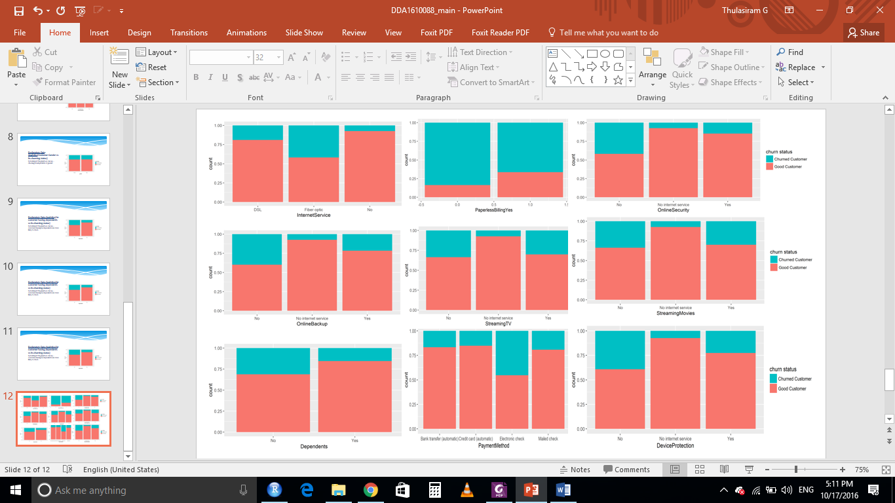
Exploratory Data Analytics - Graph
Continued…

Slide 7
Exploratory Data Analytics - Insights
Some of insights derived from Prior Slides
Monthly plan customer the most likely to churn
Person having no dependents are churning more
No device protecting - more likely to churn
Gender has no impact on churning
Whoever using fibber optic internet services, they are more likely to churn
Multiple lines have no impact on churning
Person having no online backup is more likely to churn
Person using no online security is more likely to churn
Unmarried people are churning more as compare to married people
Phone services have no impact on churning
Senior Citizens are churning more
No tech support, Streaming movies, Streaming TV more likely to churn
No internet services - Less likely to churn

Slide 8
Model Building
KNN
Naïve Bayes
Logistic Regression
SVM

Slide 9
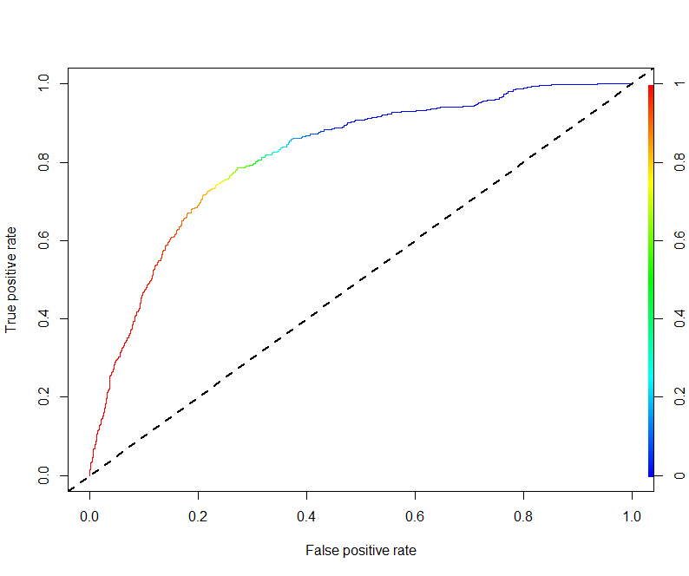
KNN
Model Development Steps –
Categorical variables were converted to numeric by creating dummy variables
Converted the data type of response variable to factor
Scaled the numerical variables
Split the data into train and test data in the proportion of 70 and 30 percent ensuring equal proportion of class labels in both train and test data set
A grid of 1 to 50 were used to find the optimal value of k.
Repeated cross validation were performed with 10 folds and 15 repetitions
After repeated cross validation, model suggested 31 as optimal value of K
Model Result Summary -
This model has good accuracy and substantial area is being covered in ROC
But as sensitivity is low which is of utmost importance considering sensitivity indicates percentage of correctly identified churned customers and its value is not that good so will not considering this model for this problem
Model Result Summary
Threshold value | Values (Numeric)
Overall Accuracy | 79.57 %
Sensitivity | 55.79%
Specificity | 88.1%
AUC | 83.33%
ROC Curve

Slide 10
Naïve Bayes
Model development Steps
Split the data into train and test data in the proportion of 70 and 30 percent ensuring equal proportion of class labels in both train and test data set
Neither scaling of numerical variables nor creation of dummy variable for categorical attributes were performed
Train data set was used to create model
Test data was used to evaluate the model
Model Summary
This model has good accuracy and substantial area is being covered in ROC
Sensitivity is high which is of utmost importance considering sensitivity indicates percentage of correctly identified churned customers and its value is comparatively good as compare to specificity so will be considering this model for this problem
Model Result Summary
Threshold value | Values (Numeric)
Overall Accuracy | 72.59%
Sensitivity | 79.47%
Specificity | 69.87%
AUC | 81.61
ROC Curve

Slide 11
Logistic Regression
Model development -
Categorical variables were converted to numeric by creating dummy variables
Converted the data type of response variable to factor
Scaled the numerical variables
Split the data into train and test data in the proportion of 70 and 30 percent ensuring equal proportion of class labels in both train and test data set
Initially a model was built with all the variables
Then using stepwise method all insignificant variables were removed.
Variables were checked for multicollinearity
Variables with high VIF and less significance was removed
KS statistics and C-statistic were computed for train and test dataset
Model Summary
This model has good accuracy and substantial area is being covered in ROC
Sensitivity is high which is of utmost importance considering sensitivity indicates percentage of correctly identified churned customers and its value is comparatively good as compare to specificity so will be considering this model for this problem
Final model metrics | Values (Numeric)
AIC value | 4178.4
Null deviance | 5699.5
Residual Deviance | 4154.4
Train Dataset |  | Test Dataset
C-statistic | 84 % | C-statistic | 84.6 %
KS-statistic | 52 % | KS-statistic | 55 %
Model Evaluation (write Accept or Reject) |  | Accepted
Threshold value (0.3) | Values (Numeric)
Overall Accuracy | 76.97%
Sensitivity | 78.25%
Specificity | 76.50%
AUC | 84.62%

Slide 12
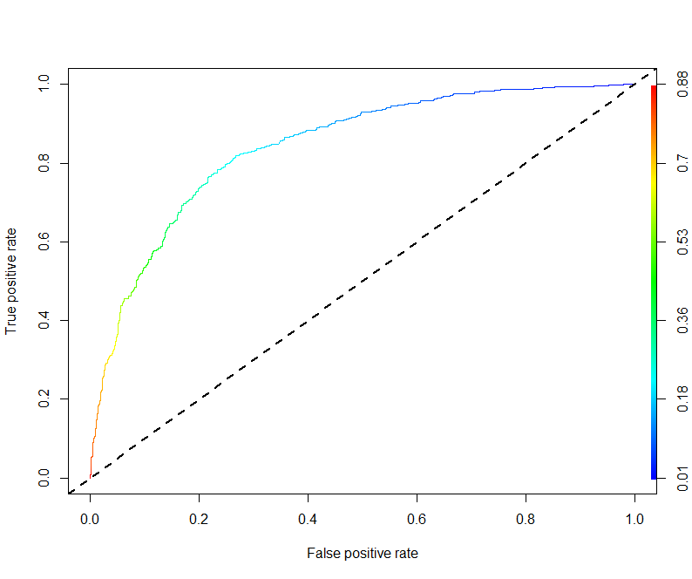
SVM
Model development
Categorical variables were converted to numeric by creating dummy variables
Converted the data type of response variable to factor
Scaled the numerical variables
Split the data into train and test data in the proportion of 70 and 30 percent ensuring equal proportion of class labels in both train and test data set
Linear kernel is selected and model is tuned with various cost parameters
The best cost value is taken and model is created from it
Various evaluation metrics like accuracy, sensitivity and specificity for the model is checked
Then radial kernel is selected and model is tuned with various parameters of cost and sigma
The best cost and sigma values are taken and model was created using it
Model Summary
This model has good accuracy and substantial area is being covered in ROC
But as sensitivity is low which is of utmost importance considering sensitivity indicates percentage of correctly identified churned customers and its value is not that good so will not considering this model for this problem
Model Result Summary
Threshold value | Values (Numeric)
Overall Accuracy | 80.33%
Sensitivity | 53.48%
Specificity | 90.06%
AUC | 84.26
ROC Curve

