Slide 1
Project Proposal
Microcontroller and
Microprocessor Laboratory
Presented By
Md. Sharia Sarker Canon (011172009)
Mueen Ishraq Ananata (0112230155)
Md. Nurul Alam Siddiqei Ador (0112230170)
Md. Ali Arman Jayed (0112231018)
Nahin Intesher (0112230169)

Slide 2
Project Proposal

Slide 3

Project Proposal
SecurePlus
Advanced Smart Home Automation System

Slide 4
Features

Slide 5



Features
Security
Features
Safety
Features
Other
Features

Slide 6
Security Features

Slide 7
Security Features
Stranger Mode
User can turn on or off Stranger Mode from mobile app. If Stranger Mode is turned on, no one can enter the house. If anyone try to enter house through main door while Stranger Mode is on:
House owner will be notified through mobile app.
Image of stranger will be send to the house owner.
If anyone try to break the door, initially he will be get warning. If he do not stop trying, he will be get electric shock.

Slide 8
Security Features
Stranger Mode
If someone anyhow go inside the house, gas can be deployed in specific rooms (Because children or old people can stay in any room)
If someone anyhow go inside the house, it will also call neighbor and nearby police station.
Face Detection
House owner can set face detection in the main door, which can be used instead of traditional locking system

Slide 9
Safety Features

Slide 10
Safety Features
Smart Alert System
If gas leak, fire or earthquake is detected, it will be start alerting and notification will be send to the user.
Smart Emergency Exit
If fire or earthquake is detected, emergency exit door will be opened and a ladder/stair will be opened to going there.

Slide 11
Other Features

Slide 12
Other Features
Smart Car Parking System
There will be a smart and secure car parking system, which can be controlled through mobile app.
Smart Cloth Drying System
If rain is detected, than cloth will be shifted under shelter and cloth will be shift outside after rain is and
Automatic
Lighting System
If user on Automatic Lighting System from mobile app, it will turn on or of lights based on outside environment.

Slide 13
Required Components

Slide 14
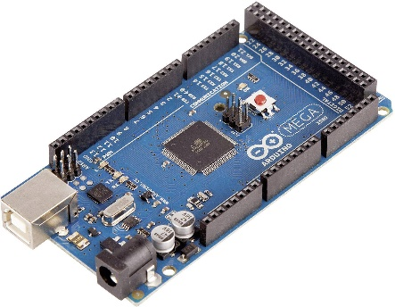
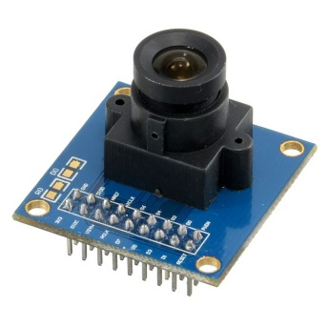
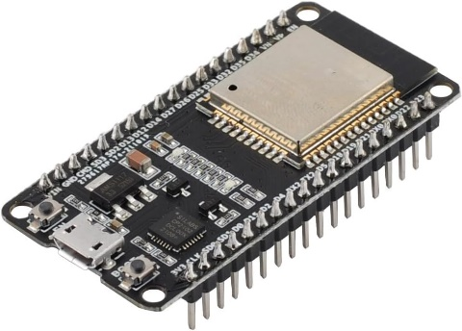
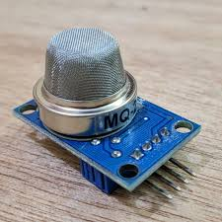
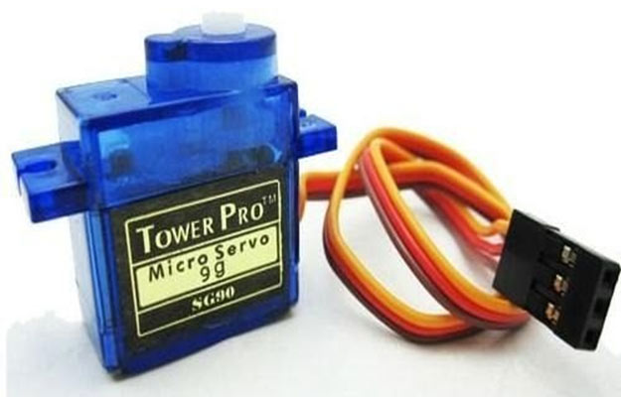
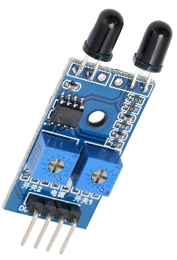
Required Components
Arduino Mega
SONAR (Ultra Sonic) Sensor
Gas Sensor
Fire Sensor
Servo Motor
OV7670 Camera Module
ESP32
Resistance
Rain Sensor Module
LDR Sensor
LED Light
Buzzer

Slide 15
Project Diagram

Slide 16
Project Diagram
Room 1
Room 2
Parking Slot
Top
View
Internal Door
Cloth Drying Section
Room 3
Main Door

Slide 17
Thanks for
Listening Us
Any Query?

