Slide 1
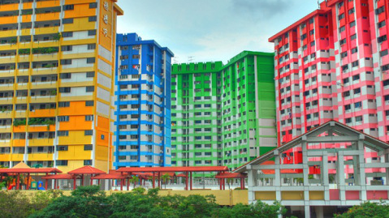
What factors affect HDB resale prices?
Predicting HDB resale prices with machine learning methods
By Nurul Anis

Slide 2
Data Cleaning
AIM: Combine the 5 .csv files provided into one cleaned dataset
STEPS TAKEN:
Removal of duplicate data
Checking and removal of data will null entries
Added years of remaining lease to all 5 data frames
Added average distance from every street to nearest MRT station
Instead of using storey range, midpoint of the storey range was used
Concatenated all 5 data frames together
Total number of observations after cleaning: 832,311

Slide 3
Average Price of Resale Flats by Flat Type
Flat Type | Average Resale Price
1-room | $63,684.43
2-room | $130,476.33
3-room | $187,632.49
4-room | $298,258.71
5-room | $400,232.79
Executive | $486,215.99
Multi-Gen | $507,678.81
Overall | $295,176.80
Executive
Multi-Gen

Slide 4
Average Resale Price against Floor/Storey

Slide 5
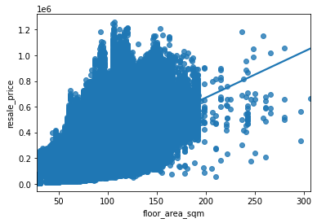
Resale price against flat size (in square metres)
Trendline has a positive slope

Slide 6
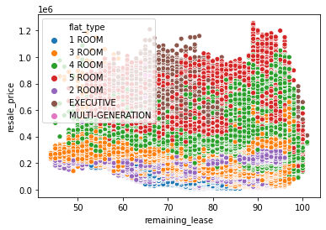
Resale price against years of remaining lease
No clear trend for remaining lease

Slide 7
Overview of data
Maximum price sold for a resale flat: $1,258,000
Minimum price sold for a resale flat: $5,000
Average price of a resale flat: $295,176.80

Slide 8
Setting up for machine learning:
1st model: storey range and flat type separated into dummy columns
2nd model: midpoint of the storey range was used as numeric variable
For the training and validation of models:
Training Set (70%) | Test Set (30%)
582,617 observations | 249,694 observations

Slide 9

ML1: Linear Regression
Root mean squared error: 99250.11
R-squared: 0.5589
 | Actual | Predicted
8383 | 102000.0 | 236097.504180
365038 | 312000.0 | 372435.926998
526953 | 178100.0 | 254895.707922
717271 | 475000.0 | 372647.800049
830146 | 700000.0 | 521418.450657

Slide 10
ML1: Linear Regression -- features and their coefficients
 | Feature | Coefficients
0 | Floor Area (in sqm) | 1739.869686
1 | Remaining lease years | -5036.774219
2 | Dist. to nearest MRT | -10848.898444
3 | 2-room flat | 30280.817780
4 | 3-room flat | 67990.757662
5 | 4-room flat | 165264.151223
6 | 5-room flat | 222911.769907
7 | Executive flat | 279336.598277
8 | Multi-generation flat | 274483.901732
9 | Storey 3 | 120647.154475
10 | Storey 5 | 6674.079496
11 | Storey 8 | 13293.053415
12 | Storey 11 | 16237.659661
13 | Storey 13 | 157075.235687
14 | Storey 14 | 51192.604237
 | Feature | Coefficients
15 | Storey 17 | 88028.766160
16 | Storey 18 | 228485.966362
17 | Storey 20 | 102394.538821
18 | Storey 23 | 125534.537426
19 | Storey 26 | 193492.443920
20 | Storey 28 | 452491.321604
21 | Storey 29 | 376571.700537
22 | Storey 32 | 543855.695885
23 | Storey 33 | 483445.865721
24 | Storey 35 | 548713.664611
25 | Storey 38 | 565462.963399
26 | Storey 41 | 597944.935157
27 | Storey 44 | 769913.407297
28 | Storey 47 | 747533.759386
29 | Storey 50 | 789565.350701
Notes:
- difficult to interpret

Slide 11
ML1: Linear Regression (2nd model)
 | Feature | Coefficients
0 | Floor Area (in sqm) | 1619.474984
1 | Remaining lease years | -5007.775218
2 | Dist. to nearest MRT | -12801.613741
3 | Midpoint of storey range | 5520.060686
4 | 2-room | 34387.279854
5 | 3-room | 74099.088714
6 | 4-room | 176236.387608
7 | 5-room | 238160.327976
8 | Executive flat | 295312.749901
9 | Multi-generation flat | 289306.675914
Root mean squared error: 101678.39
R-squared: 0.5370

Slide 12
ML2: XGBoost
Background:
made up of smaller regression trees, which combine to make the XGBoost model
has a prediction error multiple times smaller than random forest
Root mean squared error (1st model): 44555.79
 | Actual | Predicted
140855 | 280000.0 | 215235.312500
639182 | 403000.0 | 376263.406250
21695 | 65000.0 | 144094.500000
472208 | 164000.0 | 166815.625000
163766 | 294000.0 | 261164.734375

Slide 13
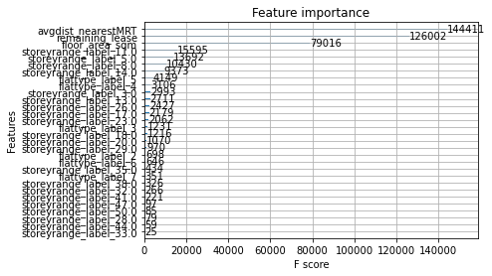
ML2: XGBoost (1st model) Feature Importance
3 most important features:
Distance to nearest MRT station
Years of remaining lease
Floor area

Slide 14
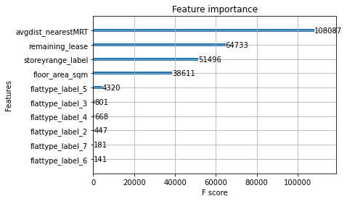
ML2: XGBoost (2nd model)
Root mean squared error (2nd model): 50839.25
3 most important features:
Distance to nearest MRT station
Years of remaining lease
Storey/floor of flat

Slide 15
ML3: K-Nearest Neighbours Regression
Sample Observations | Actual | Predicted
641888 | 675000.0 | 600836.936470
222518 | 380000.0 | 333666.666667
237065 | 118300.0 | 118000.000000
109199 | 510000.0 | 377000.000000
50030 | 165000.0 | 297070.616898
626140 | 313000.0 | 307666.666667
460492 | 170000.0 | 181375.000000
44497 | 182000.0 | 147666.666667
699668 | 448000.0 | 420000.000000
157749 | 235000.0 | 228500.000000
Background:
based on theory that observations with similar features will return similar value in dependent variable
Root mean squared error: 64953.35

Slide 16
Conclusion
 | Linear Regression | XGBoost | K-Nearest Neighbours
Root Mean Squared Error | 99250.11 | 44555.79 | 64953.35
MISSION: Find the drivers of HDB Resale Prices
CONCLUSION: Using XGBoost model (2nd model), the drivers of HDB resale prices are…
Distance to nearest MRT station
Years of remaining lease
Storey/floor of flat
Floor area in square metres
Flat type (e.g 2-room, 3-room, etc.)
Notes:
- I chose the 2nd XGBoost model based on its interpretability. In the feature importance analysis, the 1st XGBoost model’s variables were jumbled up after the first three most important features

Slide 17
Improvements for future models
Inclusion of more data regarding surrounding area:
distance from Central Business District
distance to malls, hospitals, primary schools
prestigious schools nearby?
Percentile of the storey of the flats in their respective blocks used as a numeric variable (e.g. highest floor in the block receives a score of 100%, middle floors receive score of 50%)

Slide 18
Thank you!

