Slide 1

PRODG: Practical Overlapping Community
Detection in Weighted Graphs using Deep GCNs
Md Nurul Muttakin
Muhammad Anwarul Azim
Md. Saidur Rahman
Graph Drawing & Information Visualization Lab
Department of Computer Science and Engineering
Bangladesh University of Engineering and Technology
Dhaka, Bangladesh
Md Iqbal Hossain
Research, Innovation & Impact (RII)
The University of Arizona
Tucson, Arizona, USA

Slide 2
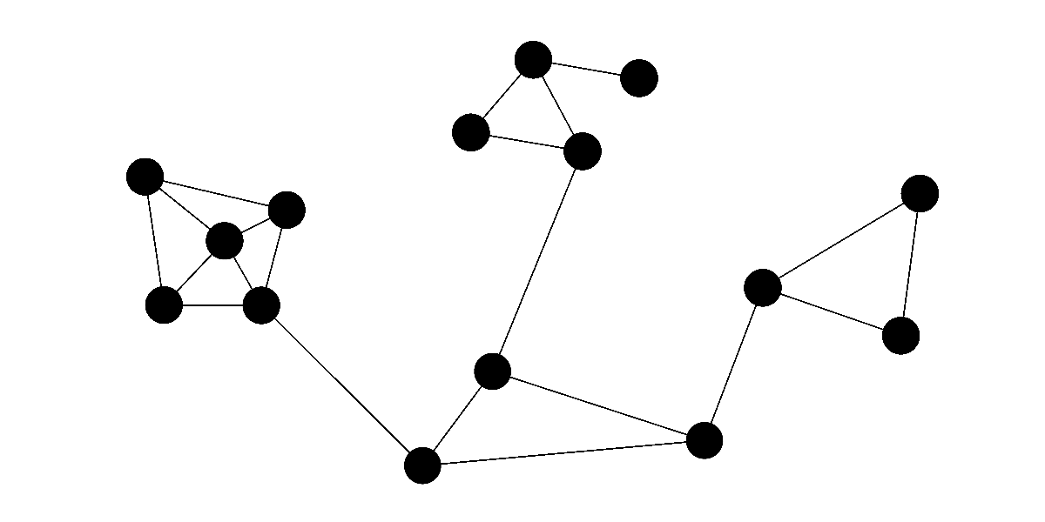
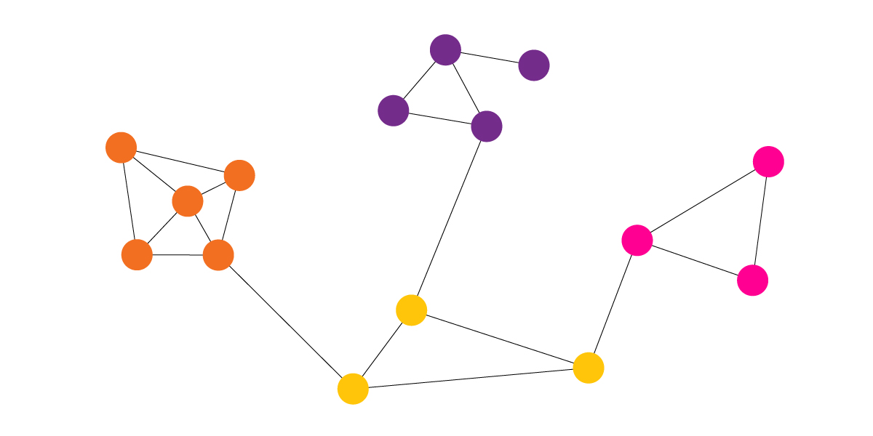
Background
Real world data can be modeled using graph
A community is a subgraph with a higher edge density within its members
4 communities
Each belongs to one community

Slide 3
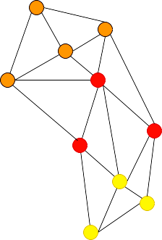
Background
Communities may be overlapping
Nodes belong to multiple communities
E.g. Mathematician or computer scientist or both in a Citation Network
How to extract such information?
How many communities are there?
Which node belongs to which community?
5
⬤
⬤

Slide 4
Background
Nodes | C₁ | C₂ | … | C_{c}
n₁ | ✓ | X | … | ✓
n₂ | X | ✓ | … | X
… | … | … | … | …
n_{n} | X | X |  | ✓
Nodes and
Weighted Edges
Overlapping Community
Detector
Weighted graph!
A^{n x n} : Adjacency Matrix
X ^{n x d}: Attribute Matrix
Deterministic Algorithm
Neural Network
Community Affiliation matrix,
F ^{n x c}

Slide 5

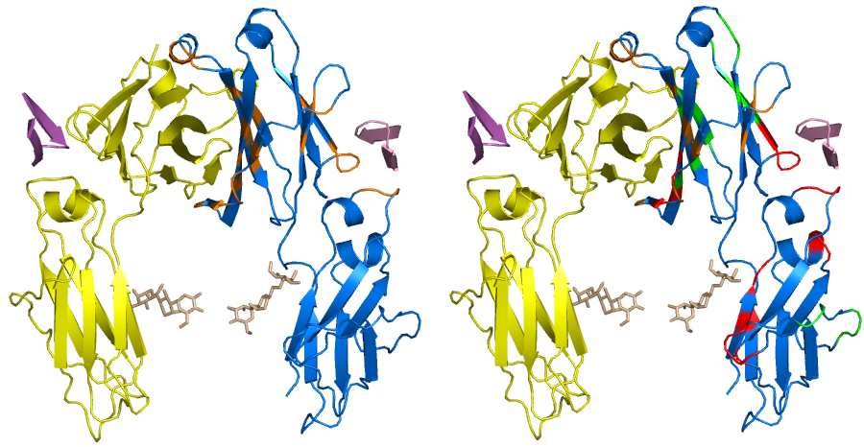
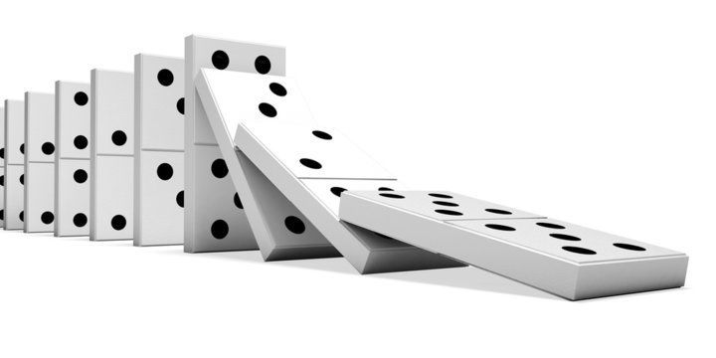
Why Detecting Communities?
Recommendation Systems
(ads, news, videos)
Protein Function Discovery
Systemic Risk Modeling
Many algorithms for community detection
Very few considered overlapping communities
Even fewer for weighted graphs

Slide 6
Related Works
Deterministic Algorithms:
DPCLUS
Amin et al., 2006
IPCA
Li et al., 2008
DCS
Muhammad et al., 2020
Designed exclusively for PPI network
Community diameter is limited to two (one hop neighbors)

Slide 7
Related Works
Neural Networks
DANMF
Ye et al., 2018
NOCD
Shchur and Günnemann, 2018
DynaResGCN
Muttakin et al., 2022
Better performance than deterministic algorithm
Number of community must be known before running!

Slide 8
Comparison
Algorithm/ Model | Neural Network (better performance) | Deep Model (better performance) | Unsupervised (practical) | Edge Weight
DynaResGCN | ✔️ | ✔️ | ❌ | ❌
NOCD | ✔️ | ❌ | ❌ | ❌
DANMF | ✔️ | ❌ | ❌ | ✔️
DCS | ❌ | ❌ | ✔️ | ✔️
DPCLUS | ❌ | ❌ | ✔️ | ✔️
IPCA | ❌ | ❌ | ✔️ | ✔️

Slide 9
A Prior Experiment
How different model leverages weights
Dataset | DANMF Weighted | DANMF Unweighted | DCS Weighted | DCS Unweighted | DPCLUS Weighted | DPCLUS Unweighted | IPCA Weighted | IPCA Unweighted
Facebook 348 | 16.4 | 19.4 | 8.2 | 8.2 | 25.9 | 25.9 | 21.84 | 21.84
Facebook 414 | 38.3 | 41.1 | 32.4 | 32.4 | 28.6 | 28.6 | 30.60 | 30.60
Facebook 686 | 12.14 | 10.99 | 6.0 | 6.0 | 11.22 | 11.22 | 13.77 | 13.77
Facebook 698 | 31.01 | 27.83 | 26.7 | 26.7 | 35.8 | 35.8 | 49.2 | 49.2
Facebook 1684 | 20.18 | 20.50 | 27.24 | 27.24 | 8.35 | 8.35 | 16.81 | 16.81
Facebook 1912 | 21.2 | 20.9 | 8.9 | 8.9 | 19.3 | 19.3 | 26.71 | 26.71
Performance comparison in NMI (higher the better)

Slide 10
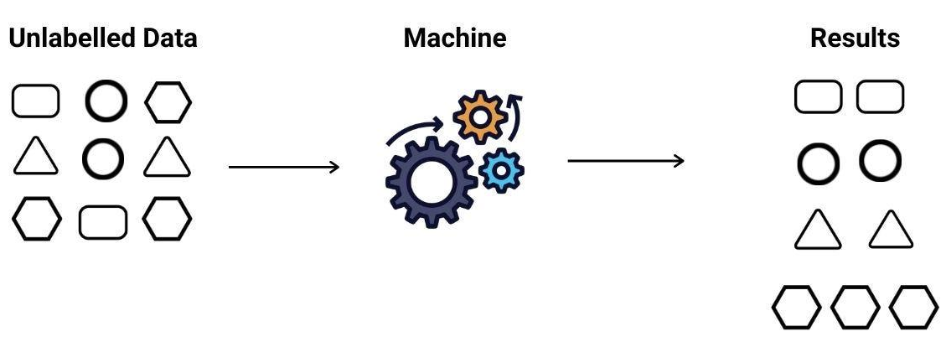
Objectives
Finding an approach that-
w
✶✶✶✶
u
v
Leverages
Edge Weights
Fully
Unsupervised
Performs
Better

Slide 11
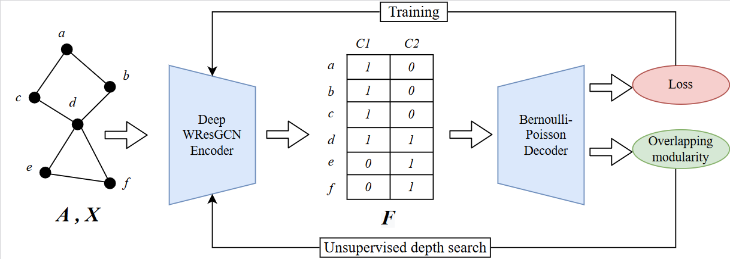
Our Method

Slide 12
Our Methods
Encoder
A Graph Neural Network with,
Graph Convolution
Weighted Dilated Aggregation
Residual Connection
WResGCN

Slide 13
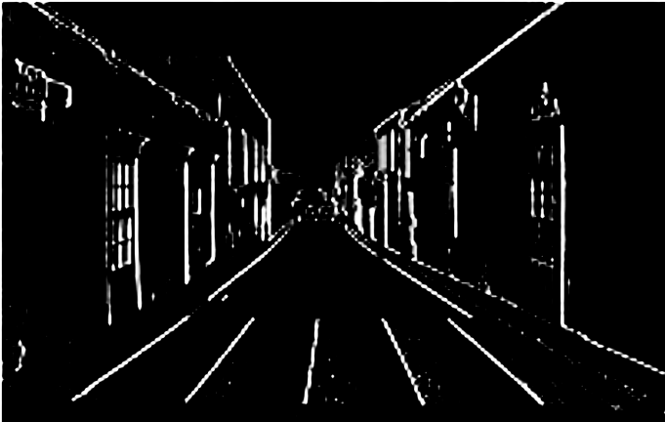

WResGCN Encoder
Convolution
Convolution is for extracting features (transforming matrix)
Straightforward for image
1 | 0 | -1
1 | 0 | -1
1 | 0 | -1
Vertical Edges

Slide 14


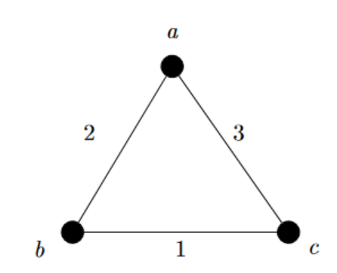
WResGCN Encoder
Convolution
 | a | b | c
a | 0 | 2 | 3
b | 2 | 0 | 1
c | 3 | 1 | 0
 | a | b | c
b | 2 | 0 | 3
a | 0 | 2 | 3
c | 3 | 1 | 0
Graphs are Permutation Invariant

Slide 15
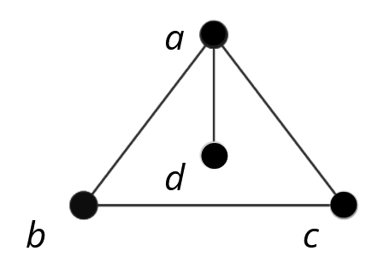
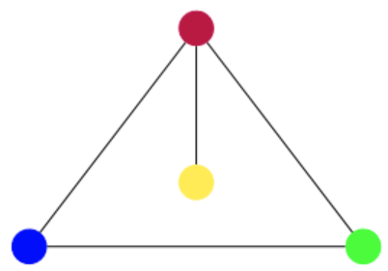
WResGCN Encoder
Graph Convolution
[ ⬤ , ⬤ , ⬤]
[ ⬤ , ⬤]
[ ⬤ , ⬤ ]
X ^{n x d} : Attribute matrix
Every node has a
Feature vector
Color as an Analogy
Message passing
All vertex sends its vector/color
to neighbors
How to combine?

Slide 16
WResGCN Encoder
Graph Convolution
Message Aggregation
Commutative Operation
(a+b = b+a)
[sum, product, max, avg, etc.]
[ ⬤ + ⬤ + ⬤] = ⬤
[ ⬤ ]
[ ⬤ + ⬤] = ⬤
[ ⬤ + ⬤ ]= ⬤

Slide 17
WResGCN Encoder
Graph Convolution
Update attributes
“Adjusting” aggregated feature
With own feature
(current layer)
Weighted Commutative operation
e.g. wx_{i} + (1-w)x_{j}
w is the weight/ parameter of that layer (eg. 0.8)
[⬤]
⬤
0.8⬤ + 0.2⬤ = ⬤
0.8⬤ + 0.2⬤ = ⬤
0.8⬤ + 0.2⬤ = ⬤
0.8⬤ + 0.2⬤ = ⬤
⬤
[ ⬤ ]
⬤
⬤
[⬤]
[⬤]
w Will be tuned at backpropagation

Slide 18
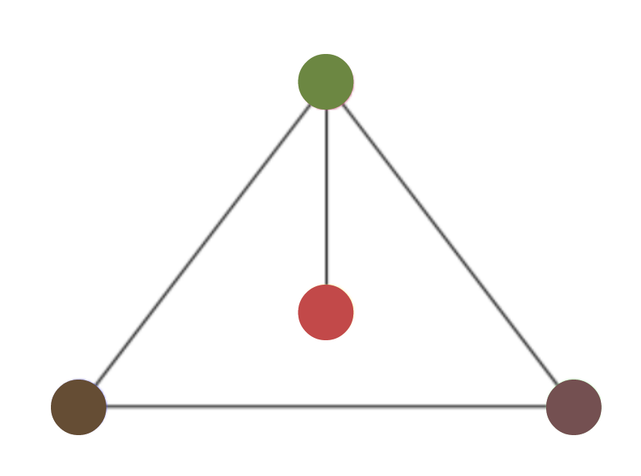
WResGCN Encoder
GCN
1st Layer
2nd Layer
…
Output → F
Number of Layers is the depth

Slide 19
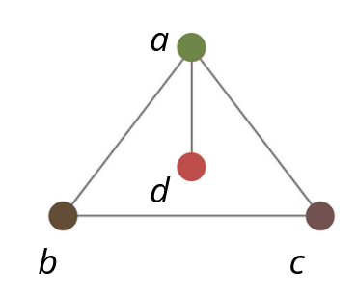
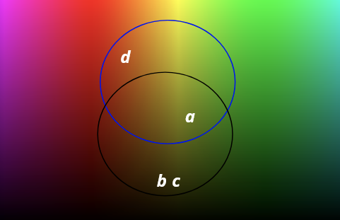
WResGCN Encoder
Getting Output
 | C₁ | C₂
a | 1 | 1
b | 0 | 1
c | 0 | 1
d | 1 | 0
d
a
b
c
Is it good?
Decoder decides

Slide 20
Decoder
 | C₁ | C₂
a | 1 | 1
b | 0 | 1
c | 0 | 1
d | 1 | 0
p_{ab}= 1- e
0.2
0.63
0.63
-(F_{a}F_{b}^{T})
0.63
0.86
0.007

Slide 21
How many layers?
⬤
⬤
⬤
⬤
1 layer
2 communities
3 layers
1 community
Number of community ≤ Dimension of the attribute vector
Increasing layers refines community affiliation

Slide 22
Optimising Encoder
Deeper Network
Real world network are complex
Deeper = More Powerful
Vanishing/ Exploding Gradient
Can’t learn
Oversmoothing
Forgot what learned

Slide 23
Optimising Encoder
Vanishing/ Exploding Gradient
Gradient: How much weights to be changed w.r.t loss
Layer 1
Layer 2
Layer 3
Layer 4
Residual Connection

Slide 24
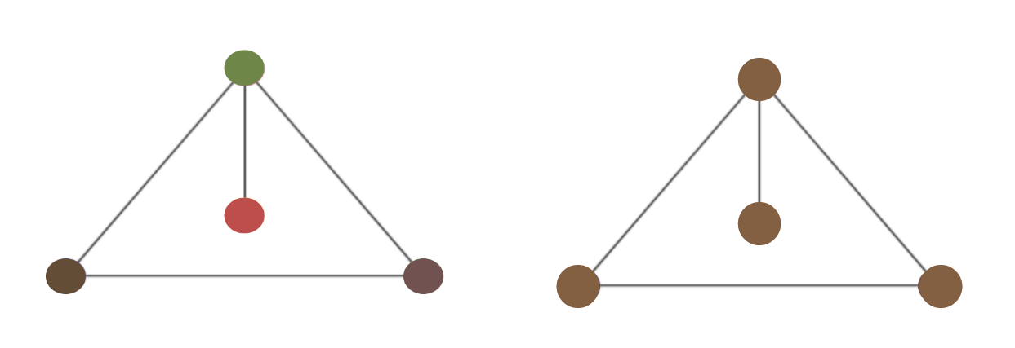
Optimising Encoder
Oversmoothing
Too many layers = Same information going to everyone
Increase variance → Add randomness
Dilated aggregation
Sufficient variance
no variance = worst

Slide 25
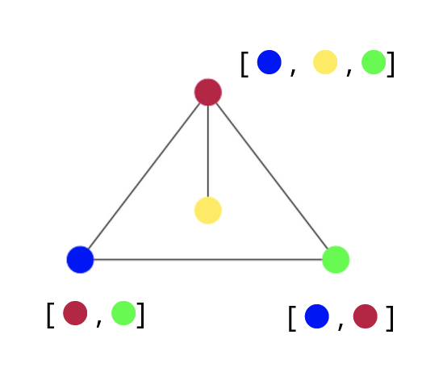
Optimising Encoder
Dilated Aggregation
Message Passing:
Messages were allowed
Only from first hop neighbors
Let’s allow some from the second hop
Randomly!

Slide 26
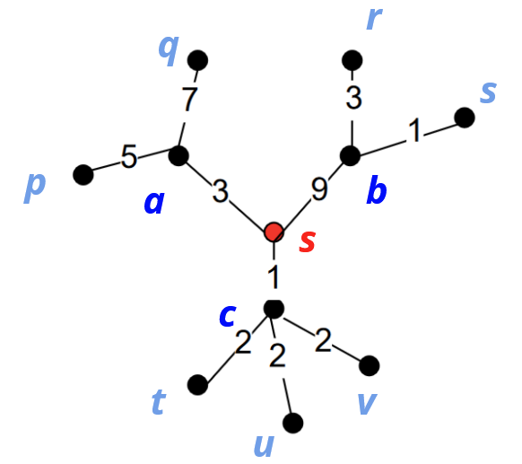
Dilated Aggregation
N(s) = {a, b, c}
For each neighbor, select the 2nd hop neighbor with the maximum weight
a → q, b → r, c → t
Augment them in N(s) with edge of same the weight
Delete 50% randomly
c → t
WResGCN
c → {t, u, v}
RWResGCN

Slide 27
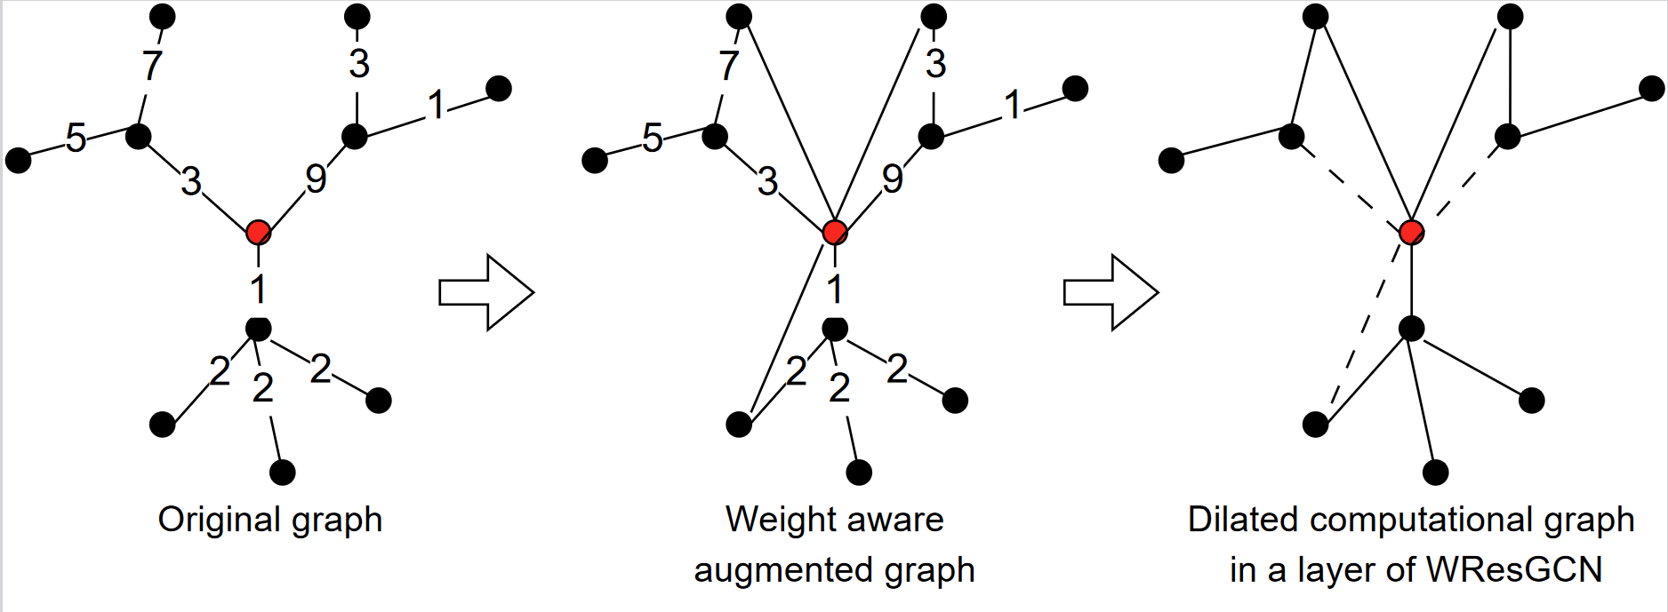
Dilated Aggregation

Slide 28
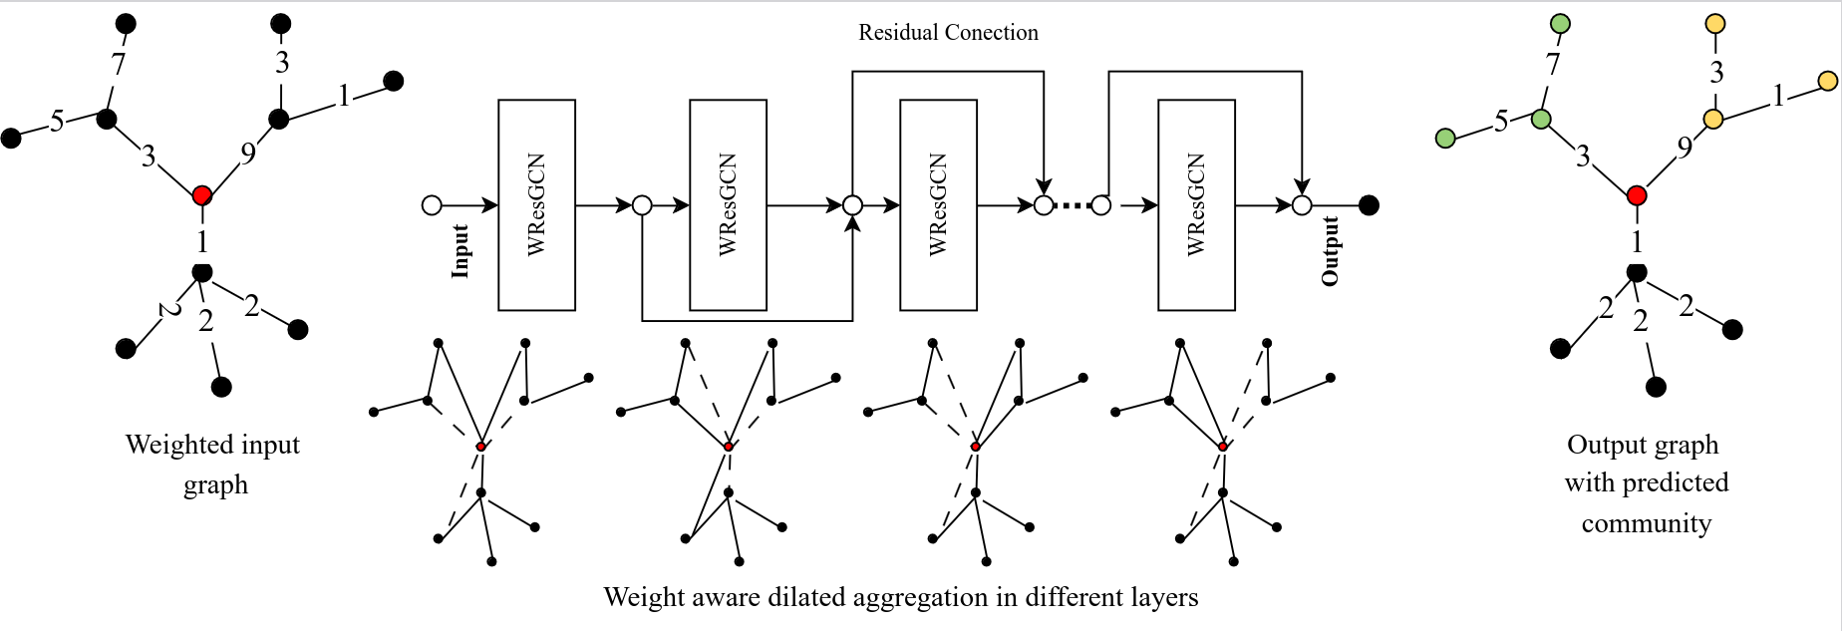
PRODG
How many layers?

Slide 29
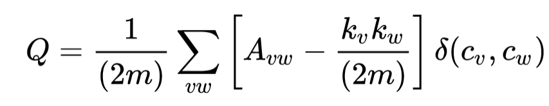
Network Depth
Modularity
Measures the “quality” of community assignment
No ground truth needed
Ranges between [-0.5, 1]
Higher the better
a
C₁ = {a}
C₂ = {b}
C₃ = {c}
C₄ = {d}
C₁ = {a, b, c, d}
C₁ = {a, d}
C₂ = {a, b. c}
d
b
c
0.125
0.14
0.21

Slide 30
Unsupervised Model Depth Search
Modularity Based Depth Search
Candidate Depth = [1,2,3]
0.13
Model 1
L₁
Selected for
Training
[Decode+
Loss Calculation +
Backpropagation]
Model 2
L₁
L₂
0.21
Model 3
L₁
L₂
L₃
0.14

Slide 31
Experiment
Dataset
We needed weighted graph with ground truth
No dataset (except PPI) met both criterion
Facebook Ego Network: Six labelled but unweighted graphs (Mcauley et al., 2014)
We added weight using-
Intuition: Weight is correlated to community belonging

Slide 32
Experiment
Dataset
Graph | Nodes | Edges | Comment
Facebook 698 | 66 | 540 | Small
Facebook 414 | 159 | 3386 | Small
Facebook 686 | 170 | 3312 | Small
Facebook 348 | 227 | 6384 | Small
Facebook 1684 | 792 | 28048 | Large
Facebook 1912 | 755 | 60050 | Large

Slide 33
Discussion
Evaluation Metrics
NMI: Normalized Mutual Information
0 = No community affiliation is correct
1= Every community affiliation is correct
Others
50 independent runs, 500 epochs with early stopping

Slide 34
Results
Performance in NMI (without node attributes)
Dataset | DCS | DPCLUS | IPCA | DANMF | NOCD | DynaResGCN | WResGCN | RWResGCN
fb–698 | 26.7 | 35.8 | 49.2 | 31.01 | 49.3 | 49.8 | 49.0 | 49.23
fb-414 | 32.4 | 28.6 | 30.60 | 38.3 | 56.3 | 56.0 | 56.82 | 56.7
fb-686 | 6.0 | 11.22 | 13.77 | 12.14 | 20.6 | 18.8 | 20.35 | 19.10
fb-348 | 8.2 | 25.9 | 21.84 | 16.4 | 34.7 | 32.63 | 34.66 | 35.4
fb-1684 | 27.24 | 8.35 | 16.81 | 20.18 | 34.7 | 42.2 | 47.08 | 44.70
fb-1912 | 8.9 | 19.3 | 26.71 | 21.2 | 36.8 | 38.0 | 39.25 | 39.34

Slide 35
Results
Performance in NMI (with node attributes)
Dataset | DCS | DPCLUS | IPCA | DANMF | NOCD | DynaResGCN | WResGCN | RWResGCN
fb-698 | 26.7 | 35.8 | 49.2 | 31.01 | 41.7 | 47.31 | 47.5 | 46.7
fb-414 | 32.4 | 28.6 | 30.60 | 38.3 | 59.8 | 54.1 | 58.50 | 58.2
fb-686 | 6.0 | 11.22 | 13.77 | 12.14 | 21.0 | 19.13 | 20.57 | 21.20
fb-348 | 8.2 | 25.9 | 21.84 | 16.4 | 36.4 | 33.5 | 34.85 | 36.0
fb-1684 | 27.24 | 8.35 | 16.81 | 20.18 | 26.1 | 38.2 | 48.0 | 45.10
fb-1912 | 8.9 | 19.3 | 26.71 | 21.2 | 35.6 | 38.40 | 38.9 | 40.0

Slide 36
Observations
Our approach performs mostly better than previous ones
Performance gain is significantly better in larger graphs
Node attributes adds small benefits

Slide 37
Future works
Designing weight aware decoder
Investigate the impact on the real-world weighted graphs with reliable ground truth
Develop theoretical foundation of this method

Slide 38
References
F. Ye, C. Chen, and Z. Zheng, “Deep autoencoder-like nonnegative matrix factorization for community detection,” in Proceedings of the 27th ACM international conference on information and knowledge management, 2018, pp. 1393–1402.
M. Altaf-Ul-Amin, Y. Shinbo, K. Mihara, K. Kurokawa, and S. Kanaya, “Development and implementation of an algorithm for detection of protein complexes in large interaction networks,” BMC bioinformatics, vol. 7, no. 1, pp. 1–13, 2006.
Mcauley, J., & Leskovec, J. (2014). Discovering social circles in ego networks. ACM Transactions on Knowledge Discovery from Data (TKDD), 8(1), 1-28.
M. Li, J.-e. Chen, J.-x. Wang, B. Hu, and G. Chen, “Modifying the dpclus algorithm for identifying protein complexes based on new topological structures,” BMC bioinformatics, vol. 9, no. 1, pp. 1–16,
2008.
M. N. Muttakin, M. I. Hossain, and M. S. Rahman, “Overlapping community detection using dynamic dilated aggregation in deep residual gcn,” arXiv preprint arXiv:2210.11174, 2022
S. A. Muhammad and K. V. Laerhoven, “Dcs: Divide and conquer strategy for detecting overlapping communities in social graphs,”
O. Shchur and S. G ̈unnemann, “Overlapping community detection with graph neural networks,” Deep Learning on Graphs Workshop, KDD, 2019.

Slide 39
Thank You

