Slide 1

OUR-KAHOOT
Atentayev Abdulla
Abdykerov Aisultan
Momynkul Nurzhan
Seitkulov Nurdaulet
Sergey Grichik

Slide 2

PURPOSE OF APP
Our-kahoot is a game-based learning platform used to review students' knowledge, for formative assessment or as a break from traditional classroom activities.

Slide 3

GOALS
Using the knowledge of Flutter we got on course
Understanding the basics of mobile development
The goal of Kahoot! is to increase engagement, motivation, enjoyment, and concentration to improve learning performance and classroom dynamics.
Create an application that will help in our further development in this area

Slide 4
- Complete self-paced challenges
Create or edit your own kahoots in minutes
- Challenge your friends with kahoots you found or created
Host a kahoot live by sharing your screen to Apple TV or via video conferencing apps
Assess progress and results with reports
CONTENT OF APP

Slide 5
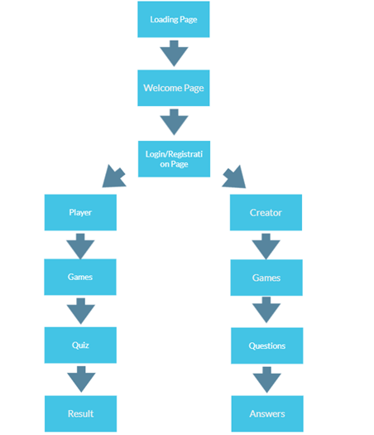

Slide 6
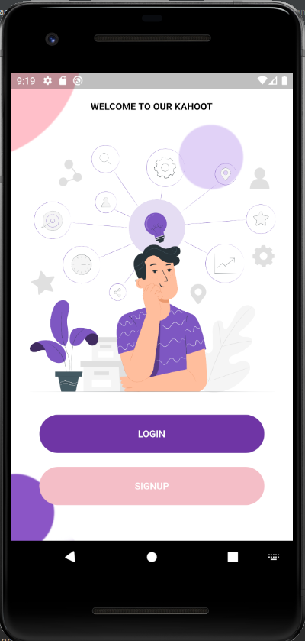
WELCOME PAGE
When user launches OUR-KAHOOT, user comes to the Welcome Page where you can log in or create an account

Slide 7
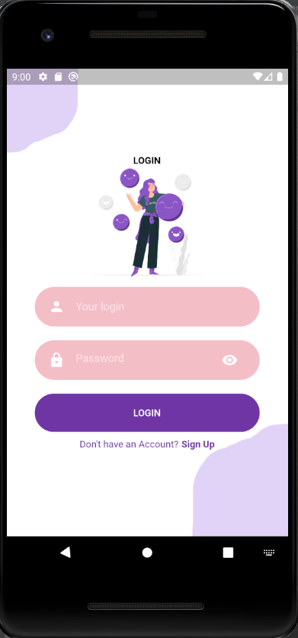
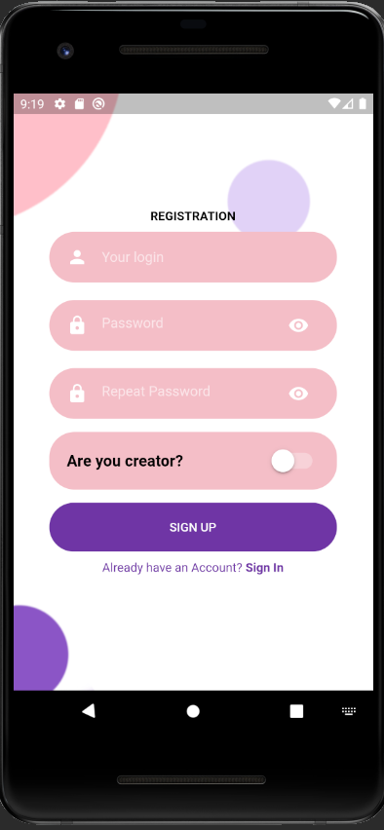
Registration and Login Page
Registration and Login page where new user can create an account or enter into account. Data is saved locally.

Slide 8
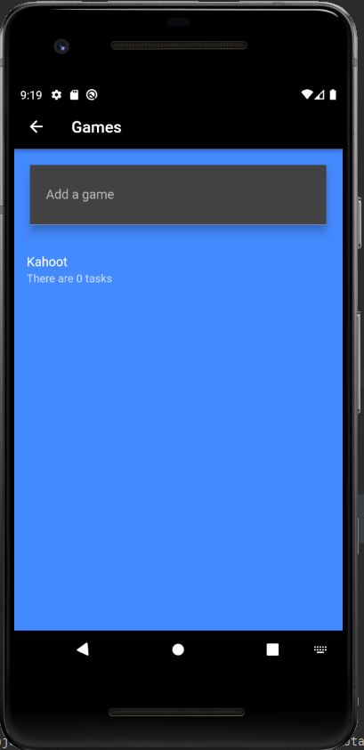
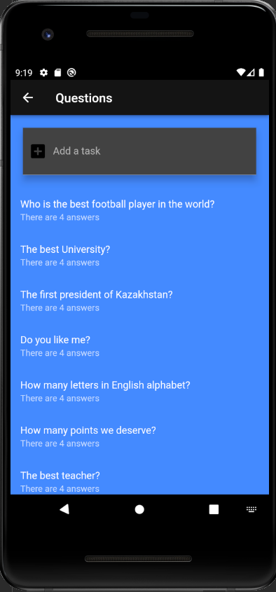
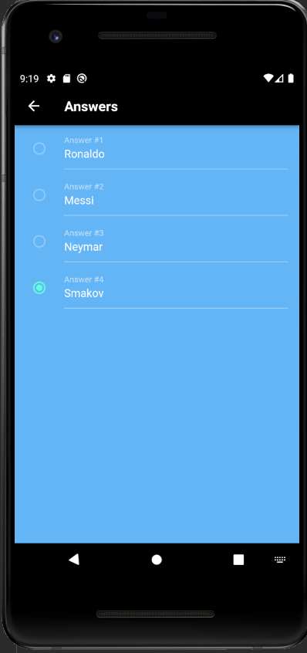
Quiz creation Page
After authorization as a quiz creator, the user can add a game in minutes for different topics, questions and answers to these questions.

Slide 9

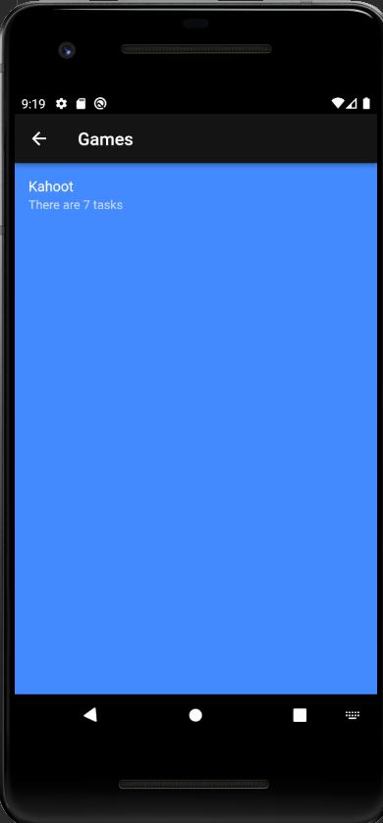
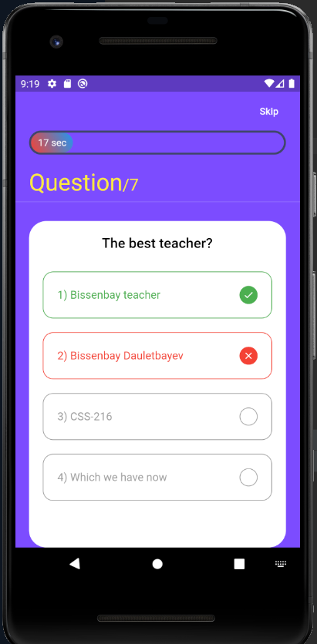
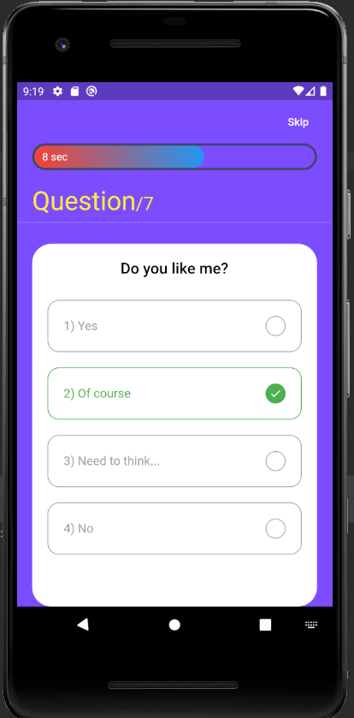
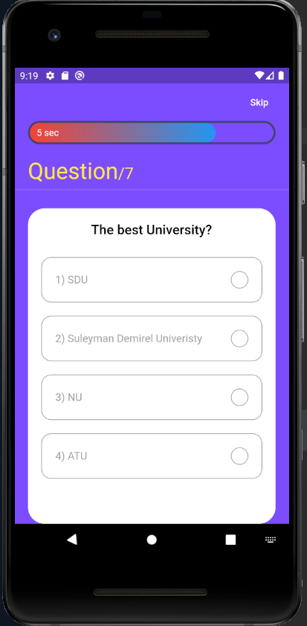
GAME USER SCREEN

Slide 10

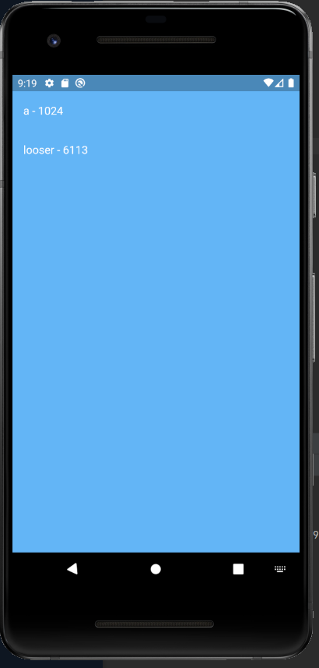
CONCLUSION
These were the options which are available for user as player and after finishing score is shown
To conclude, this app is very helpful for education goals or own purposes to examine the knowledge in some area

