Slide 1
ML Project
Aru Nazym nurzhaussyn

Slide 2

IDEA: Find a diagnosis by different symptoms

Slide 3
Our AIMs
TO LEARN A MACHINE TO SUGGEST THE RIGHT DIAGNOSIS BY LISTING SYMPTOMS.
TO SHOW THE RESULTS IN A SHORT TIME.
TO SHOW ANSWERS BY LITTLE AMOUNT OF INPUTS (SYMPTOMS).
HELP TO SOLVE THE PROBLEMS OF DOCTORS (SERVE MANY PATIENTS IN A DAY, TO SERVE THEM QUICKLY).
TO SAVE A TIME (PATIENTS MAY NOT COME TO THE HOSPITAL, TO THE DOCTOR TO FIND DIANOSIS OF THEIR PAIN).

Slide 4

TO LEARN A MACHINE TO SUGGEST THE RIGHT DIAGNOSIS BY LISTING SYMPTOMS.
FIELD OF USAGE: MEDICINE.

Slide 5
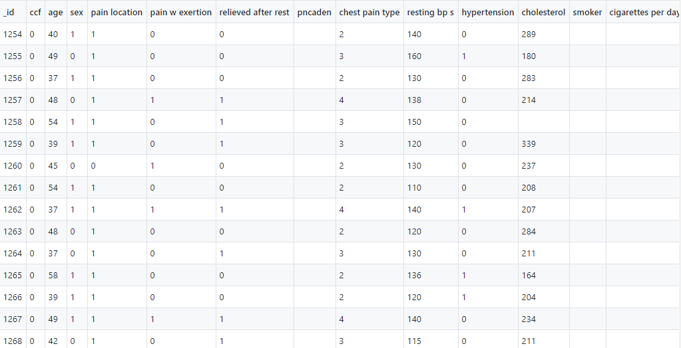

Slide 6

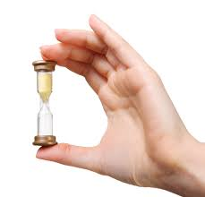
TO SHOW THE RESULTS IN A SHORT TIME

Slide 7

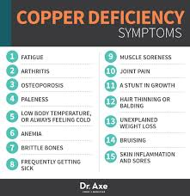
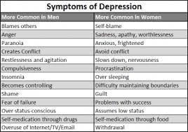

TO SHOW ANSWERS BY LITTLE AMOUNT OF INPUTS (SYMPTOMS).
For example: user enters fatigue, insomnia, pale skin, then output will be -> anemia

Slide 8



HELP TO SOLVE THE PROBLEMS OF DOCTORS (SERVE MANY PATIENTS IN A DAY, TO SERVE THEM QUICKLY).

Slide 9




TO SAVE A TIME (PATIENTS MAY NOT COME TO THE HOSPITAL, TO THE DOCTOR TO FIND DIANOSIS OF THEIR PAIN).

