Slide 1

CS1010: Programming Methodology
Week 2
Recap

Slide 2
Problem Solving Techniques
Problem: Find the range (i.e., max-min) of a list of numbers
Algorithm:
Input: Read in a list L of k numbers (ReadInput)
Compute:
Compute the maximum of a list L of k numbers (FindMax)
Compute the minimum of a list L of k numbers (???)
Compute the difference between the maximum and the minimum (Arithmetic computation)
Output: Print the range (PrintOutput)
1. Breaking it down!
2. Borrowing from what we know!
3. Wishful thinking!

Slide 3
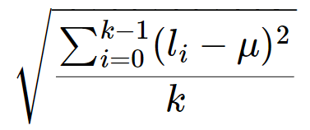
More examples
Problem: Find the standard deviation of a list L of k integers
result: sqrt ( mean ( square ( subtract (L, k, mean (L, k)), k), k)
Function calling other functions
If we treat this computation as a function stddev (L, k), it calls sqrt, mean, square and subtract to complete the computation.

Slide 4
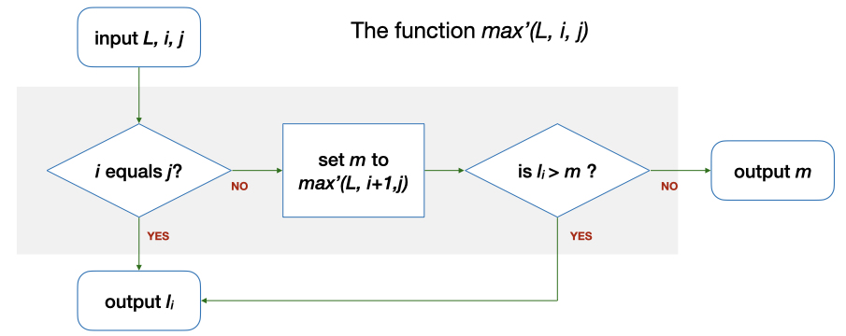
Even more examples
FindMax (Recursion): Use a function max' (L, i, j) which computes the maximum among L_{i}…L_{j} in a given list L
E.g., Let say L = {5, 9, 8, 1, 3, 2}, i = 0, j = 5. max' (L, 0, 5) = …
i (0) == j (5)? → No. m is max' (L, 1, 5) = 9 → l₀ (5) > m (9)? → No. The answer is m (9), which is the same as max (L, 6).

Slide 5
Ex #2: Yet another solution for FindMax
FindMax (Recursion): Use a function max'' (L, r) which computes the maximum among L₀…L_{r} in a given list L
E.g., Let say L = {5, 9, 8, 1, 3, 2}, r = 5. max'' (L, 5) = …
0 == r (5)? → No. m is max'' (L, 4) = 9 → l_{r} (2) > m (9)? → No. The answer is m (9), which is the same as max' (L, 0, 5)
r
max''(L, r)
r equals 0?
set m to
max''(L, r-1)
is l_{r} > m ?
l_{r}

Slide 6
Type declaration
Declare the type of a variable so that the computer can
Allocate the right number of bits in memory
Interpret the value accordingly
Examples of type declarations in C
int value; 2 or 4 bytes, signed
char ch; 1 byte
float ave; 4 bytes

Slide 7
A C program is just a collection of functions.
Remember to declare the types of your variables in a C program.

