Slide 1

CS1010: Programming Methodology
Welcome and Administrative Matters
Notes:
You may want to spend about 15 minutes on this, before moving on to the other PowerPoint files.

Slide 2




Slide 3
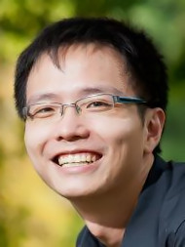



Lecturer
ZHAO Jin
(Just call me “Jin” for short)
zhaojin@comp.nus.edu.sg
Office: COM2-02-10
Consultations: by appointment
Hobbies: Music, exercise and games

Slide 4

Objectives
Learn about fundamental concepts of problem solving by computing and programming
Become proficient with C and associated programming tools (editors, debuggers)
The module is NOT just about C!
Notes:
Other language-independent and transferable skills: logical thinking, writing algorithms, test and debugging, etc.

Slide 5
Weekly Activities
Lectures:
2 hours / week on Mondays via Zoom
Tutorials / Labs
2 hours/week on Mondays and Wednesdays from Week 3 onwards.
Post-lecture Quizzes and Programming Assignments
Due on Fridays from Week 3 onwards.
Notes:
You may show them the dates of the tests on the CS1010 website.
Remember to remind students to inform us if they have clash with the test dates.
Especially for PE1 on 21 September 2013, Saturday as it falls within the official 1-week recess.

Slide 6
Tutorials / Labs
Discussion of problem sets and programming assignments
8~10 students per group
Face-to-face sessions conducted in programming labs by a student tutor
Contact Cui Wei (discw@nus.edu.sg) for registration issues.
Notes:
You may show them the dates of the tests on the CS1010 website.
Remember to remind students to inform us if they have clash with the test dates.
Especially for PE1 on 21 September 2013, Saturday as it falls within the official 1-week recess.

Slide 7
Important Dates
Midterm:
Monday, 1 March, 2021 (2 - 4pm)
Practical Exam 1:
Saturday, 6 March, 2021 (9am - 12noon)
Practical Exam 2:
Saturday, 10 April, 2021 (9am - 12noon)
Final Assessment:
Thursday, 29 April, 2021 (9 - 11am)
Please mark down the dates of all the tests!
Inform us of clashes in advance!
Notes:
You may show them the dates of the tests on the CS1010 website.
Remember to remind students to inform us if they have clash with the test dates.
Especially for PE1 on 21 September 2013, Saturday as it falls within the official 1-week recess.

Slide 8
Grading
Weightage
Post-lecture Quizzes:10%
Programming Assignments: 30%
Midterm: 10%
Practical Exam 1: 10%
Practical Exam 2: 15%
Final Assessment: 25%
NOT "bell-curved"
No-mercy Policy in Plagiarism and Cheating
Consistent effort required throughout the semester!
Notes:
You may show them the dates of the tests on the CS1010 website.
Remember to remind students to inform us if they have clash with the test dates.
Especially for PE1 on 21 September 2013, Saturday as it falls within the official 1-week recess.

Slide 9
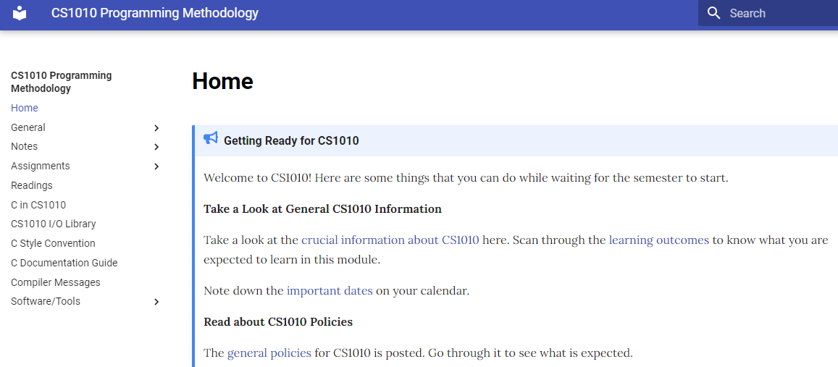
Module Website
https://github.com/nus-cs1010-2021-s2/website
Visit this website after class if you have not done so.
If you Google for CS1010, make sure you find the site for this semester, which is in blue.
Notes:
If you want, you may give students a QUICK tour of the CS1010 website.

Slide 10
Other Tools
LumiNUS
Announcements, lecture recordings, quizzes, grades…
Piazza (https://bit.ly/cs1010-2020-forum)
Online forum
Computing Servers / UNIX / Clang / Vim
Programming environment
Github
Assignment submission / grading
Notes:
You may show them the dates of the tests on the CS1010 website.
Remember to remind students to inform us if they have clash with the test dates.
Especially for PE1 on 21 September 2013, Saturday as it falls within the official 1-week recess.

Slide 11
Quick To-dos
Read up on the materials listed on the course website
Familiarize yourself with the programming environment
Revise on secondary school mathematics and notations

Slide 12
Messages for CS1010 Students
Be prepared to work Really Really HARD!
Lots of self-practice
Explore and ask questions, a lot of them, in class and outside class (forum)
Clear your doubts as soon as you can
Be open-minded
Feel free to approach us if you encounter any difficulties
Notes:
This is a slide for your customization. You can choose to tell your students anything you want. For example, if you took CS1010 last year, you can tell students about what their seniors thought about this module, or your own thoughts. If you didn’t teach CS1010, you can tell your students about what you expect of them.
You may download this PowerPoint file, and fill in this slide with your own message and show it to your students in class.

