Slide 1

CS1010: Programming Methodology
UNIT 3
Functions

Slide 2
Unit 3: Functions
Problem Solving Techniques
Functions
More examples
Even more examples

Slide 3
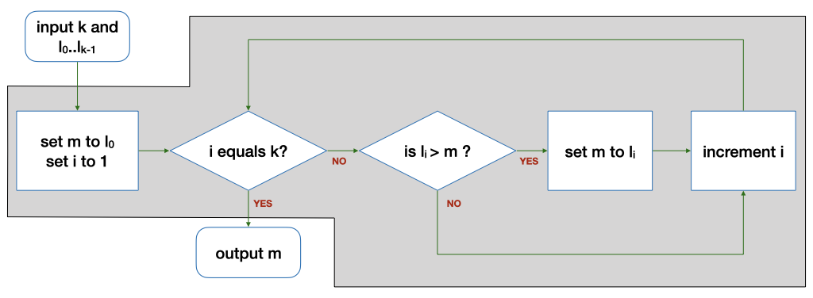
Problem Solving Techniques
What we have learnt so far…
Find the maximum among a list of numbers (FindMax).
Input
Compute
Output

Slide 4
Problem Solving Techniques
How to solve a new problem?
Find the range (i.e., max-min) of a list of numbers
Technique 1: Breaking it down!
Input: Read in a list L of k numbers
Compute: Compute the range of a given list L of k numbers
Output: Print the range

Slide 5
Problem Solving Techniques
How to solve a new problem?
Find the range (i.e., max-min) of a list of numbers
Technique 2: Borrowing from what we know!
Input: Read in a list L of k numbers
Same as the input step for FindMax (i.e., read in some numbers)
Output: Print the range
Same as the output step for FindMax (i.e., print one number)

Slide 6
Problem Solving Techniques
How about the Compute step?
Technique 3: Wishful thinking
Assume that we have a magic black box for solving a smaller problem
i.e., given some inputs, this magic black box produces a value (usually an intermediate result) that we need.

Slide 7
Problem Solving Techniques
Compute: Compute the range of a list L of k numbers
Compute the maximum of a list L of k numbers (Breaking it down)
Same as the compute step of FindMax (Borrowing from what we know)
Compute the minimum of a list L of k numbers (Breaking it down)
Assume we have it. (Wishful thinking)
Compute the difference between the maximum and the minimum

Slide 8
Problem Solving Techniques
Problem: Find the range (i.e., max-min) of a list of numbers
Algorithm:
Input: Read in a list L of k numbers
Compute:
Compute the maximum of a list L of k numbers
Compute the minimum of a list L of k numbers
Compute the difference between the maximum and the minimum
Output: Print the range
The real problem!

Slide 9
Functions
The magic black Box
Given some inputs, it produces a value that we need
Such magic black boxes are called functions
Where to find them?
Provided by the standard C library or other libraries
Example: sqrt(x) computes the square root of x
Written by you!

Slide 10
More examples
Problem: Find the mean of a list of numbers
Input…
Compute
Compute the sum of a list of numbers
Divide the sum by k
Output…
This could be a function!

Slide 11
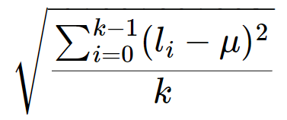
More examples
Problem: Find the standard deviation of a list L of k integers
μ: mean (L, k)
L': subtract (L, k, μ)
L'': square (L', k)
μ'': mean (L'', k)
result: sqrt (μ'')
Let say L = {1, 3, 5, 7, 9}, k = 5
μ = 5
subtract (L, k, μ) = {-4, -2, 0, 2 ,4}
square (L', k) = {16, 4, 0, 4,16}
μ'' = mean (L'', k) = 8
sqrt (μ'') = 2.83

Slide 12
More examples
Problem: Find the standard deviation of a list L of k integers
result: sqrt ( mean ( square ( subtract (L, k, mean (L, k)), k), k)
Reuse of functions
A function, once defined, can be reused any number of times!
No need to reinvent the wheel every time!
mean is used twice!

Slide 13
More examples
Problem: Find the standard deviation of a list L of k integers
result: sqrt ( mean ( square ( subtract (L, k, mean (L, k)), k), k)
Function calling other functions
If we treat this computation as a function stddev (L, k), it calls sqrt, mean, square and subtract to complete the computation.

Slide 14



Ex #1: A Simple “Drawing” Problem
Problem: Draw
a rocket ship (which is a triangle over a rectangle over an inverted V),
a male stick figure (a circle over a rectangle over an inverted V), and
a female stick figure (a circle over a triangle over an inverted V)
rocket
male
Analysis:
No particular input / compute needed.
Just draw the needed 3 figures: 1 magic box for each figure.
There are common shapes shared by the 3 figures: 1 magic box for each shape.
female

Slide 15
Ex #1: A Simple “Drawing” Problem
Problem: Draw
a rocket ship (which is a triangle over a rectangle over an inverted V),
a male stick figure (a circle over a rectangle over an inverted V), and
a female stick figure (a circle over a triangle over an inverted V)
rocket
male
female
Design:
Draw 3 Figures
Draw Rocket Ship
Draw Male Stick Figure
Draw Female Stick Figure
Draw Triangle
Draw Rectangle
Draw Inverted V
Draw Circle
Draw Rectangle
Draw Inverted V
Draw Circle
Draw Triangle
Draw Inverted V

Slide 16
Even more examples
Problem: Find the maximum among a list of numbers
Solution from Week 1: use a function max (L, k) that computes the maximum of a given list L of k numbers.

Slide 17
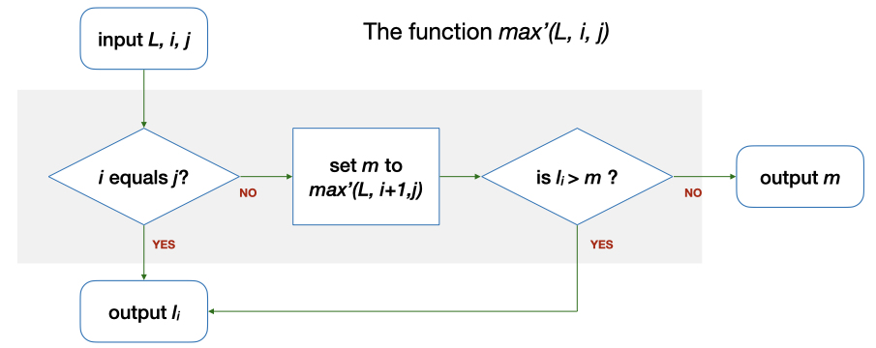
Even more examples
Alternative solution: use a function max' (L, i, j) which computes the maximum among L_{i}…L_{j} in a given list L
E.g., Let say L = {5, 9, 8, 1, 3, 2}, i = 0, j = 5. max' (L, 0, 5) = …
i (0) == j (5)? → No. m is max' (L, 1, 5) = 9 → l₀ (5) > m (9)? → No. The answer is m (9), which is the same as max (L, k).

Slide 18
Even more examples
Problem: Compute the factorial of n
E.g., Let n = 4, n! = 4! = 1*2*3*4 = 24
Solution: Use a function factorial (n) which computes factorial n???

Slide 19
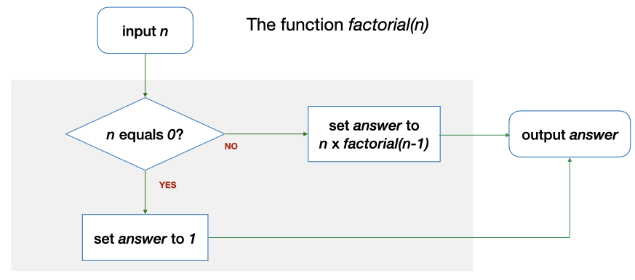
Even more examples
Solution: Use a function factorial (n) which computes factorial n???
E.g., Let say n = 4. factorial (n) = …
n (4) == 0? → No. The answer is n * factorial (3) = 4 * 6 = 24.

Slide 20
Even more examples
Function calling itself (to solve a simpler version of the problem)
max' (L, 0, 5) uses max' (L, 1, 5)
factorial (4) uses factorial (3)
This is Recursion!
This is Recursion!
This is Recursion!
This is Recursion!
…

Slide 21
Ex #2: Yet another solution for FindMax
Problem: Find the maximum among a list of numbers
Alternative solution: use a function max'' (L, r) which computes the maximum among L₀…L_{r} in a given list L
E.g., Let say L = {5, 9, 8, 1, 3, 2}, r = 5. max'' (L, 5) = …
0 == r (5)? → No. m is max'' (L, 4) = 9 → l_{r} (2) > m (9)? → No. The answer is m (9), which is the same as max (L, k).
Can you draw the flowchart?

