Slide 1

CS1010: Programming Methodology
UNIT 11
Loops

Slide 2
Unit 11: Loops
Repetition
The for Loop
The while Loop
The do-while Loop
Example
Infinite Loops!

Slide 3

Recall: Control Structures
Sequence
Selection
if-else, switch
Repetition

Slide 4
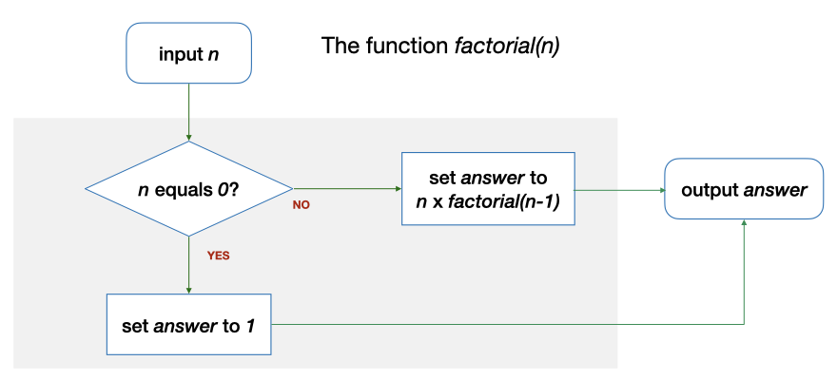
Repetition through Recursion
factorial(2) requires factorial(1), which in turn requires factorial (0)
long factorial(long n)
{
long answer;
if (n == 0) {
answer = 1;
} else {
answer = n * factorial(n - 1);
}
return answer;
}

Slide 5
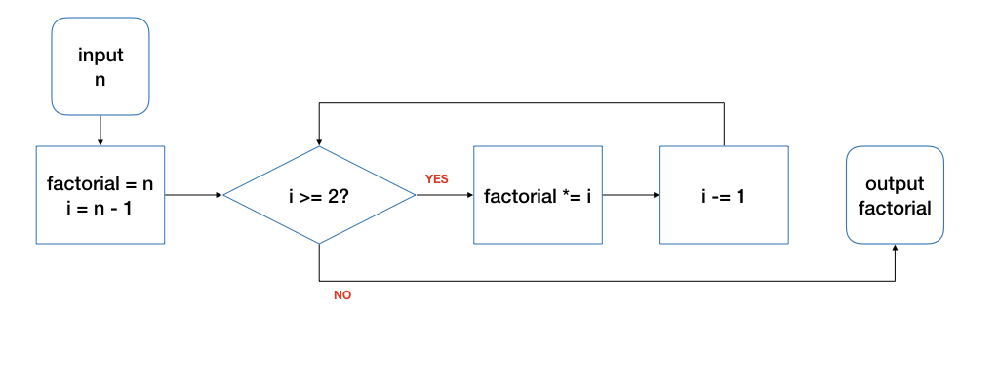
Repetition through Loops
Input: 4
n | i | factorial | i>=2? | Remark
4 | 3 | 4 | true | Before the loop
4 | 2 | 12 | true | After 1st round of the loop
4 | 1 | 24 | false | After 2nd round…

Slide 6
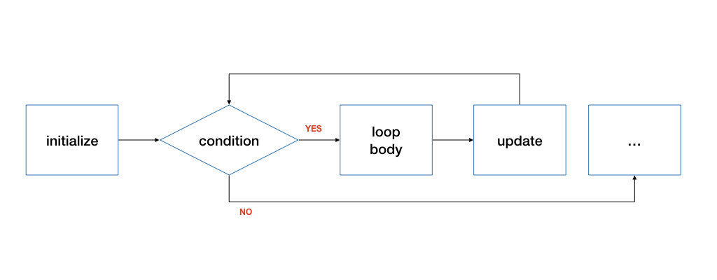
The for Loop
for ( initialize; condition; update )
{
// loop body
}
initialize: initialize the loop variable
condition: repeat loop while the condition on loop variable is true
update: change value of loop variable

Slide 7
The for Loop
long factorial(long n)
{
long product = n;
for (long i = n - 1; i >= 2; i -= 1) {
product *= i;
}
return product;
}
Any issues with this function?

Slide 8
The for Loop
long factorial(long n)
{
if (n == 0) { return 1; }
long product = n;
for (long i = n - 1; i >= 2; i -= 1) {
product *= i;
}
return product;
}

Slide 9
The while Loop
initialize
while ( condition )
{
// loop body
// update
}
Technically update is also part of loop body.

Slide 10
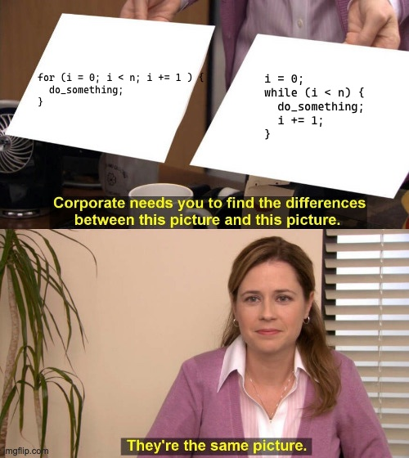
The while Loop

Slide 11
The while Loop
long i = n - 1;
while (i >= 2) {
product *= i;
i -= 1;
}
for (long i = n - 1; i >= 2; i -= 1) {
product *= i;
}

Slide 12
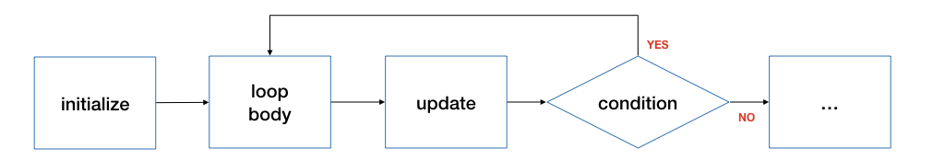
The do-while Loop
initialize
do {
// loop body
// update
} ( condition );
Do NOT forget the semi-colon at the end!
Execute the loop body at least once!

Slide 13
The do-while Loop
long i = n - 1;
do {
product *= i;
i -= 1;
} while (i >= 2);
for (long i = n - 1; i >= 2; i -= 1) {
product *= i;
}

Slide 14
Example: Hi-Lo Game
Problem: Play a Hi-Lo Game with the user using a randomly generated secret number
The secret number should be between 1 and 100 (both inclusive).
User should keep making guess until the guess is correct.
Program responses according to whether user’s guess is smaller than, larger than, or equal to the jackpot.
Analysis
Input: guesses from the user
Output: messages according to whether user’s guess is smaller than, larger than, or equal to the jackpot.

Slide 15
Example: Hi-Lo Game
Problem: Play a Hi-Lo Game with the user using a randomly generated secret number
The secret number should be between 1 and 100 (both inclusive).
User should keep making guess until the guess is correct.
Program responses according to whether user’s guess is smaller than, larger than, or equal to the jackpot.
Design
Step 1: Generate a secret number
Step 2: Read a guess from the user
Step 3: Print a message (“too high”, “too low”) if the guess is not correct.
Go back to Step 2 if the guess is not correct.
Step 4: Print a message ("you got it.").

Slide 16
Example: Hi-Lo Game
#include <stdlib.h>
#include <sys/times.h>
#include "cs1010.h"
int main()
{
// Initialize the random number generator
srandom(times(0));
// Generate a random number between 1 and 100
long answer = (random() % 100) + 1;
…

Slide 17
Example: Hi-Lo Game
…
long guess;
do {
// Read guess and feedback to user
guess = cs1010_read_long();
if (guess > answer) {
cs1010_println_string("too high");
} else if (guess < answer) {
cs1010_println_string("too low");
}
} while (guess != answer);
// { guess == answer }
cs1010_println_string("you got it. congrats!");
}
Why a do-while loop is used here?
Why else-if instead of else?

Slide 18
Infinite Loops!
long a = 2;
long b = 7;
while (a != b) {
cs1010_print_long(a);
a = a + 2;
}
2
4
6
8
10
:
:
Output: ?
Ctrl-c to interrupt
When the loop condition is always true, the loop body is executed forever – infinite loop.

