Slide 1

CS1010: Programming Methodology
Week1
Recap

Slide 2

Objectives
Learn about fundamental concepts of problem solving by computing and programming
Become proficient with C and associated programming tools (editors, debuggers)
The module is NOT just about C!

Slide 3
Problem Solving Process
Algorithmic
Determine problem features
Analysis
Iterative process
Write algorithm
Design
Produce code
Implementation
Check for correctness and efficiency
Testing

Slide 4
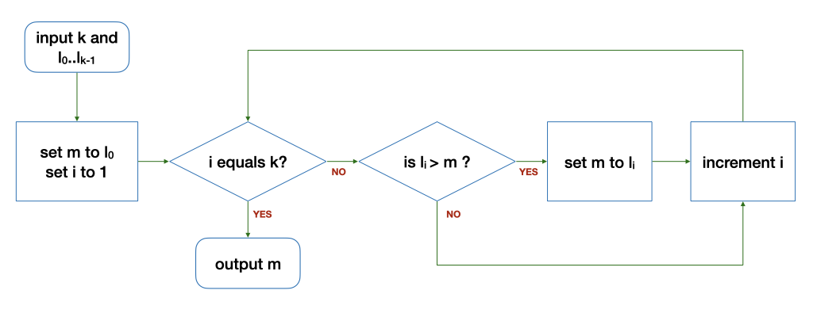
Algorithm: Example
The Flowchart
The loop
Input: 5 9 8 1 3 2
k | i | l_{i} | m | Remark
6 | 1 | 9 | 5 | Before the loop
6 | 2 | 8 | 9 | After 1st round of the loop
6 | 3 | 1 | 9 | After 2nd round…
k | i | l_{i} | m | Remark
6 | 4 | 3 | 9 | After 3rd round…
6 | 5 | 2 | 9 | After 4th round…
6 | 6 | - | 9 | After 5th round…

Slide 5
Correctness
What is wrong with this modified algorithm?
The loop
0
Input: 5 9 8 1 3 2
k | i | l_{i} | m | Remark
6 | 1 | 9 | 0 | Before the loop
6 | 2 | 8 | 9 | After 1st round of the loop
6 | 3 | 1 | 9 | After 2nd round…
k | i | l_{i} | m | Remark
6 | 4 | 3 | 9 | After 3rd round…
6 | 5 | 2 | 9 | After 4th round…
6 | 6 | - | 9 | After 5th round…

Slide 6
Correctness
What is wrong with this modified algorithm?
The loop
0
Input: 5 1
k | i | l_{i} | m | Remark
2 | 1 | 1 | 0 | Before the loop
2 | 2 | - | 1 | After 1st round of the loop

Slide 7
Correctness
What is wrong with this modified algorithm?
The loop
0
Input: -5 -1
k | i | l_{i} | m | Remark
2 | 1 | -1 | 0 | Before the loop
2 | 2 | - | 0 | After 1st round of the loop

Slide 8
The Edit, Compile and Execute Cycle
Compile
Execute
Edit
Use a compiler to translate the source code into executable
Use an editor to create/modify the source code
Execute/run the executable code
Process is iterative

Slide 9
Learning to write a program that does what you want is the easy part.
Knowing what you want your program to do is the real challenge!

