Slide 1

CS1010: Programming Methodology
Week 6
Recap

Slide 2
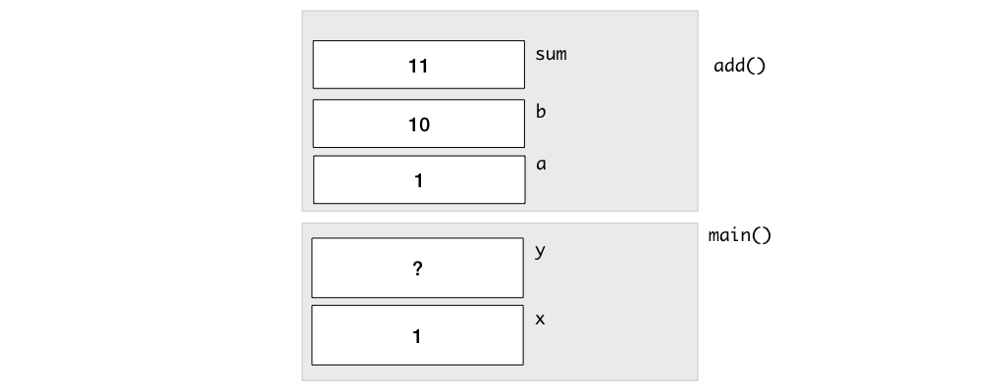
Call Stack
A Stack Frame is added to the Call Stack whenever a function is called.
long add(long a, long b) {
long x;
x = a + b;
return x;
}
int main()
{
long x = 1;
long y;
y = add(x, 10);
…
}

Slide 3
Pointers
i
12
j
12
long i = 10, j = 20;
long *p; // p is a pointer to some long variable
10
20
p
p = &i; // p now stores the address of variable i
cs1010_println_long(*p);
Important!
Now *p is equivalent to i
10
// *p accesses the value of pointed/referred variable
*p = *p + 2; // increment *p (which is i) by 2
// same effect as: i = i + 2;
p = &j; // p now stores the address of variable j
Important!
Now *p is equivalent to j
*p = i; // value of *p (which is j now) becomes 12
// same effect as: j = i;

Slide 4
Array
Problem: Compute the number of days since 1 Jan until the 1st of a given month (1-12)
E.g., days(1) → 0, days(2) → 31, days(3) → 31+28 = 59 (assuming non-leap year).
Declaring and initializing an array.
long days(long month)
{
long days_in_month[12] = {31, 28, 31, 30, 31, 30, 31, 31, 30, 31, 30, 31};
long days_since = 0;
for (long i = 0; i < month - 1; i += 1) {
days_since += days_in_month[i];
}
return days_since;
}
Why this condition?
Iterating through the elements.

Slide 5
Array and Pointer
Example: long a[10]
a[0]
a[1]
a[2]
a[3]
a[4]
a[5]
a[6]
a[7]
a[8]
a[9]
When the array name a appears in an expression, it refers to the address of the first element (i.e. &a[0]) of that array (a.k.a., Array Decay)
These 2 outputs will always be the same.
long a[3];
cs1010_println_long((long)a);
cs1010_println_long((long)&a[0]);
cs1010_println_long((long)&a[1]);
ffbff724
ffbff724
ffbff732
The computer uses starting_address + index * size_of_element to compute the actual address for an element.

Slide 6
Function Definition / Call with Array
…
int main(void) {
long foo[4] = {44, 9, 17, 1};
doubleArray(foo, 4);
return 0;
}
void doubleArray(long list[], long len) {
for (long i = 0; i < len; i++){
list[i] *= 2;
}
}
In main():
foo[0]
foo[1]
44
9
17
1
88
18
34
2
What happens if doubleArray(foo, 3) is called instead?
In doubleArray():
list
length
i
?
2
0
1
4
4
3

Slide 7

String
A char array terminated by a null character '\0' (which has the numeric value 0)
char hello1[7] = {'h', 'e', 'l', 'l', 'o', '!', '\0'};
char hello1[7] = {'h', 'e', 'l', 'l', 'o', '!', 0};
These two are the same!
char hello1[7] = {'h', 'e', 'l', 'l', 'o', '!'};
Not a string. Strange errors may occur.
char hello2[7] = "hello!";
char hello3[] = "hello!";
These are ok as well!
hello1[1] = 'v';
Individual elements can be accessed / modified.

Slide 8
Working with Strings
A loop can be used since Strings are just arrays.
char src[7] = "hello!";
char dst[7];
for (long i = 0; i <= 7; i += 1)
{
dst[i] = src[i];
}
for (long i = 0; src[i] != '\0'; i += 1)
{
dst[i] = src[i];
}
for (long *p = src; *p != '\0’; p += 1)
{
dst[i] = *p;
}
p += 1 means “Go to next element”.

Slide 9
Working with Strings
String functions can used as well.
char src[7] = "hello!";
char dst[7];
strcpy(dst, src);

Slide 10
Reflect on the first half of the semester and plan for the second half!

