Slide 1

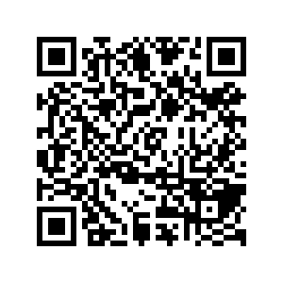
CS1010: Programming Methodology
Welcome and Administrative Matters
Live Q&A
https://pollev.com/jin

Slide 2

Welcome to CS1010!
#include "cs1010.h"
int main()
{
cs1010_println_string("Welcome!");
return 0;
}

Slide 3
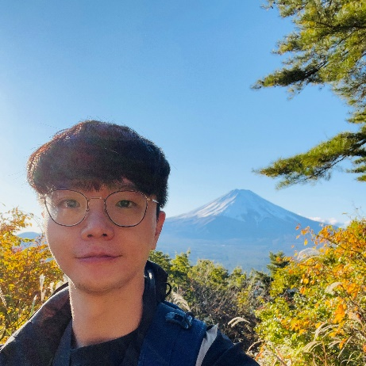



Lecturer
Zhao Jin zhaojin@comp.nus.edu.sg
(Just call me “Jin” for short)
Undergraduate, PhD, Instructor, Lecturer and Assistant Dean in SoC
Programming Methodology, Software Engineering Projects, Information Retrieval
Travelling, Music and Games

Slide 4
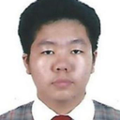
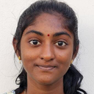
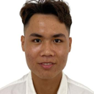
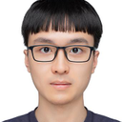
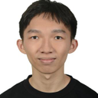
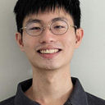
Tutors
Albert Sutiono
Govindaraj Roshni Daksha
Tram Minh Man
Yang Pei
Yap Shan Teng
Yeo Zhi Shen

Slide 5

Objectives
Learn about a systematic way to write programs for solving computation problems
Become proficient with C and associated programming tools (editors, debuggers)
The course is called Programming Methodology.
It is NOT just about coding in C!

Slide 6
Weekly Activities / Workload
Lectures:
2 hours / week on Tuesdays at 10am-12nn
Tutorials
2 hours / week on Mondays from Week 3 onwards.
11 Quizzes and 8 sets of Programming Exercises
As many hours as needed
Due on Tuesdays (general) / Fridays (extended) from Week 2 onwards.
Formative assessments
Preparation, Revision and additional Practices
As many hours as needed

Slide 7
Tutorials
Hands-on activities and programming exercises
~10 students per group
Face-to-face sessions conducted in programming labs by a student tutor

Slide 8
Important Assessments
Practical Exam 0:
20 February 2024, Tuesday, 6-9pm
Midterm:
5 March 2024, Tuesday, 10am-12noon
Practical Exam 1:
19 March 2024, Tuesday, 6-9pm
Practical Exam 2:
9 April 2024, Tuesday, 6-9pm
Final Assessment:
30 April 2024 Tuesday, 1-3pm
Mark down these dates!

Slide 9
Important Assessments
For Special Considerations
Midterms + Practical Exams: Email Jin no later than 24 hours after the end of the assessment.
Final Assessments: Use NUS Student portal.
Make-ups and alternative assessments (if any) are always harder than the original. =P

Slide 10
Grading
Weightage
Quizzes: 5%
Programming Exercise: 5%
Midterm: 15%
Practical Exam 0/1/2: 10%/15%/20%
Final Assessment: 30%
NOT "bell-curved"
Consistent effort required throughout the semester!

Slide 11
Late Submission Policy
No late submissions will be considered
You are allowed to miss up to 10% of the submissions for quizzes and programming exercises.
Feedback may NOT be provided.
For special consideration
Email Jin no later than 24 hours after the deadline that makes you miss more than 10% of submissions.

Slide 12

Use of AI tools
NOT allowed for important assessments
Midterm, Practical Exams and Final assessment
Allowed for formative assessments
Quizzes and programming exercises
ONLY for understanding and learning
NO point using it to generate answers

Slide 13
Plagiarism
Plagiarism is NOT allowed and will be reported
All parties involved to be penalized equally.
NO point plagiarizing in general
However, discussions are allowed and encouraged to promote peer learning.
Bottom Line: write your own code and do NOT share it with anyone!

Slide 14
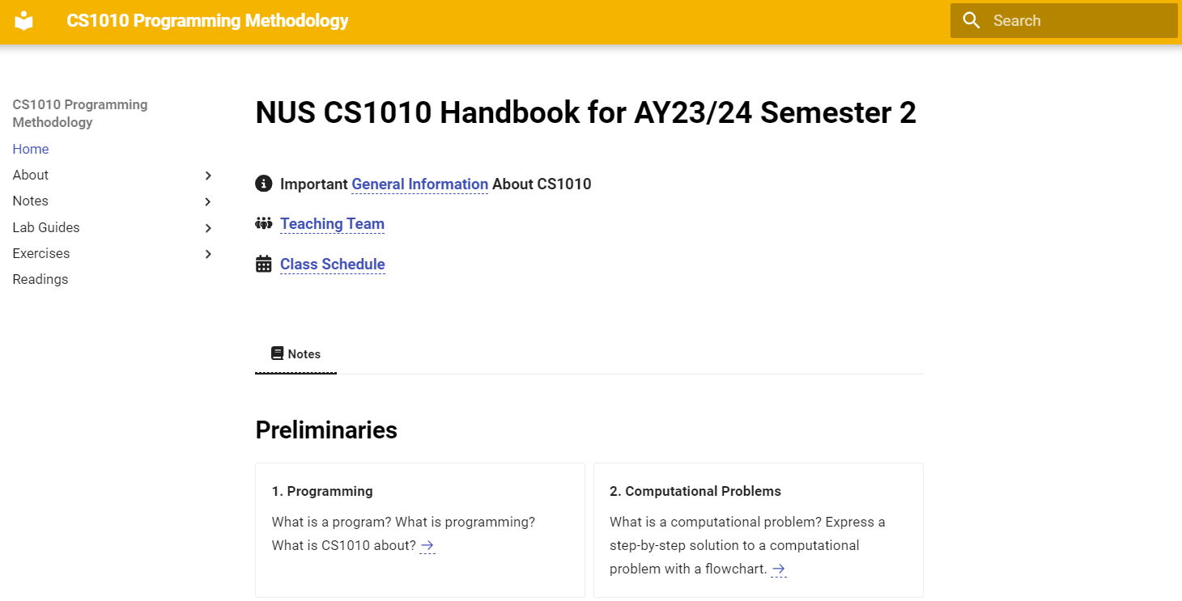
Course Website (The Handbook)
https://nus-cs1010-2324-s2.github.io/website
Visit this website after class if you have not done so.
If you Google for CS1010, make sure you find the site for this semester, which is in yellow.
Notes:
BUG: Screenshot

Slide 15
Other Tools
Canvas
Announcements, quizzes, grades, internal materials
Piazza (https://bit.ly/cs1010-2320-forum)
Online forum
PE Servers / Unix / Git / Vim / Clang
Programming-related service / tools
Github
Assignment submission / grading

Slide 16
Messages for CS1010 Students
Practice, practice, practice!
Work hard and smart
Ask questions / discuss with others
In class and outside class (forum)
As often / soon as you can
Approach the teaching team for assistance

