Slide 1


CS1010: Programming Methodology
Week 4
Recap
Live Q&A
https://pollev.com/jin

Slide 2
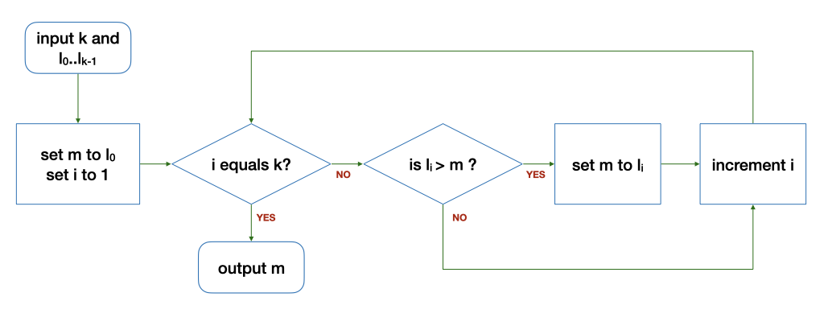
Recall: Control structures
Sequence
After step X, do step Y.
Selection
If … then … else …
Repetition
Keep going as long as ...

Slide 3
if-else Statements
if (n == 0) {
answer = 1;
} else {
answer = n * factorial(n - 1);
}
true
exp?
false
if (m >= x) {
m = x; // update max
}
cs1010_println_long(m);
true
exp?
false

Slide 4
More than 2 possibilities?
Problem: Print a letter grade based on a score
A possible solution:
if score is 8 or higher → print A
if score is less than 8 but 5 or higher → print B
if score is less than 5 but 3 or higher → print C
if score is less than 3 → print D
Score | Letter Grade
8 or higher | A
Less than 8 but 5 or higher | B
Less than 5 but 3 or higher | C
Less than 3 | D
Completely separate steps!

Slide 5
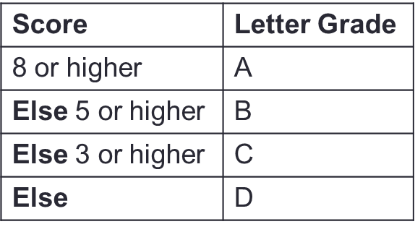
if-(else-if-)else… Statements
Problem: Print a letter grade based on a score
…
if (score >= 8) {
// print "A"
} else if (score >= 5) {
// print "B"
} else if (score >= 3) {
// print "C"
} else {
// print "D"
}
…
Dependent on previous checks.
No nesting.

Slide 6
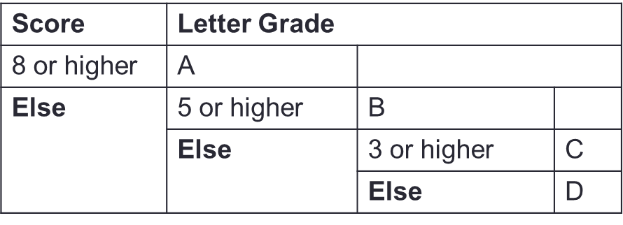
Nested if-else Statements
Problem: Print a letter grade based on a score
…
if (score >= 8) {
// print "A"
} else {
if (score >= 5) {
// print "B"
} else {
if (score >= 3) {
// print "C"
} else {
// print "D"
}
}
}
…
Dependent on previous checks.
With nesting.

Slide 7
Ex#1: CS1010 Schedule
Problem: Print the CS1010 schedule based on day (1/2/3/4/5) and time (1000/1100/…)
 | 1000 | 1100 | 1200 | 1300 | 1400 | 1500 | 1600 | 1700
1 (Mon) | Tutorial | Tutorial | Tutorial | Tutorial | - | - | - | -
2 (Tue) | Lecture | Lecture | - | - | - | - | - | -
3 (Wed) | - | - | - | - | - | - | - | -
4 (Thu) | - | - | - | - | - | - | - | -
5 (Fri) | - | - | - | - | - | - | - | -
 | Activity
day is 1 and time is between 1000-1400 | Tutorial
Else day is 2 and time is between 1000-1200 | Lecture
Else | No activity

Slide 8
Ex#1: CS1010 Schedule
Problem: Print the CS1010 schedule based on day (1/2/3/4/5) and time (1000/1100/…)
 | 1000 | 1100 | 1200 | 1300 | 1400 | 1500 | 1600 | 1700
1 (Mon) | Tutorial | Tutorial | Tutorial | Tutorial | - | - | - | -
2 (Tue) | Lecture | Lecture | - | - | - | - | - | -
3 (Wed) | - | - | - | - | - | - | - | -
4 (Thu) | - | - | - | - | - | - | - | -
5 (Fri) | - | - | - | - | - | - | - | -
 | Activity
day >= 3 | No activity
Else | day is 2 | time is between 1000-1200 | Lecture
 |  | Else | No activity
 | Else | time is between 1000-1400 | Tutorial
 |  | Else | No activity

Slide 9
Boolean Values
Data type: bool (requires stdbool.h)
bool is_diff = x != y; // evaluates to true or false
if (is_diff) {
cs1010_println_string("x and y store different values.");
} else {
cs1010_println_string("x and y store the same value.");
}

Slide 10
Boolean Values
Data type: bool (requires stdbool.h)
…
int main(){
…
if (is_diff(x, y)) {
cs1010_println_string("x and y store different values.");
} else {
cs1010_println_string("x and y store the same value.");
}
…
}
bool is_diff(long x, long y)
{
return x!=y;
}

Slide 11
Logical Operators
For combining two or more Boolean values.
Examples:
If the birth year of a person is between 1995 and 2005, this person is Generation Z → (birth_year >= 1995) && (birth_year <= 2005)
If the birth year of a person is either before 1995 or after 2005, this person is not Generation Z → (birth_year < 1995) || (birth_year > 2005)
Logical operators: && (and), || (or), ! (not).
A | B | A && B | A || B | !A
False | False | False | False | True
False | True | False | True | True
True | False | False | True | False
True | True | True | True | False

Slide 12

Common Mistakes
Common Mistakes
if (n = 0) …
This assigns 0 to n instead.
double expected_value = 0.3;
double sum = 0.1 + 0.2;
if (sum == expected_value) { : }
The expression could be false since not all real numbers can be represented accurately.
…
if ((sum <= expected_value + 0.01) && (sum >= expected_value - 0.01))…
Allow for inaccuracy in the computation.
if ((expected_value – 0.01) <= sum <= (expected_value + 0.01)…
This does not work either due to associativity.

Slide 13
Short-Circuit Evaluation
expr1 && expr2
If expr1 is false, skip evaluating expr2 and return false immediately, as the result will always be false.
Example: (birth_year >= 1995) && (birth_year <= 2005)
expr1 || expr2
If expr1 is true, skip evaluating expr2 and return true immediately, as the result will always be true.
Example: (birth_year < 1995) || (birth_year > 2005)
Make things faster in some cases
Example: (number < 100000) && is_prime(number) VS
is_prime(number) && (number < 100000)

Slide 14
Assertion
For specifying, understanding, checking of logic.
Problem: Find the maximum value between two variables
((max == x) && (max > y)) || ((max >= x) && (max == y))
if (x > y) {
// { x > y }
max = x;
// {max == x && max > y}
else {
// { x <= y }
max = y;
// {max >= x && max == y}
}
x > y
x <= y

Slide 15
Think logically! Clarify your doubts before PE0!

