Slide 1


CS1010: Programming Methodology
UNIT 14
Pointers
Live Q&A
https://pollev.com/jin

Slide 2
Unit 14: Pointers
Memory Address
The Address-of (&) Operator
Pointers and the Dereference (*) Operator
Common Mistakes
NULL Pointer

Slide 3
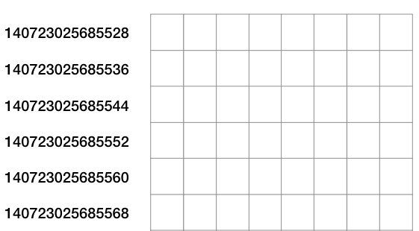
Memory Address
Every location in the memory has an address (i.e., a unique index number).
Usually we visualize the memory as a 2D grid.
What are the addresses of these slots?
140723025685542
140723025685563
Addresses for the first slot in each row.

Slide 4
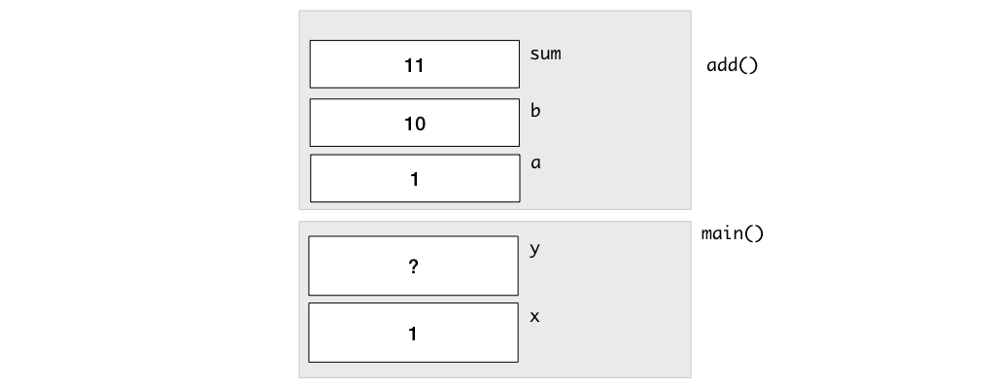
Memory Address
Do the two sum variables share the same addresses? How to confirm your answer?
long add(long sum, long a, long b) {
sum = a + b;
…
}
int main()
{
long x = 1;
long sum;
add(sum, x, 10);
…
}

Slide 5
The Address-of (&) Operator
The address-of (&) operator can be used to obtain the address of a variable.
The address can be cast into long and then printed with cs1010_println_long().
long add(long sum, long a, long b) {
sum = a + b;
cs1010_println_long((long)&sum);
…
}
int main()
{
long x = 1;
long sum;
add(sum, x, 10);
cs1010_println_long((long)&sum);
…
}
Outputs:
140723025685528 140723025685552
The addresses printed change every time.

Slide 6
Pointers and the Dereference (*) Operator
Two purposes
Declares a pointer (i.e., a variable for storing a memory address).
Accesses a memory location given an address
double *addr;
double c;
addr = &c;
addr is of the type double * (i.e., a pointer to a double variable) and it stores the address of c.
*addr = 1.0;
This accesses the address stored in addr and changes the value at the address to 1.0.
addr
c
Since the address stored in addr actually belongs to c, *addr is equivalent to c!
1.0

Slide 7
Example
i
12
j
12
long i = 10, j = 20;
long *p; // p is a pointer to some long variable
10
20
p
p = &i; // p now stores the address of variable i
cs1010_println_long(*p);
Important!
Now *p is equivalent to i
10
// *p accesses the value of pointed/referred variable
*p = *p + 2; // increment *p (which is i) by 2
// same effect as: i = i + 2;
p = &j; // p now stores the address of variable j
Important!
Now *p is equivalent to j
*p = i; // value of *p (which is j now) becomes 12
// same effect as: j = i;

Slide 8
Common Mistakes
Unmatched types
Uninitialized pointers
Missing deference operator
double *addr;
long c;
addr = &c;
addr is for storing addresses of double variables, not long variables.
double *addr;
*addr = 1.0
addr is uninitialized so *addr refers to an unknown location.
long x;
long *ptr;
x = 1;
ptr = &x;
ptr += 1;
This changes the address in ptr, not the value of x.

Slide 9
NULL pointer
A pointer that contains the NULL value
Commonly used to indicate that the pointer is invalid
double *addr;
addr = NULL;
addr points to nothing.

