Slide 1


CS1010: Programming Methodology
UNIT 15
Pointers
Live Q&A
https://pollev.com/jin

Slide 2
Unit 15: Pointers
Memory Address
The Address-of (&) Operator
Pointers and the Dereference (*) Operator
NULL Pointer
Common Mistakes
Pointer Arithmetics
Pointer and Array

Slide 3
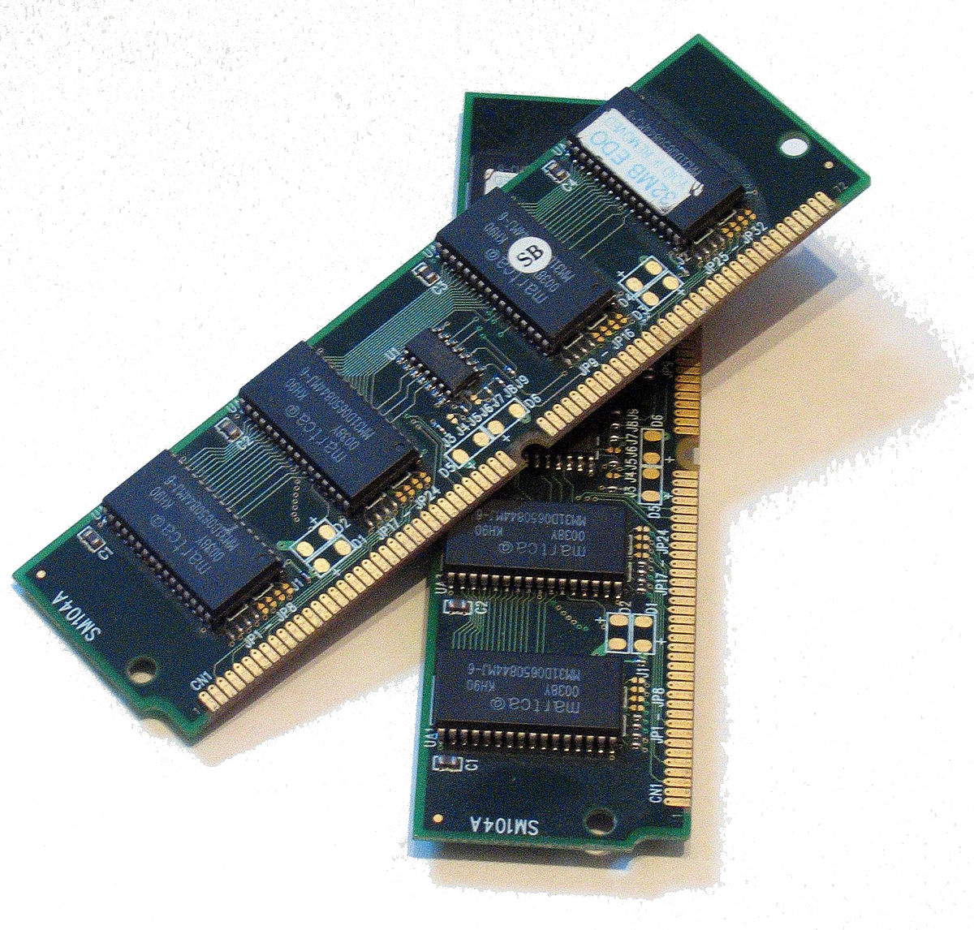
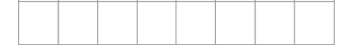
Memory Address
Every location in the memory
Can be used to store 1 byte (i.e., 8 bits) of data
Has an address (i.e., a unique index number).
10001011
1 GB ~= 1 billion byte
…
…
25685528
25685532
What is the address of this location?

Slide 4
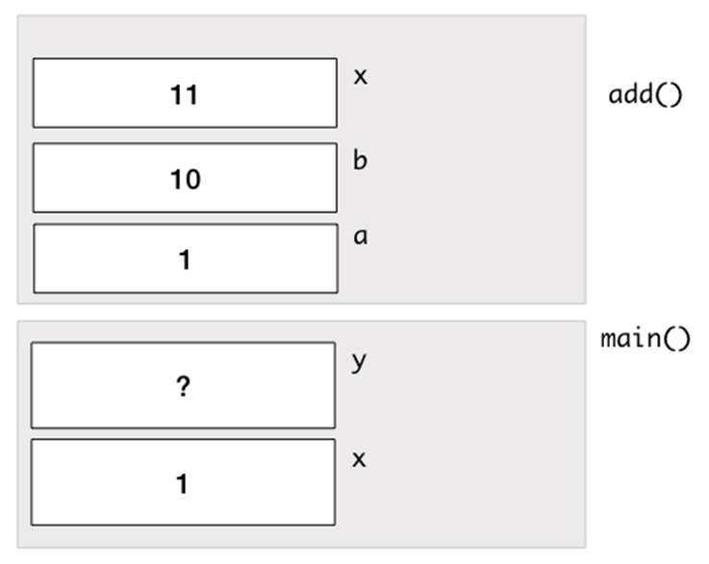
Memory Address
Do the two x variables share the same addresses? How to confirm your answer?
long add(long a, long b) {
long x;
x = a + b;
return x;
}
int main() {
long x = 1;
long y;
y = add(x, 10);
return 0;
}

Slide 5
The Address-of (&) Operator
The address-of (&) operator can be used to obtain the address of a variable.
The address can be printed using cs1010_println_pointer().
long add(long a, long b) {
long x;
x = a + b;
cs1010_println_pointer(&x);
return x;
}
int main(){
long x = 1;
long y;
y = add(x, 10);
cs1010_println_pointer(&x);
return 0;
}
Sample outputs:
25685528
25685552
The two addresses are always different from each other.

Slide 6
Pointers and the Dereference (*) Operator
Two purposes
Declares a pointer (i.e., a variable for storing a memory address).
Accesses a memory location given an address
double *addr;
double c;
addr = &c;
addr is of the type double * (i.e., a pointer to a double variable) and it stores the address of c.
*addr = 1.0;
This accesses the address stored in addr and changes the value at the address to 1.0.
addr
c
Since the address stored in addr actually belongs to c, *addr is equivalent to c!
1.0

Slide 7
Example
i
12
j
12
long i = 10, j = 20;
long *p; // p is a pointer to some long variable
10
20
p
p = &i; // p now stores the address of variable i
cs1010_println_long(*p);
Important!
Now *p is equivalent to i
10
// *p accesses the value of pointed/referred variable
*p = *p + 2; // increment *p (which is i) by 2
// same effect as: i = i + 2;
p = &j; // p now stores the address of variable j
Important!
Now *p is equivalent to j
*p = i; // value of *p (which is j now) becomes 12
// same effect as: j = i;

Slide 8
NULL pointer
A pointer that contains the NULL value
Commonly used to indicate that the pointer is invalid
double *addr;
addr = NULL;
addr points to nowhere.

Slide 9
Common Mistakes
Unmatched types
Uninitialized pointers
Null pointer exception
double *addr;
long c;
addr = &c;
addr is for storing addresses of double variables, not long variables.
double *addr;
*addr = 1.0
addr is uninitialized so *addr refers to an unknown location.
double *addr;
addr = NULL;
*addr = 5;
Exception since addr points to nowhere.

Slide 10
Pop Quiz
What is the result of *ptr + 1?
*ptr is equivalent to x, so *ptr + 1 is 2!
But how about ptr + 1?
long x;
long *ptr;
x = 1;
ptr = &x;

Slide 11
Pointer Arithmetics
What is the result of ptr + 1?
Adding 1 to a pointer itself gives the address of the size of the variable pointed to by the pointer.
If x is at location 1000 and a long variable takes up 8 bytes…
ptr is 1000.
ptr + 1 is 1008.
long x;
long *ptr;
x = 1;
ptr = &x;

Slide 12
Pointer and Array
What is the result of ptr + 1?
Remember: When the array name a appears in an expression, it refers to the address (location) of the first element (i.e. &a[0]) of that array (a.k.a., Array Decay).
If a (i.e., &a[0]) is 1000…
ptr is 1000 (i.e., &a[0])
ptr + 1 is 1008 (i.e., &a[1])
In other words, we can use ptr + i to access a[i].
long a[10];
long *ptr;
ptr = a;

