Slide 1


CS1010: Programming Methodology
UNIT 20
Efficiency
Live Q&A
https://pollev.com/jin

Slide 2
Unit 22: Efficiency
Good Habits for Writing Efficient Code
Time Complexity Analysis

Slide 3
Good Habits for Writing Efficient Code
No redundant work
Do only what is necessary.
bool is_prime(long n){
for (long i = 2; i <= n - 1; i += 1) {
if (n % i == 0) {
return false;
}
}
return true;
}
100 seconds vs 3 seconds on is_prime(10000000001)!
bool is_prime(long n){
for (long i = 2; i <= sqrt(n); i += 1) {
if (n % i == 0) {
return false;
}
}
return true;
}
This is more efficient!

Slide 4
Good Habits for Writing Efficient Code
Why only check up to sqrt(n) instead of n-1?
If there is a factor k greater than sqrt(n), n / k is also a factor, which it is less than sqrt(n).
Therefore, if there are no factors up to sqrt(n), there cannot be any factors bigger than sqrt(n).
Therefore, it is safe to only check up to sqrt(n).
Example: Let say n = 18, sqrt(n) ~= 4.
If there is a factor greater than 4 (e.g., 9)…
n / k (i.e., 18 / 9 = 2) is also a factor, which is less than 4.
Therefore, it is safe to only check up to 4.
Note that 1 and n itself are not part of the discussion.

Slide 5
Good Habits for Writing Efficient Code
No duplicates
Do NOT repeat work.
Example
Compute the range of a list of k numbers.
Solution 1
Go through the list once to compute the maximum
Go through the list (again) to compute the minimum
Compute maximum – minimum
Solution 2
Go through the list once to compute both the maximum and the minimum at the same time
Compute maximum – minimum
This is more efficient!

Slide 6
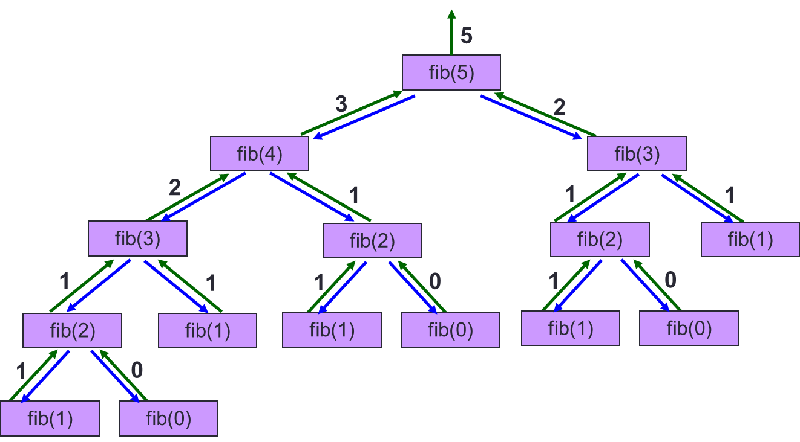
Good Habits for Writing Efficient Code
No duplicates
Do NOT repeat work.
Example
long fib(long n) {
if (n == 1 || n == 2)
return n;
else
return fib(n - 1) + fib(n - 2);
}
The iterative version is more efficient!

Slide 7
Time Complexity Analysis
The Naïve approach: Count the number of steps required for an input n…
Example
7 steps per iteration: 1 comparison + 2 additions + 4 assignments
n – 2 iterations
2 extra steps: 1 assignment (initialization) + 1 comparison (final check of condition).
7n – 12 in total
for (long i = 2; i != n; i += 1) {
first = second;
second = third;
third = first + second;
}
The key loop in the iterative version of fib.
Too detailed and not particularly useful…

Slide 8
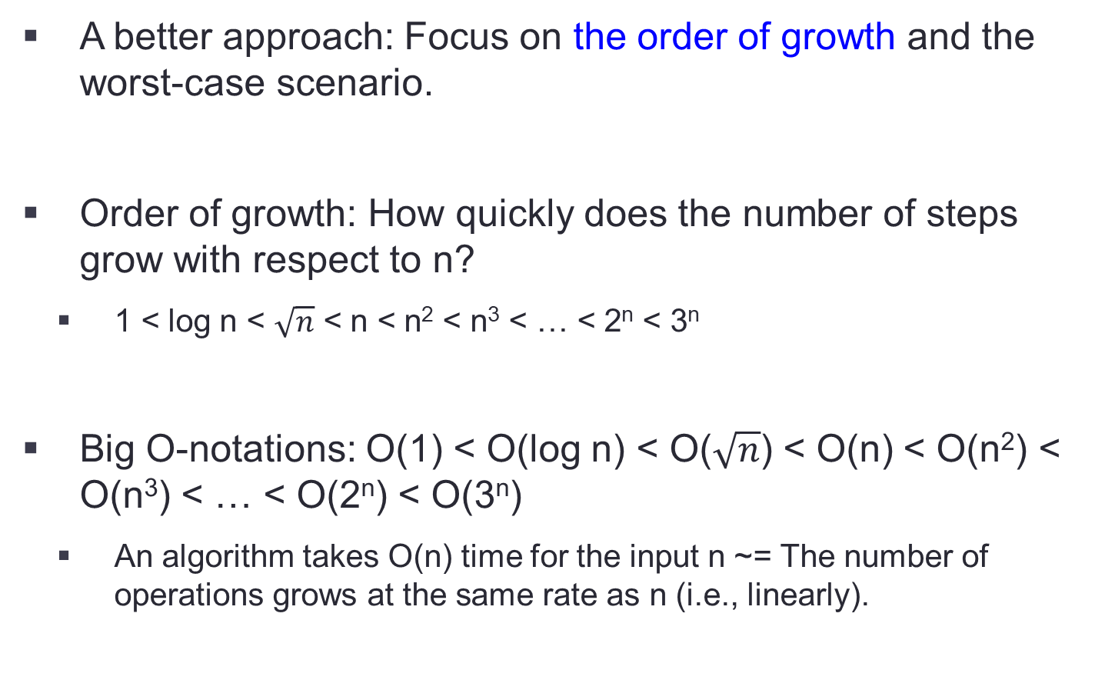
Time Complexity Analysis
A better approach: Focus on the order of growth and the worst-case scenario.
Order of growth: How quickly does the number of steps grow with respect to n?
1 < log n < $\sqrt{n}$ < n < n² < n³ < … < 2^{n} < 3^{n}
Big O-notations: O(1) < O(log n) < O($\sqrt{n}$) < O(n) < O(n²) < O(n³) < … < O(2^{n}) < O(3^{n})
An algorithm takes O(n) time for the input n ~= The number of operations grows at the same rate as n (i.e., linearly).

Slide 9
Time Complexity Analysis
A better approach: Focus on the order of growth and the worst-case scenario.
Example
Initial computation: 7n – 12
Drop constants and keep only the term with the highest rate of growth.
Final result: O(n)
for (long i = 2; i != n; i += 1) {
first = second;
second = third;
third = first + second;
}

Slide 10
Time Complexity Analysis
A better approach: Focus on the order of growth and the worst-case scenario.
Best / worst-case scenario: The input that leads to the minimal / maximum computation
The best case is usually trivial so we should focus on worst case.

Slide 11
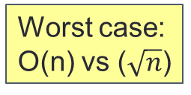
Time Complexity Analysis
A better approach: Focus on the order of growth and the worst-case scenario.
Example
bool is_prime(long n){
for (long i = 2; i <= n - 1; i += 1) {
if (n % i == 0) {
return false;
}
}
return true;
}
Best case:
Both O(1)
Worst case: O(n) vs ($\sqrt{n}$)
bool is_prime(long n){
for (long i = 2; i <= sqrt(n); i += 1) {
if (n % i == 0) {
return false;
}
}
return true;
}
This is more efficient!

Slide 12
More examples
Draw a rectangle given the dimensions m and n.
1
2
3
4
5
6
7
8
9
10
11
12
13
14
15
void draw_line(long m, char *first, char *mid, char *last) {
cs1010_print_string(first);
for (long j = 0; j < m - 2; j += 1) {
cs1010_print_string(mid);
}
cs1010_println_string(last);
}
void draw_rectangle(long m, long n) {
draw_line(m, TOP_LEFT, HORIZONTAL, TOP_RIGHT);
for (long i = 0; i < n - 2; i += 1) {
draw_line(m, VERTICAL, " ", VERTICAL);
}
draw_line(m, BOTTOM_LEFT, HORIZONTAL, BOTTOM_RIGHT);
}
┏ ━ ━ ━ ┓ ┃ ┃ ┃ ┃
┗ ━ ━ ━.┛
O(mn)

Slide 13
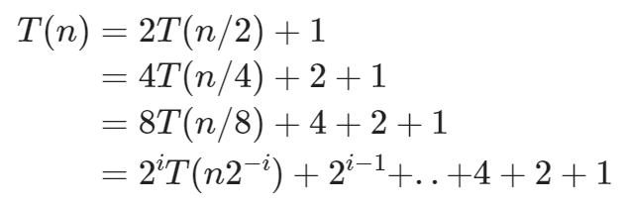
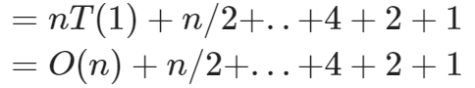
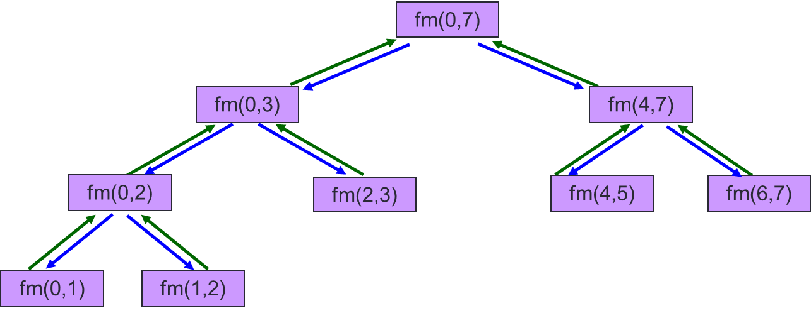
More examples
Recursive find max
long find_max(const long list[], long start, long end){
if (start >= end – 1){
return list[start];
}
long mid = (start + end) / 2;
long left = find_max(list, start, mid);
long right = find_max(list, mid, end);
if (left >= right) {
return left;
}
return right;
}
O(n)

Slide 14
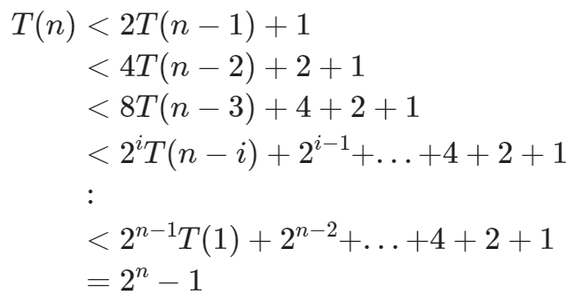
More examples
Fibonacci
long fib(long n) {
if (n == 1 || n == 2)
return n;
else
return fib(n-1) + fib(n-2);
}
long fib(long n) {
if (n == 1 || n == 2)
return n;
else
return fib(n - 1) + fib(n - 2);
}
O(2^{n})

Slide 15
More examples
Collatz
1
2
3
4
5
6
7
8
9
long count_num_of_steps(long n)
{
long num_of_steps = 0;
while (n != 1) {
n = collatz(n);
num_of_steps += 1;
}
return num_of_steps;
}
O(??) since the loop may not terminate.

Slide 16
Homework
Post-Lecture Diagnostic Quiz
Problem Set 19-20
Exercise 4 & 5

