Slide 1

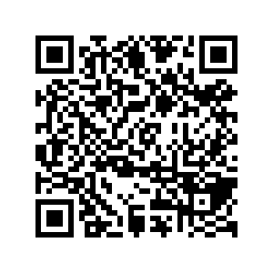
CS1010: Programming Methodology
Week 12
Recap
Live Q&A
https://pollev.com/jin

Slide 2
Get used to thinking recursively…
recursively…
recursively…
recursively…
…

