Slide 1

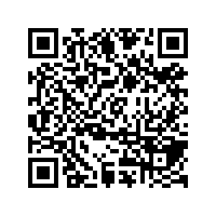
CS1010: Programming Methodology
Week1
Recap
Live Q&A
https://pollev.com/jin

Slide 2

Objectives
Learn about a systematic way to write programs for solving computation problems
Become proficient with C and associated programming tools (editors, debuggers)
The course is called Programming Methodology.
It is NOT just about coding in C!

Slide 3
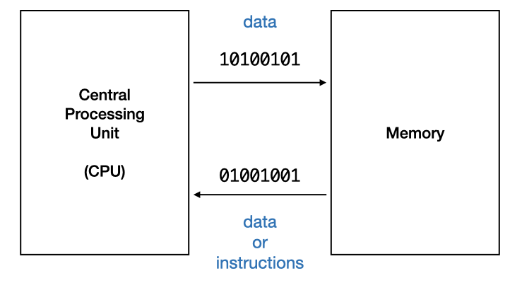
Program and Programming Language
Computer is designed to respond to programs written in machine code directly.
However, we commonly write programs in high-level programming languages, such as C.

Slide 4
The Edit, Compile and Execute Cycle
Compile
Execute
Edit
Use a compiler to translate the source code into executable
Use an editor to create/modify the source code
Execute/run the executable code
Process is iterative

Slide 5
Computational Problems and Algorithms
Computational Problems
have well-defined inputs, outputs, and constraints.
can be solved step-by-step by a computer.
Algorithms
are a well-defined computational procedure consisting of a set of instructions.
Take some values as the input and produces some values as the output.

Slide 6
Problem Solving Process
Algorithmic
Determine problem features
Analysis
Iterative process
Write algorithm
Design
Produce code
Implementation
Check for correctness and efficiency
Testing

Slide 7
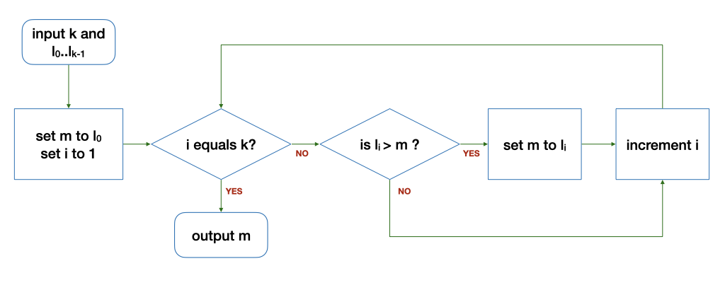
Algorithm: Example
Find the maximum of a list of numbers
What are the variables and control structures used and what they are used for?
The loop
Input: 6 5 9 8 1 3 2

Slide 8
Algorithm: Example
Find the maximum of a list of numbers
The loop
Input: 6 5 9 8 1 3 2
k | i | l_{i} | m | Remark
6 | 1 | 9 | 5 | Before the loop
6 | 2 | 8 | 9 | After 1st round of the loop
6 | 3 | 1 | 9 | After 2nd round…
k | i | l_{i} | m | Remark
6 | 4 | 3 | 9 | After 3rd round…
6 | 5 | 2 | 9 | After 4th round…
6 | 6 | - | 9 | After 5th round…

Slide 9
Correctness
What is wrong with the modified algorithm?
The loop
0
Input: 6 5 9 8 1 3 2
k | i | l_{i} | m | Remark
6 | 1 | 9 | 0 | Before the loop
6 | 2 | 8 | 9 | After 1st round of the loop
6 | 3 | 1 | 9 | After 2nd round…
k | i | l_{i} | m | Remark
6 | 4 | 3 | 9 | After 3rd round…
6 | 5 | 2 | 9 | After 4th round…
6 | 6 | - | 9 | After 5th round…

Slide 10
Correctness
What is wrong with the modified algorithm?
The loop
0
Input: 6 10 9 8 1 3 2
k | i | l_{i} | m | Remark
6 | 1 | 9 | 0 | Before the loop
6 | 2 | 8 | 9 | After 1st round of the loop
6 | 3 | 1 | 9 | After 2nd round…
k | i | l_{i} | m | Remark
6 | 4 | 3 | 9 | After 3rd round…
6 | 5 | 2 | 9 | After 4th round…
6 | 6 | - | 9 | After 5th round…

Slide 11
Correctness
What is wrong with the modified algorithm?
The loop
0
Input: 6
-5 -9 -8 -1 -3 -2
k | i | l_{i} | m | Remark
6 | 1 | 9 | 0 | Before the loop
6 | 2 | 8 | 0 | After 1st round of the loop
6 | 3 | 1 | 0 | After 2nd round…
k | i | l_{i} | m | Remark
6 | 4 | 3 | 0 | After 3rd round…
6 | 5 | 2 | 0 | After 4th round…
6 | 6 | - | 0 | After 5th round…

Slide 12
Learning to write a program that does what you want is the easy part.
Knowing what you want your program to do is the real challenge!

