Slide 1

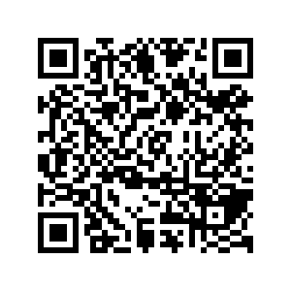
CS1010: Programming Methodology
UNIT 4
Types
Live Q&A
https://pollev.com/jin

Slide 2
Unit 4: Types
Bits and Bytes
Types
Type Declaration

Slide 3
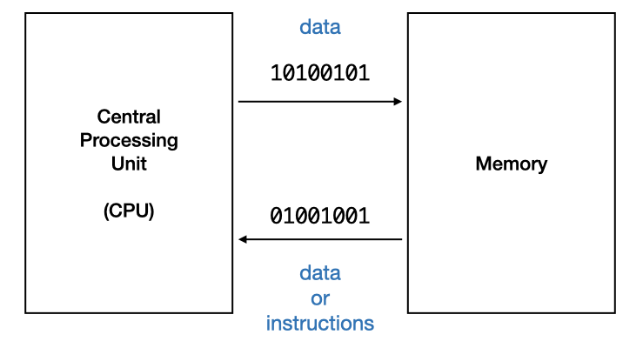
Bits
All data are just 0s and 1s in a computer
Bits
1 bit = one single digit = one switch (transistor)
2 states: 0 or 1 (e.g., off or on, false or true)

Slide 4
Bytes
Bytes
1 byte = 8 bits
256 possibilities: 00000000, 00000001, …, 11111111 (e.g., integers from 0 to 255)
More bits and/or bytes = more data can be stored / represented.

Slide 5
Types
How to interpret 0010101011001001…?
Integer
8 bits (1 byte), unsigned: 0~255
00101010: 42
11001001: 201
8 bits (1 byte), signed: -128~127
00101010: 42
11001001: -55
32 bits (4 bytes), signed
0010101011001001: 10953
More bits required for larger integers

Slide 6
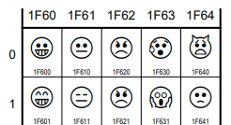
Types
How to interpret 0010101011001001…?
Characters
8 bits (1 byte): ASCII characters (e.g., letters, punctuations)
00101010: *
11001001: É
32 bits (4 bytes): Unicode characters (e.g. letters, emoticons, Mahjong tiles)

Slide 7
Types
How to interpret 0010101011001001…?
Real numbers
32 bits (4 bytes):
1.53484220797e-41
64 bits (8 bytes):
5.41150101889917339836595798829e-320
Loss of precision occurs often
More bits required for higher precision

Slide 8
Types
How to interpret 0010101011001001…?
Compound Types
Sequence of characters (a string)
Pair of real numbers (a point)
A string, a character, a number (a person)
…
No fixed size
To be introduced at the end of this course.

Slide 9
Type declaration
Type declaration for variables (before use) is compulsory in C so that the computer can
Allocate the right number of bits in memory
Interpret the value accordingly
Examples of type declarations in C
long value; 4 bytes, an integer
char ch; 1 byte, a character
double ave; 8 bytes, a real number

Slide 10
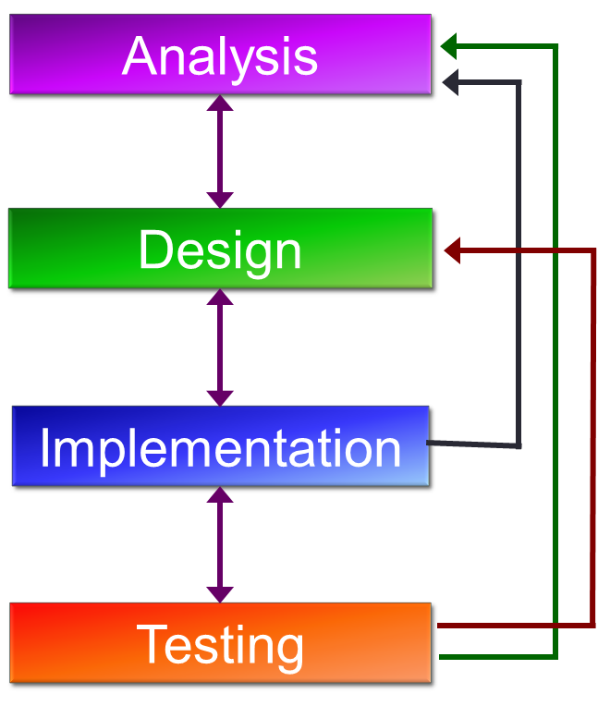
In the context of problem solving
Figure out what variables you need
Declare and use them accordingly in the program

Slide 11
Homework
Post-Lecture Diagnostic Quiz (1%)
To be due next Tuesday, 2pm.
Unlimited number of attempts.
Problem Set 3.1 to 3.2 (under Unit 3)
To be discussed in the forum

