Slide 1


CS1010: Programming Methodology
Week 2
Recap
Live Q&A
https://pollev.com/jin

Slide 2
Problem Solving Process
Algorithmic
Determine problem features
Analysis
Iterative process
Write algorithm
Design
Produce code
Implementation
Check for correctness and efficiency
Testing

Slide 3
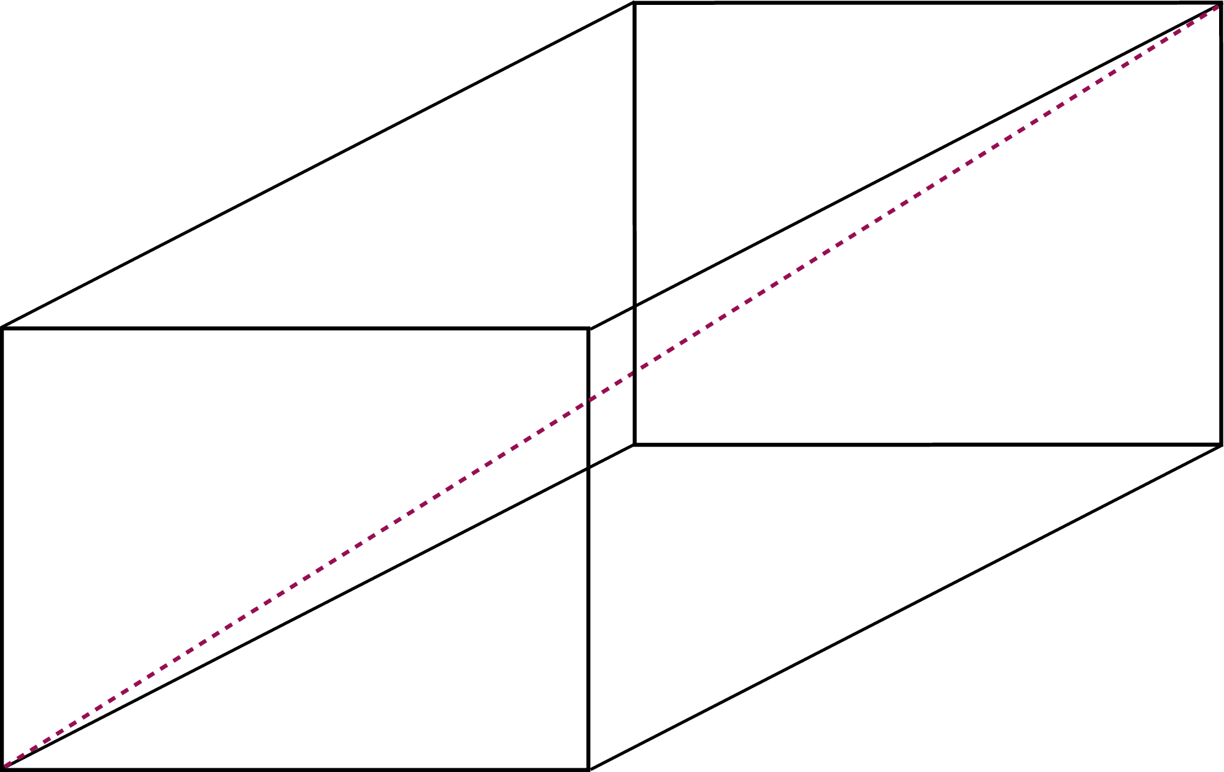
Problem Solving Techniques
Ex00-Q6: Find the surface area and the diagonal of a cuboid
Problem Analysis
Inputs: width (integer), length (integer), height (integer)
Outputs: surface area (integer), diagonal (real number)
Constraints: The outputs are the surface area and the diagonal of the cuboid represented by the inputs.

Slide 4
Problem Solving Techniques
Ex00-Q6: Find the surface area and the diagonal of a cuboid
Algorithm Design
Input:
Read in an integer for the width (CS1010 Lib.)
Read in an integer for the length (CS1010 Lib.)
Read in an integer for the height (CS1010 Lib.)
Compute: …
Output: …
1. Breaking it down!
2. Borrowing from what we know!
3. Wishful thinking!

Slide 5
Problem Solving Techniques
Ex00-Q6: Find the surface area and the diagonal of a cuboid
Algorithm Design
Input: …
Compute:
Compute the surface area (compute surface area function)
Compute the diagonal (compute diagonal function)
Output: …
1. Breaking it down!
2. Borrowing from what we know!
3. Wishful thinking!

Slide 6
Problem Solving Techniques
Ex00-Q6: Find the surface area and the diagonal of a cuboid
Algorithm Design
Input: …
Compute: …
Output:
Print the surface area, which an integer (CS1010 Lib.)
Print the diagonal, which is a real number (CS1010 Lib.)
1. Breaking it down!
2. Borrowing from what we know!
3. Wishful thinking!

Slide 7
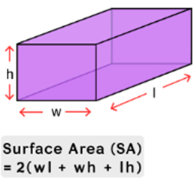
Problem Solving Techniques
Ex00-Q6: Find the surface area and the diagonal of a cuboid
Algorithm Design
Compute surface area function
Compute surface_area as 2 * (width * length + width * height + length * height) (formula)
Quite a bit of redundancy in the computation of area.
1. Breaking it down!
2. Borrowing from what we know!
3. Wishful thinking!

Slide 8
Problem Solving Techniques
Ex00-Q6: Find the surface area and the diagonal of a cuboid
Algorithm Design
Compute surface area function
Compute the bottom area (compute area function)
Compute the front area (compute area function)
Compute the side area (compute area function)
Compute the surface_area as 2 * the sum of the 3 areas
1. Breaking it down!
2. Borrowing from what we know!
3. Wishful thinking!

Slide 9
Problem Solving Techniques
Ex00-Q6: Find the surface area and the diagonal of a cuboid
Algorithm Design
Compute area function
Compute the area as rect_length * rect_width
1. Breaking it down!
2. Borrowing from what we know!
3. Wishful thinking!

Slide 10
Problem Solving Techniques
Ex00-Q6: Find the surface area and the diagonal of a cuboid
Algorithm Design
Compute diagonal function
Compute the sum_of_squares as width * width + length * length + height * height (formula)
Can be improved with a square / power function.
Compute the diagonal as the square root of sum_of_squares (C Math Lib.)
1. Breaking it down!
2. Borrowing from what we know!
3. Wishful thinking!

Slide 11
Ex #2: Yet another solution for FindMax
FindMax (Recursion): Use a function max'' (L, r) which computes the maximum among L₀…L_{r} in a given list L
E.g., Let say L = {5, 9, 8, 1, 3, 2}
max'' (L, 0) = 5
max'' (L, 1) = 9
max'' (L, 2) = 9
max'' (L, 3) = 9
max'' (L, 4) = 9
max'' (L, 5) = 9
l₀, l₁ , l₂, l₃, l₄, l₅

Slide 12
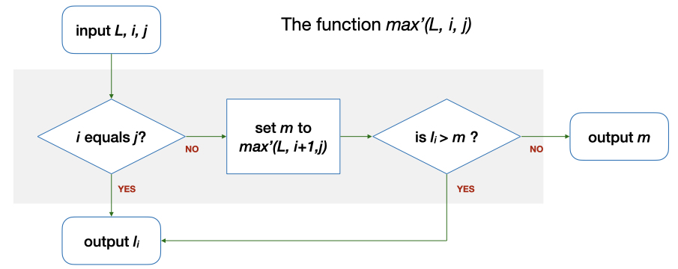
Ex #2: Yet another solution for FindMax
FindMax (Recursion): Use a function max'' (L, r) which computes the maximum among L₀…L_{r} in a given list L
Let say L = {5, 9, 8, 1, 3, 2}, Base case: r = 0
0 == r (0)? → Yes. Output l₀ (5).
r
max''(L, r)
r equals 0?
set m to
max''(L, r-1)
is l_{r} > m ?
l_{r}
l₀, l₁ , l₂, l₃, l₄, l₅

Slide 13
Ex #2: Yet another solution for FindMax
FindMax (Recursion): Use a function max'' (L, r) which computes the maximum among L₀…L_{r} in a given list L
Let say L = {5, 9, 8, 1, 3, 2}, Recursive Case: r = 5
0 == r (5)? → No. m is max'' (L, 4) = 9 → l₄ (2) > m (9)? → No. The answer is m (9).
r
max''(L, r)
r equals 0?
set m to
max''(L, r-1)
is l_{r} > m ?
l_{r}
l₀, l₁ , l₂, l₃, l₄, l₅

Slide 14
Type declaration
Type declaration for variables (before use) is compulsory in C so that the computer can
Allocate the right number of bits in memory
Interpret the value accordingly
Examples of type declarations in C
long value; 4 bytes, an integer
char ch; 1 byte, a character
double ave; 8 bytes, a real number

Slide 15
Practice the problem-solving process and techniques.
Get started with recursion.
Know the types of your variables and declare them before use in a C program.

