Slide 1

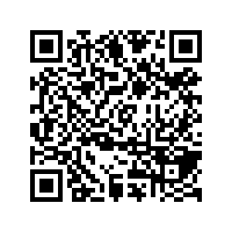
CS1010: Programming Methodology
UNIT 16
String
Live Q&A
https://pollev.com/jin

Slide 2
Unit 16: String
Characters
String
String Copy
Common Mistake

Slide 3

Recap: Characters
The data type char can be used to store single characters (e.g., 'g', '4'…)
Special characters
'\0': null character
'\t': tab
'\n': newline
char c1 = 'g';
char c2 = '4';
Not the same as c2 = 4!
char c3 = '100';
Only single characters can be stored.

Slide 4
String
A char array terminated by a null character '\0' (which has the numeric value 0)
char hello1[7] = {'h', 'e', 'l', 'l', 'o', '!', '\0'};
char hello1[7] = {'h', 'e', 'l', 'l', 'o', '!', 0};
These two are the same!
char hello1[7] = {'h', 'e', 'l', 'l', 'o', '!'};
Not a string. Strange errors may occur.
char hello2[7] = "hello!";
char hello3[] = "hello!";
These are ok as well!
hello1[1] = 'v';
Individual elements can be accessed / modified.

Slide 5
String
If the string does not need to be modified…
char *hello4 = "hello!";
The pointer points to the string which is stored in a protected part of the memory.
hello4[1] = 'v';
Individual elements can be accessed but CANNOT be modified.

Slide 6
String Copy
A loop or the string function strcpy (requires string.h) stringcan be used to make a copy
char src[7] = "hello!";
char dst[7];
for (long i = 0; i <= 7; i += 1)
{
dst[i] = src[i];
}
Can you rewrite the condition using src[i] instead?
char src[7] = "hello!";
char dst[7];
strcpy(dst, src);

Slide 7
Common Mistake
Forgetting the '\0' character!
char src[6] = "hello!";
char src[] = "hello!";
char dst[6];
strcpy(dst, src);

Slide 8
Homework
Post-Lecture Diagnostic Quiz
Problem Set 13-16
Exercise 2
Midterm Preparation

