Slide 1


CS1010: Programming Methodology
UNIT 3
Functions
Live Q&A
https://pollev.com/jin

Slide 2
Unit 3: Functions
Problem Solving Techniques
Functions
More examples
Even more examples

Slide 3
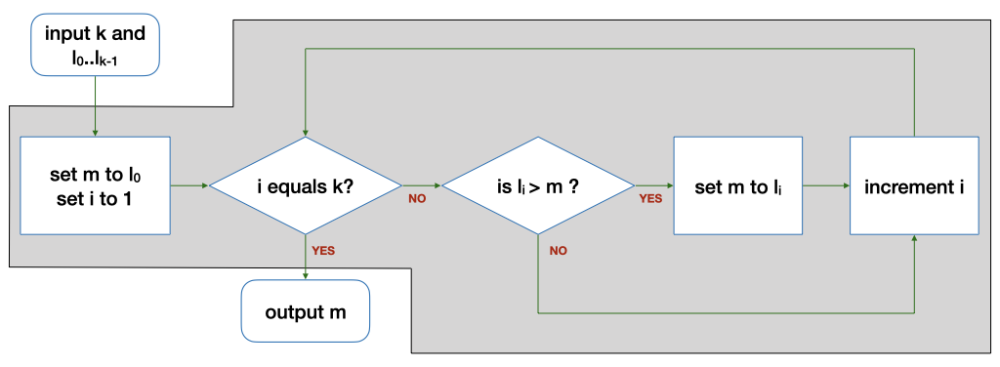
Problem Solving Techniques
What we have learnt so far…
Find the maximum among a list of numbers (FindMax) … with a 3-step process.
Input
Compute
Output

Slide 4
Problem Solving Techniques
How to solve a new problem?
Find the range (i.e., max-min) of a list of numbers
Technique 1: Breaking it down!
Input: Read in a number k and a list L of k numbers
Compute: Compute the range of a given list L of k numbers
Output: Print the range

Slide 5
Problem Solving Techniques
How to solve a new problem?
Find the range (i.e., max-min) of a list of numbers
Technique 2: Borrowing from what we know!
Input: Read in a list L of k numbers
Same as the input step for FindMax (i.e., read in some numbers)
Output: Print the range
Same as the output step for FindMax (i.e., print one number)

Slide 6
Problem Solving Techniques
How about the Compute step?
Technique 3: Wishful thinking
Assume that we have a magic black box for solving a smaller problem
i.e., given some inputs, this magic black box produces a value (usually an intermediate result) that we need.

Slide 7
Problem Solving Techniques
Compute: Compute the range of a list L of k numbers
Compute the maximum of a list L of k numbers (Breaking it down)
Same as the compute step of FindMax (Borrowing from what we know)
Compute the minimum of a list L of k numbers (Breaking it down)
Assume we have it. (Wishful thinking)
Compute the difference between the maximum and the minimum

Slide 8
Problem Solving Techniques
Problem: Find the range (i.e., max-min) of a list of numbers
Algorithm:
Input: Read in a list L of k numbers
Compute:
Compute the maximum of a list L of k numbers
Compute the minimum of a list L of k numbers
Compute the difference between the maximum and the minimum
Output: Print the range
The real problem!

Slide 9
Functions
The magic black box
Given some inputs, it produces a value that we need
Such magic black boxes are called functions
Where to find them?
Provided by the standard C library or other libraries
Example: sqrt(x) computes the square root of x
Written by you!

Slide 10
More examples
Problem: Find the mean of a list of numbers
Input…
Compute
Compute the sum of a list of numbers
Divide the sum by k
Output…
This could be a function!

Slide 11
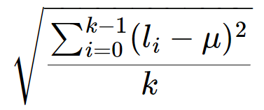
More examples
Problem: Find the standard deviation of a list of numbers
μ: mean (L, k)
L': subtract (L, k, μ)
L'': square (L', k)
μ'': mean (L'', k)
result: sqrt (μ'')
Let say k = 5, L = {1, 3, 5, 7, 9},
μ = 5
subtract (L, k, μ) = {-4, -2, 0, 2 ,4}
square (L', k) = {16, 4, 0, 4,16}
μ'' = mean (L'', k) = 8
sqrt (μ'') = 2.83

Slide 12
More examples
Problem: Find the standard deviation of a list L of k integers
result: sqrt ( mean ( square ( subtract (L, k, mean (L, k)), k), k)
Reuse of functions
A function, once defined, can be reused any number of times!
No need to reinvent the wheel every time!
mean is used twice!

Slide 13
More examples
Problem: Find the standard deviation of a list L of k integers
result: sqrt ( mean ( square ( subtract (L, k, mean (L, k)), k), k)
Function calling other functions
If we treat this computation as a function stddev (L, k), it calls sqrt, mean, square and subtract to complete the computation.

Slide 14



Ex #1: A Simple “Drawing” Problem
Problem: Draw
a rocket ship (which is a triangle over a rectangle over an inverted V),
a male stick figure (a circle over a rectangle over an inverted V), and
a female stick figure (a circle over a triangle over an inverted V)
rocket
male
Analysis:
No particular input / compute needed.
Just draw the needed 3 figures: 1 magic box for each figure.
There are common shapes shared by the 3 figures: 1 magic box for each shape.
female

Slide 15
Ex #1: A Simple “Drawing” Problem
Problem: Draw
a rocket ship (which is a triangle over a rectangle over an inverted V),
a male stick figure (a circle over a rectangle over an inverted V), and
a female stick figure (a circle over a triangle over an inverted V)
rocket
male
female
Design:
Draw 3 Figures
Draw Rocket Ship
Draw Male Stick Figure
Draw Female Stick Figure
Draw Triangle
Draw Rectangle
Draw Inverted V
Draw Circle
Draw Rectangle
Draw Inverted V
Draw Circle
Draw Triangle
Draw Inverted V

Slide 16
Even more examples
Problem: Find the maximum among a list of numbers
Solution from Week 1: use a function max (L, k) that computes the maximum of a given list L of k numbers.

Slide 17
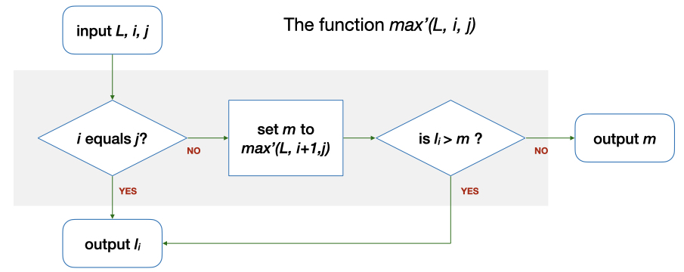
Even more examples
Alternative solution: use a function max' (L, i, j) which computes the maximum among L_{i}…L_{j} in a given list L
E.g., Let say L = {5, 9, 8, 1, 3, 2}, i = 5, j = 5. max' (L, 5, 5) = …
i (5) == j (5)? → Yes. Output l₅.
l₀, l₁ , l₂, l₃, l₄, l₅
This is the base case.

Slide 18
Even more examples
Alternative solution: use a function max' (L, i, j) which computes the maximum among L_{i}…L_{j} in a given list L
E.g., Let say L = {5, 9, 8, 1, 3, 2}, i = 4, j = 5. max' (L, 4, 5) = …
i (4) == j (5)? → No. m is max' (L, 5, 5) = 2 → l₄ (3) > m (2)? → Yes. The answer is l₄ (3).
l₀, l₁ , l₂, l₃, l₄, l₅

Slide 19
Even more examples
Alternative solution: use a function max' (L, i, j) which computes the maximum among L_{i}…L_{j} in a given list L
E.g., Let say L = {5, 9, 8, 1, 3, 2}, i = 0, j = 5. max' (L, 0, 5) = …
i (0) == j (5)? → No. m is max' (L, 1, 5) = 9 → l₀ (5) > m (9)? → No. The answer is m (9), which is the same as max (k, L).
l₀, l₁ , l₂, l₃, l₄, l₅

Slide 20
Even more examples
Problem: Compute the factorial of n
E.g., Let n = 4, n! = 4! = 1*2*3*4 = 24
Solution: Use a function factorial (n) which computes factorial n???

Slide 21
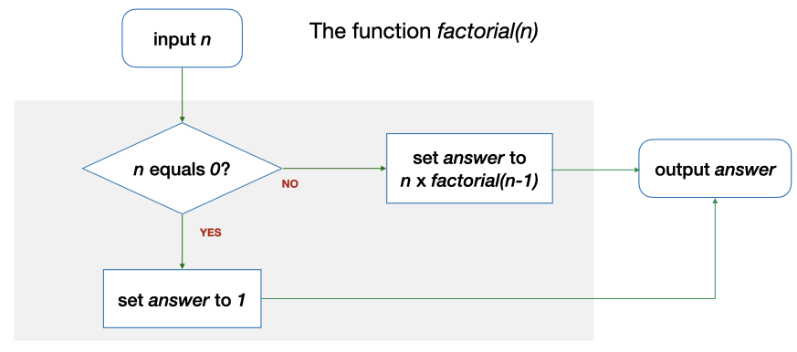
Even more examples
Solution: Use a function factorial (n) which computes factorial n???
E.g., Let say n = 0. factorial (n) = …
n (4) == 0? → Yes. The answer is 1.
This is the base case.

Slide 22
Even more examples
Solution: Use a function factorial (n) which computes factorial n???
E.g., Let say n = 4. factorial (n) = …
n (4) == 0? → No. The answer is n * factorial (3) = 4 * 6 = 24.

Slide 23
Even more examples
Function calling itself (to solve a simpler version of the problem)
max' (L, 0, 5) uses max' (L, 1, 5)
factorial (4) uses factorial (3)
This is Recursion!
This is Recursion!
This is Recursion!
…
This is the Base Case!

Slide 24
Ex #2: Yet another solution for FindMax
Problem: Find the maximum among a list of numbers
Alternative solution: use a function max'' (L, r) which computes the maximum among L₀…L_{r} in a given list L
E.g., Let say L = {5, 9, 8, 1, 3, 2}, r = 5. max'' (L, 5) = …
0 == r (5)? → No. m is max'' (L, 4) = 9 → l_{r} (2) > m (9)? → No. The answer is m (9), which is the same as max (L, k).
Can you draw the flowchart?
l₀, l₁ , l₂, l₃, l₄, l₅

Slide 25
What have You Learnt?
Problem solving techniques
Algorithms with functions
But how about the variables (i.e., data) used in the algorithms?

