Slide 1

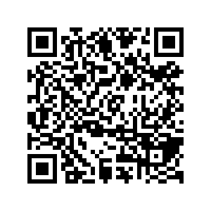
CS1010: Programming Methodology
UNIT 24
Permutation
Live Q&A
https://pollev.com/jin

Slide 2
Unit 24: Permutation
Permutation

Slide 3
Permutation
Problem: Generate all permutations of the characters in a string of length n.
Example:
Let say the string is "abc" (n = 3)
To generate: abc, acb, bac, bca, cab, cba…

Slide 4
Permutation
Problem: Generate all permutations of the characters in a string of length n.
Recursive Thinking
What if we have a magic box for generating Generate all permutations of the characters in a string of length n-1?
Examples
Let say the string is "abc" (n = 3)
Take "a", generate all permutations with "bc" (i.e., "bc" and "cb"), combine "a" with them (i.e., "abc" and "acb")
Take "b", generate all permutations with "ac"…

Slide 5
Permutation
O(n!)
// Generate all permutations of all the characters // in a[curr] … a[len-1]
void permute(char a[], long len, long curr) {
// base case
if (curr == len - 1) {
cs1010_println_string(a);
return;
}
// Permute with the first letter as the start
permute(a, len, curr + 1);
// Swap each remaining letter with the first letter, permute and swap back
for (long i = curr + 1; i < len; i += 1) {
swap(a, curr, i);
permute(a, len, curr + 1);
swap(a, i, curr);
}
}

