Slide 1

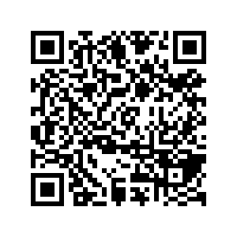
CS1010: Programming Methodology
The Future
Live Q&A
https://pollev.com/jin

Slide 2
Week 13: The Future
Exam Matters
CS2030 / CS2040

Slide 3
Exam Matters
Date: 29 April 2021 (Thursday)
Time: 9am to 11am
Format: Face-to-face
Venue: LT15
Open Book
You can refer to printed/written notes
Calculators allowed
Although you do not need one

Slide 4
Exam Matters
Scope:
Units 1-29
Assignments 1-9
Tutorials 1-11
Format:
MCQs
Short Structured Questions
Long (Programming) Questions

Slide 5
Tips
MCQs
Understanding of Concepts
Tracing
Track inputs / intermediate results / outputs using tables and diagrams
Program Analysis
Time Complexity

Slide 6
Tips
Short Structured Questions
Tracing
Logical Thinking
Program Analysis
Assertion / Loop Invariant

Slide 7
Tips
Long Programming Questions
Coding on Paper
Problem Solving
Familiarity with C Syntax
Tracing
Track your own code
Factors beyond Correctness
Time Complexity
Memory Management

Slide 8
Help Session
22 April (Thu), 2-4pm
Online
Past year paper + Q&A

Slide 9
From CS1010…
Mainly Procedural
Get input
Compute
Compute intermediate results
Compute final results
Print output
Simple Data Structures / Algorithms
max
last
box1
length
width
height
23
17
5
12
38
44
77
84
90

Slide 10
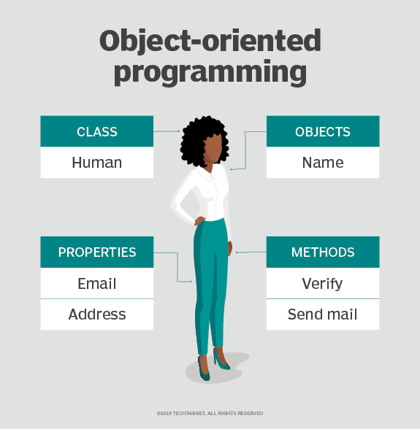
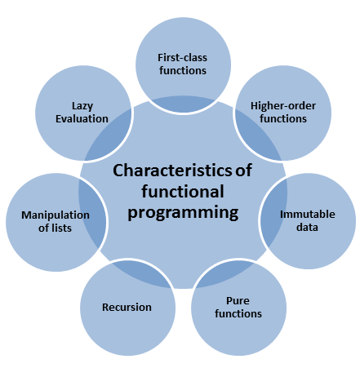
To CS2030…
Modern Programming Paradigms
https://searchapparchitecture.techtarget.com/definition/object-oriented-programming-OOP
https://www.modernescpp.com/index.php/the-definition-of-functional-programming

Slide 11
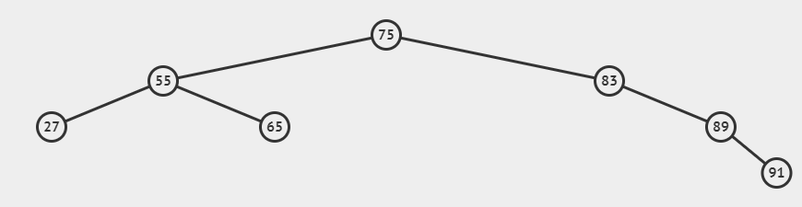
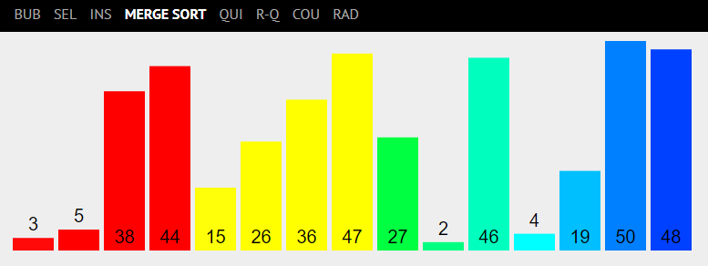
To CS2040…
More about Data Structures and Algorithms
https://visualgo.net/en/

Slide 12
All the best for your Final Assessments!

