Slide 1

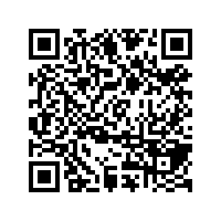
CS1010: Programming Methodology
Week 5
Recap
Live Q&A
https://pollev.com/jin

Slide 2
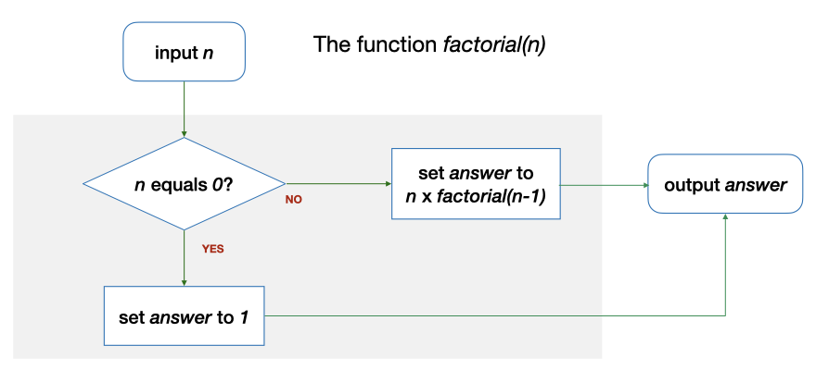
Repetition through Recursion
factorial(2) requires factorial(1), which in turn requires factorial (0)
long factorial(long n)
{
long answer;
if (n == 0) {
answer = 1;
} else {
answer = n * factorial(n - 1);
}
return answer;
}

Slide 3
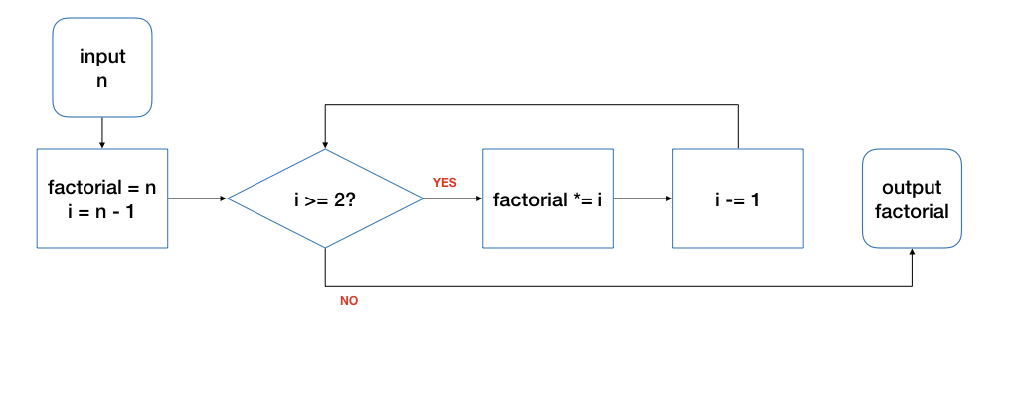
Repetition through Loops
Input: 4
n | i | factorial | i >= 2? | Remark
4 | 3 | 4 | true | Before the loop
4 | 2 | 12 | true | After 1st round of the loop
4 | 1 | 24 | false | After 2nd round…
Tracing is an important skill!

Slide 4
The for Loop
Good for repetitions that have an explicit start / end / update.
long factorial(long n)
{
long product = n;
for (long i = n - 1; i >= 2; i -= 1) {
product *= i;
}
return product;
}

Slide 5
The while Loop
long i = n - 1;
while (i >= 2) {
product *= i;
i -= 1;
}
for (long i = n - 1; i >= 2; i -= 1) {
product *= i;
}

Slide 6
The do-while Loop
long i = n - 1;
do {
product *= i;
i -= 1;
} while (i >= 2);
for (long i = n - 1; i >= 2; i -= 1) {
product *= i;
}

Slide 7
Loop Invariant
An assertion that is true before the loop, after each iteration of the loop, and after the loop.
1
2
3
4
5
6
7
8
9
10
11
12
13
14
15
16
long factorial(long n)
{
if (n == 0) { return 1; }
long product = 1;
long i = 1;
// Line A: before the loop
while (i < n) {
// Line B: beginning of each iteration
i += 1;
// Line C: …
product *= i;
// Line D: after each iteration
}
// Line E: after the loop
return product;
}

Slide 8
Loop Invariant
Think in terms of the purpose of the loop
1
2
3
4
5
6
7
8
9
10
11
12
13
14
15
16
long factorial(long n)
{
if (n == 0) { return 1; }
long product = 1;
long i = 1;
// A: { product == i! }
while (i < n) {
// B: { product == i! }
i += 1;
// C: { product == (i-1)! }
product *= i;
// D: { product == i! }
}
// E: { product == i! }
return product;
}
n! = 1 * 2 * 3 …* n

Slide 9
You should start preparing for Midterm and PE1!

