Slide 1


CS1010: Programming Methodology
UNIT 10
Assertion
Live Q&A
https://pollev.com/jin

Slide 2
Unit 10: Assertion
Assertion
De Morgan's Law

Slide 3
Assertion
A logical expression that must be always (i.e., regardless of input) true for the program to be correct.
Can be written anywhere in the code and checked automatically (e.g., using assert() from assert.h)
Useful for ensuring the algorithm is correctly translated
… // some code for Step 1
// {Assertion that must be true after Step 1}
… // some code for Step 2
// {Assertion that must be true after Step 2}
… // some code for Step 3
// {Assertion that must be true after Step 3}

Slide 4
Example 1
Important: Write assertions based on what should be true, not your code!
Problem: Find the maximum value between two variables
if (…) {
// { x > y }
…
// {max == x && max > y}
else {
// { x <= y }
…
// {max >= x && max == y}
}
x > y
x <= y

Slide 5
Example 1
Important: Write assertions based on your algorithm, not your code!
Problem: Find the maximum value between two variables
((max == x) && (max > y)) || ((max >= x) && (max == y))
if (x > y) {
// { x > y }
max = x;
// {max == x && max > y}
else {
// { x <= y }
max = y;
// {max >= x && max == y}
}
x > y
x <= y

Slide 6
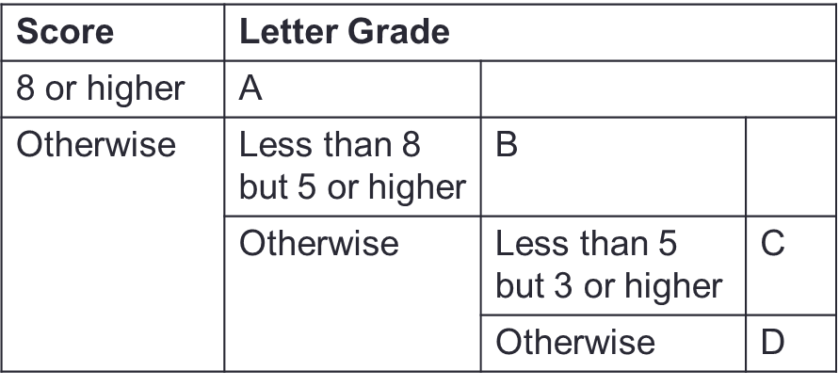
Example 2
Problem: Print a letter grade based on a score
if (…) {
// { score >= 8 }
} else {
// { score < 8 }
if (…) {
// { score < 8 && score >=5 }
} else {
// { score < 5 }
if (…) {
// { score < 5 && score >=3}
} else {
// {score < 3}
}
}
}

Slide 7
Example 2
Problem: Print a letter grade based on a score
if (score >= 8) {
// { score >= 8 }
} else {
// { score < 8 }
if (score >= 5) {
// { score < 8 && score >=5 }
} else {
// { score < 5 }
if (score >= 3) {
// { score < 5 && score >=3}
} else {
// {score < 3}
}
}
}

Slide 8
De Morgan's Law
!(e1 && e2) is the same as (!e1) || (!e2)
!(e1 || e2) is the same as (!e1) && (!e2)
Help to quickly write the assertion for false block
if (…) {
// { (birth_year >= 1995) && (birth_year <= 2005) }
} else {
// { !((birth_year >= 1995) && (birth_year <= 2005)) }
}
// { (!(birth_year >= 1995) || !(birth_year <= 2005) }
// { (birth_year < 1995) || (birth_year > 2005) }

Slide 9
Homework
Post-Lecture Diagnostic Quiz (1%)
Problem Set 8/9/10
Exercise 1
PE preparation

