Slide 1

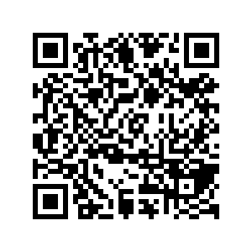
CS1010: Programming Methodology
UNIT 1
What is a Program?
Live Q&A
https://pollev.com/jin

Slide 2




Hardware
Monitor and speaker (output)
Houses CPU, memory, hard disk, etc.
Software
Keyboard and mouse (input)

Slide 3
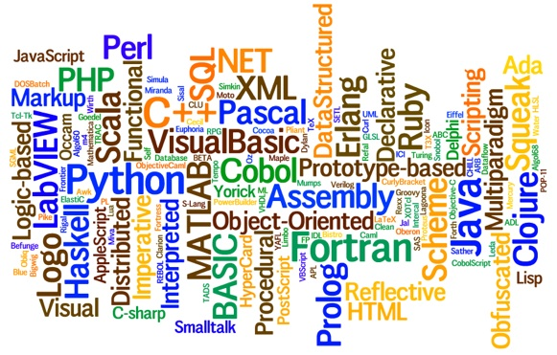
Program (software)
A sequence of step-by-step instructions executed on computers (hardware) to perform a certain task
Programming languages
Languages for writing programs

Slide 4
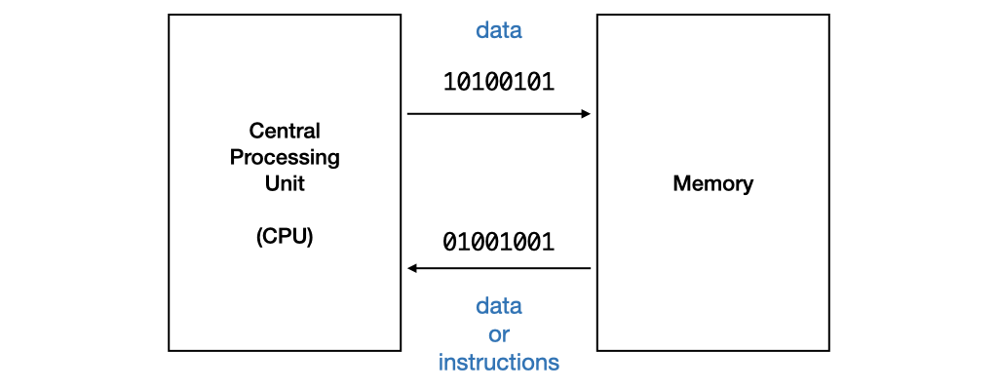
Program Execution
The CPU processes data or instructions from memory and stores data into memory.
Such data or instructions must be in machine code in binary format
E.g., 0001001101101110

Slide 5
Beyond Machine Code
Assembly code
High-level language program
Use mnemonic to represent the instructions, such as load, add, move, etc. in a more human-readable way.
Still difficult to write since the operations are really simple and machine-specific.
Requires translation
Detailed knowledge of the machine is not required. High level of abstraction, such as control structures, functions, object-oriented programming.
Ease of writing and understanding.
Eg: Java, C, C++, Python.

Slide 6
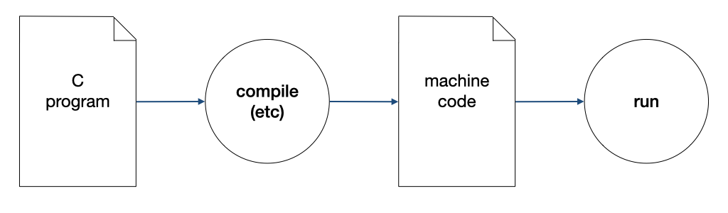
Compilation
A compiler compiles a program written in a high-level language to machine code.

Slide 7
The Edit, Compile and Execute Cycle
Compile
Execute
Edit
Use a compiler to translate the source code into executable
Use an editor to create/modify the source code
Execute/run the executable code
Process is iterative

Slide 8
What have You Learnt?
Fundamentals about Hardware and Software
Programming languages
The edit, compile, execute cycle
But how about problem solving by programming?

Slide 9
CS1010: Programming Methodology
UNIT 2
Computational Problems and Algorithms
Live Q&A
https://pollev.com/jin

Slide 10
Unit 2: Computational Problems and Algorithms
Computational Problems
Algorithm
Flowchart
Variables
Correctness

Slide 11
Computational Problems
Problems that
have well-defined inputs, outputs, and constraints
can be solved step-by-step by a computer

Slide 12
Computational Problems
Example (Decision Problem)
Is a given integer (e.g., 137) a prime number?
What are the inputs, outputs, and constraints?
Is there a step-by-step method to solve it using a computer?

Slide 13
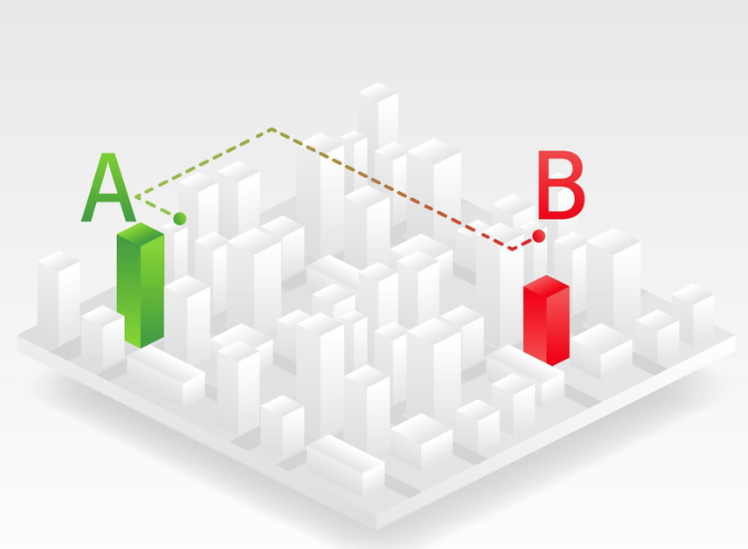
Computational Problems
Example (Decision Problem)
Is there a route from Point A to Point B?
What are the inputs, outputs and constraints?
Is there a step-by-step method to solve it using a computer?

Slide 14
Computational Problems
Example (Search Problem)
Find a route from Point A to Point B.
Example (Counting Problem)
How many different routes are there from Point A to Point B?
Example (Optimization problem)
Find the shortest route from Point A to Point B.

Slide 15
Non-Computational Problems
Examples
What is the meaning of life?
Do I look good in this outfit?
What is the answer to the Ultimate Question of Life, the Universe, and Everything?

Slide 16
Problem Solving Process
Algorithmic
Determine problem features
Analysis
Iterative process
Write algorithm
Design
Produce code
Implementation
What is an algorithm?
Check for correctness and efficiency
Testing

Slide 17
Algorithm
An algorithm is a well-defined computational procedure consisting of a set of instructions, that takes some value or set of values as input, and produces some value or set of values as output.
Input
Algorithm
Output
‘Algorithm’ stems from ‘Algoritmi’, the Latin form of al-Khwārizmī, a Persian mathematician, astronomer and geographer.
Source: http://en.wikipedia.org/wiki/Algorithm

Slide 18
Algorithm: Example
Problem: Find the maximum among a list of numbers.
Sample input: 6, {5, 9, 8, 1, 3, 2}
Sample output: 9
What are the inputs, outputs and constraints?
Inputs: a number k = the size of the list, a list of k numbers l = ⟨l₀,...,l_{k−1}⟩
Outputs: a number m
Constraints: m ∈ L and m ≥ l_{i} for all i.
l₀, l₁ , l₂, l₃, l₄, l₅

Slide 19
Algorithm: Example
Problem: Find the maximum among a list of numbers.
Sample input: 6, {5, 9, 8, 1, 3, 2}
Sample output: 9
What is the (rough) algorithm?
Scan through the list and keep track of the maximum
l₀, l₁ , l₂, l₃, l₄, l₅

Slide 20
Algorithm: Example
Problem: Find the maximum among a list of numbers.
Sample input: 6, {5, 9, 8, 1, 3, 2}
Sample output: 9
What is the (detailed) algorithm?
Record the maximum (m) so far with m = l₀ initially
Record the index (i) of the number being considered with i = 1 initially
l₀, l₁ , l₂, l₃, l₄, l₅

Slide 21
Algorithm: Example
Problem: Find the maximum among a list of numbers.
Sample input: 6, {5, 9, 8, 1, 3, 2}
Sample output: 9
What is the (detailed) algorithm?
Keep going as long as there are more numbers (i.e., i does not equal k)
if m < l_{i}, then update m with the value of l_{i}
Increase i by 1
l₀, l₁ , l₂, l₃, l₄, l₅

Slide 22
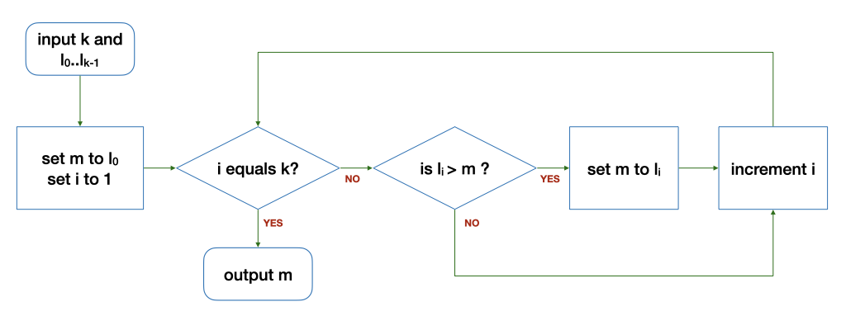
Algorithm: Example
The Flowchart
The loop
Input: 6 5 9 8 1 3 2
k | i | l_{i} | m | Remark
6 | 1 | 9 | 5 | Before the loop
6 | 2 | 8 | 9 | After 1st round of the loop
6 | 3 | 1 | 9 | After 2nd round…
k | i | l_{i} | m | Remark
6 | 4 | 3 | 9 | After 3rd round…
6 | 5 | 2 | 9 | After 4th round…
6 | 6 | - | 9 | After 5th round…

Slide 23
Variables
i, m, k, l and l_{k} are variables (a.k.a., data)
They hold a value in their respective location in the memory
You can
read a value from a variable (e.g., output m)
write a value to a variable (e.g., set i to 1)
compare values of two variables (e.g., i equals k?)
Perform arithmetic operations on variables (e.g., compute i + 1)

Slide 24
Control structures
Sequence
After step X, do step Y.
Selection
If … then … else …
Repetition
Keep going as long as ...

Slide 25
Correctness
An algorithm is correct (i.e., bug free) if it works on all valid inputs.
Very often, a buggy algorithm works on some inputs but fails on others…
To check correctness, you can
Find a counter-example to disprove the algorithm
Carefully choose a set of test cases to verify the correctness
Argue formally about the property of the algorithms

Slide 26
Correctness
What is wrong with this modified algorithm?
0

Slide 27
Homework
Post-Lecture Quiz
To be released every Tuesday, 2pm and due the next Tuesday, 2pm
Unlimited number of attempts.
Problem Set 2.1 to 2.3 (under Unit 2)
To be discussed in the forum and tutorials
Course website and programming environment
Submission of Github account name via Canvas

