Slide 1

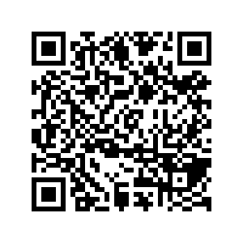
CS1010: Programming Methodology
Welcome and Administrative Matters
Live Q&A
https://pollev.com/jin

Slide 2


Welcome to CS1010!
#include "cs1010.h"
int main()
{
cs1010_println_string("Welcome!");
return 0;
}

Slide 3
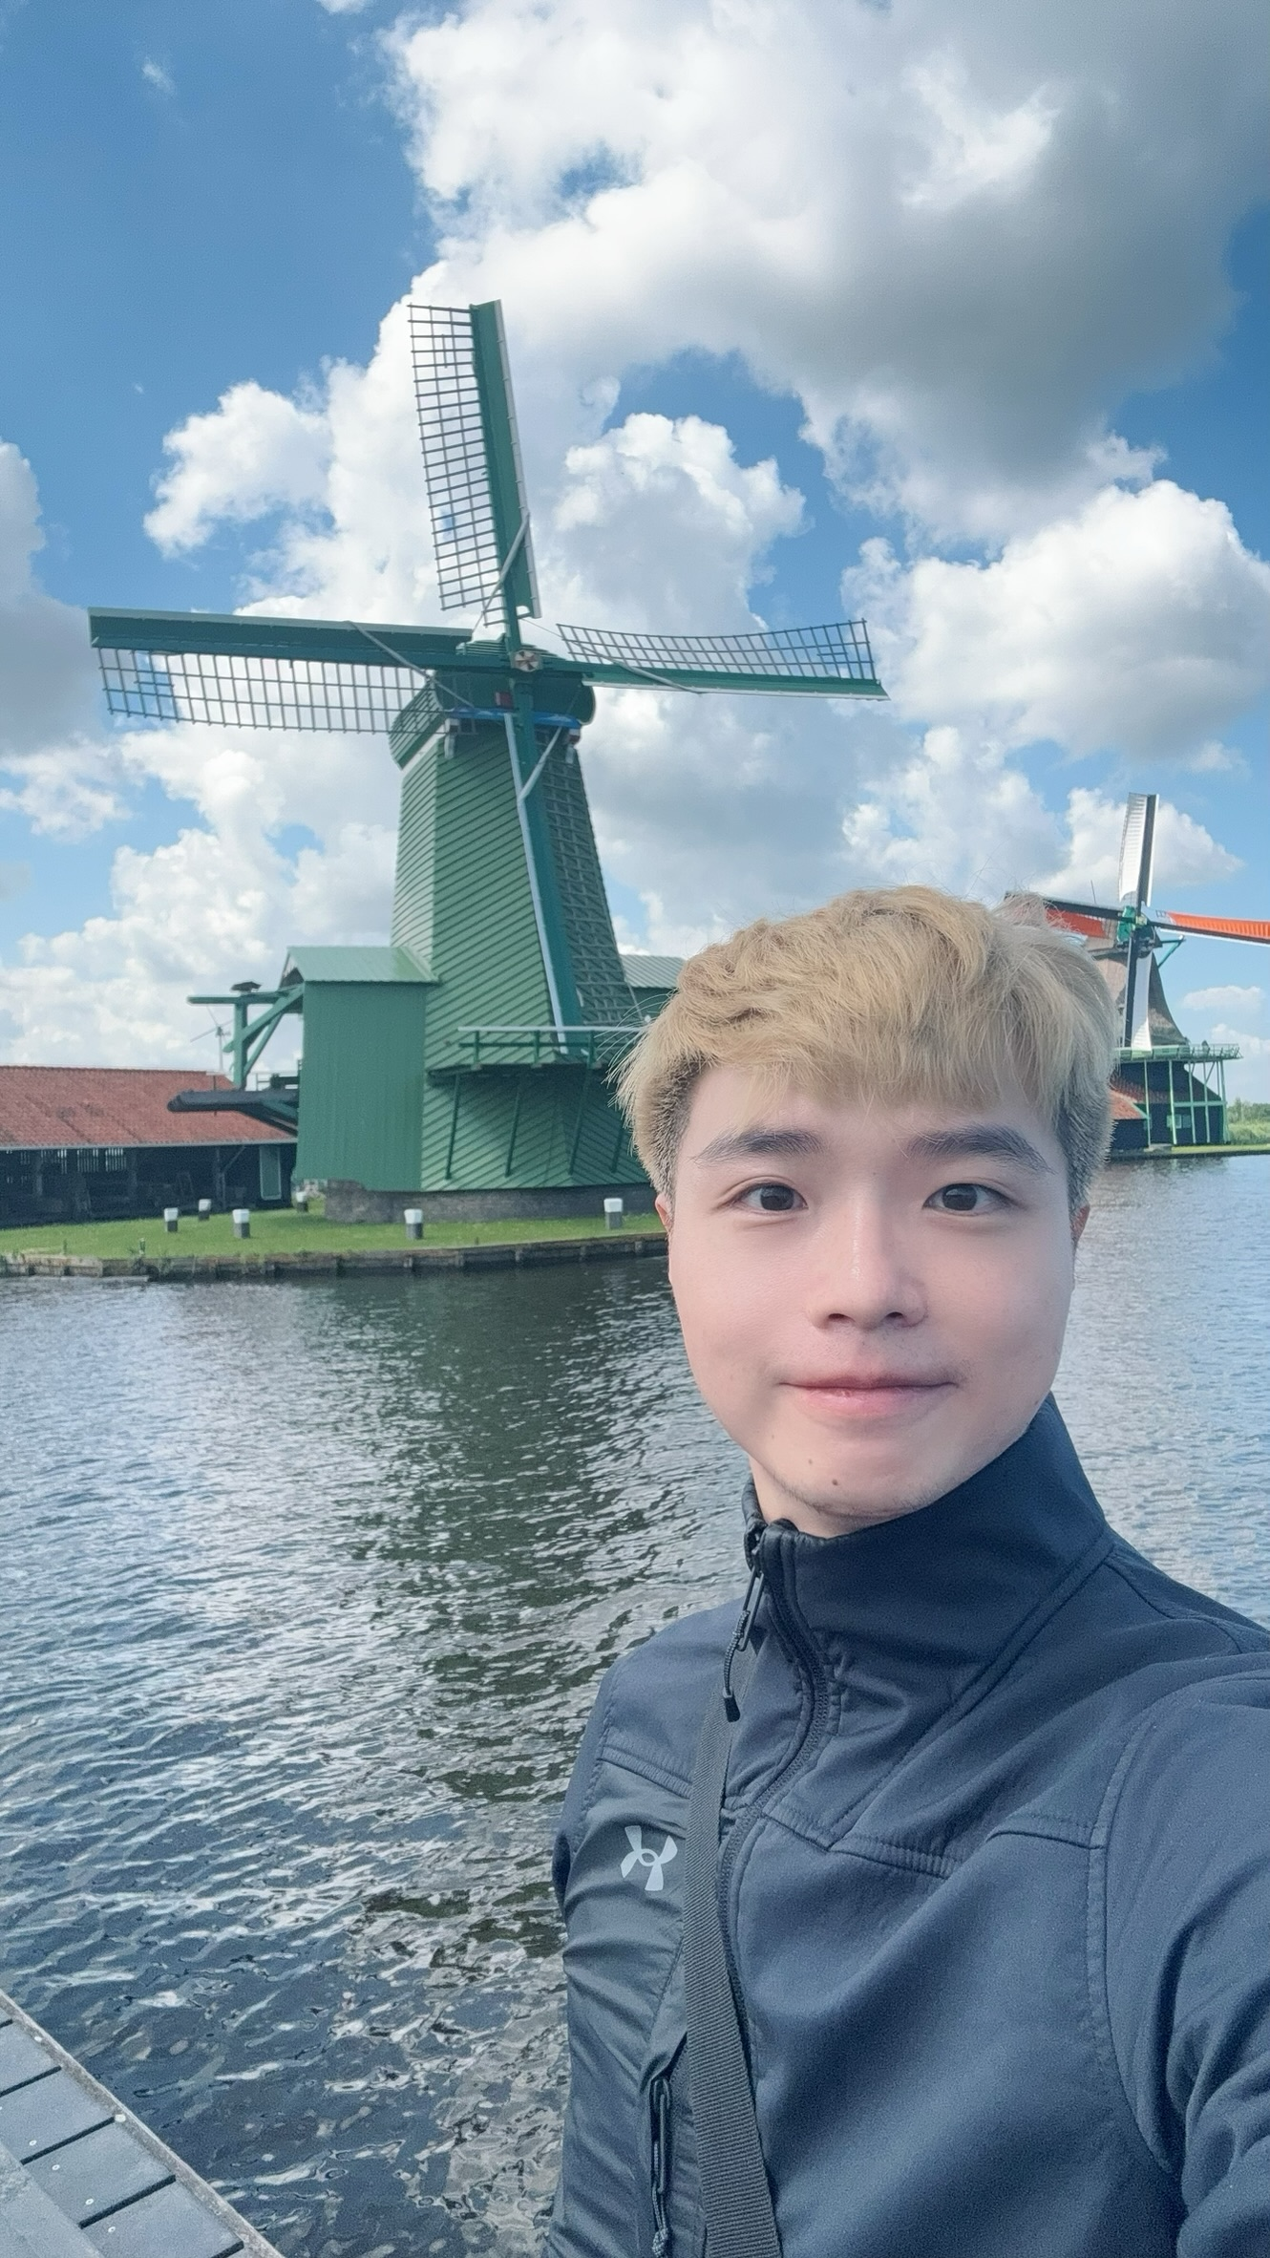

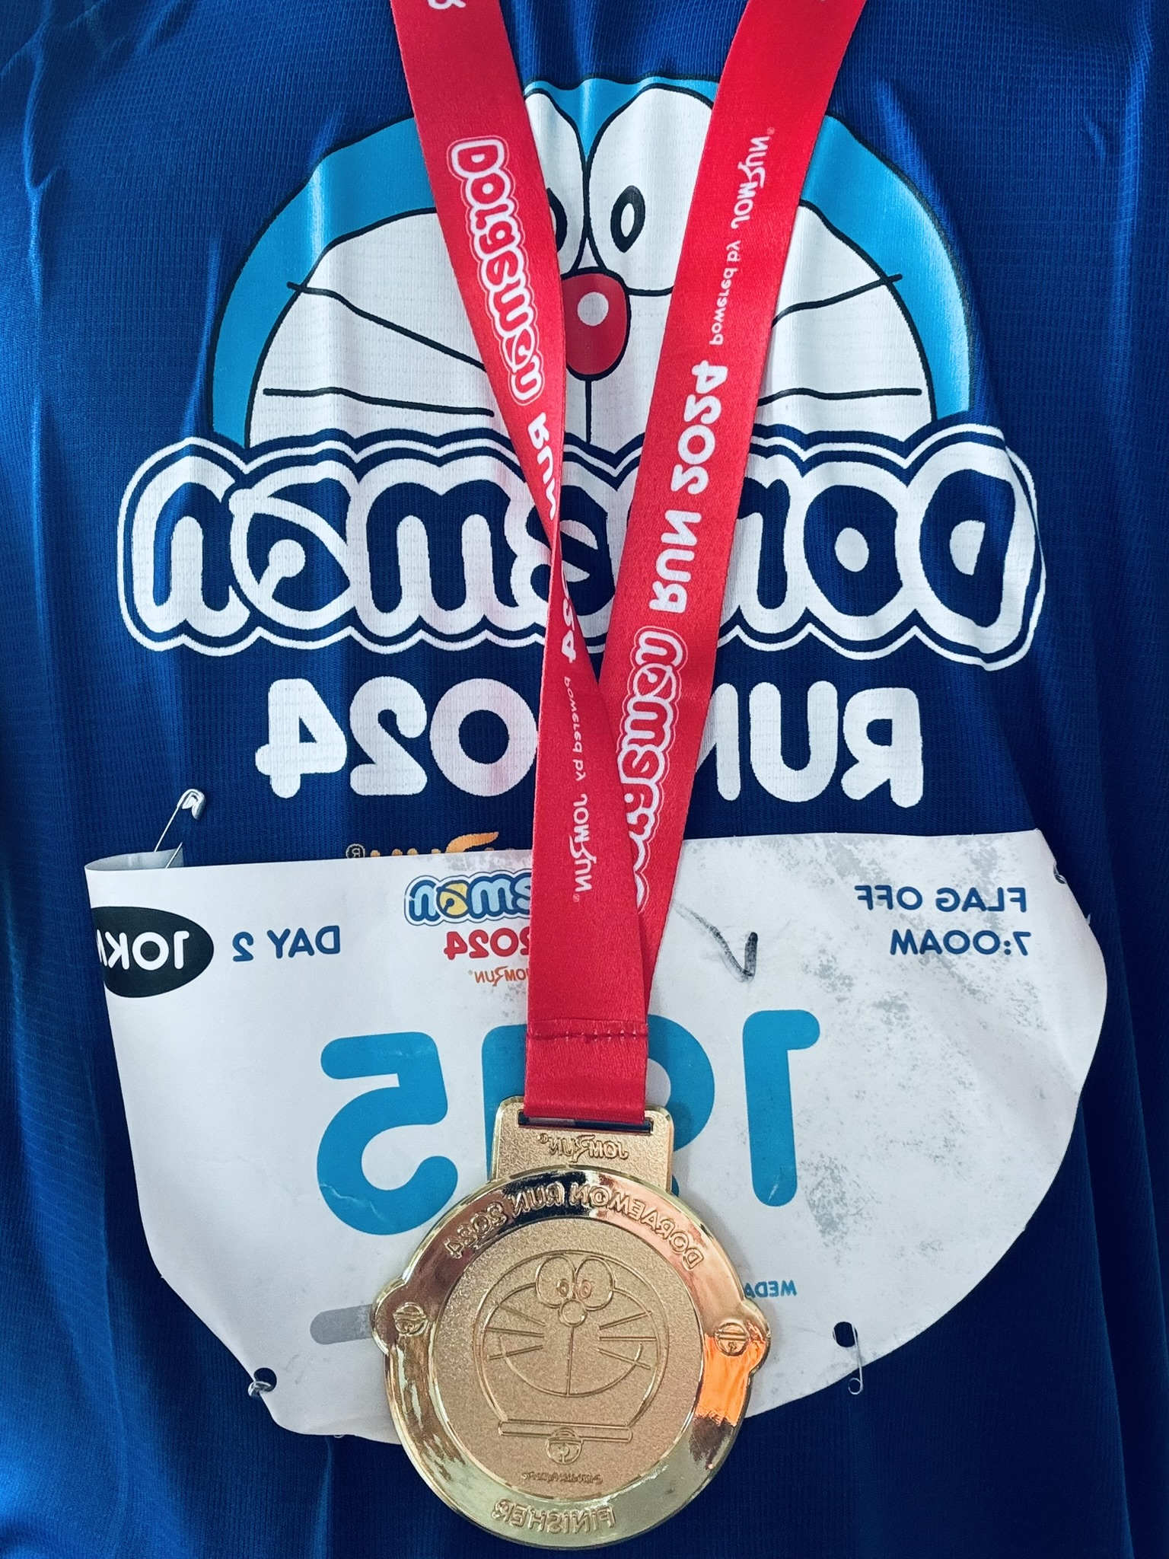

Lecturer
Zhao Jin zhaojin@comp.nus.edu.sg
(Just call me “Jin” for short)
- Undergraduate, PhD, Instructor, (Senior) Lecturer and Assistant Dean
- Programming Methodology, Orbital, Information Retrieval

Slide 4
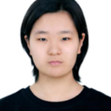
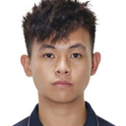
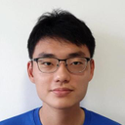
Tutors
Ren Tianle
Steve Chia Min Xu
Wu Xingyu

Slide 5

Objectives
Learn about a systematic way to write programs for solving computational problems
Explore various hardware-related topics, such as memory management.
Become proficient with C and associated programming tools (editors, debuggers)
The course is called Programming Methodology.
It is NOT just about coding in C!

Slide 6
CS1010 is NOT for you if you want to…
Learn programming for general tasks such as data analytics and machine learning
Focus on software development and bypass the hardware-related topics
Use high-level programming tools
You might want to consider other variants of CS1010 or even courses outside SoC.

Slide 7
Weekly Activities / Workload
Lectures:
2 hours / week on Tuesdays at 10am-12nn
Tutorials
2 hours / week on Mondays from Week 3 onwards.
11 Quizzes and 8 sets of Programming Exercises
As many hours as needed
Due on Tuesdays (general) / Fridays (extended) from Week 2 onwards.
Formative assessments
Preparation, Revision and additional Practices
As many hours as needed

Slide 8
Tutorials
Conducted in programming labs by tutors
2 hours long: 10am-12nn and 12nn-2pm
~10 students per group
Problem sets, programming exercises and hands-on activities.

Slide 9
Important Assessments
Practical Exam 0:
18 February, 6-9pm (Week 6)
Midterm:
4 March 10am-12nn (Week 7)
Practical Exam 1:
18 March, 6-9pm (Week 9)
Practical Exam 2:
8 April, 6-9pm (Week 12)
Final Assessment:
29 April, 5-7pm
Mark down these dates!
All of them are Tuesday.

Slide 10
Important Assessments
For Special Considerations
Midterms + Practical Exams: Email Jin no later than 24 hours after the end of the assessment.
Final Assessments: Use the NUS Student portal.
Make-up assessments (if any) are always harder than the original. =P

Slide 11

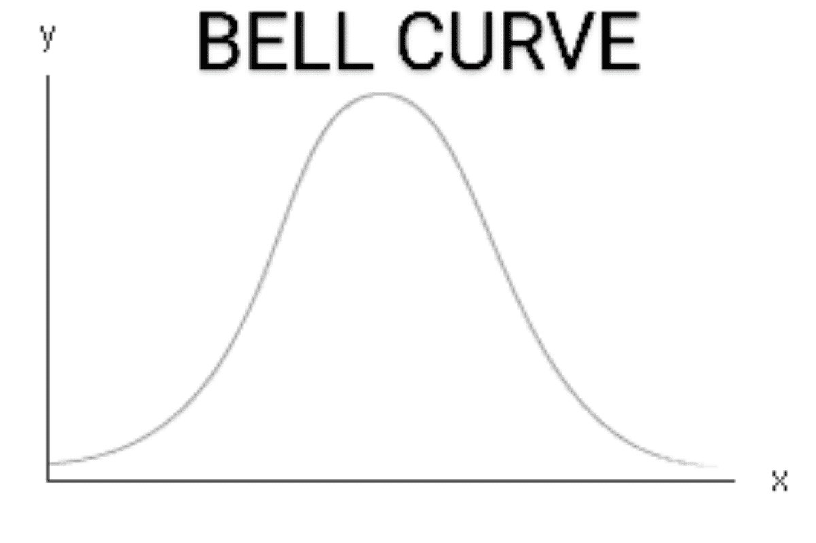

Grading
Weightage
Quizzes: 5%
Programming Exercise: 5%
Midterm: 15%
Practical Exam 0/1/2: 10%/15%/20%
Final Assessment: 30%
NOT "bell-curved"
Consistent effort required throughout the semester!

Slide 12
Late Submission Policy
No late submissions will be considered
You are allowed to miss up to 10% of the submissions for quizzes and programming exercises.
Feedback may NOT be provided.
For special consideration
Email Jin no later than 24 hours after the deadline that makes you miss more than 10% of submissions.

Slide 13

Use of AI tools
NOT allowed for important assessments
Midterm, Practical Exams and Final assessment
Allowed for formative assessments
Quizzes and programming exercises
ONLY for understanding and learning
NO point using it to generate answers

Slide 14
Plagiarism
Plagiarism is NOT allowed and will be reported
ALL parties involved to be penalized equally.
NO point plagiarizing in general
However, high-level discussions are allowed and encouraged to promote peer learning.
Bottom Line: write your own code and do NOT share / discuss it with anyone!

Slide 15
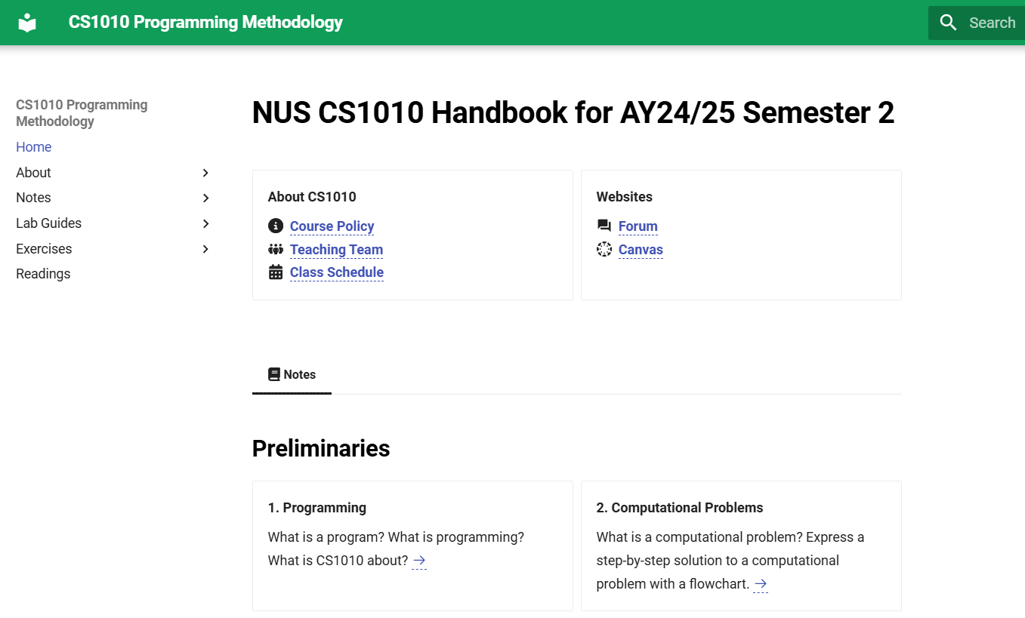
Course Website (The Handbook)
https://nus-cs1010-2425-s2.github.io/website
Visit this website after class if you have not done so.
If you Google for CS1010, make sure you find the site for this semester, which is in green.

Slide 16
Other Tools
Canvas (https://canvas.nus.edu.sg/courses/69892)
Announcements, quizzes, grades, internal materials
Ed (https://edstem.org/us/courses/70897/discussion)
Online forum
PE Servers / Unix / Git / Vim / Clang
Programming-related service / tools
Github (https://github.com/)
Assignment submission / grading

Slide 17
Messages for CS1010 Students
Practice, practice, practice!
Work hard and smart
Ask questions / discuss with others
In class and outside class (forum)
As often / soon as you can
Approach the teaching team for assistance

