Slide 1


CS1010: Programming Methodology
Week 11
Recap
Live Q&A
https://pollev.com/jin

Slide 2
Common Types of Recursion
Integers
Base case: a single digit or 0
Recursive case: number – 1 or number / 10
Example: factorial, sumDigits
1D arrays (including strings)
Base case: an array of 1 element or an empty array
Recursive case: the array minus the first / last element, or left / right half of the elements.
Example: findMax, binarySearch
2D arrays
Base case: a single row / column or an empty array
Recursive case: the array minus one row and / or a column

Slide 3
Exercise #1: Counting Occurrence
Problem: Given an array
long list[ ] = { 9, -2, 1, 7, 3, 9, -5, 7, 2, 1, 7, -2, 0, 8, -3 }
We want
countValue(7, list, 15)
to return 3 (the number of times 7 appears in the 15 elements of list).

Slide 4
Counting Occurrences (by Iteration)
long countValue_iter(long value, long arr[], long size) {
long count = 0;
for (long i = 0; i < size; i += 1){
if (value == arr[i]){
count += 1;
}
}
return count;
}
Can you solve this problem by recursion?

Slide 5
Counting Occurrences (by Recursion v1)
To get countValue(7, list, 15) to return 3.
Recursive thinking goes…
9
-2
1
7
3
9
-5
7
2
1
7
-2
0
8
-3
… and get someone to count the 7 in this smaller problem, …
If I handle the last element myself, …
… then, depending on whether the last element is 7 or not, my answer is either his answer plus 1 or his answer by itself!

Slide 6
Counting Occurrences (by Recursion v1)
long countValue(long value, long arr[], long size) {
if (size == 0){
return 0;
} else {
long answer = countValue(value, arr, size-1);
if (value == arr[size-1]){
return 1 + answer;
} else {
return answer;
}
}
countValue(7, list, 15) → countValue(7, list, 14) → … countValue(7, list, 0)

Slide 7
Counting Occurrences (by Recursion v2)
To get countValue(7, list, 15) to return 3.
Recursive thinking goes…
9
-2
1
7
3
9
-5
7
2
1
7
-2
0
8
-3
If I handle the first element myself, …
… and get someone to count the 7 in this smaller problem, …
… then, depending on whether the first element is 7 or not, my answer is either his answer plus 1 or his answer by itself!

Slide 8
Counting Occurrences (by Recursion v2)
long countValue_v2(long value, long arr[],
long start, long size) {
if (start == size)
return 0;
else {
long answer = countValue_v2(value, arr, start+1, size);
if (value == arr[start]) {
return 1 + answer;
} else {
return answer;
}
}
}
countValue(7, list, 15) → countValue_v2(7, list, 0, 15) → countValue_v2(7, list, 1, 15) → … countValue_v2(7, list, 15, 15)
long countValue(long value, long arr[], long size) {
return countValue_v2(value, arr, 0, size);
}

Slide 9
Counting Occurrences (by Recursion v3)
To get countValue(7, list, 15) to return 3.
Recursive thinking goes…
9
-2
1
7
3
9
-5
7
2
1
7
-2
0
8
-3
If I get someone to count the 7 in this smaller problem, …
… and get someone to count the 7 in this smaller problem, …
… then, my answer is the sum of these two answers!
long countValue_v3(long value, long arr[],
long start, long end);

Slide 10
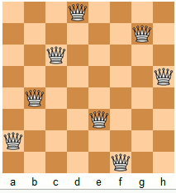
N Queens
Problem: Given a n x n chessboard, find a possible placement of n queens on the chessboard, such that the queens do not threaten each other
Analysis
A placement is a sequence of positions for n rows
{'d', 'g', 'c', 'h', 'b', 'e', 'a', 'f'}
There cannot be repeated positions since two queens cannot be in the same column.

Slide 11
N Queens
Implementation:
O(n!)
void nqueens(char queens[], long n, long row) {
if (row == n-1) {
if (!threaten_each_other_diagonally(queens, n)) {
cs1010_println_string(queens);
}
return;
}
nqueens(queens, n, row + 1);
for (long i = row + 1; i < n; i++) {
swap(queens, row, i);
nqueens(queens, n, row + 1);
swap(queens, row, i);
}
}
queens = {a, b, c, d, e, f, g, h}
Try solutions {a, …}
Try solutions {b, …}
…
Try solutions {h, …}

Slide 12
Common Types of Enumeration
Try solutions with
Each of the given elements as the starting element (n queens)
Each of the possible directions (e.g., a walk in a maze)
Each of the possible color for the current cell (e.g., coloring problem)
…

Slide 13
N Queens
Implementation: (with pruning)
void nqueens(char queens[], long n, long row) {
…
if (!threaten_each_other_diagonally(queens, row)) {
nqueens(queens, n, row + 1);
}
for (long i = row + 1; i < n; i++) {
swap(queens, row, i);
if (!threaten_each_other_diagonally(queens, row)) {
nqueens(queens, n, row + 1);
}
swap(queens, row, i);
}
}

Slide 14
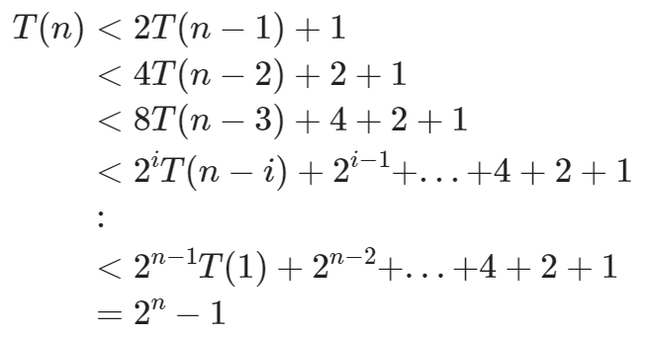
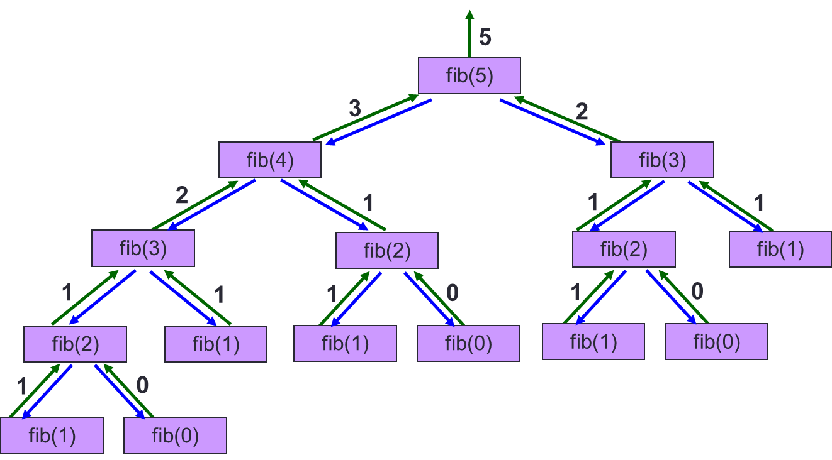
Fibonacci
long fib(long n) {
if (n == 1 || n == 2)
return n;
else
return fib(n-1) + fib(n-2);
}
long fib(long n) {
if (n == 1 || n == 2)
return n;
else
return fib(n - 1) + fib(n - 2);
}
O(2^{n})

Slide 15
Fibonacci with Memoization
long fib(long n, long memo[]) {
if (memo[n] == -1){
if (n <= 1) {
memo[n] = n;
} else {
memo[n] = fib(n-1, memo) + fib(n-2, memo);
}
}
return memo[n];
}

Slide 16
Get used to thinking recursively…
recursively…
recursively…
recursively…
…

